Slide 1

HTML5 WebSocket Overview
The Web Communication Revolution
Reduced Complexity
High Performance
Web. Upgraded.
Enterprise Support
1

Slide 2
Agenda
Introduction to HTML5 WebSocket
WebSocket API
WebSocket Protocol

Slide 3
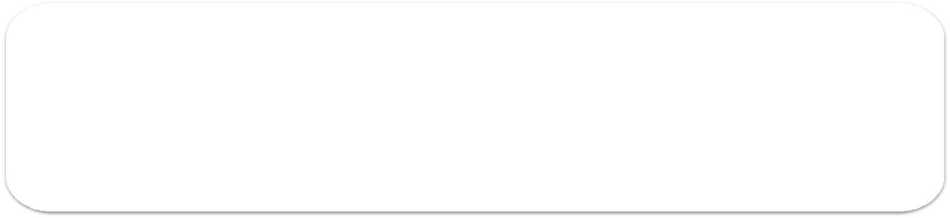






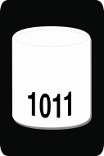


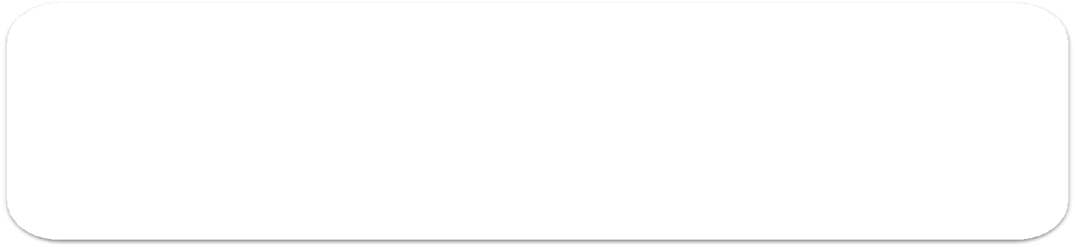
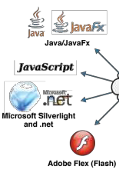






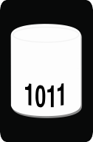






Architectural (R)evolution
Legacy Web
Half Duplex
Full duplex
Web
Browser
Web Tier
Middleware
Back-end server
Living Web
WebSocket
Full duplex
Web
WebSocket Server
Back-end server

Slide 4

Limitations of HTTP
Designed for document transfer
Request-response interaction
Bi-directional but still half-duplex
Traffic flows in only one direction at a time
Stateless
Header overhead
information is
sent with each HTTP request and response

Slide 5


Emulating full-duplex HTTP
AJAX (Asynchronous JavaScript + XML)
Content can change without loading the entire page
User-perceived low latency
Comet
Technique for server push
Lack of a standard implementation
Comet adds lots of complexity

Slide 6
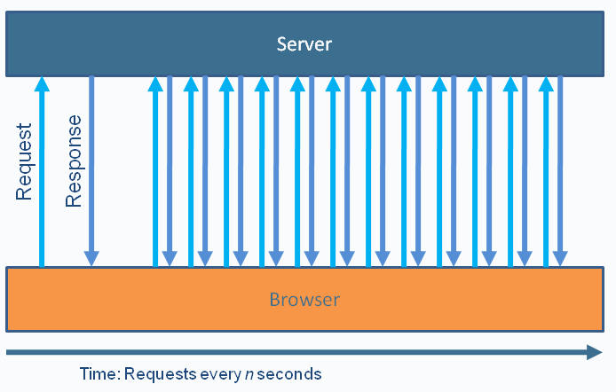
Polling
Polling is "nearly real-time"
Used in Ajax applications to simulate real-time
communication
Browser sends HTTP requests at regular
intervals and immediately receives a response

Slide 7
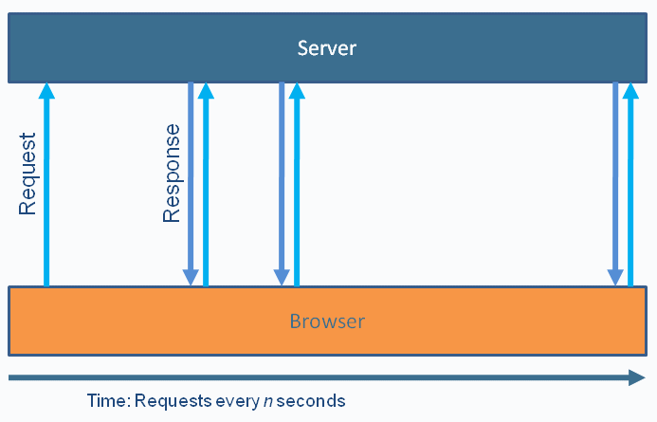
Long Polling
a/k/a Asynchronous polling
Browser sends a request to the server, server
keeps the request open for a set period
Speed limited by response-request-response
Request/response headers add overhead on
the wire

Slide 8
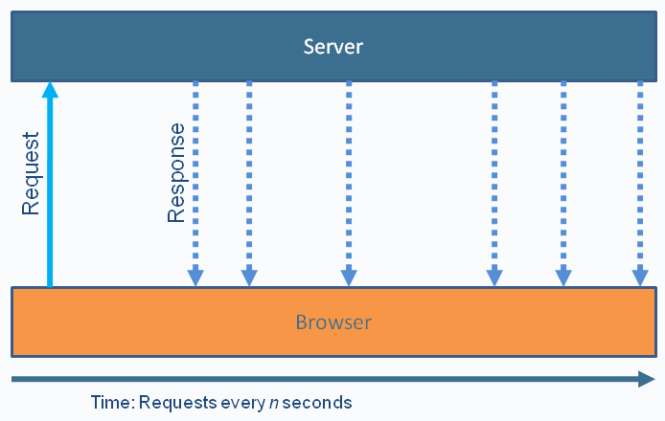
Streaming
More efficient, but sometimes
problematic
Possible complications:
Proxies and firewalls
Response builds up and must be flushed periodically
Cross-domain issues to do with browser
connection limits

Slide 9

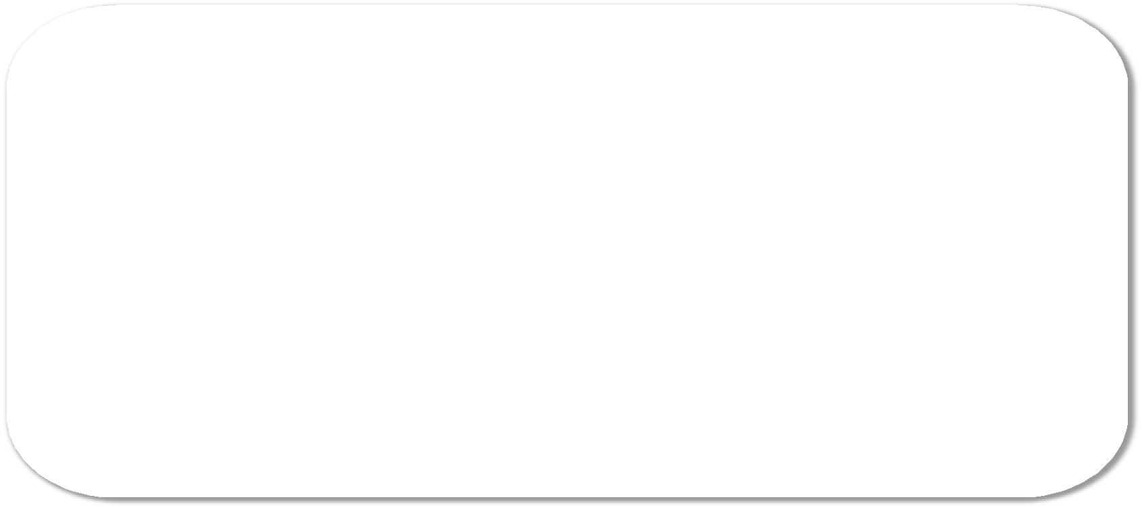
HTTP Request Headers
Client
GET /PollingStock//PollingStock HTTP/1.1 Host: localhost:8080
User-Agent: Mozilla/5.0 (Windows; U; Windows rv:1.9.1.5) Gecko/20091102 Firefox/3.5.5 Accept:
NT 5.1; en-US;
text/html,application/xhtml+xml,application/xml;q=0.9,*/*;q=0.8 Accept-Language: en-us
Accept-Encoding: gzip,deflate
Accept-Charset: ISO-8859-1,utf-8;q=0.7,*;q=0.7 Keep-Alive: 300
Connection: keep-alive
Referer: http://localhost:8080/PollingStock/ Cookie: showInheritedConstant=false;
showInheritedProtectedConstant=false; showInheritedProperty=false; showInheritedProtectedProperty=false; showInheritedMethod=false; showInheritedProtectedMethod=false; showInheritedEvent=false; showInheritedStyle=false; showInheritedEffect=false;
10

Slide 10


HTTP Response Headers
Server
HTTP/1.x 200 OK
X-Powered-By: Servlet/2.5
Server: Sun Java System Application
Server 9.1_02
Content-Type: text/html;charset=UTF-8 Content-Length: 321
Date: Sat, 07 Nov 2009 00:32:46 GMT
Total overhead: 871 bytes (example)
Often 2K+ bytes
e.g. cookies

Slide 11




HTTP Header Traffic Analysis
Client | Overhead Bytes | Overhead Mbps
1,000 | 871,000 | ~6,6*
10,000 | 8,710,000 | ~66
100,000 | 87,100,000 | ~665
* 871,000 bytes = 6,968,000
bits = ~6.6 Mbps

Slide 12


Overhead…
"Reducing kilobytes of data to 2 bytes…and reducing latency from 150ms to 50ms is far more than marginal. In fact, these two factors alone are enough to make WebSocket seriously interesting to Google."
—Ian Hickson (Google, HTML5 spec lead)

Slide 13

HTML5 WebSocket Overview

Slide 14
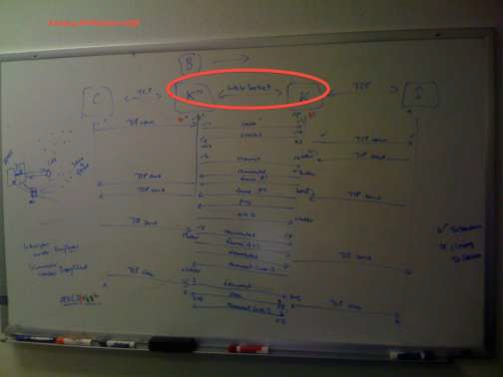
WebSocket History
Originally added to HTML5 specification as
TCPConnection
Moved to its own specification later on

Slide 15
HTML5 WebSocket
W3C API and IETF Protocol
Leverages Cross-Origin Resource Sharing
Enables web pages to communicate with a remote
host
Shares port with existing HTTP content
Allows unlimited connections per Origin
Unlike HTTP which is limited by convention
One WebSocket handshake in progress per Origin
Two schemes:
• ws://
wss://

Slide 16
USING THE WEBSOCKET API

Slide 17


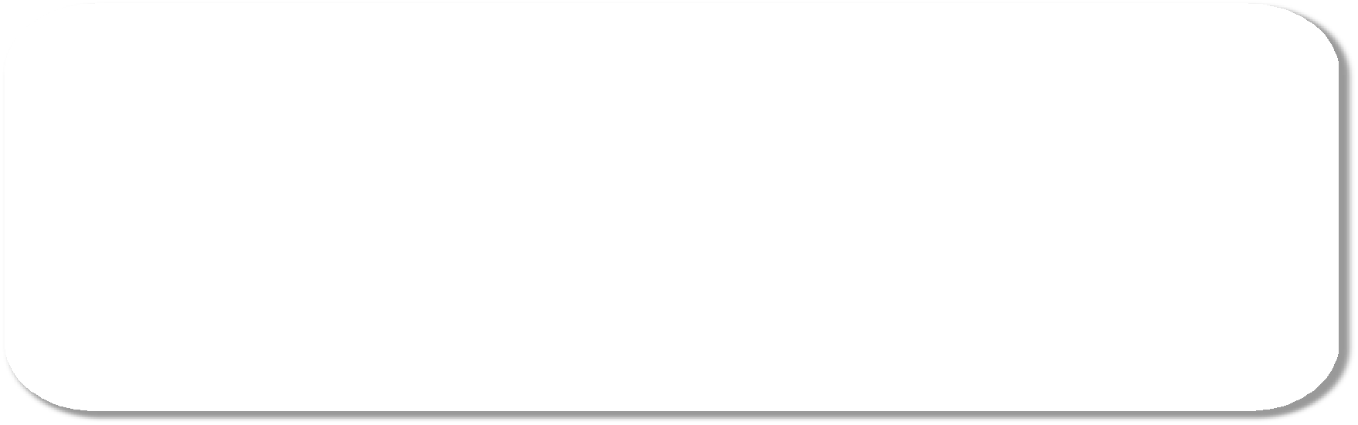
Checking for support
JavaScript
var status = document.getElementById("support");
if (window.WebSocket) { // or Modernizr.websocket status.innerHTML = "HTML5 WebSocket is supported";
} else {
status.innerHTML = "HTML5 WebSocket is not supported";
}

Slide 18
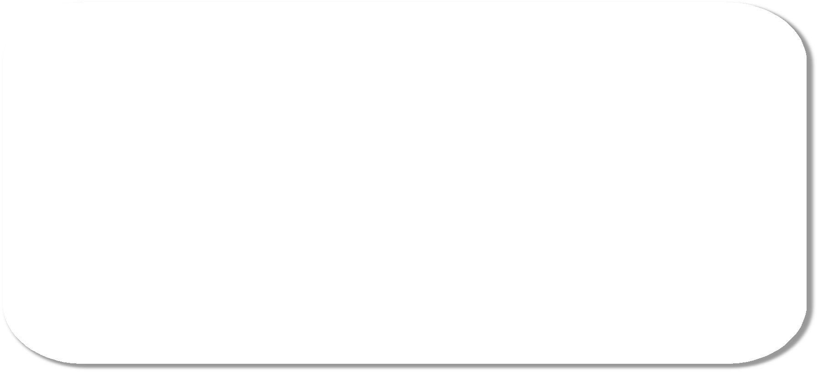
Using the WebSocket API
JavaScript
//Create new WebSocket
var mySocket = new WebSocket("ws://www.WebSocket.org");
// Associate listeners mySocket.onopen = function(evt) {
};
mySocket.onclose = function(evt) { alert("closed w/ status: " + evt.code};
};
mySocket.onmessage = function(evt) { alert("Received message: " + evt.data);
};
mySocket.onerror = function(evt) {
alert("Error);
};

Slide 19
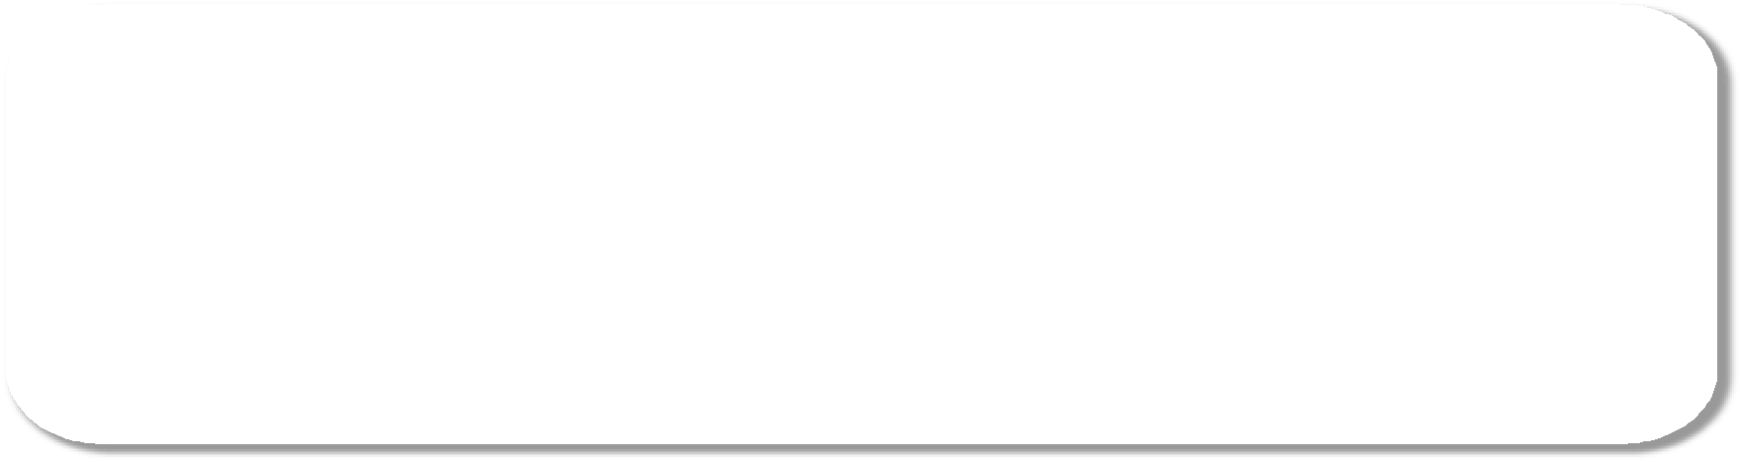
Using the WebSocket API
JavaScript
// Sending data mySocket.send("WebSocket Rocks!");
// Close WebSocket mySocket.close();
20

Slide 20
WebSocket API
Available? | window.WebSocket or Modernizr.websocket
Events | onopen, onerror, onmessage
Functions | send, close
Attributes | url, readyState, bufferedAmount, extensions, protocol
http://dev.w3.org/html5/websockets/
Italics: -08 and later

Slide 21

Browser Support
Native:
Chrome 4+
Safari 5+
Firefox 4+
Opera 10.7+
Internet Explorer 10+

Slide 22
WebSocket Servers Libraries
Kaazing
Socket.io (node.js)
Apache-websocket
Cramp
Nowjs
SockJS
SuperWebSocket
Jetty
Atmosphere
APE Project
Xsockets
Orbited
Atmosphere
Autobahn
CouchDB
Netty
Misultin
Cowboy
YAWS
Juggernaut
PHP Websocket
websockify
ActiveMQ
HornetMQ
phpwebsocket
Protocol::WebSocket
em-websocket
Jwebsocket
WaterSprout Server
Pywebsocket
And more…
Client Libraries
Web-socket-js (JavaScript)
AS3 WebSocket (ActionScript)
.NET WebSocket client (.NET)
Anaida (.NET)
WebSocket Sharp (.NET)
Silverlight WebSocket client
Java WebSocket Client
Arduino C++ WebSocket client
Ruby-web-socket
•
•
ZTWebSocket (Objective-C) Libwebsockets (C)

Slide 23
THE WEBSOCKET PROTOCOL

Slide 24




















WebSocket Protocol History
“draft-hixie-thewebsocketprotocol-xx” IETF Network Working Group
Version | Date | Details
-00 | Jan. 9 2009 | Initial version
-52 | Oct. 23 2009 | Subprotocol concept introduced
-76 | May 6 2010 | Used in older browsers (FF4, etc.)
“draft-ietf-hybi-thewebsocketprotocol-xx” (IETF HyBi Working Group)
Version | Date | Details
-01 | Aug. 31 2010 | Added binary format
-04 | Jan. 11 2011 | Introduced data masking to address proxy server security issue Introduced including protocol version number in handshake
-14 | Sep. 8 2011 | Guidance on version number negotiation
RFC 6455 | Dec. 2011 | Final version http://tools.ietf.org/html/rfc6455

Slide 25
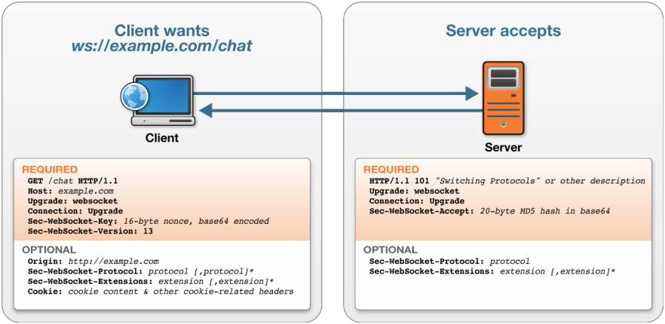
WebSocket Handshake

Slide 26
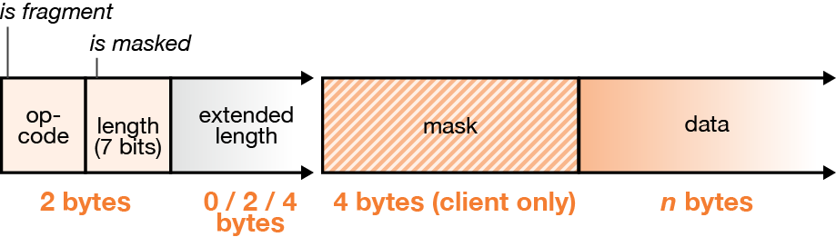
WebSocket Frames
Have a few header bytes
Text or binary data
Frames are masked from client to server

Slide 27
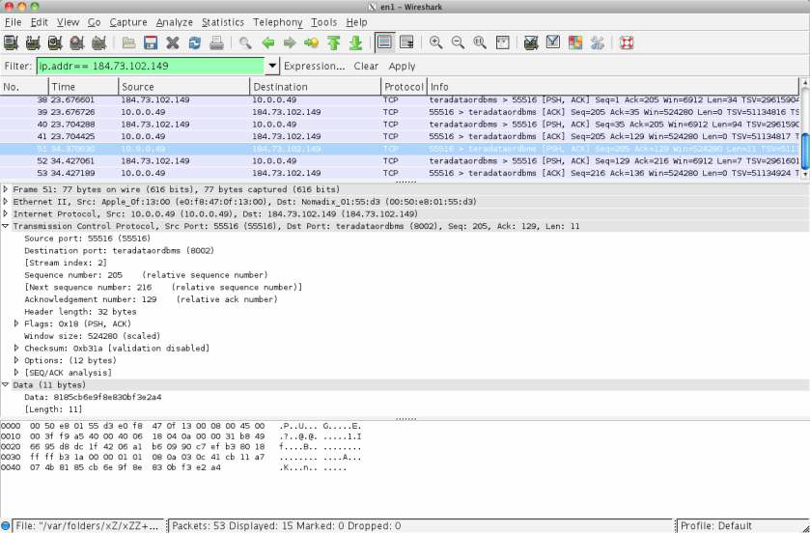
WebSocket Frames
Wireshark Trace of WebSocket Message (Client to Server)
FIN bit,
MASK bit,
RSV bits, Op- payload mask payload
Code length
81 85 CB 6E 9F 8E 83 0B F3 E2 A4
83 0B F3 E2 A4 XOR CB 6E 9F 8E CB
-- -- -- -- --
48 65 6C 6C 6F
H e l l o

Slide 28
WebSocket Efficiency
 | HTTP | WebSocket
Overhead | 100s of bytes | 2-6 bytes (typical)
Latency | New connection each time | None: Use existing connection
Latency (polling) | Wait for next interval | No waiting
Latency (long polling) | None, if request sent earlier + time to set up next request | No waiting

Slide 29
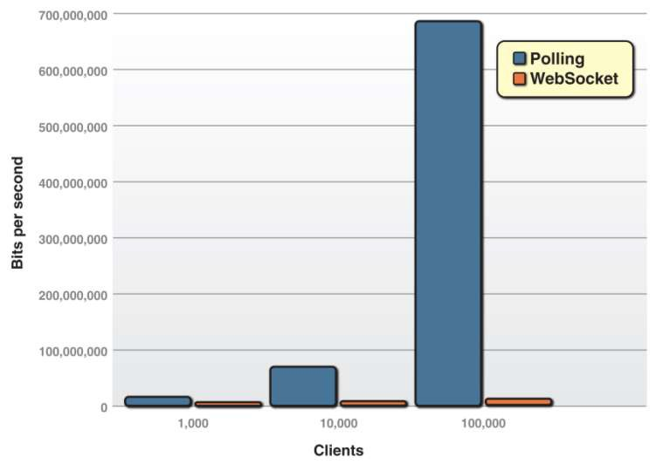
Polling vs. WebSocket
30

Slide 30
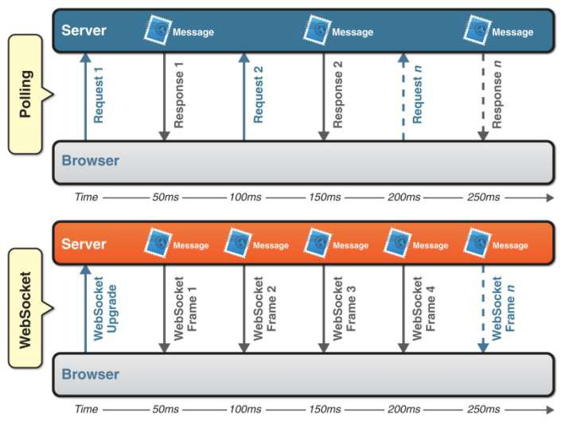
Latency Reduction

Slide 31
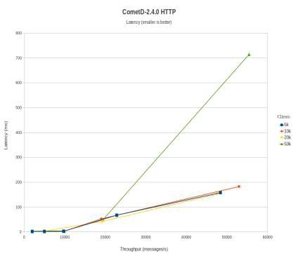
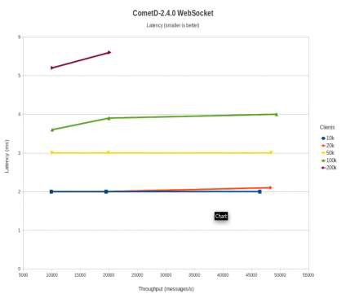
WebSocket Benchmark
Using Comet
Using WebSocket
http://webtide.intalio.com/2011/09/cometd-2-4-0-websocket-benchmarks/

Slide 32
Why WebSocket? WebSocket is about…
Performance
WebSocket makes real-time communication much more efficient.
Simplicity
WebSocket makes communication between a client and server
over the web much simpler.
Standards
WebSocket is an underlying network protocol that enables you to build other standard protocols on top of it.
HTML5
WebSocket is part of an effort to provide advanced capabilities to HTML5 applications in order to compete with other platforms.

Slide 33




















Demo – Mobile Notifications
Notification Demo Examples
Gate Change Announcement
Flight Cancellation
Refund Request Process
Push Notification
APNS
F I R E W AL L
TCP/HTTP
Cloud to Device Msg
Notifications Engine
ERP
Refund
System
CRM
HTML5 WebSocket
iOS/Android Native or HTML5 Hybrid App
Enterprise Messaging System / Apache ActiveMQ
HTML5 WebSocket
Flight Control
Finance
System
Legend
Background / Unidirectional
Foreground / Bi-directional, Low Latency, Guaranteed Delivery

