Slide 1
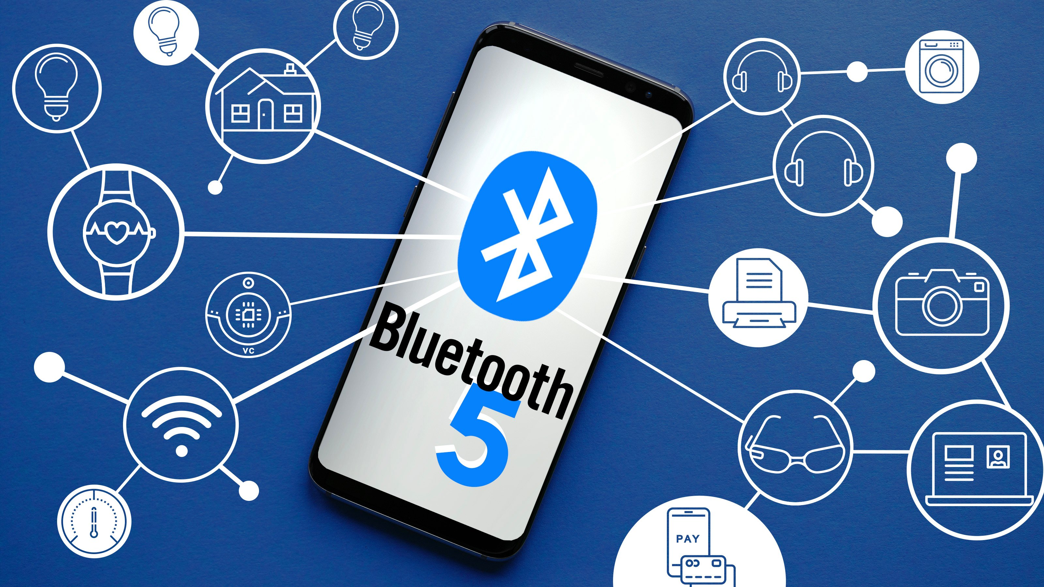

Slide 2
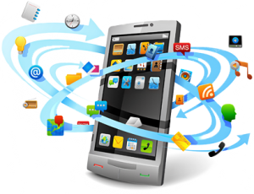



Devices Connected to Internet
1990s
2000s
2021
≃ 1 Billion Devices
Age of Smart Phones
≃ 2 Billion Devices
Age of IoT
≃ 48 Billion Devices
Bluetooth Low Energy (LE) has been actively evolved to make it a key enabler of the Internet of Things (IoT), focusing on the edge tier of IoT systems.
Bluetooth 5 brings some major advances to the technology and makes it ideal for an even broader range of IoT scenarios.
≃ 30% devices are forecasted to include Bluetooth technology

Slide 3
Introduction
Bluetooth has already existed for almost 20 years and is used today in approximately 8.2 billion devices, so it has already demonstrated its robustness and dependability.
To fulfill requirements set forth by the new IoT scene, the Bluetooth SIG announced the Bluetooth 5 specification in December 2016.
The latest Bluetooth standard improves bandwidth, range, broadcasting, and coexistence features.

Slide 4
Latest Devices
The Samsung Galaxy S8 launched with Bluetooth 5 support in April 2017.
In September 2017, the iPhone 8, 8 Plus and iPhone X launched with Bluetooth 5 support as well.
Apple also integrated 'Bluetooth 5' in their new HomePod offering released on February 9, 2018.

Slide 5
Bluetooth 5 or Bluetooth 5.0 ?
Marketing drops the point number; so that it is just "Bluetooth 5" (not 5.0 or LE like Bluetooth 4.0).
The change is for the sake of "Simplifying our marketing, communicating user benefits more effectively and making it easier to signal significant technology updates to the market."
- Bluetooth SIG

Slide 6

Major Improvements
2x Speed
4x Range
Maximum Transmit Power
Low Energy Channel Selection Algorithm #2
8x Advertising Capacity
High Duty Cycle Non-Connectable Advertising
Slot Availability Mask (SAM)

Slide 7
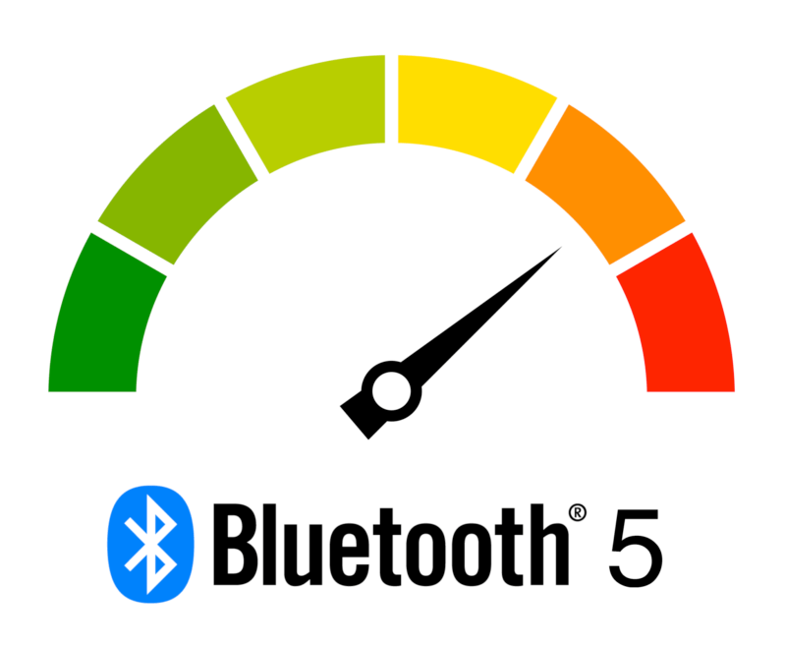
2x Speed
One of the major features in Bluetooth 5 is a new 2 Mbps PHY.
Bluetooth 4.x devices only support a single 1 Mbps PHY rate, but Bluetooth 5 devices are capable of supporting either the 1 Mbps or 2 Mbps PHY rates.
By doubling the PHY rate, the amount of data that devices can transfer is almost doubled as shown in the table on next slide.
Another benefit of the faster PHY is the reduced time required for transmitting and receiving data, which translates to a lower average current consumption.
This is explained by the fact that more time can be spent in low-power sleep modes.

Slide 8
Comparison of 1M and 2M Bluetooth low energy PHYs
PHY | Symbol rate | Error detection | Range multiplier | PDU Length | Minimum packet time | Maximum packet time | Maximum throughput
1M | 1M symbols/s | CRC | 1 x | 0 - 257 B | 80 µs | 2.12 ms | 800 kbps
2M | 1 M symbols/s | CRC | 0.8 x | 0 - 257 B | 44 µs | 1.064 ms | 1438 kbps
Doubling the throughput while providing low-power consumption will allow applications to provide faster data transfers for use cases like over-the-air (OTA) firmware upgrades or transmitting of days’ worth of collected data from a sensor.
It will also improve latency and responsiveness for time critical applications such as medical devices and security systems.

Slide 9
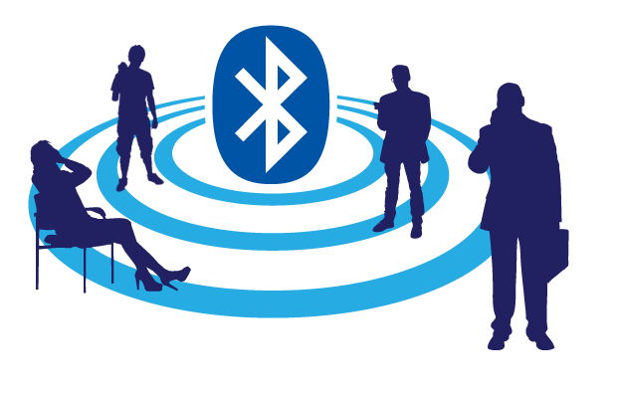
4x Range
The LE long range feature of Bluetooth 5 can quadruple the range and deliver robust and reliable connections.
This means that whole-house and building coverage, as well as new use cases for outdoor, industrial, and commercial applications will become a reality.
Those are something Bluetooth has not been able to address earlier, or when it has, the range has been limited.
So, how can Bluetooth 5 provide 4x the range?

Slide 10
LE Codec PHY’s
The BLE5-Stack supports transferring data over the mandatory symbol rate of 1 mega symbol per second (Msym/s) where 1 symbol represents 1 bit.
This results in a bit rate of 1 megabit per second (Mb/s), which is referred to as LE 1M PHY. The stack also supports an optional symbol rate of 2 Msym/s, with bit rate of 2 Mb/s, which is referred to as LE 2M PHY. This LE 2M PHY feature is introduced in the Bluetooth Core Specification Version 5.0 in addition to the LE 1M PHY previously supported.
In addition to the 2M PHY, Bluetooth 5 contains two additional optional PHYs called LE Coded PHYs.
The LE Coded PHYs actually use the 1M PHY rate, but the actual payload is coded either with 500 kbps (S=2) or 125 kbps (S=8) rate, whereas the preamble and access address use the 1M coding.
LE Coded PHY’s also use a slightly different packet format versus the 1M and 2M PHYs.
Using the coded PHYs improves the RX sensitivity, which also means improved range.
Typically, a 4-6 dB RX sensitivity improvement can be achieved using either the 500 kbps or 125 kbps PHY and this usually converts to a 2-4x range improvement.

Slide 11
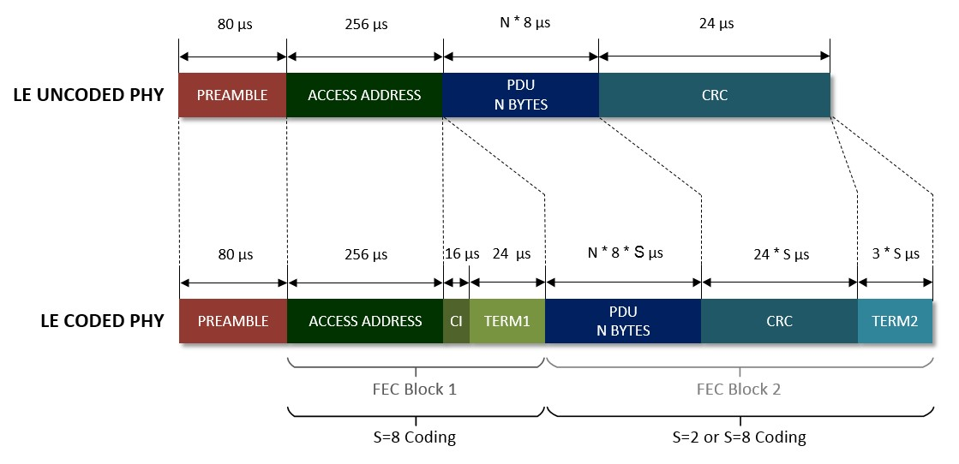
Bluetooth 5 un-coded vs. coded PHY packet format

Slide 12
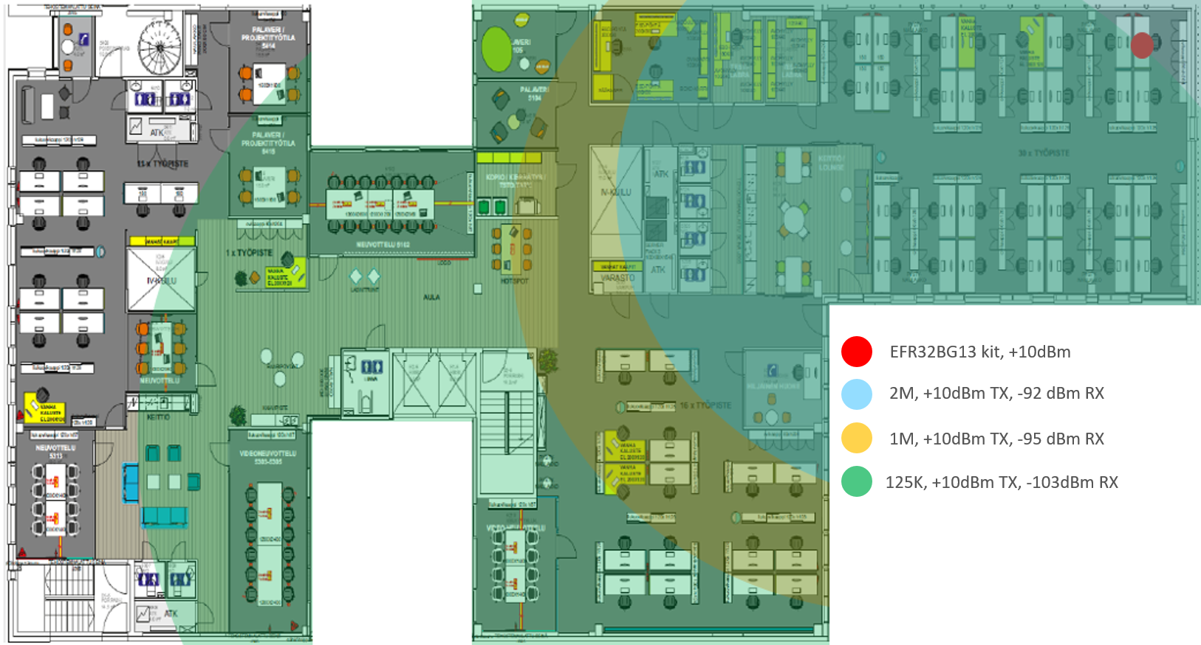
Comparing between 1Mbit PHY and LE Coded PHY (125kbps) the range is roughly double due to the sensitivity improvements.

Slide 13
Forward Error Correction and Pattern Mapper
LE Coded PHYs also change the bit stream processing for TX and RX operations, and add two steps into the packet transmissions and reception.
First of all, forward error correction is applied to the packet so that the receiver has a capability to correct bit errors upon reception of the packet and improve packet error rate.
Secondly, a pattern mapper is applied to the packet to improve the efficiency of the communications.
The figure shows the new bit stream PDU processing sequence.

Slide 14
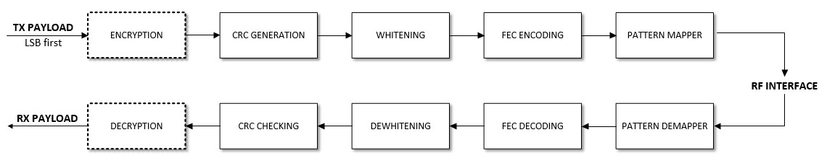
LE Coded PHY TX and RX packet processing

Slide 15

Maximum Transmit Power
Maximum transmit power in Bluetooth 5 is defined to be +20 dBm, while in the Bluetooth 4 specification this level was defined at +10 dBm.
Increasing the TX power by 10x of course can have a radical impact to the maximum range.
Using a +20 dBm TX power with Bluetooth low energy technology is however not that straightforward.
Different regulatory bodies do not allow transmit powers higher than 10 dBm due to the simplified hopping sequence and the small number of channels Bluetooth with low energy radios can use while advertising or in a connection.
However, the Bluetooth 5 specification includes enhancements to both advertising and channel selection algorithms that make it possible to use more RF channels than Bluetooth 4.
These enhancements may allow Bluetooth 5 devices to use higher than +10 dBm transmit power globally in the future, improving range and creating more robust connections.

Slide 16
Channel Selection Algorithm #2 (CSA#2)
One of the new features is Channel Selection Algorithm #2 (CSA#2).
It both improves the interference tolerance of the Bluetooth radio as well allows the radio to limit the minimum number of RF channels the radio can use in high interference environments.
When limiting the minimum number of channels to 15 it should be possible to increase the TX power above the +10 dBm limit.

Slide 17
8x Advertising Capacity
One of the major areas of improvement in the Bluetooth 5 specification is how Bluetooth advertisement (beaconing) works.
The new specification contains significant updates to beaconing capabilities compared to previous versions of the specification.
One of the basic improvements in Bluetooth 5 advertising is the Advertising Data Sets feature.
It allows a single Bluetooth 5 device to send out multiple individual advertisement data sets with unique intervals and advertisement data.

Slide 18
Beacons
At a basic level, beaconing is a way to deliver very short messages and track Bluetooth-enabled devices over a short distance, without the need for pairing between the beacon and the device.
The only requirement is that the device, typically an Apple or Android smartphone or tablet, has an installed app dedicated to beaconing.
The retail industry is currently the primary user of beaconing, so let’s use this is an application example.

Slide 19
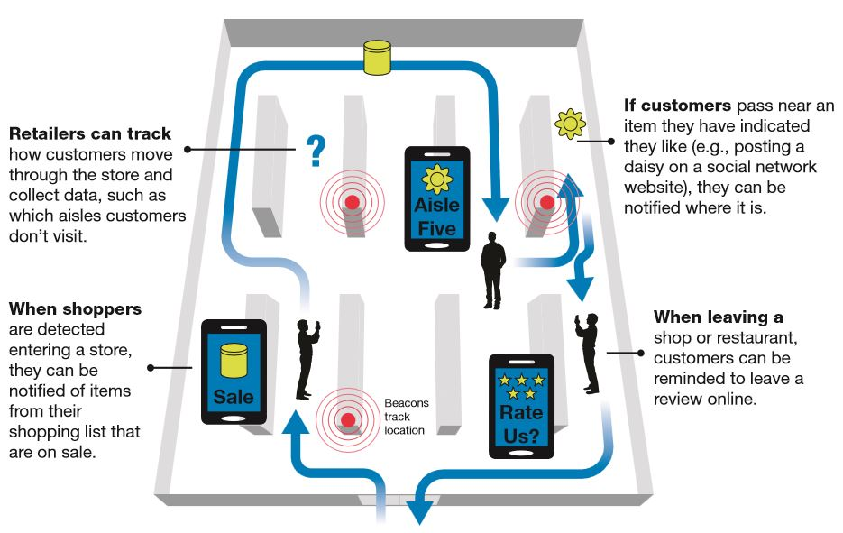
A typical scenario for beacons shows how they can be placed anywhere, tracking where shoppers go.

Slide 20
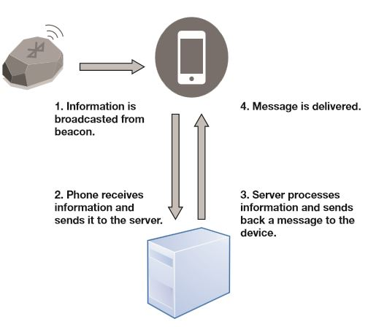
As beacons transmit only, they do not gather personal information, which minimizes security issues.
The usefulness of beacons depends entirely on what the retailer or other organization chooses to do with the information they provide.
For example, a retailer can determine what products shoppers seemed most interested in, where they go in a store, and if they buy something (Figure).
A typical scenario for beacons shows how they can be placed inconspicuously anywhere, tracking where shoppers go

Slide 21
Unfortunately, until Bluetooth 5, the maximum message length that could be transmitted by a beacon was limited to 31 bytes—too small to even contain all the characters in most URLs or provide a text message long enough to convey any useful information.
Bluetooth 5 solves this by increasing message length to 255 bytes so much more information can be accommodated.
Bluetooth 5 also provides higher data rates that should benefit not only beaconing but many other applications as well.

Slide 22
Slot Availability Masks
Bluetooth 5 made some changes to help improve coexistence with other radio technologies on devices such as smartphones.
Bluetooth uses the 2.4GHz ISM band and this is immediately adjacent to the Mobile Wireless Standard (MWS) bands, such as are used for LTE.
There’s potential for interference between the two systems, with transmissions from one desensitizing the receiver on the other.
Bluetooth 5 introduces a system called Slot Availability Masks, which allows Bluetooth to indicate the availability of its time slots and to synchronize in an optimal manner with the use of the adjacent MWS bands.

Slide 23
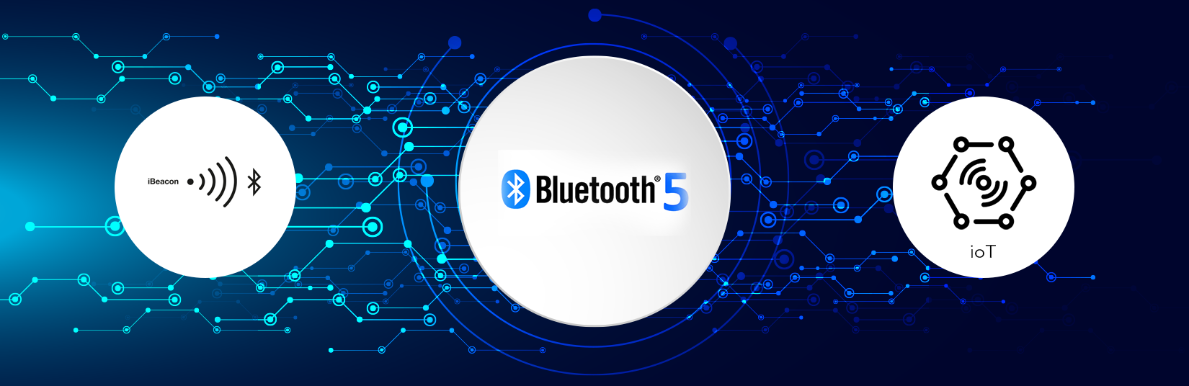
Conclusion
Bluetooth 5 represents another step change in Bluetooth technology. Its greater range, improved beacon support, higher data rate, greater message length, and dozens of other enhancements combined with frugal use of power, low implementation cost, and massive market penetration, ensure it will continue to be a highly competitive connectivity solution for years to come. Bluetooth 5 will have a substantial impact in many sectors and further position it as the low power wireless technology of choice for the Internet of Things.

