Slide 1
The Cellular Concept

Slide 2
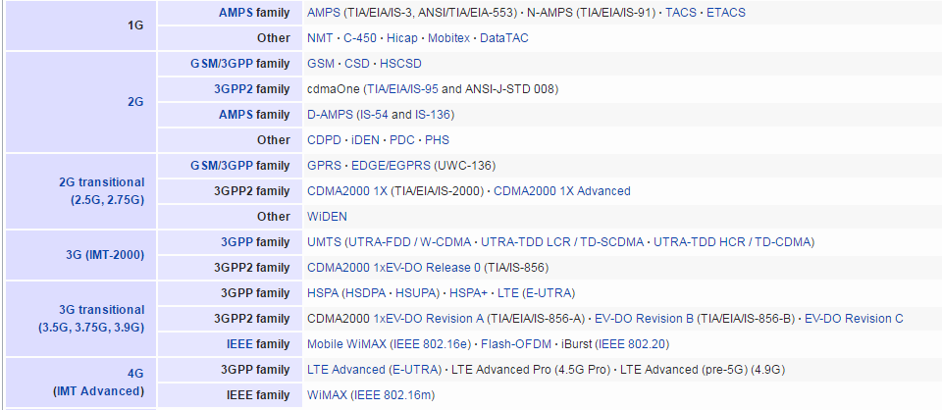
Mobile phone Generations

Slide 3
History of cellular Systems
Initial mobile networks were called 1G and were
based on analog communication in radio paths.
The early 1990 saw replacement of 1G networks with 2G which used digital communication in radio paths.
Four competing technologies were deployed:
GSM
IS-95
PDC
US-TDMA(or D-AMPS)

Slide 4
2G Systems
GSM: European Telecom Standards Institute
developed the GSM specifications in 1989.
– It used 25Mhz spectrum in 900MHz band. Later 1800MHz and 1900Mhz bands were added
IS-95: Based on CDMA scheme developed by
Qualcomm.
PDC: Personal Digital Cellular was popular in Japan
US-TDMA was popular in US, called as D-AMPS and was backward compatible with 1G system AMPS

Slide 5
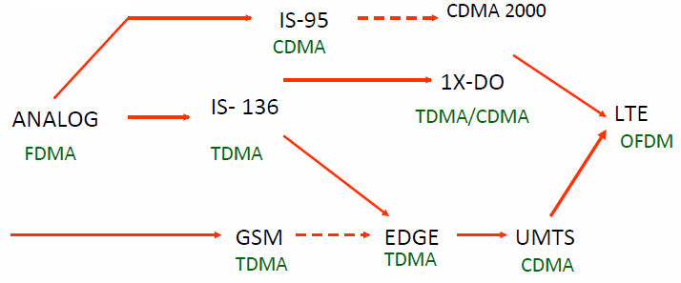
Evolution of Cellular Networks
1G
2G
2.5G
3G
4G

Slide 6
GSM

Slide 7
What is GSM?
Global System for Mobile communication (derived from original Groupe Spécial Mobile)
– In 1982, CEPT created the GSM to develop a standard for a mobile telephone system that could be used across Europe
Original GSM (or GSM900) is now supplemented by GSM1800(or DCS1800) and GSM1900 (or PCS1900)
More than 70% of mobile users in the world used GSM technology
GSM technology covers more than 80% population of the world

Slide 8
Structure of GSM Network
Functional entities of GSM
The Mobile Station(MS)
Also called as handset
Provides access to the user
The Base Station Subsystem (BSS)
Base stations and their controllers
The Network Switching Subsystem (NSS)
The part most similar to a fixed network
This is sometimes also just called the core network
Used for connecting calls among users

Slide 9
Structure of GSM Network
Functional entities of GSM (continued)
The Operation Support Subsystem(OSS)
For configuring the network
For maintenance of the network
The GPRS Core Network
optional part which allows packet based Internet
connections
Functions and interfaces are defined in the standard

Slide 10
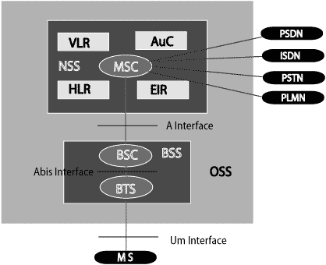
PLMN: The area covered by one network operator. A PLMN can contain one or more MSCs

Slide 11




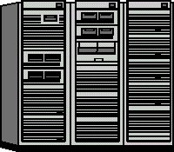

GSM Network Architecture
Access Network:
Base Station Subsystem
Core Network: GSM CS network
HLR
VLR EIR
AuC
BSC
Mobile Station
BTS
SS7
MSC
PSTN
BTS
Um
Abis
A

Slide 12
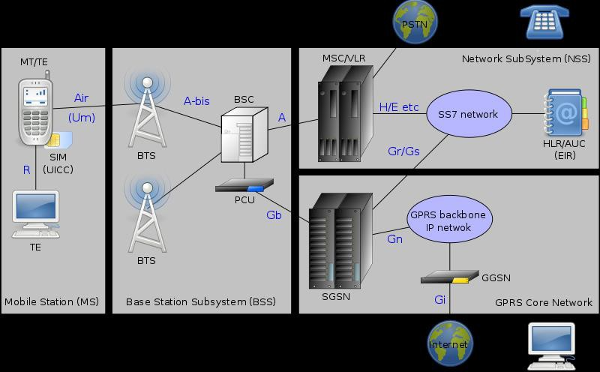
Key Elements in GSM Network

Slide 13
GSM Interfaces
Um Interface
Mobile Station and Base Station Subsystem communicate across Um interface, also known as air interface or radio link.
Abis interface
Base Transceiver Station (BTS) and Base Station Controller (BSC) communicate across Abis interface.
A interface
Base Station Subsystem communicates with Mobile service Switching Center (MSC) across A interface.

Slide 14
GSM Functional Entities(contd.)
Registers
HLR – Home Location Register
VLR – Visitor Location Register
AUC – Authentication Centre
EIR – Equipment Identification Register

Slide 15
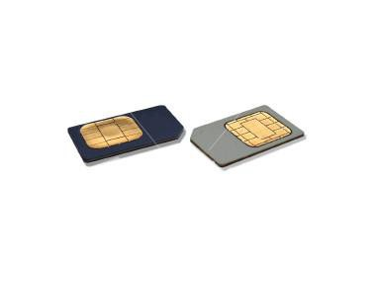
Subscriber Identity Module
A small smart card
Encryption codes needed to identify the subscriber
Subscriber IMSI(International mobile subscriber identity) number
Subscriber’s own information (telephone directory)
Third party applications (banking etc.)
Can also be used in other systems besides GSM, e.g., some WLAN access points accept SIM based user authentication

Slide 16
Subscriber Identity Module (SIM)
The smart card provided by service provider
Plugs into Mobile Equipment and remains in it, till
duration of use
Stores the 15 digit International Mobile Subscriber Identity (IMSI)
The first 3 digits are the Mobile Country Code
Next 3 digits are Mobile Network Code
The remaining digits are the mobile station identification number (MSIN) within the network's customer base

Slide 17
Subscriber Identity Module (SIM)
SIM carries following information
IMSI
Authentication Key
Subscriber Information
Access control class
Forbidden PLMN (Public Land Mobile Network)
Cipher key
TMSI(Temporary Mobile Subscriber Identity )
Additional GSM services
Location Area Identity

Slide 18
1G Cellular Systems
Analog signaling for user traffic
No encryption
eavesdropping possible
Inferior call quality
Easily degraded by noise
Spectrum inefficiency
Each RF carrier is dedicated to single user regardless of whether the user is active (speaking) or not (idle within the call)
AMPS(Advanced Mobile Phone System) in US
TACS(Total Access Communication System) in Europe

Slide 19
Advanced Mobile Phone System
Developed by Bell labs and deployed in 1982
Uses a number of 30Khz channels
Carries only voice.
AMPS was allocated bandwidth in 800MHz by FCC
Each cellular telephone includes a Numeric Assignment Module (NAM) in ROM
Telephone number
Serial number of the unit
When phone is turned on this info. is sent to MTSO

Slide 20
2G Cellular Systems
Key improvements over 1G
Digital traffic channels
Readily support digital data
Voice is encoded in digital form
Encryption
Encryption of all traffic to prevent eavesdropping
Error detection and correction
Results in better voice reception
Channel access
Each channel is dynamically shared between
users

Slide 21
2G Cellular Systems
 | GSM | IS-136 | IS-95
Year Introduced | 1990 | 1991 | 1993
Access Method | TDMA | TDMA | CDMA
Base station band | 935–960MHz | 869–894MHz | 869–894MHz
Mobile station band | 890–915MHz | 824-849MHz | 824-849MHz
Channel bandwidth | 200KHz | 30KHz | 1250KHz
Number of channel | 125 | 832 | 20
Users per channel | 8 | 3 | 35
Modulation | GMSK | DQPSK | QPSK

Slide 22
GSM Enabled Technologies

Slide 23
Mobile Wireless Data Networks
Driver for Growth
Popularity of internet
Desire for anytime, anywhere data communication
Short Message Service (SMS)
Multimedia Messaging Service (MMS)
General Packet Radio Service (GPRS)
Enhanced Data Rates for GSM Evolution (EDGE)

Slide 24
Constraints with existing network
Data Rates too slow – about 9.6 kbps
Connection setup time too long
Inefficient resource utilization for bursty traffic
Proves expensive for bursty traffic utilization
No efficient method for packet transfers

Slide 25
Comparison of GSM & GPRS
 | GSM | GPRS
Data Rates | 9.6 Kbps | 14.4 to 115.2 Kbps
Modulation Technique | GMSK | GMSK
Billing | Duration of connection | Amount of data transferred
Type of Connection | Circuit – Switched Technology | Packet - Switched Technology

Slide 26
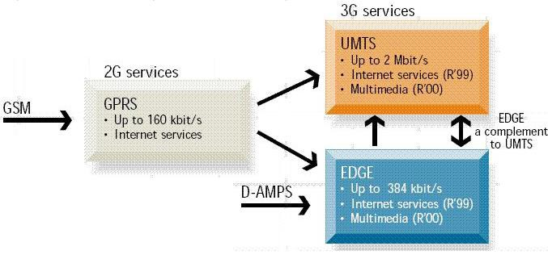
Evolution of GSM Networks

Slide 27
3G Systems
3G has been in gestation since 1992
International Telecommunications Union (ITU) began
work on a standard called IMT-2000.
IMT stands for International Mobile Telecommunications
The number 2000 initially had three meanings
The year that services should become available
The frequency range in MHz that would be used
and the data rate in Kbits/sec
Regulators, vendors and carriers could not agree
The path to 3G will be gradual, and everyone wants to ensure compatibility with their existing systems

Slide 28
3G Systems
Voice quality comparable to public switched
telephone network
144kbps data rate for users in high speed vehicles
384kbps to stationary or slow moving users
Support for 2.048 Mbps for office use
Symmetrical and asymmetrical data transmission
rates
Support for both packet and circuit switched data services
More efficient use of spectrum

Slide 29
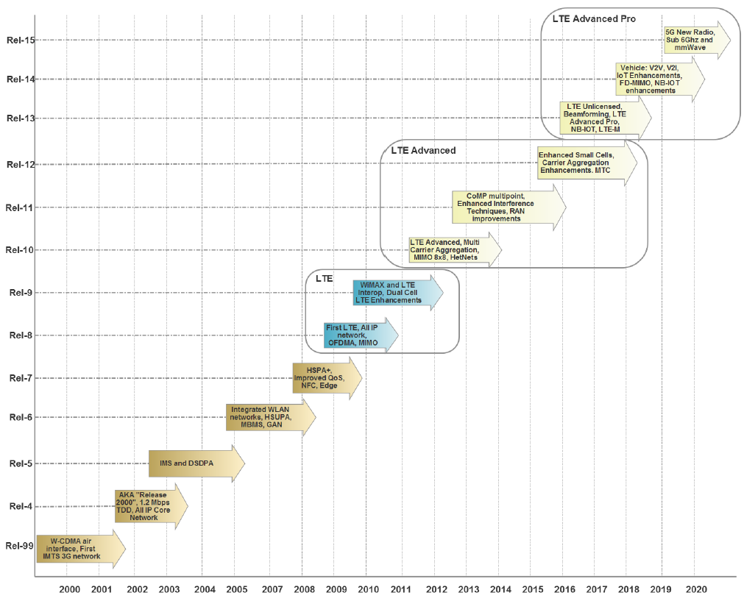
3rd Generation Partnership Project till 2020

Slide 30
4G (LTE)
LTE stands for Long Term Evolution
Next Generation mobile broadband technology
Promises data transfer rates of 100 Mbps
Based on UMTS 3G technology
Optimized for All-IP traffic

Slide 31
Facts about 4G/LTE
LTE is the successor technology not only of UMTS but also of CDMA 2000.
LTE is important because it will bring up to 50 times performance improvement and much better spectral efficiency to cellular networks.
LTE introduced to get higher data rates, 300Mbps peak downlink and 75 Mbps peak uplink. In a 20MHz carrier, data rates beyond 300Mbps can be achieved under very good signal conditions.
LTE is an ideal technology to support high date rates for the services such as voice over IP VOIP , streaming multimedia, videoconferencing or even a high-speed cellular modem.

Slide 32
Cont..
LTE uses both Time Division Duplex TDD and Frequency Division Duplex FDD mode.
All LTE devices must support MIMO Multiple Input Multiple Output transmissions, which allow the base station to transmit several data streams over the same carrier simultaneously.
All interfaces between network nodes in LTE are now IP based, including the backhaul connection to the radio base stations.
Quality of Service QoS mechanism have been standardized on all interfaces to ensure that the requirement of voice calls for a constant delay and bandwidth, can still be met when capacity limits are reached.

Slide 33
4G-LTE spectrum allocation and bands
There are 55 LTE bands in existence, partly due to spectrum fragmentation and market strategies. LTE is also split into two categories that are not compatible:
Time Division Duplex (TDD): TDD uses a single frequency space for uplink and downlink data. The transmission direction is controlled via time slots.
Frequency Division Duplex (FDD): In an FDD configuration, the base station (eNodeB) and the user equipment (UE) will open a pair of frequency spaces for uplink and downlink data. An example may be LTE band-13, which has an uplink range of 777 to 787 MHz and a downlink range of 746 to 756 MHz. Data can be sent simultaneously to both the uplink and downlink.

Slide 34
4G-LTE topology and architecture
Evolved Universal Terrestrial Radio Access Network (E-UTRAN): This is 4GLTE air interface to LTE UE devices. E-UTRAN uses OFDMA for the downlink portion and SC-FDMA for the uplink.
eNodeB: This is the core of the radio network. It handles communications between the UE and the core (EPC).
User Equipment (UE): This is the client hardware and is composed of Mobile Terminations (MT), which perform all the communication functions, Terminal Equipment (TE), which manages terminating data streams, and the Universal Integrated Circuit Card (UICC), which is the SIM card for identity management.
Evolved Packet Core (EPC): In the design of LTE, the 3GPP decided to build a flat architecture, and separate user data (called the user plane) and control data (called the control plane).

Slide 35
Evolved Packet Core
The EPC has five basic components listed here:
Mobility Management Equipment (MME): Responsible for control plane traffic, authentication and security, location and tracking, and mobility issue handlers. The MME also needs to recognize mobility in IDLE mode.
Home Subscriber Server (HSS): This is a central database associated with the MME that contains information about the network operator subscribers. This may include keys, user data, maximum data rates on the plan, subscriptions, and so on.
Servicing Gateway (SGW): Responsible for user plane and user data flow. Essentially, it acts as a router and forwards packets between the eNodeB and PGW directly.

Slide 36
Cont..
Public Data Network Gateway (PGW): Connects mobile networks to external sources including the internet or other PDN networks. It also allocates the IP address for the mobile devices connected. The PGW manages the Quality of Service (QoS) for various internet services such as video streaming and web browsing.
Policy Control and Charging Rules Function (PCRF): This is another database that stores policies and decision-making rules. It also controls the flow-based charging functions.
Public Data Network (PDN): This is the external interface, and for the most part, the internet. It can include other services, data centers, private services, and so on.

Slide 37
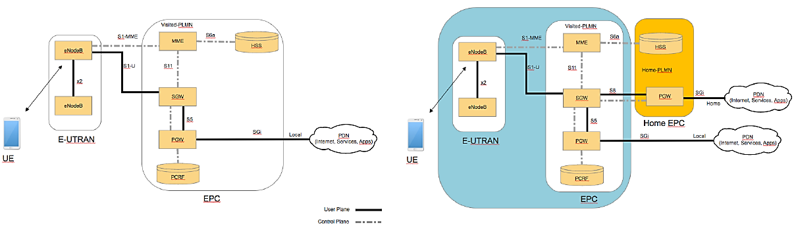
4G LTE Architecture

Slide 38
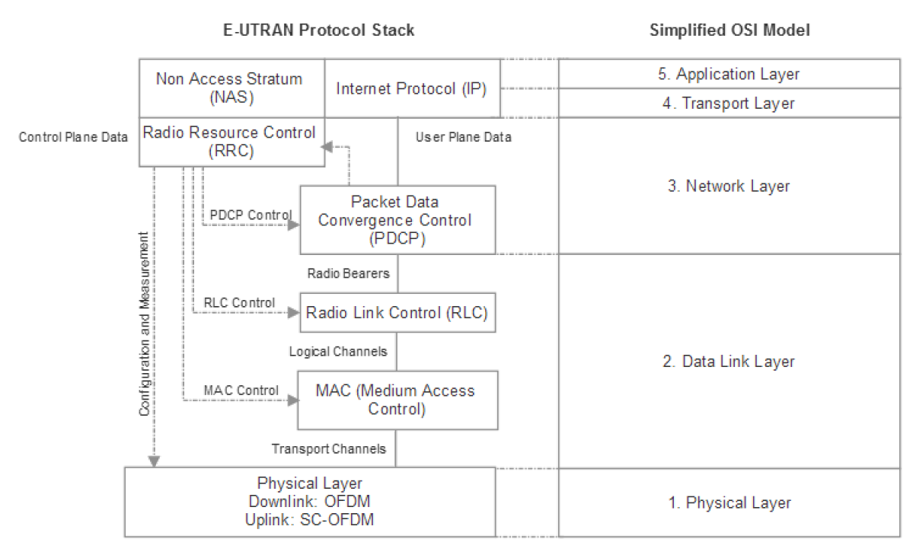
4G-LTE E-UTRAN protocol stack

Slide 39
5G Introduction
5G (or 5G-NR for new radio) is the next generation IP-based communication standard being drafted and designed to replace 4G-LTE.
5G promises to deliver substantial abilities for IoT, commercial, mobile, and vehicular use cases.
5G also improves bandwidth, latency, density, and user cost.
5G is not a continuing evolution of 4G; it derives from 4G but is a new set of technologies.
In our scope , we will only discuss elements that pertain to IoT use cases or are of merit and have the potential to become part of the 5G specification.

Slide 40
5G features
The consensus of features in 5G that should be understood and have a good prospect of being in the final release are:
1. Enhanced Mobile Broadband (eMBB):
1 to 10 GBps connections to UEs/endpoints in the field (not theoretical)
100% coverage across the globe (or perception of)
10 to 100x the number of connected devices over 4G-LTE
Connectivity at a speed of 500 km/h
2. Ultra-Reliable and Low-Latency Communications (URLLC):
Sub < 1 ms end-to-end round-trip latency
99.999% availability (or perception of)
3. Massive Machine Type Communications (mMTC):
1000x bandwidth per unit area; this implies roughly 1 million nodes in 1 km²
Up to a 10 year battery life on endpoint IoT nodes
90% reduction in network energy usage:

Slide 41
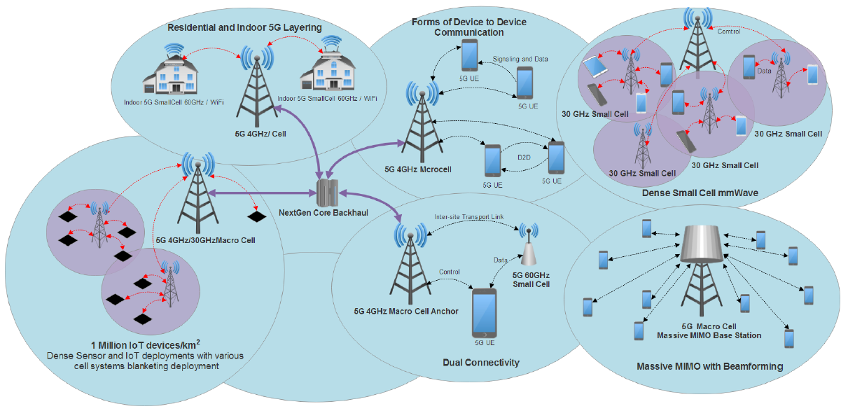
5G Topologies
From left to right: 1 million node density through small cells and macrocell deployment. Indoor and home use of 60 Ghz with macrocell at 4 Ghz backhaul. Dual connectivity example with split control and data planes using two radios for user data and 4 GHz microcells for the control plane. Device to device connectivity. Massive MIMO with beamforming from a single mmWave antenna. Density increase with a mix of small cells in mmWave for blanket coverage of user data.

Slide 42
5G Frequencies
Current 4G-LTE systems mainly use frequencies below the 3 GHz range.
5G will radically change the spectrum usage. 5G may use a multitude of frequencies.
Under strong consideration is the use of millimeter waves (mmWave) in the unlicensed 24 to 100 GHz range.
These frequencies directly address Shannon's Law by increasing the bandwidth B of the law with extremely wide channels. Since the mmWave space is not saturated or sliced up by various regulatory bodies, channels as wide as 100 MHz in the 30 GHz to 60 GHz frequencies are possible.
This will provide the technology to support multi-gigabit per second speeds.
The principal issues with mmWave technology are free space path loss, attenuation, and penetration.
Free path loss is significant only if the antenna gain is independent of frequency. If we keep the antenna area constant, it is possible to mitigate the effects of path loss.
This requires Massive-MIMO (M-MIMO) technology. M-MIMO will incorporate macrocell towers with 256 to 1024 antennas. Beamforming at the macrocell will be used as well.

Slide 43
5G New Waveforms
4G-LTE uses OFDM, which works well for large data transmissions. However, for IoT the packets are much smaller. The overhead for OFDM also impacts latency in very dense IoT deployments.
Hence, new waveforms are being architected for consideration:
Non-orthogonal Multiple Access (NOMA): Allows multiple users to share a wireless medium.
Filter Bank Multi-Carrier (FBMC): Controls the shape of subcarrier signals to remove side-lobes through DSPs.
Sparse Coded Multiple Access (SCMA): Allows data to be mapped to different code from different codebooks.

Slide 44
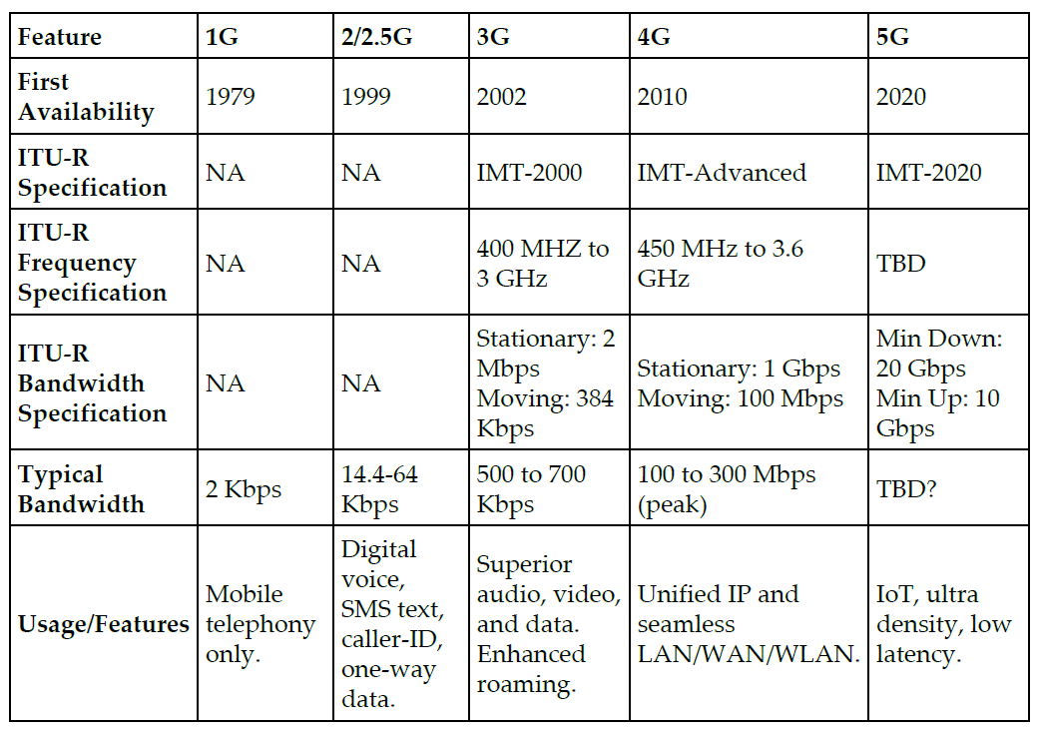
Summary

Slide 45
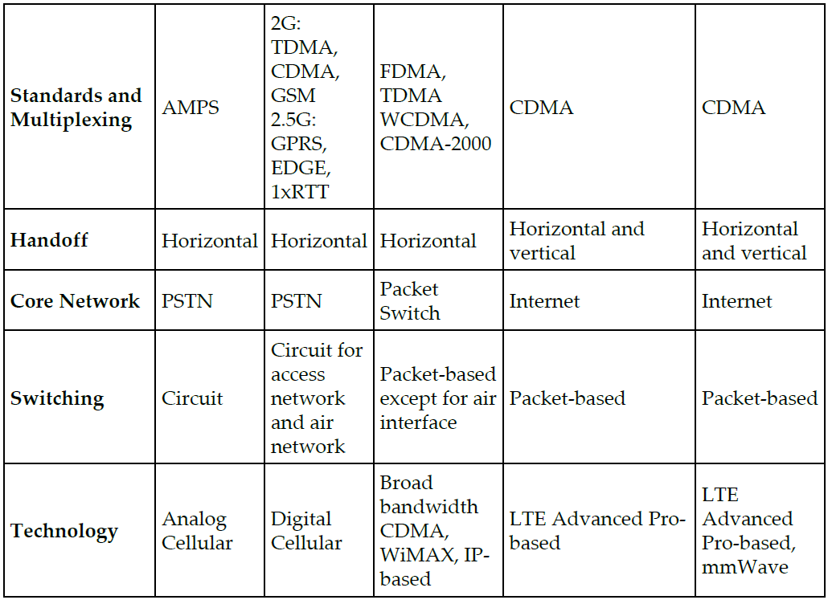
Cont..

Slide 46
Thank You

