Slide 1
IrDA

Slide 2

IrDA
The Infrared Data Association (IrDA) defines physical specifications communications protocol standards for the short range exchange of data over infrared light,
IrDA is a very short-range free-space optical communication.
IrDA specifications includes its own protocol stack.
IrDA has a new standard, IrFM, for Infrared financial messaging also known as "Point & Pay".
For the devices to communicate via IrDA they must
have a direct line of sight

Slide 3
Characteristics of IR
Infrared lies in electromagnetic spectrum just below
visible light
Characteristics that IR shares with visible light
Operates at high frequencies
Travels in straight lines
Does not penetrate physical objects
Other IR Characteristics
Has an abundance of available bandwidth that is unregulated
Has potential to operate at high data rates
Is more secure than radio frequency transmissions

Slide 4
Characteristics of IR
Avoids many kinds of interference that affect RF signals
Components are small and consume little power
IR transmissions can be directed or diffused
Directed transmission uses a narrow beam and line of sight
Both emitter and detector must be aimed directly at
one another
Diffused transmission uses a wide beam and reflected light
Both emitter and detector point at a reflection point on the ceiling

Slide 5
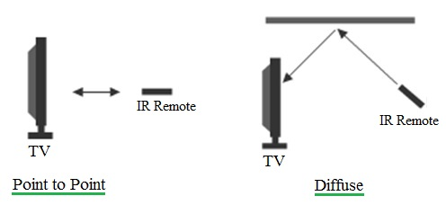

Slide 6
IrDA
Infrared Data Association (IrDA) is the most
commonly used infrared connection today
It links different devices such as notebook computers, Personal Digital Assistants (PDA) handheld devices, cameras, watches, printers, pagers, and storage devices.
IrDA specifications include
physical devices
network protocols used for communication

Slide 7
IrDA Devices
Communicate with minimal pre-configuration
Provide point-to-point data transfer between only two
devices at a time
Inexpensive technology – low cost components
Unlike RF, transmission speed do not vary with
distance.
– the distance between two IrDA devices must be sufficient to make the connection.

Slide 8
Three versions of IrDA
IrDA Version | Speed
Serial Infrared (SIR) | 9600-115,200 bps
Fast Infrared(FIR) | 4 Mbps
Very Fast Infrared(VFIR) | 16 Mbps

Slide 9
Multiple Infrared Connections
Single IrDA device cannot be connected to more than
one other IrDA device at a time.
IrDA devices use
infrared light emitting diodes (LEDs) to send
photodiodes to receive signals
Single IrDA link can establish multiple simultaneous
connections
When two IrDA devices establish a connection, multiple programs can utilize it
to send and receive mail
to update calendar and contact information,
to print documents

Slide 10
Factors to Improve Communication
Transparent window in front of IR module should be
flat instead of curved
Window should be violet to minimize loss of signal
Module should be recessed several millimeters into device case to minimize interference from ambient light

Slide 11
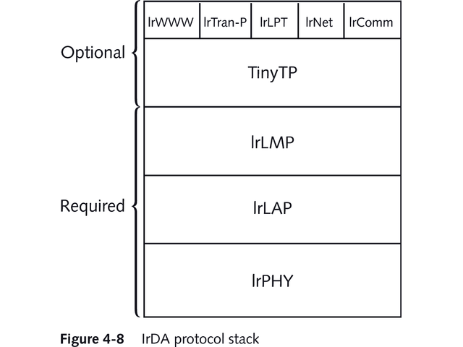
Simplified IrDA Protocol Stack

Slide 12
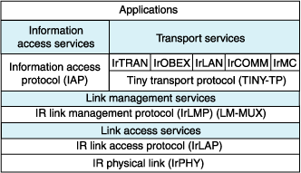
Full blown IrDA Protocol Stack

Slide 13
Functions of the Layers
IrDA Physical Layer Protocol (IrPHY) controls
hardware that sends and receives signals
IrDA Link Access Protocol (IrLAP) encapsulates frames and defines how connections are established
IrDA Link Management Protocol (IrLMP) allows devices to detect other devices and act as a multiplexer
IrDA Transport Protocol (Tiny TP) manages channels, corrects errors, divides data into packets, and reassembles original data

Slide 14
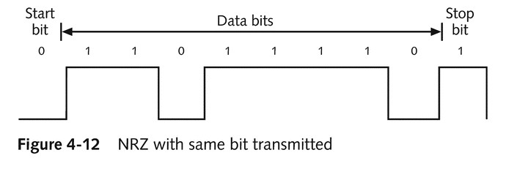
Coding
Standard RS-232 serial ports can use NRZ (non- return-to-zero) techniques that keep output level the same for the entire bit period
IrDA devices cannot use NRZ technology
They use RZI that uses the inverse of RZ
RZI increases voltage for a 0 bit and no voltage for a 1 bit

Slide 15
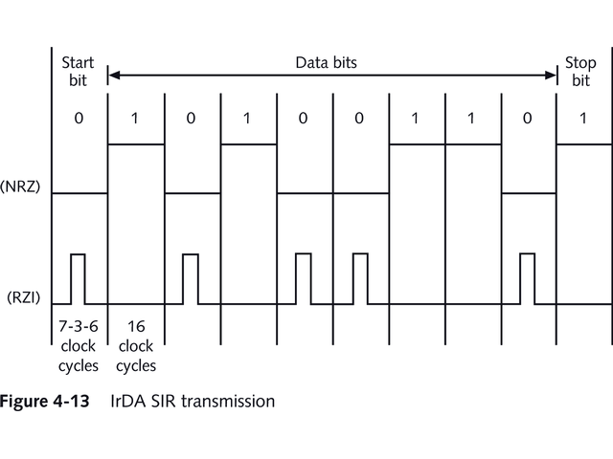
Return to Zero Inverted
122
© 2012, HTDG,C-DAC

Slide 16
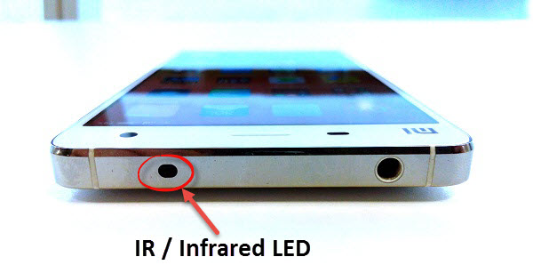
IrDA enabled products

Slide 17
RFID

Slide 18
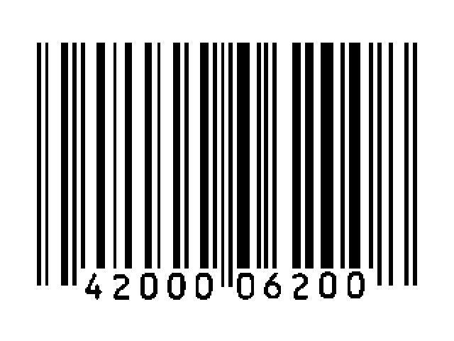
Introduction
Automatic Identification procedures have been very
popular in
Service industry
Purchasing and distribution logistics industry
Manufacturing companies
Material flow systems
The omnipresent barcode labels had started a revolution in identification systems years ago
Today they are found to be inadequate
Low storage capacity
Cannot be reprogrammed

Slide 19
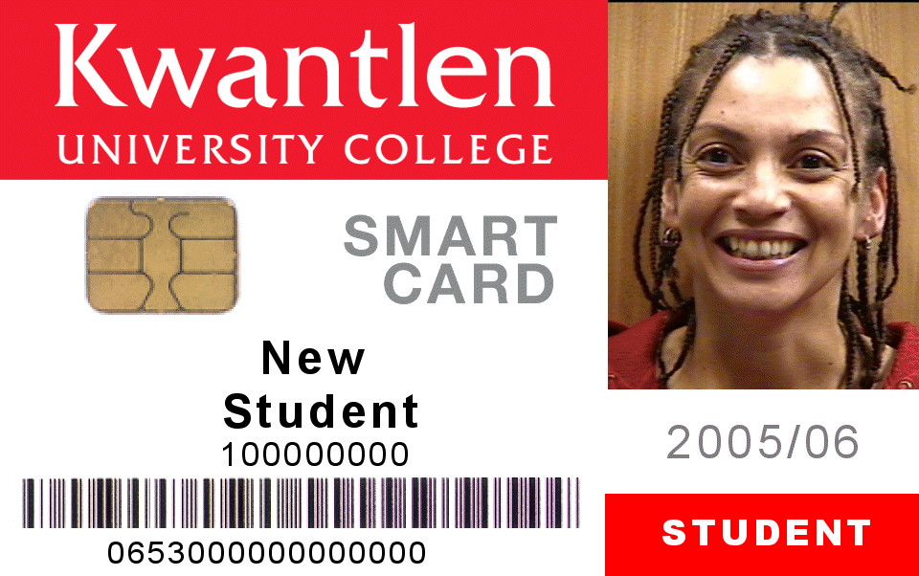
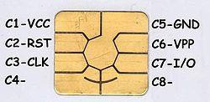
Introduction
The technically optimal solution would be storage of
data in a silicon chip
The most common form of electronic data carrying device, today is the smart card
However the mechanical contact used in the card is sometimes impractical

Slide 20
Smart Card
A smart card, 85.60 × 53.98 mm sized card with
embedded logic to process data.
There are two broad categories.
Memory cards contain only non-volatile memory storage components, and some specific security logic.
Microprocessor cards contain volatile memory and microprocessor components.
The card is made of plastic, generally PVC
Smart cards can be used for identification,
authentication, and data storage

Slide 21
RFID
A contact less transfer of data between the carrying
device and its reader is far more flexible
In ideal case the power required for operation should also be sent by the reader using contact less technology
Due to the techniques used for transfer of power and data, contact less ID systems are also called as RFID (Radio Frequency Identification) systems

Slide 22
Popular Auto ID techniques
Barcode
Fingerprint
OCR
Biometric
Auto-ID
Retina
Smart Cards
RFID

Slide 23
Types of RFID cards
Most RFID tags contain at least two parts.
An integrated circuit for storing and processing information, modulating and demodulating a radio- frequency (RF) signal, and other specialized functions.
An antenna for receiving and transmitting the signal
RFID cards are also known as "proximity" or "proxy" cards and come in three general varieties:
passive,
semi-passive (also known as semi-active),
active

Slide 24
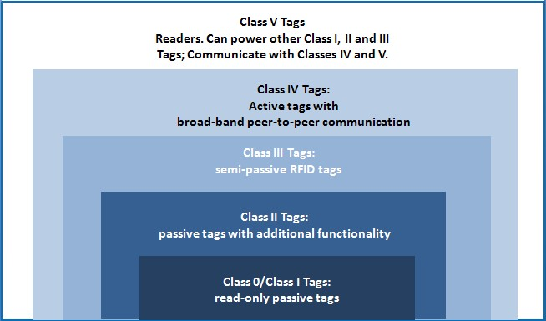
Classes of RFID

Slide 25
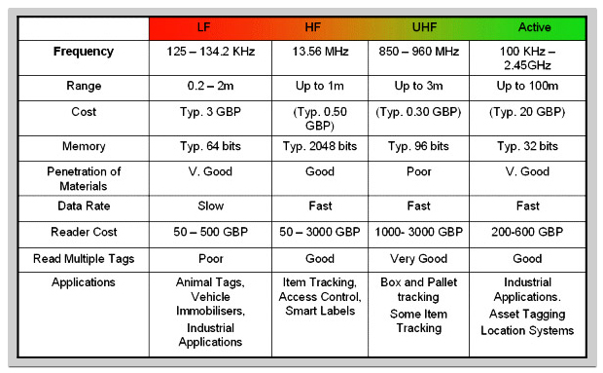
RFID Operating Frequency

Slide 26
Passive
Passive RFID tags have no internal power supply.
The minute electrical current induced in the antenna by the incoming RF signal provides just enough power for the IC in the tag to power up and transmit a response.
Most passive tags signal by backscattering the carrier
signal from the reader. Antenna is designed to
collect power from the incoming signal
transmit the outbound backscatter signal.

Slide 27
Passive
The response of a passive RFID tag is not just an ID number
The tag chip can contain nonvolatile EEPROM for storing data.
Lack of an onboard power supply means that the device can be quite small
Small enough to be embedded under the skin.
the smallest devices available are 0.15 mm × 0.15 mm, and are thinner than a sheet of paper (7.5 micrometers)

Slide 28
Semi-passive
Very similar to passive tags except for the addition of a
small battery.
This battery allows the tag IC to be constantly powered
Aerial need not collect power from the incoming signal.
Aerials therefore are optimized for the backscattering
signal.
Semi-passive RFID tags are thus faster in response,
less reliable and powerful than active tags.
Semi-passive tags offer benefits in metal or fluids rich
conditions
typically scatter the RF field and can cause non-reads with passive tags

Slide 29
Active
Active RFID tags have their own internal power source
Active tags are typically much more reliable
Have ability to conduct a "session" with a reader.
transmit at higher power levels than passive tags,
more effective in "RF challenged" environments like water metal (shipping containers, vehicles), or at longer distances.
Many active tags have practical ranges of hundreds of meters, and a battery life of up to 10 years.
.

Slide 30
Active
Some active RFID tags include sensors such as
temperature logging
used in concrete maturity monitoring
to monitor the temperature of perishable goods.
Active tags have range of ~ 100m and larger
memories
Have ability to store additional information sent by the transceiver.

Slide 31
The RFID system
An RFID system may consist of several components:
tags,
tag readers,
edge servers,
middleware,
application software.
Data is transmitted by a mobile device, called a tag,
It is read by an RFID reader
Processed according to the needs of a particular
application.

Slide 32
The RFID system
The data transmitted by the tag may provide
identification
location information
specifics about the product tagged,
price,
Color
date of purchase, etc.
RFID quickly gained attention because of its ability to track moving objects.
As the technology is refined, more pervasive and
possibly invasive uses for RFID tags are in the works

Slide 33
Working of system
Individual objects are equipped with a small, inexpensive tag.
The tag contains a transponder and a memory chip
– Contains a unique electronic product code.
The interrogator, contains an antenna contains a transceiver and decoder
It emits a signal activating the RFID tag so it can read and write
data to it.
When an RFID tag passes through the electromagnetic zone, it detects the reader's activation signal.
The reader decodes the data encoded in the tag's integrated circuit (silicon chip) the data is passed to the host computer.
The application software on the host processes the data

Slide 34
Example
Books in a library are tagged with RFID.
Security gates can detect if book has been properly checked out of the library.
When users return items
the security bit is re-set the item
record in the Integrated library system is automatically
updated.
a return receipt can be generated.
Books can be roughly sorted into bins by the return equipment.
This tool can be used to put books into shelf-ready order

Slide 35
Near Field Communication
(NFC)
491

Slide 36
WHAT IS NFC???
NFC or Near Field Communication is a short range high frequency wireless communication technology.
A radio communication is established by touching the two phones or keeping them in a proximity of a few centimeters.
NFC is mainly aimed for mobile or handheld devices.
NFC is an extension of Radio frequency identification or RFID technology.
RFID is mainly used for tracking and identification by sending radio waves.

Slide 37

EVOLUTION OF NFC TECHNOLOGY
In 2004, NFC Forum was formed by Nokia, Philips, Sony, to set standards for NFC . Every NFC enabled device will have “N-Mark” trademark ,developed by NFC Forum.
N MARK TRADEMARK

Slide 38
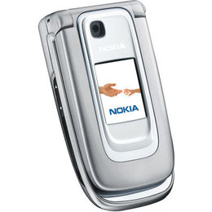
EVOLUTION OF NFC TECHNOLOGY
In 2006 First mobile phone( nokia 6131) with NFC released by NOKIA.

Slide 39
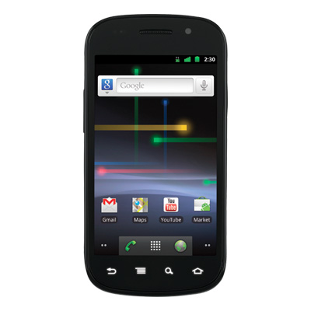
EVOLUTION OF NFC TECHNOLOGY
In 2010
First android phone SAMSUNG NEXUS S with NFC support released.

Slide 40
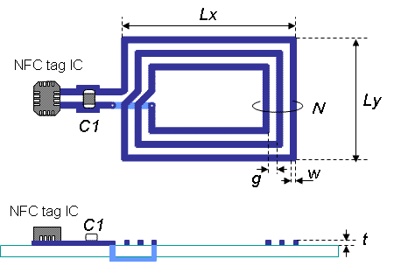
NFC TAG

Slide 41
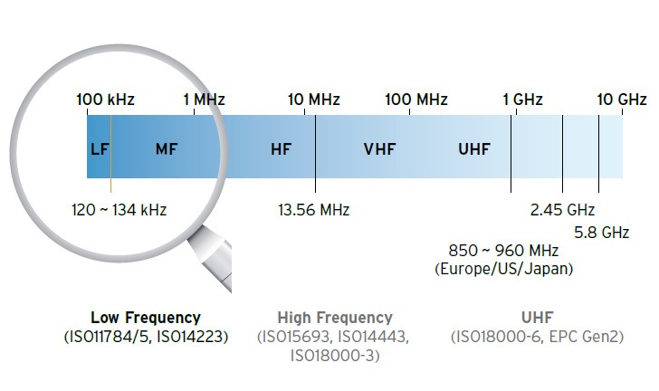
Frequency- High Freq
NFC

Slide 42
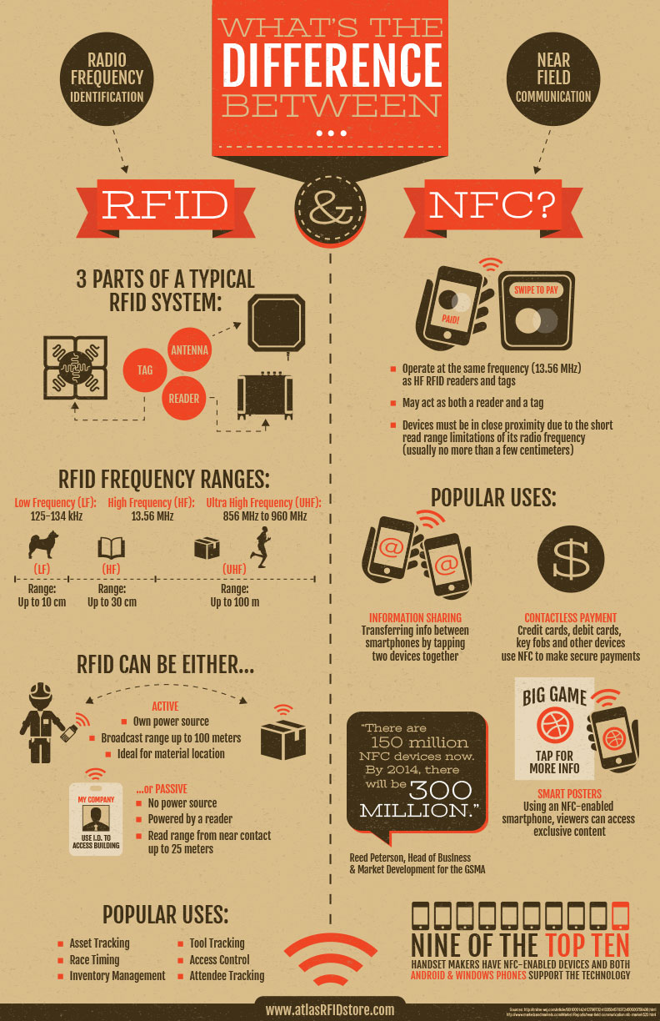
Difference - NFC & RFID

Slide 43
Difference - NFC & RFID

Slide 44
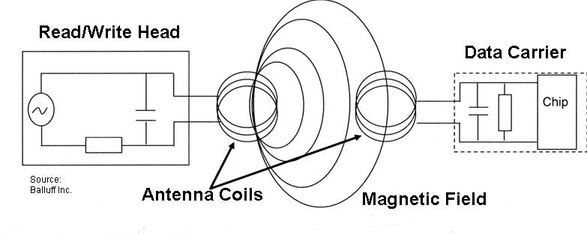
OPERATION OF NFC
Near field communication is based on inductive-coupling.
NFC works using magnetic induction between two loop antennas located within each other's 'near field’.

Slide 45
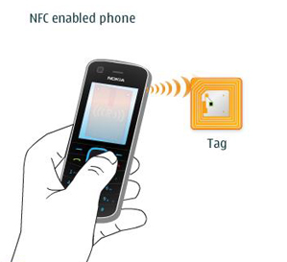
OPERATION OF NFC
operating frequency 13.56 MHz.data rate 106 kbit/s to 424 kbit/s.
NFC use an initiator and a target; the initiator actively generates an RF field that can power a passive target.
Initiator
Device
Target

Slide 46
MODES OF OPERTAION
MODES OF OPERATION
ACTIVE MODE
PASSIVE MODE

Slide 47
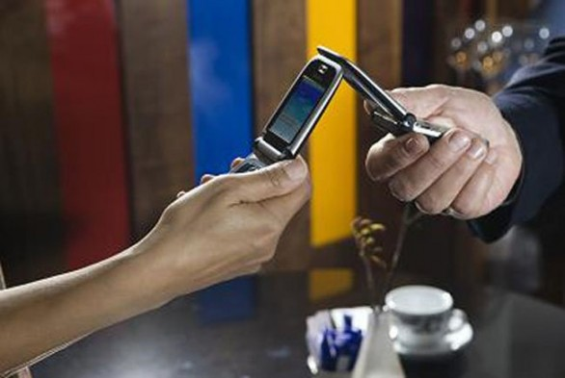
MODES OF OPERATION
In Active mode, both devices with NFC chip generates an electromagnetic field and exchange data.
Two NFC enabled devices transfer-ring data in active mode

Slide 48

MODES OF OPERATION
In Passive mode, there is only one active device and the other uses that field to exchange information.
A NFC-enabled mobile phone is paired with a RFID-tagged "smart poster"

Slide 49
APPLICATION OF NFC
NFC applications can be split into the following three basic categories:
Touch and Go
Touch and Confirm
Touch and Connect

Slide 50
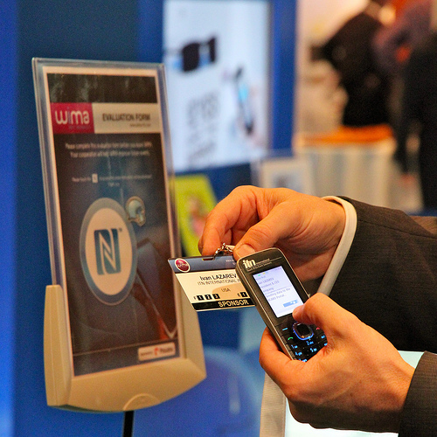
APPLICATION OF NFC
Touch and Go
Applications such as access control or transport/event ticketing, where the user needs only to bring the device storing the ticket or access code close to the reader. Example for picking up an Internet URL from a smart label on a poster.
Touch and go
Mode of application

Slide 51

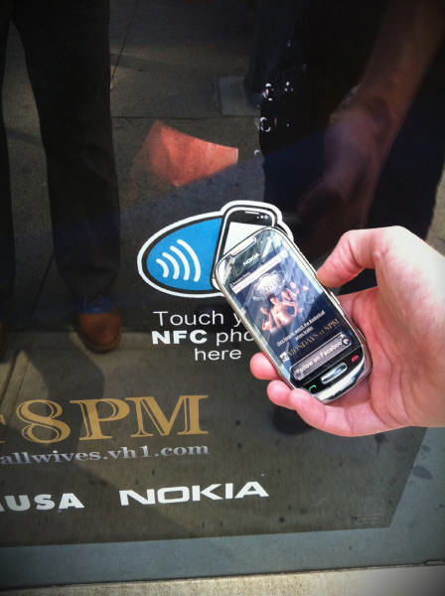
APPLICATION OF NFC
Movie buff gathering info about a movie
using his NFC enabled Mobile Phone

Slide 52
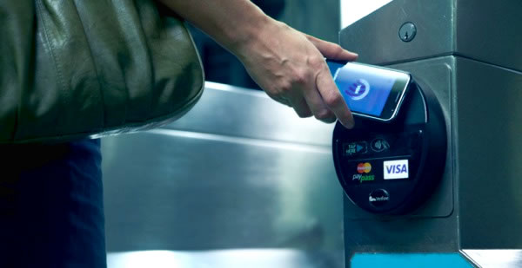
APPLICATION OF NFC
Touch and Confirm
Applications such as mobile payment where the user has to confirm the interaction by entering a password or just accepting the transaction.

Slide 53
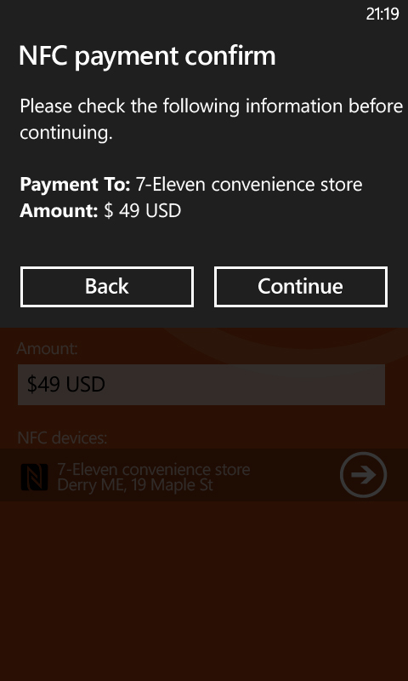
APPLICATION OF NFC
The
screenshot from a mobile device showing the confirmation message.

Slide 54
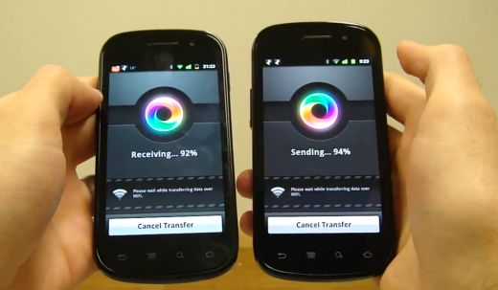
APPLICATION OF NFC
Touch and Connect
Linking two NFC-enabled devices to enable peer to peer transfer of data such as downloading music, exchanging images or synchronizing address books.
Data transfer via NFC

Slide 55
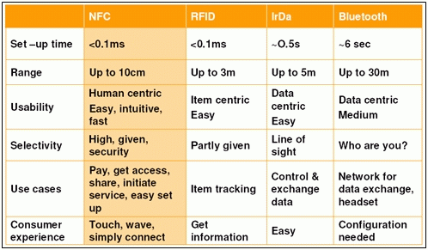
COMPARISON WITH EXISTING TECHNOLOGY

Slide 56
ADVANTAGES OF NFC
High convenience to the user, because the data exchange is done by bringing two mobiles together.
Reduces cost of electronic issuance .
Secure communication.
No special software.
No manual configuration and settings.
No search and pair procedure.

Slide 57
DISADVANTAGES OF NFC
The system has the limitation that it can be operated only with devices under a short range i.e around 10 cm.
The data transfer rate is very less at about 106kbps, 212 kbps and 424kbps.

Slide 58
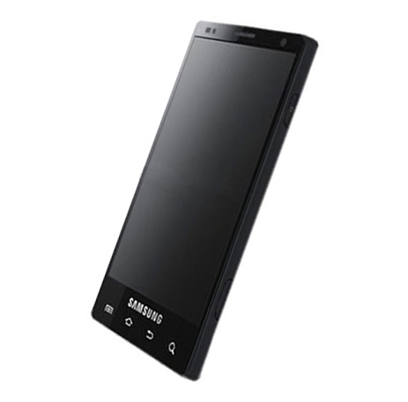
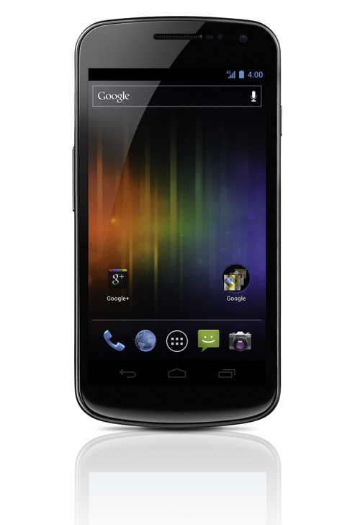
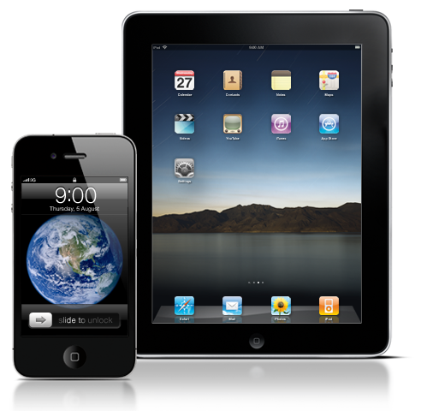
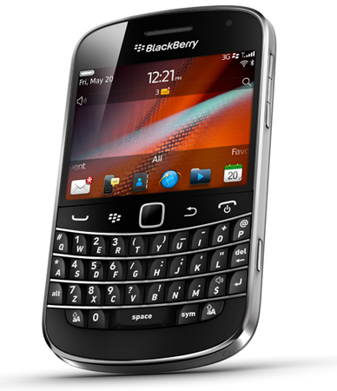
DEVICES WITH NFC TECHNOLOGY

Slide 59
Thank You
491

