Slide 1
Logical Link Control
&
Media Access Control
&
TCP/IP Overview

Slide 2
Overview
The architecture of a LAN is best described in terms of a layering of protocols that organize the basic functions of a LAN
This section opens with a description of the standardized protocol architecture for LANs, which includes
Logical Link Control (LLC) layer
This section provides an overview of LLC layer

Slide 3
IEEE 802 standard
IEEE 802 standard defines:
Physical layer protocol
Data link layer protocol
Medium Access (MAC) Sublayer
Logical Link Control (LLC) Sublayer

Slide 4
IEEE 802 standard
802.2: Logical Link Control (LLC)
explained in this section
802.3: CSMA/CD (Ethernet)
explained in this section
802.11: Wireless LANs
will be explained in further lectures

Slide 5
802 Layers functions
Physical
Encoding/decoding
Preamble generation/removal
Bit transmission/reception
Transmission medium and topology
Logical Link Control
Interface to higher levels
Flow and error control
Medium Access Control
Data assembly and dismantle into frames
Govern access to LAN transmission medium

Slide 6
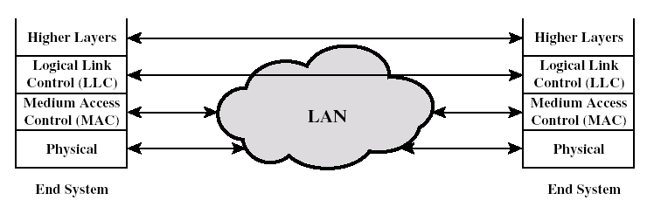
Scope of LAN protocols
Consider two stations that communicate via a shared medium LAN.
Higher layers (above LLC) provide end-to-end services between the stations
Below the LLC layer, the MAC provides the necessary logic for gaining access to the network

Slide 7
Data Link Layer
Network Layer
Data Link Layer
Logical Link Control Sublayer
Medium Access Sublayer
Physical Layer

Slide 8
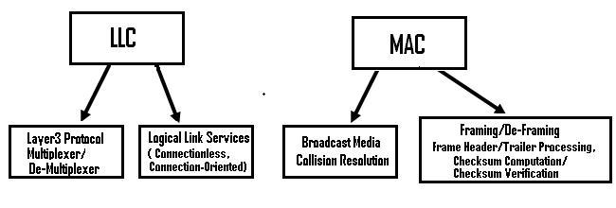

Slide 9
Medium Access Control (1)
Assembly of data into frame with address and error detection fields
Disassembly of frame and performing of
Address recognition
Error detection
Govern access to transmission medium
Not found in traditional layer 2 data link control
For the same LLC, several MAC options may be available

Slide 10
Medium Access Sublayer (2)
Medium access (MAC) sublayer is not important on point-to-point links
The MAC sublayer is only used in broadcast or shared channel networks
MAC protocols enable two stations (or nodes) using a shared communication resource to establish, maintain and terminate a connection.
Examples: Satellite, Ethernet, Cellular

Slide 11
Shared Medium
A local area network (LAN) that shares its total available bandwidth with all transmitting stations.
In the past, when shared media LANs ran out of capacity to serve their users effectively, they were upgraded by replacing the network hubs with switches.

Slide 12
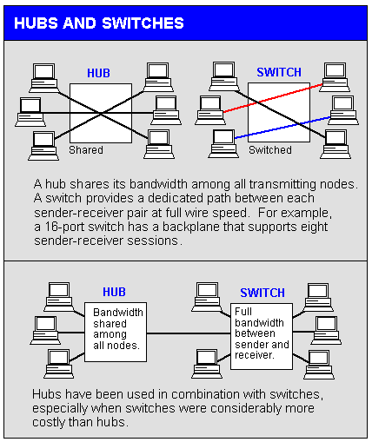

Slide 13
Logical Link Control (LLC)
The LLC layer for LANs is concerned with the transmission of a link-level protocol data unit (PDU) between two stations, without the necessity of an intermediate switching node
It has two characteristics:
It must support the multi-access, shared medium nature of the link
It is relieved from some details of link access by the MAC layer

Slide 14
LLC Services
Unacknowledged connectionless service
Datagram-style
Does not involve any flow and error control mechanisms
Data delivery is not guaranteed
Connection mode service
A logical connection is set up between two stations
Flow and error control are provided
Acknowledged connectionless service
A cross between the previous services
Datagrams are to be acknowledged
No prior logical connection is set up

Slide 15
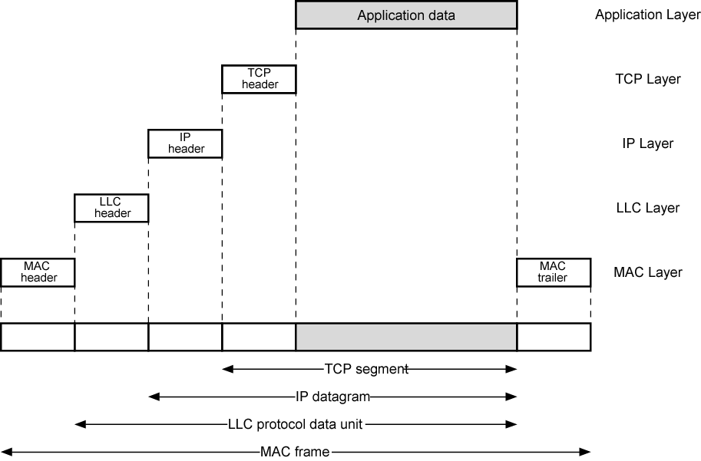
LAN Protocols in Context

Slide 16
The TCP/IP Reference Model

Slide 17
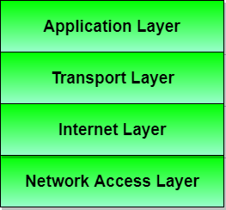
TCP/IP means Transmission Control Protocol and Internet Protocol.
It is the network model used in the current Internet architecture as well. Protocols are set of rules which govern every possible communication over a network. These protocols describe the movement of data between the source and destination or the internet. They also offer simple naming and addressing schemes.

Slide 18
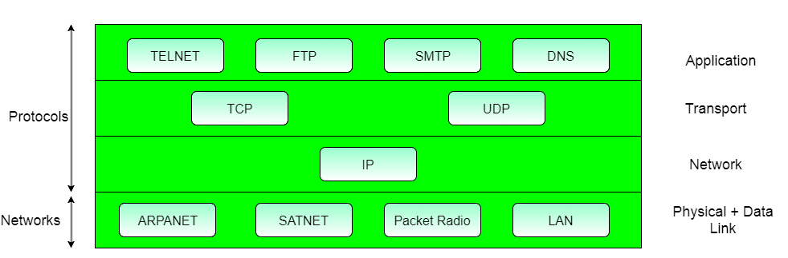
Protocols and networks in the TCP/IP model:

Slide 19
Layer 1: Host-to-network Layer
Lowest layer of the all.
Protocol is used to connect to the host, so that the packets can be sent over it.
Varies from host to host and network to network.

Slide 20
Layer 2: Internet layer
Selection of a packet switching network which is based on a connectionless internetwork layer is called a internet layer.
It is the layer which holds the whole architecture together.
It helps the packet to travel independently to the destination.
Order in which packets are received is different from the way they are sent.

Slide 21
cont..
IP (Internet Protocol) is used in this layer.
The various functions performed by the Internet Layer are:
Delivering IP packets
Performing routing
Avoiding congestion

Slide 22
Layer 3: Transport Layer
It decides if data transmission should be on parallel path or single path.
Functions such as multiplexing, segmenting or splitting on the data is done by transport layer.
The applications can read and write to the transport layer.
Transport layer adds header information to the data.
Transport layer breaks the message (data) into small units so that they are handled more efficiently by the network layer.
Transport layer also arrange the packets to be sent, in sequence.

Slide 23
Cont..
It defines two end-to-end protocols: TCP and UDP TCP(Transmission Control Protocol): It is a reliable connection-oriented protocol which handles byte-stream from source to destination without error and flow control.
UDP(User-Datagram Protocol): It is an unreliable connection-less protocol that do not want TCPs, sequencing and flow control. Eg: One-shot request-reply kind of service.

Slide 24
Layer 4: Application Layer
The TCP/IP specifications described a lot of applications that were at the top of the protocol stack. Some of them were SSH, FTP, DNS etc.
FTP(File Transfer Protocol) is a protocol, that allows File transfer amongst computer users connected over a network. It is reliable, simple and efficient.

Slide 25
Cont..
DNS(Domain Name Server) resolves an IP address into a textual address for Hosts connected over a network.
It allows peer entities to carry conversation.

