Slide 1
Socket Programming

Slide 2
Background

Slide 3
Demultiplexing
●
Convert host-to-host packet delivery service into a process-to-process communication channel
Application process
Application process
Application process
0
16
31
SrcPort | DstPort
Length | Checksum
Ports
Data
Queues
Packets demultiplexed
Transport
Packets arrive

Slide 4
Byte Ordering
●
Two types of “Byte ordering”
Network Byte Order: High-order byte of the number is stored in memory at the lowest address
Host Byte Order: Low-order byte of the number is stored in memory at the lowest address
Network stack (TCP/IP) expects Network Byte Order
Conversions:
●
–
htons() - Host to Network Short htonl() - Host to Network Long ntohs() - Network to Host Short ntohl() - Network to Host Long
–
–
–

Slide 5
What is a socket?
●
Socket: An interface between an application process and transport layer
– The application process can send/receive messages to/from another application process (local or remote)via a socket
In Unix jargon, a socket is a file descriptor – an integer associated with an open file
Types of Sockets: Internet Sockets, unix sockets,
X.25 sockets etc
– Internet sockets characterized by IP Address (4 bytes), port number (2 bytes)
●
●

Slide 6
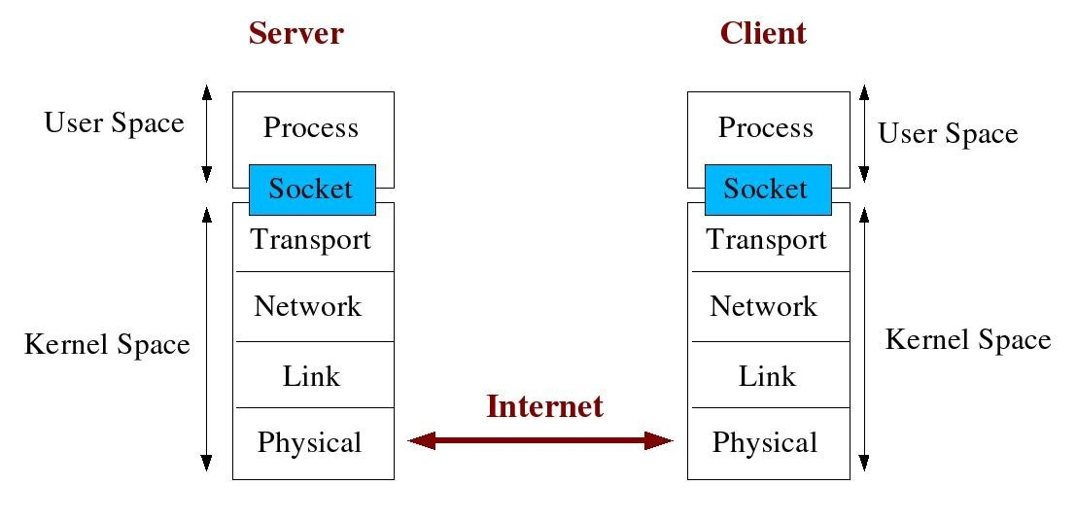
Socket Description

Slide 7
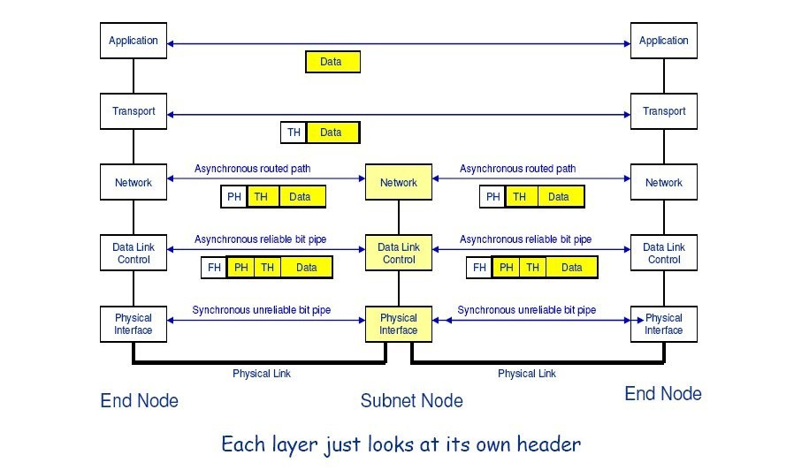
Encapsulation

Slide 8
Types of Internet Sockets
●
Stream Sockets (SOCK_STREAM)
Connection oriented
Rely on TCP to provide reliable two-way connected communication
Datagram Sockets (SOCK_DGRAM)
Rely on UDP
Connection is unreliable
●

Slide 9
socket() -- Get the file descriptor
●
int socket(int domain, int type, int protocol);
domain should be set to PF_INET
type can be SOCK_STREAM or SOCK_DGRAM
set protocol to 0 to have socket choose the correct protocol based on type
socket() returns a socket descriptor for use in later system calls or -1 on error
int sockfd;
sockfd = socket (PF_INET, SOCK_STREAM, 0);

Slide 10
Socket Structures
●
struct sockaddr: Holds socket address information for many types of sockets
struct sockaddr {
unsigned short sa_family; //address family AF_xxx unsigned short sa_data[14]; //14 bytes of protocol addr
}
struct sockaddr_in: A parallel structure that makes it easy to reference elements of the socket address
struct sockaddr_in {
●
short int | sin_family; | // set to AF_INET
unsigned short int | sin_port; | // Port number
struct in_addr | sin_addr; | // Internet address
unsigned char | sin_zero[8]; | //set to all zeros
}
sin_port and sin_addr must be in Network Byte Order
●

Slide 11
Dealing with IP Addresses
●
struct in_addr {
unsigned long s_addr; // that's a 32­bit long, or 4 bytes
};
int inet_aton(const char *cp, struct in_addr *inp);
struct sockaddr_in my_addr;
●
my_addr.sin_family = AF_INET; my_addr.sin_port = htons(MYPORT); inet_aton(“10.0.0.5”,&(my_addr.sin_addr)); memset(&(my_addr.sin_zero),'\0',8);
inet_aton() gives non-zero on success; zero on failure
–
●
To convert binary IP to string: inet_noa()
printf(“%s”,inet_ntoa(my_addr.sin_addr));

Slide 12
bind() - what port am I on?
●
Used to associate a socket with a port on the local
machine
The port number is used by the kernel to match an incoming packet to a process
int bind(int sockfd, struct sockaddr *my_addr, int addrlen)
–
●
sockfd is the socket descriptor returned by socket()
my_addr is pointer to struct sockaddr that contains information about your IP address and port
addrlen is set to sizeof(struct sockaddr) returns -1 on error
–
–
–
–
my_addr.sin_port = 0; //choose an unused port at random
my_addr.sin_addr.s_addr = INADDR_ANY; //use my IP adr

Slide 13
Example
int sockfd;
struct sockaddr_in my_addr;
sockfd = socket(PF_INET, SOCK_STREAM, 0);
my_addr.sin_family = AF_INET; my_addr.sin_port = htons(MYPORT);
order
// host byte order
// short, network byte
my_addr.sin_addr.s_addr = inet_addr("172.28.44.57"); memset(&(my_addr.sin_zero), '\0', 8); // zero the rest of the struct bind(sockfd, (struct sockaddr *)&my_addr, sizeof(struct
sockaddr));
/****** Code needs error checking. Don't forget to do that ****** /

Slide 14
connect() - Hello!
●
Connects to a remote host
int connect(int sockfd, struct sockaddr *serv_addr, int addrlen)
sockfd is the socket descriptor returned by socket()
serv_addr is pointer to struct sockaddr that contains information on destination IP address and port
addrlen is set to sizeof(struct sockaddr)
returns -1 on error
No need to bind(), kernel will choose a port
●
●

Slide 15
Example
#define DEST_IP
"172.28.44.57"
#define DEST_PORT 5000
main(){
int sockfd;
struct sockaddr_in dest_addr;
// will hold the destination addr
sockfd = socket(PF_INET, SOCK_STREAM, 0); dest_addr.sin_family = AF_INET; // host byte order
dest_addr.sin_port = htons(DEST_PORT); // network byte order
dest_addr.sin_addr.s_addr = inet_addr(DEST_IP);
memset(&(dest_addr.sin_zero), '\0', 8); // zero the rest of the struct connect(sockfd, (struct sockaddr *)&dest_addr, sizeof(struct sockaddr));
/******* Don't forget error checking ********/

Slide 16
listen() - Call me please!
●
Waits for incoming connections
int listen(int sockfd, int backlog);
sockfd is the socket file descriptor returned by socket()
backlog is the number of connections allowed on the incoming queue
listen() returns -1 on error
Need to call bind() before you can listen()
●
socket() bind()
listen() accept()
●
●
●
●

Slide 17
accept() - Thank you for calling !
●
accept() gets the pending connection on the port you are listen()ing on
int accept(int sockfd, void *addr, int *addrlen);
sockfd is the listening socket descriptor
information about incoming connection is stored in addr which is a pointer to a local struct sockaddr_in
addrlen is set to sizeof(struct sockaddr_in)
accept returns a new socket file descriptor to use for this accepted connection and -1 on error
●

Slide 18
Example
#include <string.h>
#include <sys/types.h>
#include <sys/socket.h>
#include <netinet/in.h>
#define MYPORT 3490
#define BACKLOG 10 main(){
// the port users will be connecting to
// pending connections queue will hold
int sockfd, new_fd; // listen on sock_fd, new connection on new_fd
struct sockaddr_in my_addr; // my address information
struct sockaddr_in their_addr; // connector's address information int sin_size;
sockfd = socket(PF_INET, SOCK_STREAM, 0);

Slide 19
Cont...
my_addr.sin_family = AF_INET;
my_addr.sin_port = htons(MYPORT); order
// host byte order
// short, network byte
my_addr.sin_addr.s_addr = INADDR_ANY; // auto-fill with my IP memset(&(my_addr.sin_zero), '\0', 8); // zero the rest of the struct
// don't forget your error checking for these calls:
bind(sockfd, (struct sockaddr *)&my_addr, sizeof(struct sockaddr));
listen(sockfd, BACKLOG);
sin_size = sizeof(struct sockaddr_in);
new_fd = accept(sockfd, (struct sockaddr *)&their_addr, &sin_size);

Slide 20
send() and recv() - Let's talk!
●
The two functions are for communicating over stream sockets or connected datagram sockets.
int send(int sockfd, const void *msg, int len, int flags);
sockfd is the socket descriptor you want to send data to (returned by socket() or got from accept())
msg is a pointer to the data you want to send
len is the length of that data in bytes
set flags to 0 for now
sent() returns the number of bytes actually sent (may be less than the number you told it to send) or -1 on error
●

Slide 21
send() and recv() - Let's talk!
●
int recv(int sockfd, void *buf, int len, int flags);
sockfd is the socket descriptor to read from
buf is the buffer to read the information into
len is the maximum length of the buffer
set flags to 0 for now
recv() returns the number of bytes actually read into the buffer or -1 on error
If recv() returns 0, the remote side has closed connection on you

Slide 22
sendto() and recvfrom() - DGRAM style
●
int sendto(int sockfd, const void *msg, int len, int flags, const struct sockaddr *to, int tolen);
to is a pointer to a struct sockaddr which contains the destination IP and port
tolen is sizeof(struct sockaddr)
int recvfrom(int sockfd, void *buf, int len, int flags, struct sockaddr *from, int *fromlen);
from is a pointer to a local struct sockaddr that will be filled with IP address and port of the originating machine
fromlen will contain length of address stored in from
●

Slide 23
close() - Bye Bye!
●
int close(int sockfd);
Closes connection corresponding to the socket descriptor and frees the socket descriptor
Will prevent any more sends and recvs

Slide 24
Connection Oriented Protocol
Server
Client
socket()
bind()
socket()
listen()
connect()
accept()
send()
recv()
recv()
send()
close()
close()

Slide 25
Connectionless Protocol
Server Client
socket()
bind()
socket()
bind()
recvfrom()
sendto()
sendto()
recvfrom()
close()
close()

Slide 26
Miscellaneous Routines
●
int getpeername(int sockfd, struct sockaddr
*addr, int *addrlen);
Will tell who is at the other end of a connected stream socket and store that info in addr
int gethostname(char *hostname, size_t size);
Will get the name of the computer your program is running on and store that info in hostname
●

Slide 27
Miscellaneous Routines
●
struct hostent *gethostbyname(const char
*name);
struct hostent {
char *h_name; char **h_aliases; int h_addrtype;
int h_length; char
//official name of host
//alternate names for the host
//usually AF_NET
//length of the address in bytes
**h_addr_list; //array of network addresses for the host
}
#define h_addr h_addr_list[0]
●
Example Usage:
struct hostent *h;
h = gethostbyname(“www.iitk.ac.in”); printf(“Host name : %s \n”, h­>h_name);
printf(“IP Address: %s\n”,inet_ntoa(*((struct in_addr *)h­>h_addr)));

Slide 28
Advanced Topics
Blocking Select
Handling partial sends Signal handlers Threading
●
●
●
●
●

Slide 29
Summary
●
Sockets help application process to communicate with each other using standard Unix file descriptors
Two types of Internet sockets: SOCK_STREAM and SOCK_DGRAM
Many routines exist to help ease the process of communication
●
●

Slide 30
References
●
Books:
Unix Network Programming, volumes 1-2 by W. Richard Stevens.
TCP/IP Illustrated, volumes 1-3 by W. Richard Stevens and Gary R. Wright
Web Resources:
Beej's Guide to Network Programming
www.ecst.csuchico.edu/~beej/guide/net/
●

