Slide 1
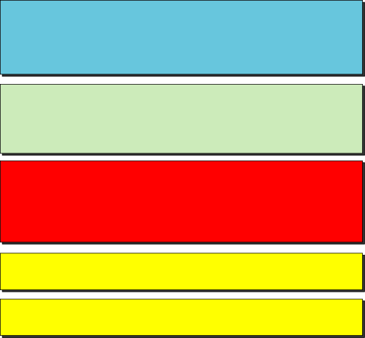
Chapter 12
Transmission Control Protocol
Objectives
Upon completion you will be able to:
Be able to name and understand the services offered by TCP
Understand TCP’s flow and error control and congestion control
Be familiar with the fields in a TCP segment
Understand the phases in a connection-oriented connection
Understand the TCP transition state diagram
Be able to name and understand the timers used in TCP
Be familiar with the TCP options
TCP/IP Protocol Suite
‹#›

Slide 2
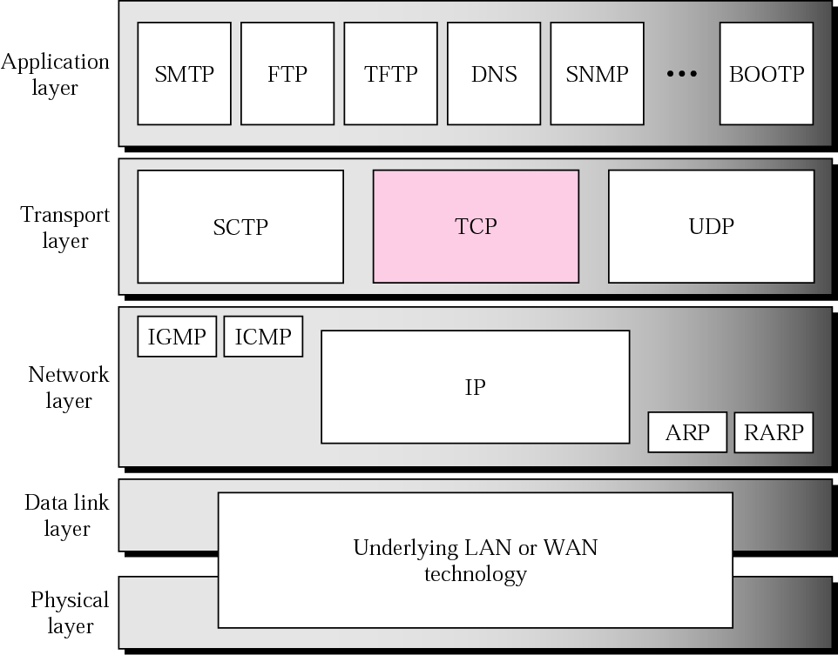
Figure 12.1 TCP/IP protocol suite
TCP/IP Protocol Suite
‹#›

Slide 3
12.1 TCP SERVICES
We explain the services offered by TCP to the processes at the application layer.
The topics discussed in this section include:
Process-to-Process Communication
Stream Delivery Service
Full-Duplex Communication
Connection-Oriented Service
Reliable Service
TCP/IP Protocol Suite
‹#›

Slide 4
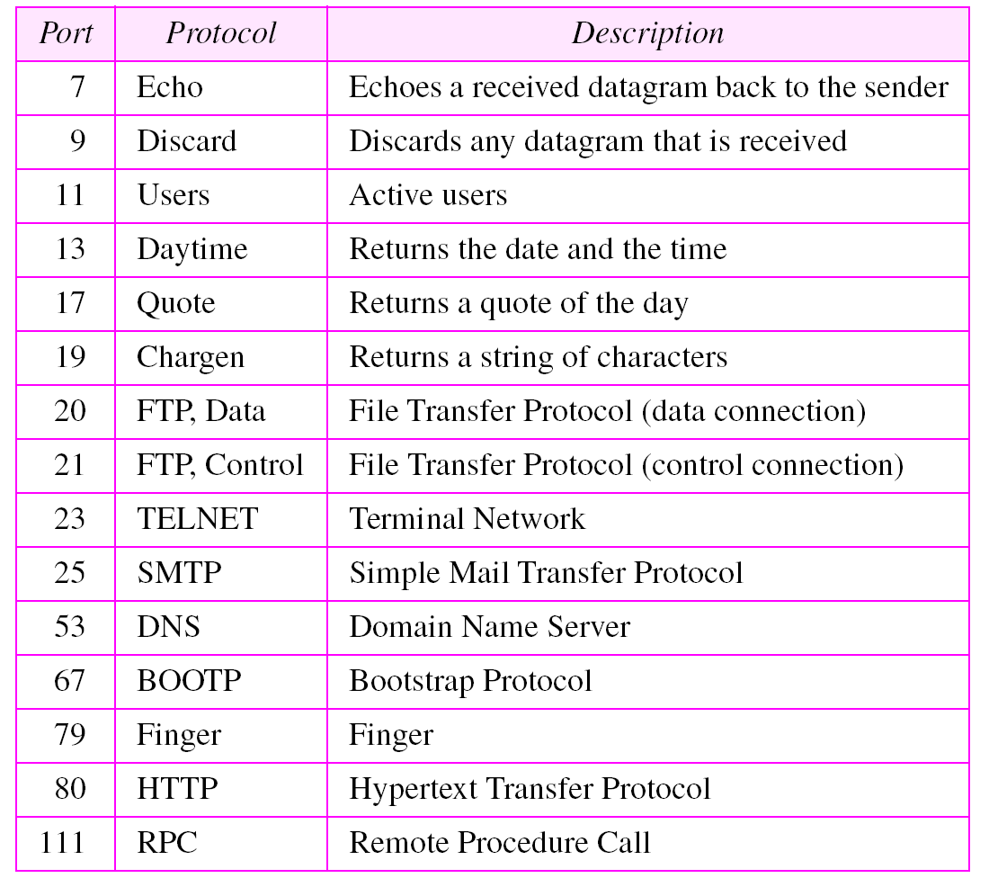
Table 12.1 Well-known ports used by TCP
TCP/IP Protocol Suite
‹#›

Slide 5
Example 1
As we said in Chapter 11, in UNIX, the well-known ports are stored in a file called /etc/services. Each line in this file gives the name of the server and the well-known port number. We can use the grep utility to extract the line corresponding to the desired application. The following shows the ports for FTP.
$ grep ftp /etc/services
ftp-data 20/tcp ftp-control 21/tcp
TCP/IP Protocol Suite
‹#›

Slide 6
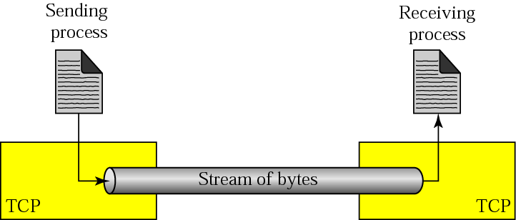
Figure 12.2 Stream delivery
TCP/IP Protocol Suite
‹#›

Slide 7
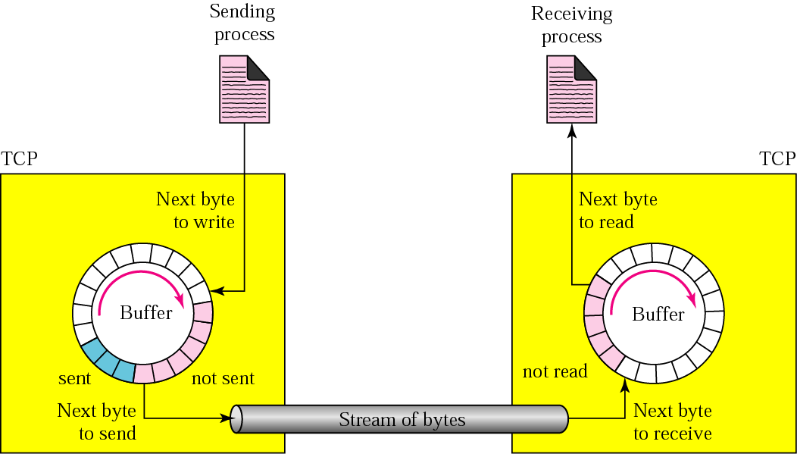
Figure 12.3 Sending and receiving buffers
TCP/IP Protocol Suite
‹#›

Slide 8
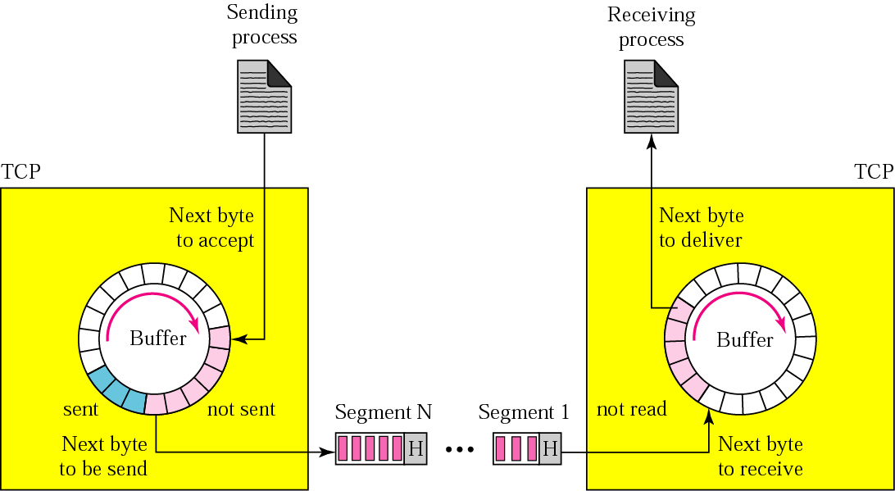
Figure 12.4 TCP segments
TCP/IP Protocol Suite
‹#›

Slide 9
12.2 TCP FEATURES
To provide the services mentioned in the previous section, TCP has several features that are briefly summarized in this section.
The topics discussed in this section include:
Numbering System
Flow Control
Error Control Congestion Control
TCP/IP Protocol Suite
‹#›

Slide 10

Note:
The bytes of data being transferred in each connection are numbered by TCP. The numbering starts with a randomly generated number.
TCP/IP Protocol Suite
‹#›

Slide 11
Example 2
Suppose a TCP connection is transferring a file of 5000 bytes. The first byte is numbered 10001. What are the sequence numbers for each segment if data is sent in five segments, each carrying 1000 bytes?
Solution The following shows the sequence number for each segment:
Segment 1 ➡ Sequence Number: 10,001 (range: 10,001 to 11,000)
Segment 2 ➡ Sequence Number: 11,001 (range: 11,001 to 12,000)
Segment 3 ➡ Sequence Number: 12,001 (range: 12,001 to 13,000)
Segment 4 ➡ Sequence Number: 13,001 (range: 13,001 to 14,000)
Segment 5 ➡ Sequence Number: 14,001 (range: 14,001 to 15,000)
TCP/IP Protocol Suite
‹#›

Slide 12
Note:
The value in the sequence number field of a segment defines the number of the first data byte contained in that segment.
TCP/IP Protocol Suite
‹#›

Slide 13
Note:
The value of the acknowledgment field in a segment defines the number of the next byte a party expects to receive.
The acknowledgment number is cumulative.
TCP/IP Protocol Suite
‹#›

Slide 14
12.4 A TCP CONNECTION
TCP is connection-oriented. A connection-oriented transport protocol establishes a virtual path between the source and destination. All of the segments belonging to a message are then sent over this virtual path. A connection-oriented transmission requires three phases: connection establishment, data transfer, and connection termination.
The topics discussed in this section include:
Connection Establishment
Data Transfer
Connection Termination
Connection Reset
TCP/IP Protocol Suite
‹#›

Slide 15
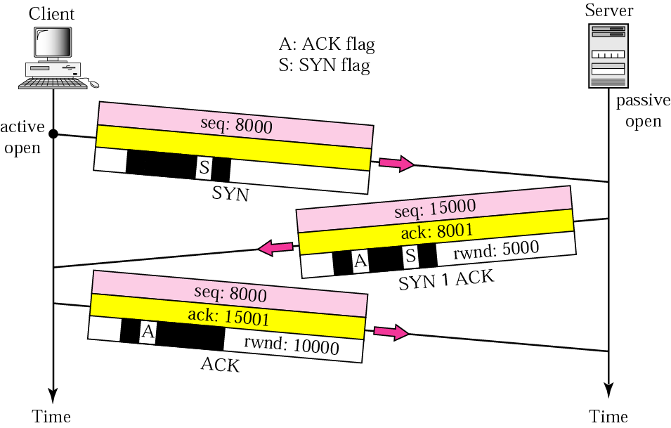
Figure 12.9 Connection establishment using three-way handshaking
TCP/IP Protocol Suite
‹#›

Slide 16
Note:
A SYN segment cannot carry data, but it consumes one sequence number.
TCP/IP Protocol Suite
‹#›

Slide 17
Note:
A SYN + ACK segment cannot carry data, but does consume one sequence number.
TCP/IP Protocol Suite
‹#›

Slide 18
Note:
An ACK segment, if carrying no data, consumes no sequence number.
TCP/IP Protocol Suite
‹#›

Slide 19
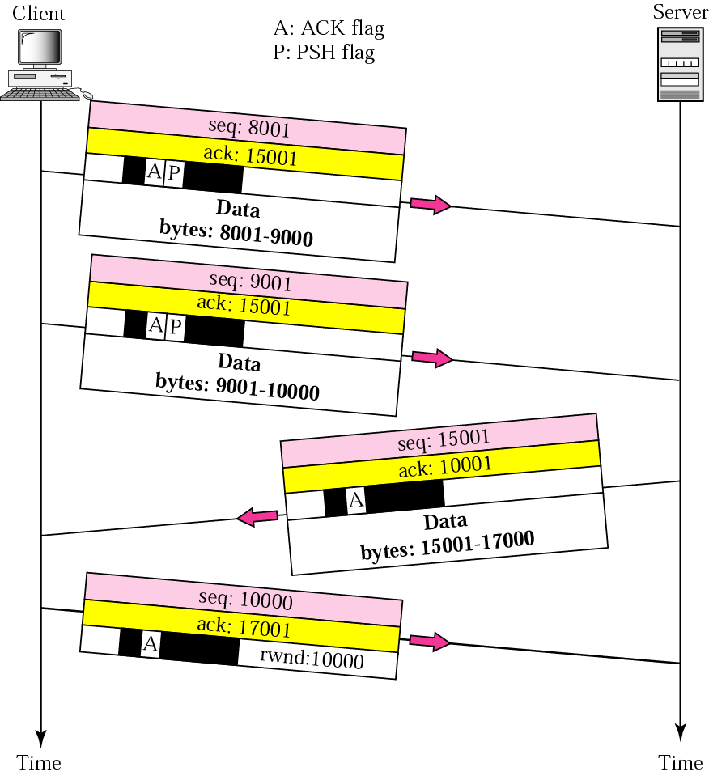
Figure 12.10 Data transfer
TCP/IP Protocol Suite
‹#›

Slide 20
Note:
The FIN segment consumes one sequence number if it does not carry data.
TCP/IP Protocol Suite
‹#›

Slide 21
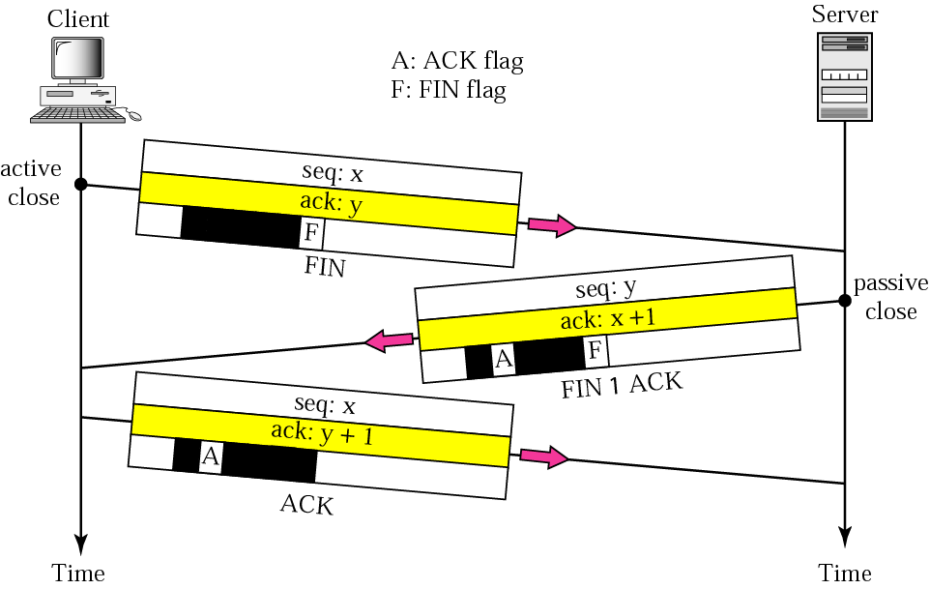
Figure 12.11 Connection termination using three-way handshaking
TCP/IP Protocol Suite
‹#›

Slide 22
Note:
The FIN + ACK segment consumes one sequence number if it does not carry data.
TCP/IP Protocol Suite
‹#›

