Slide 1
Introduction to
Advanced WiFi Networking
Notes:
This 60 minute talk covers WiFi protocols, channels and radio modes, and how to use them to
Version 2.3 @2010-03-12

Slide 2
Goals
The goal of this lecture is to introduce:
802.11 family of radio protocols
802.11 radio channels
Wireless network topologies
WiFi modes of operation
Strategies for routing network traffic
Frequently Asked Questions

Slide 3


Wireless networking protocols
The 802.11 family of radio protocols are commonly referred to as WiFi.
802.11a supports up to 54 Mbps using the 5 GHz unlicensed bands.
802.11b supports up to 11 Mbps using the 2.4 GHz unlicensed band.
802.11g supports up to 54 Mbps using the 2.4 GHz unlicensed band.
802.11n supports up to 600 Mbps using the 2.4 GHz and 5 GHz unlicensed bands.
802.16 (WiMAX) is not 802.11 WiFi! It is a completely different technology that uses a variety of licensed and unlicensed frequencies.
Notes:
The specific technologies used by WiFi equipment include 802.11a, b, g, and n. 802.11n was ratified by the IEEE in September 2009, so it is a very new standard.
802.11g is backwards compatible with 802.11b, and 802.11n is backwards compatible with 802.11a when operating at 5 GHz, and b/g when operating at 2.4 GHz. By using wider channels, 802.11n loses backwards compatibility but can have much greater throughput, around 100 Mbps or more. The standard allows for even better performance by using multiple data streams. We expect equipment that supports these higher data rates to enter the market soon now that the standard has been ratified.
802.11a,b, and g are now part of the IEEE 802.11-2007 standard which encompasses all the amendments ratified up to that year, including 802.11e that deals with QoS.
Note that WiMax is not the same thing as WiFi. It is a completely different standard that operates in licensed and unlicensed frequencies.

Slide 4
Compatibility of standards
AP
 | 802.11a | 802.11b | 802.11g | 802.11n | 802.16
802.11a | Yes |  |  | Yes @5GHz
802.11b |  | Yes | Yes (slower) | Yes @2.4GHz
802.11g |  | Yes (slower) | Yes | Yes @2.4GHz
802.11n | Yes @5GHz | Yes @2.4GHz | Yes @2.4GHz | Yes
802.16 |  |  |  |  | Yes
C
L
I
E
N
T

Slide 5
Data rates
Note that the “data rates” quoted in the WiFi specifications refer to the raw radio symbol rate, not the actual TCP/IP throughput rate. The difference is called protocol overhead, and is needed by the WiFi protocol to manage collisions, retransmissions, and general management of the link.
A good rule of thumb is to divide the radio symbol rate by two to obtain the maximum practical TCP/IP throughput. For example, a 54 Mbps 802.11a link has a maximum practical throughput of roughly 25 Mbps. An 11 Mbps 802.11b link has a maximum throughput of about 5 Mbps.
Notes:
WiFI uses the same channel for both directions of traffic, so when a radio is transmitting cannot be receiving. This limits the throughput.
Several vendors claim “Turbo” data rates of 108 Mbps. This is achieved by using 44MHz wide channels instead of the normal 22MHz. In most cases this is not practical.

Slide 6
MAC layer: CSMA vs. TDMA
802.11 WiFi uses Carrier Sense Multiple Access (CSMA) to avoid transmission collisions. Before a node may transmit, it must first listen for transmissions from other radios. The node may only transmit when the channel becomes idle.
Other technologies (such as WiMAX, Nstreme, and AirMAX) use Time Division Multiple Access (TDMA) instead. TDMA divides access to a given channel into multiple time slots, and assigns these slots to each node on the network. Each mode transmits only in its assigned slot, thereby avoiding collisions.
Notes:
CSMA and TDMA are completely different media access methods. Technologies such as AirMAX or Nstreme may use 802.11 WiFi hardware, but the protocol is not compatible with standard WiFi!
TDMA is particularly well suited for point to point links, where there are no wasted time slots. In point to multipoint applications at short distances CSMA is more efficient.
TDMA also provides inherent Quality of Service (QoS) since the maximum time for a station to gain access to the medium is bounded.
A sort of QoS can be offered in CSMA by establishing independent queues for different type of traffic and allowing shorter interframe spacings for high priority traffic like voice, but there will be no guaranteed maximum latency.

Slide 7
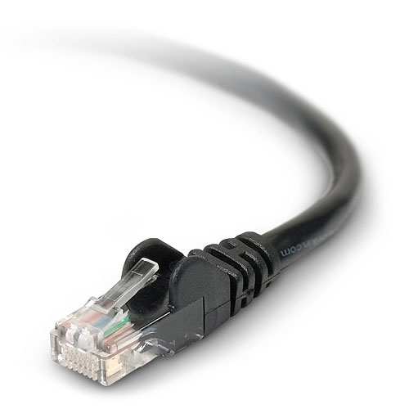
Layer one
WiFi devices must agree on several parameters before they can communicate with each other. These parameters must be properly configured to establish “layer one” connectivity:
TCP/IP Protocol Stack
5 | Application
4 | Transport
3 | Internet
2 | Data Link
1 | Physical
Radio channel
Radio operating mode
Network name
Security features
7
Notes:
The physical layer on an Ethernet network is a wire: is it plugged in?
To establish the same layer of connectivity with WiFi, certain parameters must be set. Obviously, the devices must use the same channel or they cannot even “hear” each other. The operating mode of the radio must be properly configured or there cannot be communication. The name of the network (also called the ESSID) must match. And any security features must also be configured correctly.
Unless these parameters are properly set, it is as if the “cable” is not yet plugged in. This configuration procedure will be analyzed with greater details in another lecture (AP configuration).

Slide 8
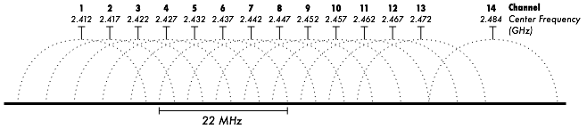
802.11 WiFi Channels
WiFi devices must use the same channel in order to communicate with each other. They send and receive on the same channel, so only one device may transmit at any time. This kind of connection is called half-duplex.
Notes:
In half-duplex communications, only one device may transmit at any time. This may very different from Ethernet networks, where full duplex mode (simultaneous transmit and receive) is also allowed by the standard for some hardware configurations. As we will see, this becomes an important consideration when making long distance wireless networks.

Slide 9
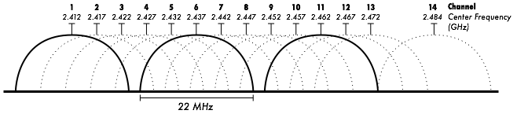
Non-overlapping channels: 1, 6, 11
Notes:
You can choose to use channels that do not overlap at all. If you operate 802.11 equipment on non-overlapping channels, they will not interfere with each other. For example, channels 1, 6, and 11 do not overlap with each other.
(This has been explained with greater details and more examples in the lecture on “Comparative use of unlicensed spectrum”)

Slide 10
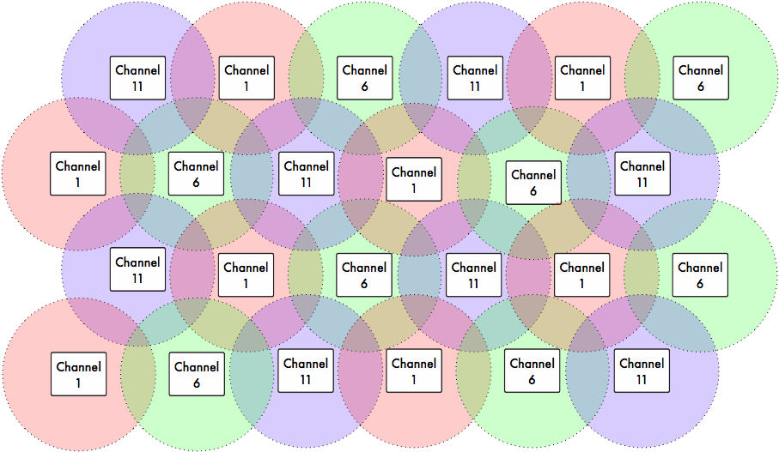
AP channel re-use
Notes:
This picture represents one scheme for selecting channels for your access points that do not overlap. If you are careful about AP placement, you can cover an arbitrarily large campus using only three channels, with no adjacent channel interference.Of course, the real world is never this pretty, so this is an ideal diagram. The coverage of access points is never a perfect circle. Also, consider the topographical problem of extending the network in three dimensions, as you have in multiple floors of a building.

Slide 11
Wireless network topologies
Any complex wireless network can be thought of as a combination of one or more of these types of connections:
Point-to-Point
Point-to-Multipoint
Multipoint-to-Multipoint
Notes:
To step back for a moment from WiFi, let’s consider a network using any generic wireless technology. These are the three fundamental topologies that can be combined to create an arbitrarily complex wireless network.
It’s important to come back to these basic building blocks. As your network grows, it is easy for the complexity of the network to run away with you. But if you reduce parts of the network to just one of these three topologies, it becomes clear how information will flow through the network.
Keep in mind that none of these topologies is the “best” kind of network. Each has strengths and weaknesses, and should be applied appropriately to the networking problem you need to solve.

Slide 12

Point to Point
The simplest connection is the point-to-point link. These links can be used to extend a network over great distances.
Notes:
Point to point links have the greatest possible throughput out of any of the basic network topologies, since there is very little contention for resources.

Slide 13
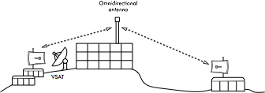
Point to Multipoint
When more than one node communicates with a central point, this is a point-to-multipoint network.
Notes:
The point to multipoint network is the most common kind of topology: think of an access point with many clients.
Many times, point-to-point links will evolve into point-to-multipoint networks when word gets around that it is possible to connect to the Internet over wireless.
The engineering behind point to multipoint links is very different from point-to-point links. You can’t expect to simply replace a dish with an omnidirectional antenna and expect it to work. Going from a point-to-point to a point-to-multipoint network adds complexity, since you now have multiple nodes contending for network resources. The end result is that overall throughput goes down.

Slide 14

Multipoint to Multipoint
When any node of a network may communicate with any other, this is a multipoint-to-multipoint network (also known as an ad-hoc or mesh network).
Notes:
Multipoint-to-multipoint networks are considerably more complex, but also much more flexible than point-to-multipoint networks. There is no central authority in mesh networks. The mesh protocol automatically adds new nodes as they come online, without the need to change the configuration of any existing nodes.
Mesh networks can be difficult to tune compared to point-to-point and point-to-multipoint networks. One obvious difficulty is choosing a channel to use for the network. Since every node communicates with each other, only one channel can be used for a given mesh. This greatly reduces the maximum possible throughput.

Slide 15
802.11a and b
Both introduced at the same time
Both use CSMA/CA
802.11a
Faster
More expensive to manufacture
Operated in 5Ghz band
Mainly used in industrial settings
802.11b
Slower
Cheaper to manufacture
Operated in 2.4Ghz band.
Mainly used in residential settings

Slide 16
802.11g
Pretty much the most common wireless network in use today.
Operates on 2.4Ghz band
Provides up 54Mbit/s bandwidth
108Mbit/s with special implementations
Uses OFDM for modulation
Adopted quickly after release for cheap and high bandwidth

Slide 17
802.11n
Newest member of the 802.11 family.
Has rated 600Mbit/s bandwidth
Introduces MIMO
Multiple-Input Multiple-Output
OFDM Modulation
Uses higher frequencies for increased number of carrier waves

Slide 18


802.11n – New Technologies
Beam Forming
Takes advantage of multi-antenna setup
Makes signals from separate antenna arrive in sync
Out of sync leads to interference
In sync leads to greater signal strength

Slide 19
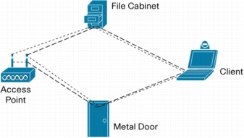
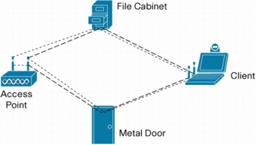
802.11n – New Technologies
Multipath/Spatial Diversity
Multiple antenna/radios send/receive signals
Different signals reach receivers at different times
Use math to combine signals for greater quality
Each stream can carry separate data

Slide 20
802.11n – New Technologies
Guard interval reduction
Guard interval is a time of radio silence
Used to avoid interference
802.11n can reduce guard interval from 800us to 400us.

Slide 21
802.11n – New Technologies
Frame aggregation
Aggregate multiple frames destined for a specific AP and send them together to reduce overhead

Slide 22
WiFi radio modes
WiFi devices can be operated in one of these modes:
Master (access point)Managed (also known as client or station)Ad-hoc (used for mesh networks)
Monitor (not normally used for communications)
Other proprietary non-802.11 modes (e.g. Mikrotik Nstreme or Ubiquiti AirMAX)
Each mode has specific operating constraints, and radios may only operate in one mode at a time.
Notes:
WiFi radios can operate in one of these four modes.Most devices can only operate in one mode at a time, so it cannot (for example) act as an access point and a client at the same time.
But you can have a wireless router that accepts more than one radio in which case you can have a radio acting as an Access Point and another as a client. This is often used to enhance the throughput of mesh networks.
In managed mode, the radio channel is not specified. It scans all channels and changes to match the AP automatically (choosing the one with the strongest signal). In ad-hoc mode, a radio is configured with a name and channel, and the radio will not change channels to match other ad-hoc radios with the same name.

Slide 23
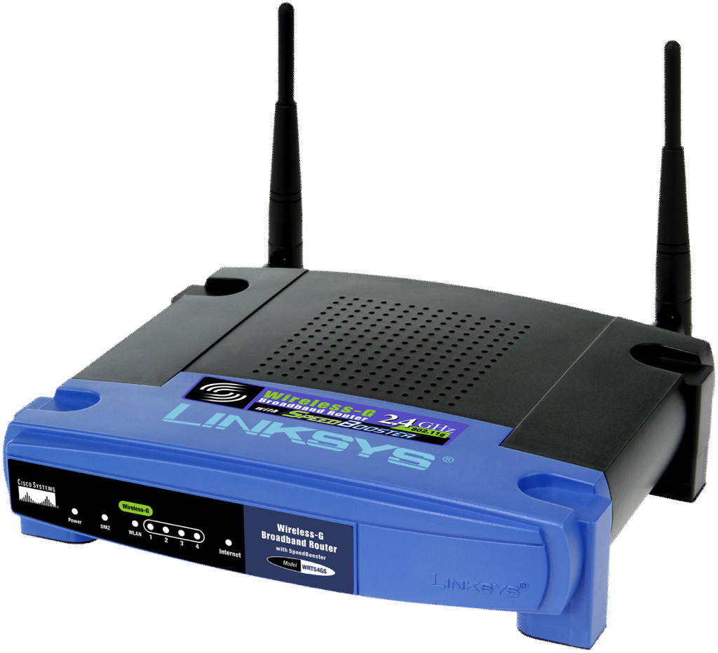
Master mode
Master mode (also called AP or infrastructure mode) is used to provide an infrastructure with an access point connecting different clients. The access point creates a network with a specified name (called the SSID) and channel, and offers network services on it.WiFi devices in master mode can only communicate with devices that are associated with it in managed mode.
Notes:
SSID means “Service Set IDentifier”. It sometimes called also ESSID (Extended SSID) or BSSID (Basic SSID), with the same meaning (not really, but the difference is not important for us now...).
For more details, see: http://en.wikipedia.org/wiki/Service_set_(802.11_network)
Access points create point-to-multipoint WiFi networks. A radio operating in master mode acts as an access point, advertising a network of a certain name on a certain channel, and allows wireless clients to connect to it. There may be limitations on the max number of clients allowed (this limit varies across AP models).

Slide 24

Managed Mode
Managed mode is sometimes also referred to as client mode. Wireless devices in managed mode will join a network created by a master, and will automatically change their channel to match it.
Clients using a given access point are said to be associated with it. Managed mode radios do not communicate with each other directly, and will only communicate with an associated master (and only with one at a time).
Notes:
Sometimes a device working in client (managed) mode is also called “station” or “CPE” (Customer-premises equipment or customer-provided equipment).
Clients can only talk to one AP at a time.

Slide 25
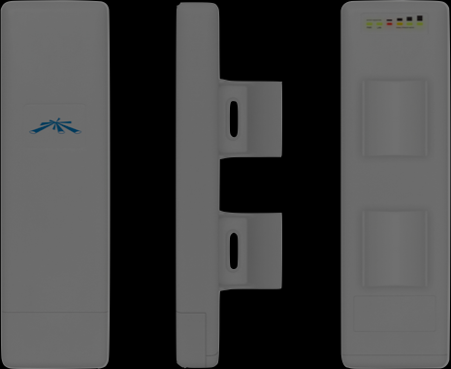
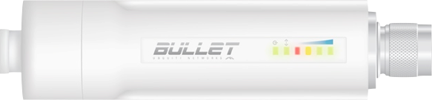
Ad-hoc Mode
Ad-hoc mode is used to create mesh networks with:
No master devices (APs)
Direct communication between neighbors
Devices must be in range of each other to communicate, and they must agree on a network name and channel.
Notes:
Ad-hoc mode is used to create mesh networks. This is done by creating a multipoint-to-multipoint network when there is no master available.
Ad hoc mode can also be used to establish a link between to WiFI equipped laptops without using an Access Point.
In ad-hoc mode, each wireless card communicates directly with its neighbors.
Some vendors do not implement properly the ad hoc mode thus impairing interoperability.

Slide 26

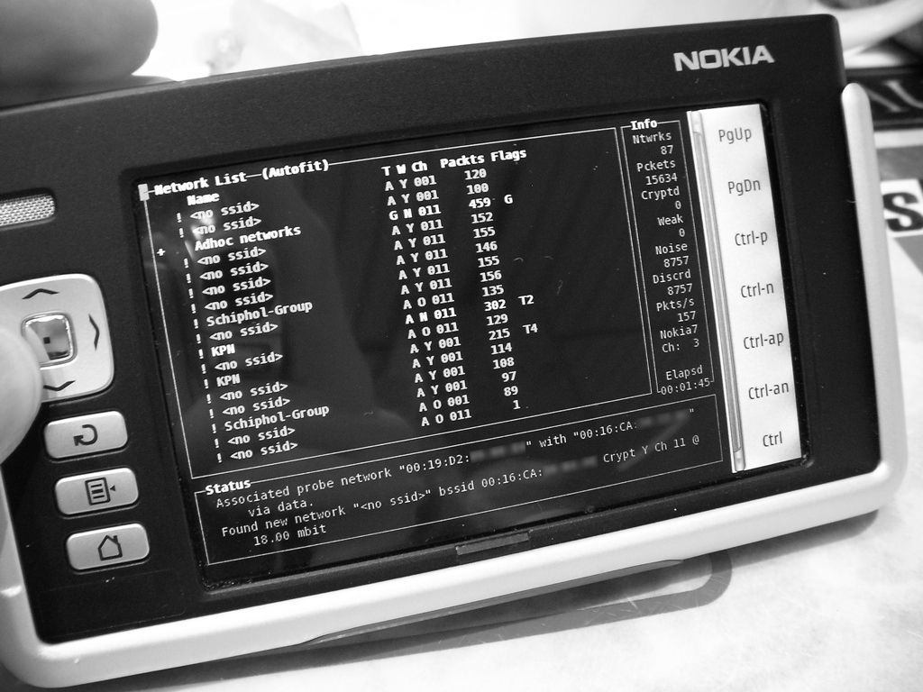
Monitor Mode
Monitor mode is used to passively listen to all radio traffic on a given channel. This is useful for:
Analyzing problems on a wireless link
Observing spectrum usage in the local area
Performing security maintenance tasks
Notes:
Monitor mode is used by some tools (such as Kismet) to passively listen to all radio traffic on a given channel. This is useful for analyzing problems on a wireless link or observing spectrum usage in the local area.
Monitor mode is not used for normal communications.

Slide 27
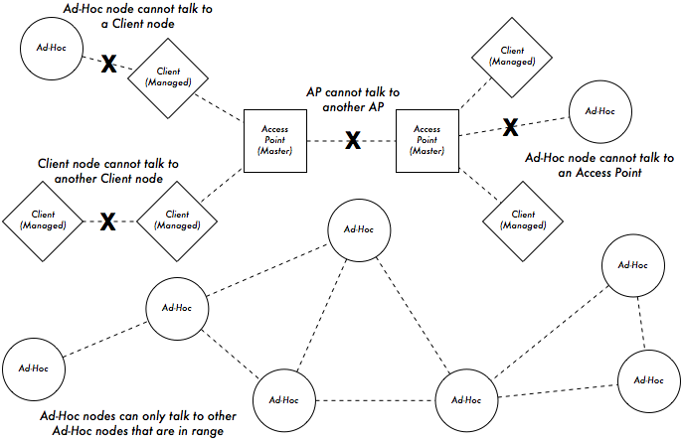
WiFi radio modes in action
27
Notes:
Access points cannot communicate with other access points over the air. A feature of WiFi called WDS (Wireless Distribution System) can allow up to five APs to communicate with each other via wireless, but throughput is greatly reduced, and vendor interoperability problems are common, so relying on it is generally discouraged.
Clients cannot communicate with other clients, unless they are in range of a common AP. It is a common problem that two laptops may be sitting in the same room but one can get on the network while the other cannot. If the AP is far away, and one laptop has a better antenna than the other, then only the better laptop may be able to access the network. Even though the clients are in range of each other, this does not help. Clients must be in range of an access point to use the network.
Ad-hoc nodes can only talk to other ad-hoc nodes that are in range.

Slide 28
Wireless Distribution System (WDS)
It is possible to allow Access Points to communicate with each other directly by using the WDS protocol. It can be useful, but it has several limitations.
WDS may not be compatible with equipment from different vendors.
Since WiFi is half-duplex, the maximum throughput is halved at each hop.
WDS only supports a small number of connected APs (typically five).
WDS cannot support some security features, such as WPA encryption.
Notes:
WDS is mentioned in the WiFi standard, but the actual implementation is not fully specified, therefore different vendors often use incompatible implementations.

Slide 29
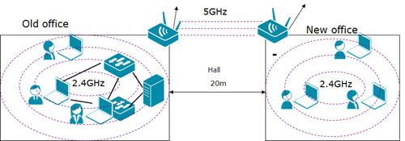
WDS

Slide 30
Routing traffic
802.11 WiFi provides a link-local connection. It does not provide any routing functionality! Routing is implemented by higher level protocols.
TCP/IP Protocol Stack
5 | Application
4 | Transport
3 | Internet
2 | Data Link
1 | Physical
}
WiFi
Notes:
Complex networks use some kind of routing protocol to relay traffic between nodes. WiFi only provides a link-local network connection, up through TCP/IP layer two.

Slide 31
Bridged networking
For a simple local area wireless network, a bridged architecture is usually adequate.
Advantages
Very simple configuration
Roaming works very well
Disadvantages
Increasingly inefficient as nodes are added
All broadcast traffic is repeated
Virtually unusable on very large wide-area networks
Notes:
The simplest network topology from layer two up is the bridge. If you bridge the Ethernet interface to the wireless, it creates a wireless “hub”, nearly the same as if every client connected an Ethernet cable to the same hub.
While the configuration is simple, it comes at a cost of efficiency, since every device on the network now shares the same broadcast domain.

Slide 32
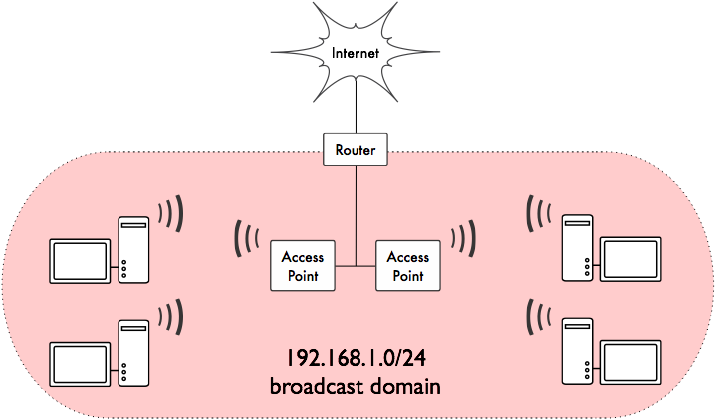
Bridged access points
Notes:
All access points in a bridged network share the same broadcast domain. All broadcast traffic (DHCP requests, ARP traffic) is sent to every node on the network. This ties up radio resources with unnecessary traffic.

Slide 33
Routed networking
Large networks are built by applying routing between nodes.
Static routing is often used on point-to-point links.
Dynamic routing (such as RIP or OSPF) can be used on larger networks, although they are not designed to work with imperfect wireless links.
Mesh routing protocols work very well with wireless networks, particularly when using radios in ad-hoc mode.
Notes:
Instead of bridging access points directly to the Ethernet, we can limit the broadcast domains to individual APs.
Traditional dynamic routing protocols work well, as long as the wireless connections are strong. Historically, a problem with slow connectivity on a link is regarded as congestion, so the protocol “backs off” and transmits less frequently to help reduce the problem. But on a wireless link, slow connectivity may be a symptom of a weak signal or interference, which is indistinguishable from congestion. Reducing the transmission rate may actually make the problem worse, while immediate retransmission may be a better strategy.
Modern mesh routing protocols (such as OLSR or BATMAN) can make use of information about link quality to make better decisions about routing and retransmissions.

Slide 34
Routed networking
As the network grows, it becomes necessary to use some sort of routing scheme to maintain traffic efficiency.
Advantages
Broadcast domains are limited, making more efficient use of radio bandwidth
Arbitrarily large networks can be made
A variety of routing protocols and bandwidth management tools are available
Disadvantages
More complex configuration
Roaming between APs is not supported

Slide 35
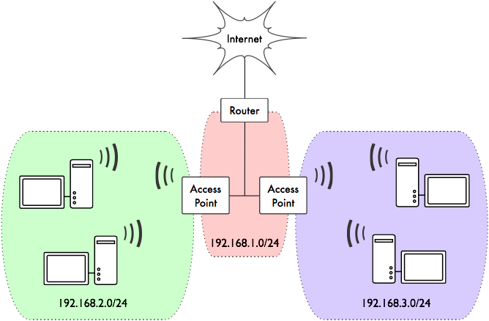
Routed access points
Notes:
The same network can be made much more efficient by using routing instead of bridging. This reduces the size of the broadcast domains to include a single access point.
Using routing does break roaming, which is generally only a problem for IP phones or other devices that expect to maintain TCP connections when physically moving around the network.

Slide 36
A few important concepts
I can give you answers to some questions, indeed :-)
What is a device?
What is an Access Point (AP)? Can it be also a client? Are they different hardware?
What is firmware? Why may I want to change it?
I don’t understand the differences between AP, device, firmware, protocols...
Notes:
The answers will be given in the next slides.

Slide 37
A few important concepts
device
(hardware)
firmware
(O.S.+software)
+
hardware features:
power
frequencies
ports (radio, ethernet)
connectors, etc...
firmware features:
modes (AP/client/…)
supported protocols
allowed max power
allowed frequencies
settings you can do…
all of this together makes up your AP/client
Notes:
We call a “device” the combination of a piece of hardware AND its Operating System (usually called firmware). The OS may also include other pieces of software (e.g.: a device can run a dedicated distribution of Linux with additional packages/commands).

