Slide 1
Automated Emergency Brake
Modern Automotive Software Development
Team 2

Slide 2
Contents
1. Introduction
2. Standard & historical background
3. Subject background
4. The team & roles
5. Milestones
6. Requirements
7. Implementation
8. Validation concept
9. Results

Slide 3
Introduction
Motivation behind AEB
~1.35 million road deaths annually worldwide
Human error → over 90% of accidents
Rear-end collisions
Possible solutions
Radar-based
Camera-based
LiDAR
Sensor fusion
ISO 26262: Functional safety standard → ASIL A-D classification
Euro NCAP: AEB scoring since 2014

Slide 4
Standards & historical background
1990s: Radar and sensor tech introduced in adaptive cruise control
2003: Toyota Pre-Collision System → first mass-market AEB
2008: Mercedes-Benz PRE-SAFE Brake, Volvo City Safety
2014: Euro NCAP begins scoring AEB in safety ratings
2022: EU mandates AEB on all newly type-approved cars
2024: EU mandates AEB on all newly registered cars

Slide 5
Subject background
Subject concept
Agile methodology
2 program increments, sprint-based planning
Roles: product owner, scrum master, developers
Events: planning, review, retro, „daily” standup
Tools
ROS2 Humble, C++, VS Code
GitHub Projects
CooperativeResearchPlatform Simulator, Foxglove visualizer

Slide 6
The team & roles
Name | Tasks
András | behavior planner, intervention, visualization
Anna | plan long emergency, config, documentation
Dani | decision making, integration
Edina | plan long emergency, robustness, documentation, ppt
Szabolcs | collision detection, visualization, jerk & speed limit
Timót | collision detection, milestones, node integartion, ppt
Zoltán | control long emergency, intervention
Scrum Master: Timót Product Owner: Edina Developers: András, Anna, Dani, Szabolcs, Zoltán

Slide 7
Milestones
M1: Foundation & Architecture
Skeletons
Node integration
Visualization
M2: Functional Logic
Collision event detection
Decision making
Intervention
M3: System Integration & Core Functionality
Collision detection integration
Decision making integration
Intervention integration
M4: Robustness & Finalization
Robustness
Configurability
Documentation
Presentation

Slide 8
Requirements
Input: Object list (pos, vel, accel) + ego state
Output: Target speed + warning signal
Range: 0–50 km/h
Cycle time: 20 ms
HARA – Hazard Analysis
H-01 No intervention on avoidable collision → ASIL D
H-02 Unintended emergency braking → ASIL C
H-03 Faulty decision due to sensor dropout → ASIL D
Safety Goals
SG-01 Timely braking on avoidable collision → ASIL D
SG-02 Minimize unintended interventions → ASIL C
SG-03 Degraded but safe operation on sensor fault
→ ASIL D
Functional Safety Req. (FSR)
FSR-01 Deceleration profile within accel & jerk limits
FSR-02 Handle stationary, decelerating, constant-speed, reversing objects
FSR-03 Distinguish avoidable vs. unavoidable collision
FSR-04 Robust to 5-cycle dropout & ±10% sensor noise
FSR-05 3 configurable Soft Limit modes (accel & jerk)
Technical Safety Req. (TSR)
TSR-01 Sensor validity check each cycle
TSR-02 Extrapolation up to 5 missing cycles
TSR-03 Noise filtering (low-pass / state estimator)
TSR-09 Strategy: noAction / warning / avoid / impact
Software Safety Req. (SWE)
SWE-01 Deterministic fixed-cycle execution
SWE-02 Float overflow & numeric stability handling
SWE-04 State machine: Monitor / Warning / Partial / Full Brake
SWE-06 Trace log for diagnostics

Slide 9
Implementation
ROS2
Middleware
crp_msgs, autoware_planning_msgs, autoware_control_msgs
Nodes
behavior_planner
plan_long_emergency
ctrl_long_emergency
Data Flow
simulator
/ego, /scenario
↓
behavior_planner
plan/target_space
plan/strategy_behavior
↓
plan_long_emergency
plan/longEmergency/trajectory
↓
ctrl_long_emergency
/control/command/control_cmd
↓
simulator

Slide 10
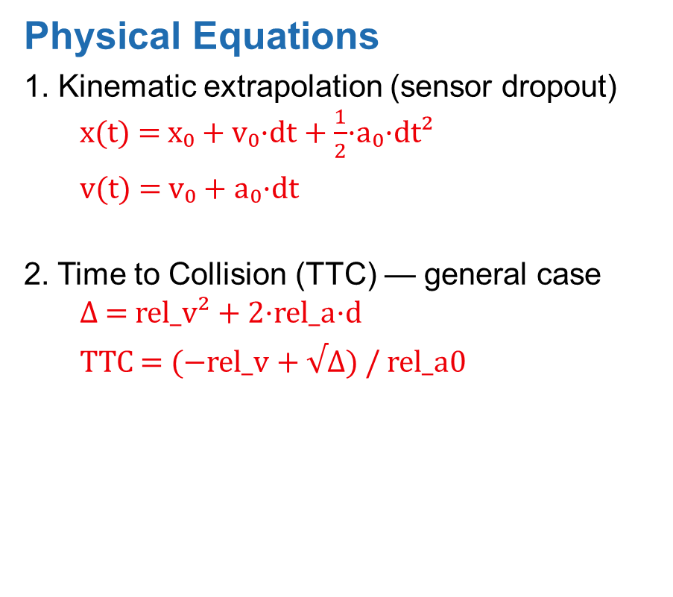
Implementation
Physical Equations
1. Kinematic extrapolation (sensor dropout)
x(t) = x₀ + v₀·dt + $\frac{1}{2}$·a₀·dt²
v(t) = v₀ + a₀·dt
2. Time to Collision (TTC) — general case
Δ = rel_v² + 2·rel_a·d
TTC = (−rel_v + √Δ) / rel_a0
3. Required deceleration
a = −v² / (2 · s_stop)
4. Target speed interpolation
v_target = v_ego − (v_ego − v_traj) / cycles

Slide 11
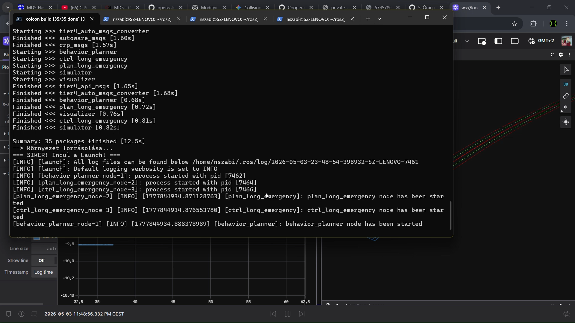
Validation concept
Simulation
Tests done with the Cooperative Research Platform simulator and Foxglove visualizer
Inspect running software → simulator → Foxglove visualization
Velocity plot
Acceleration plot
3D visualisation with Foxglove

Slide 12
Results
AEB activates on a stationary object – vehicle stops
TTC based decision making running at 50 Hz
Sensor dropout handled
No unintended braking when no object is present
Next steps
Only front collision detection
3 configurable sensitivity levels in progress
ctrl_long_emergency stale message issue – partially mitigated in plan_long_emergency
Full fix: add timestamp check in ctrl node

