Slide 1
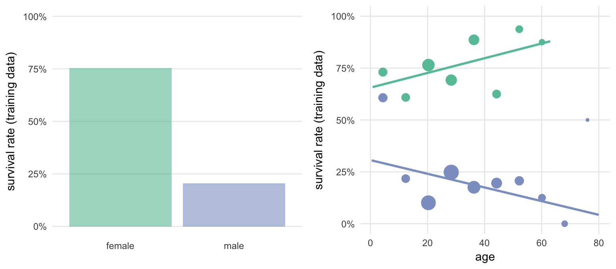
Ratchets Iteration as a strategy in Kaggle competitions
Titanic: Machine learning from disaster

Slide 2
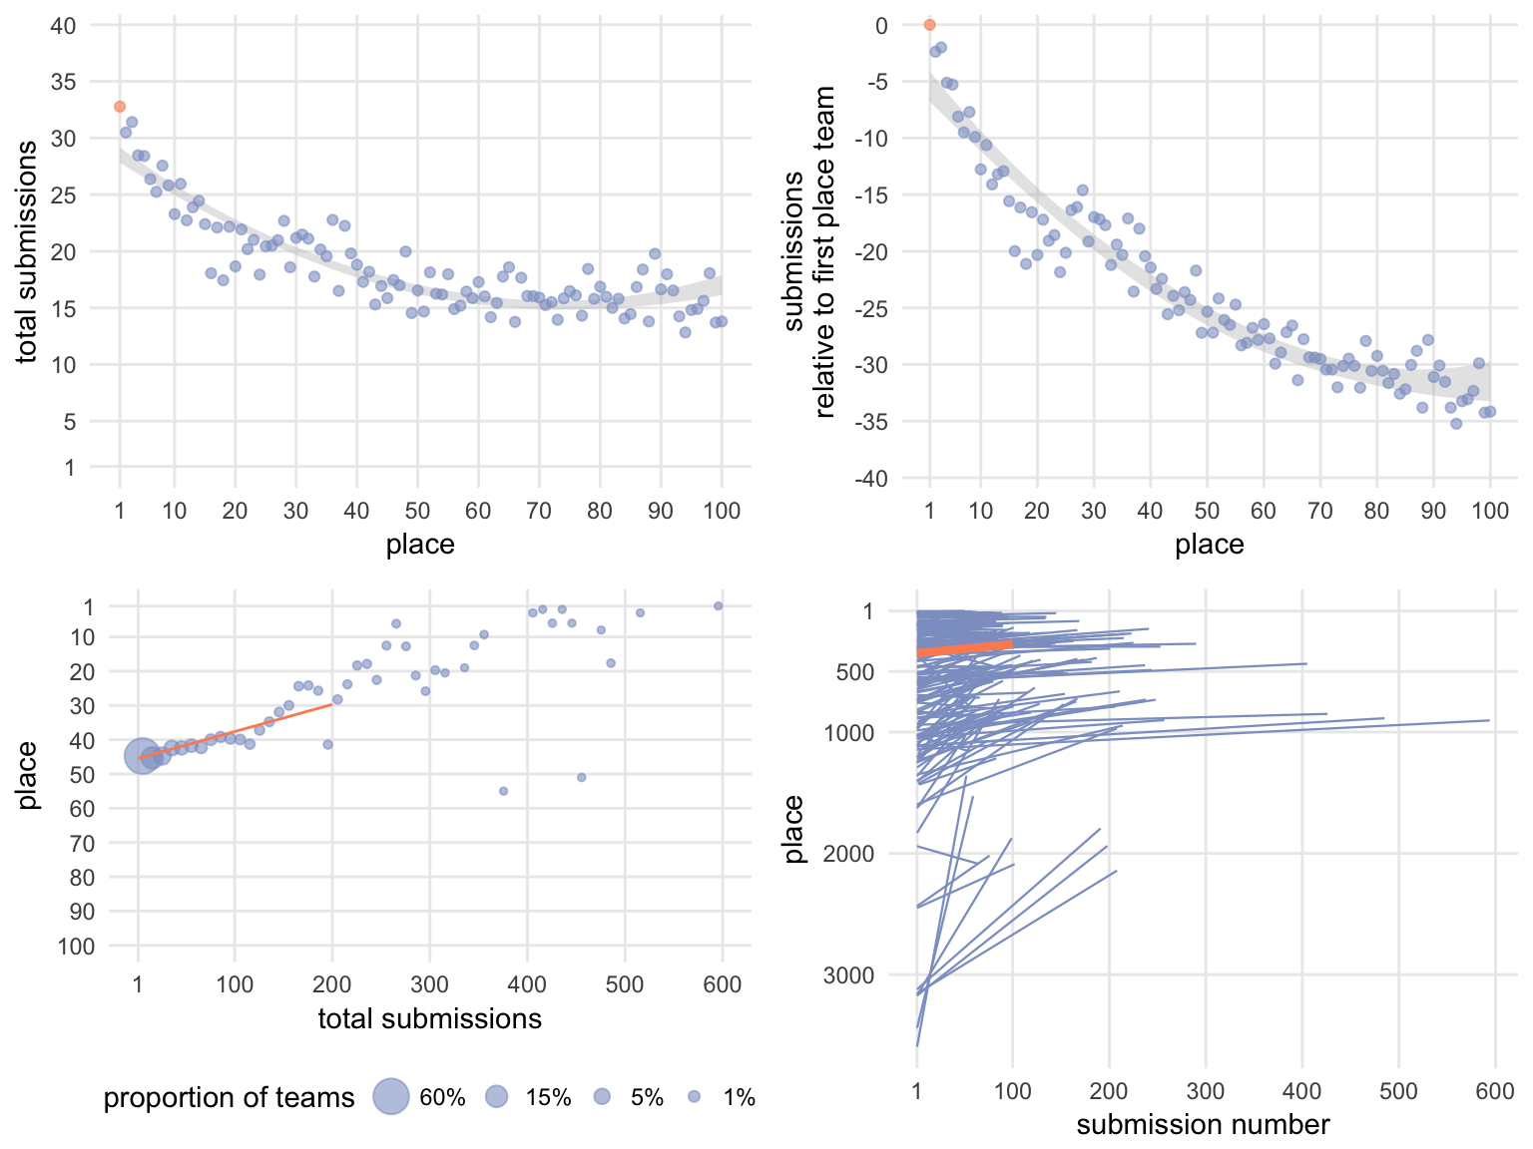
Do teams that make more submissions place better?

Slide 3
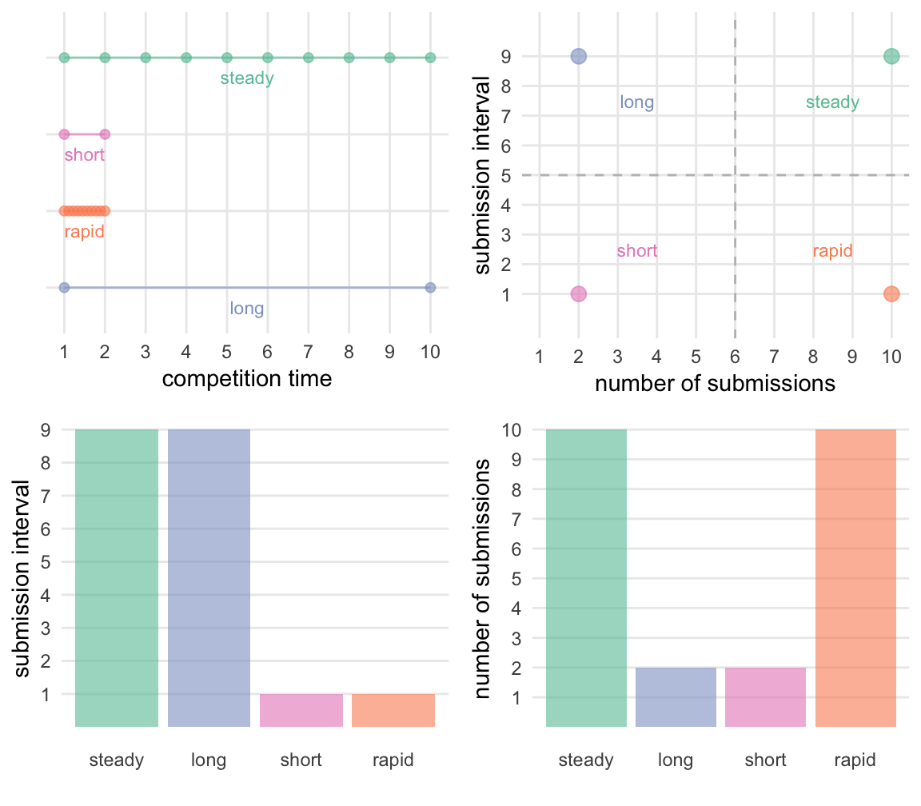
Is it more submissions or is it spending more time?

Slide 4
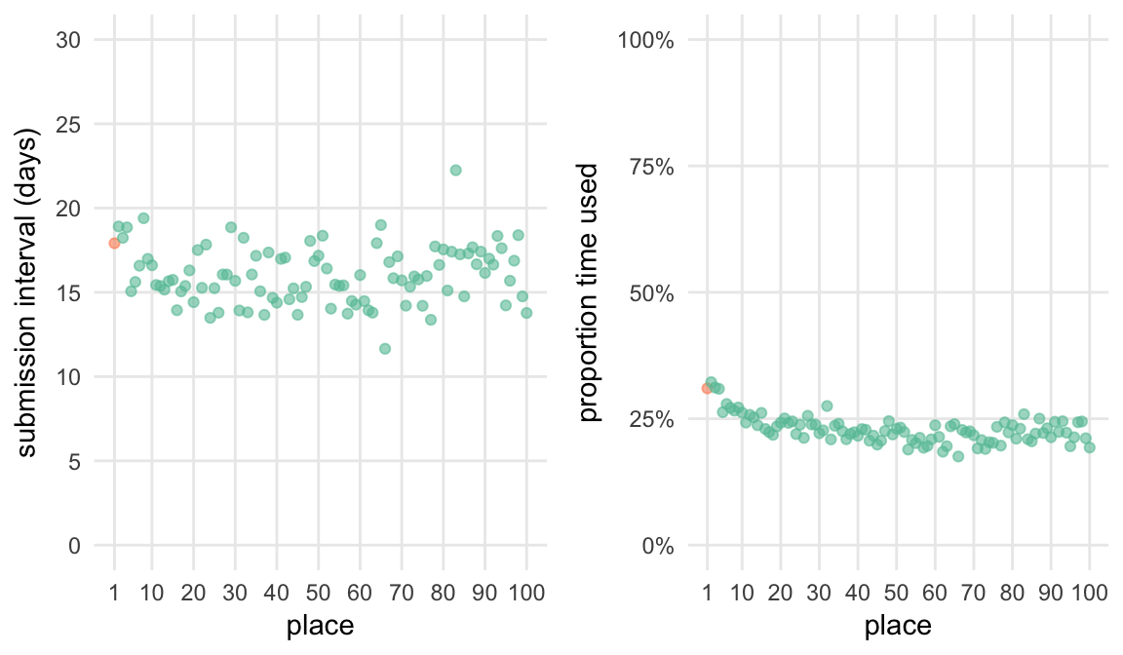
Top place teams do not spend more time on the problem

Slide 5
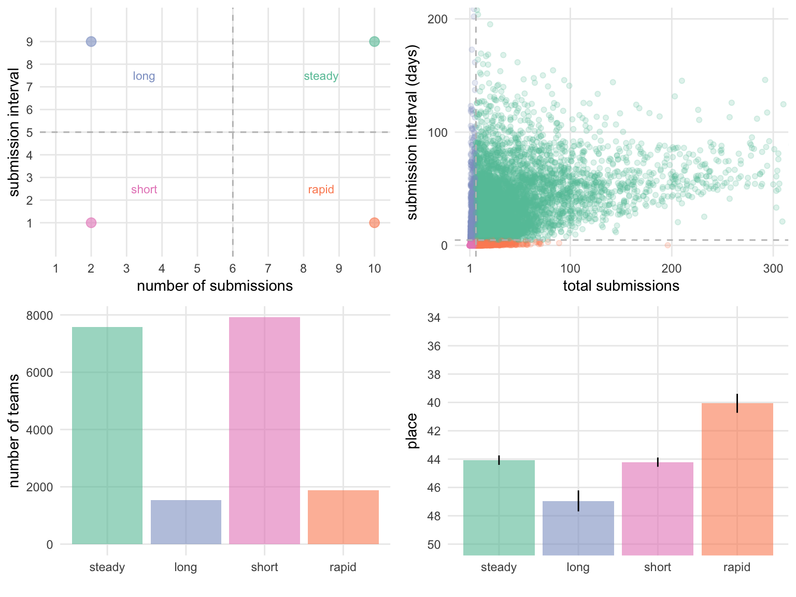
Rapid iteration is correlated with competition success

