Slide 1
Automating Building Energy Simulation Workflows with Python: Eppy and EnergyPlus API
By: Pedram Nojedehi, Zeinab Khorasani Zadeh, Hussein Elehwany
Friday, July 18, 2025

Slide 2

Whole-Building Energy simulation tool
EnergyPlus
Open-source simulation engine for modelling whole-building energy performance
Developed by the U.S. Department of Energy, currently managed by NREL (National Renewable Energy Laboratory)
Widely used in research and industry for detailed modelling of energy systems and user-defined control strategies for HVAC, lighting, and renewables.

Slide 3

Simulation Timeline without EMS & Automation
Fixed input only
EX: Weather data, occupancy schedule
Results only reflect initial assumptions
No interaction or decision making
Preprocessing
Simulation Runtime
Outputs
Temperatures
Energy use
EnergyPlus Schedule
OR
No feedback, no learning, no real-time adaptation.
All control logic must be defined upfront via IDF schedules or CSVs.

Slide 4

Simulation Timeline With EMS
Simulation timeline with EMS
Weather data
Preprocessing
Simulation Runtime
Outputs
Temperatures
Energy use
Read internal variables (e.g., zone temp)
Modify actuators (e.g., thermostat setpoint)
Control
Method using EMS logic
EMS can respond to conditions during simulation, but cannot access external data or store past results

Slide 5

Why Eppy?
EnergyPlus Eppy is a scripting language developed by Santosh Philip for EnergyPlus IDF files and EnergyPlus output files.
Eppy is written in the programming language Python.
You can programmatically navigate, search, and modify EnergyPlus IDF files using Eppy.
The power of using a scripting language allows you to do the following:
Make a large number of changes in an IDF file with a few lines of Python (Eppy) code.
Use conditions and filters when making changes to an IDF file
Make changes to multiple IDF files.
Read data from the output files of an EnergyPlus simulation run. [IMHO: not mature enough yet!]
Based on the results of an EnergyPlus simulation run, generate the input file for the next simulation run. This could be easily used to help you with optimization problems.
Notes:
Based on eppy

Slide 6

Python, Eppy, and Text Files
We can do all of this for a simple reason: everything is built in textual form and has a structure.
All models in EnergyPlus are text files called IDF*. Text files are human-readable and are platform-agnostic.
There is a special text file called an IDD* file that describes all the objects that can be in an EnergyPlus model.
Then, Eppy reads these text files and pushes them into classic Python data structures, like lists and dictionaries.
* Input Data File
** Input Data Dictionary
Notes:
There is a special text file called an IDD file that describes all the objects that can be in an EnergyPlus model. Again, this file is human-readable, and it is very well documented with comments.
So, If you are an advanced python user, you can replicate many of eppy’s capabilities directly through Python without relying on eppy.

Slide 7
Simulation Timeline With Eppy
Simulation timeline with EMS
Looping through various inputs (including weather files)
and outputs
Preprocessing
Simulation Runtime
Outputs
Preprocessing
Simulation Runtime
Outputs
Preprocessing
Simulation Runtime
Outputs
Preprocessing
Simulation Runtime
Outputs
Preprocessing
Simulation Runtime
Outputs
Preprocessing
Simulation Runtime
Outputs
Preprocessing
Simulation Runtime
Outputs
Preprocessing #n
Simulation #n
Outputs #n
Programmatically changing inputs based on
the outputs of previous simulations
Read / Modify / Remove
Any IDF objects

Slide 8
What can Eppy do?
A few examples:
Change construction for all north facing walls.
Change the glass type for all windows larger than 2 square meters.
Change the number of people in all the interior zones.
Change the lighting power in all south facing zones.
Change the efficiency and fan power of all rooftop units.
Notes:
If you are an advanced python user, you can do the majority of eppy’s capabilities directly through Python without relying on eppy.

Slide 9
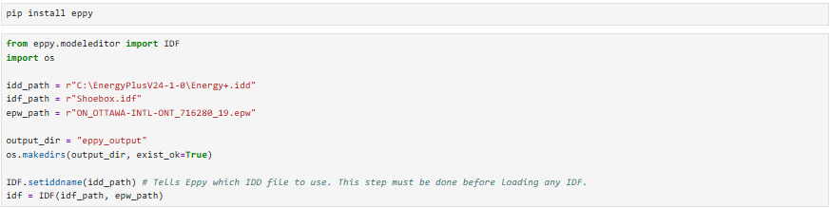
Initialization and Loading Models
Notes:
“We start by importing the IDF class from the eppy.modeleditor module. This is the core class that allows us to load, edit, and save .idf files.”
“We also import the os module for handling file paths and directories.”
“Here we load the IDF file using the IDF object.
The .idd file is like a dictionary—it tells eppy how to interpret IDF objects.
The .idf file is our building model.
The .epw file is weather data. We also create an output directory to store simulation results.”

Slide 10
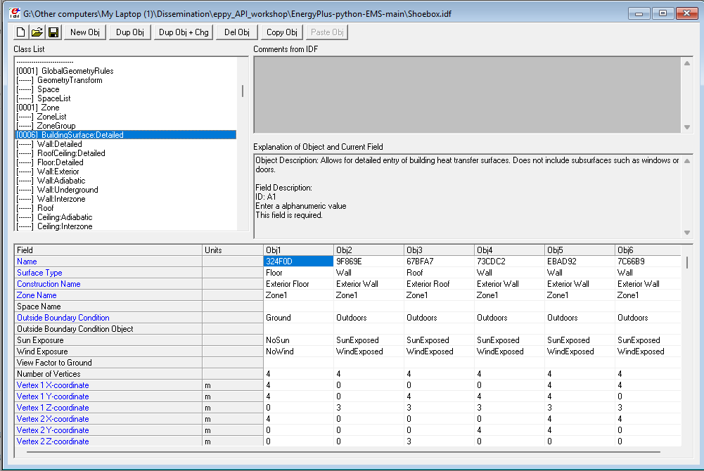
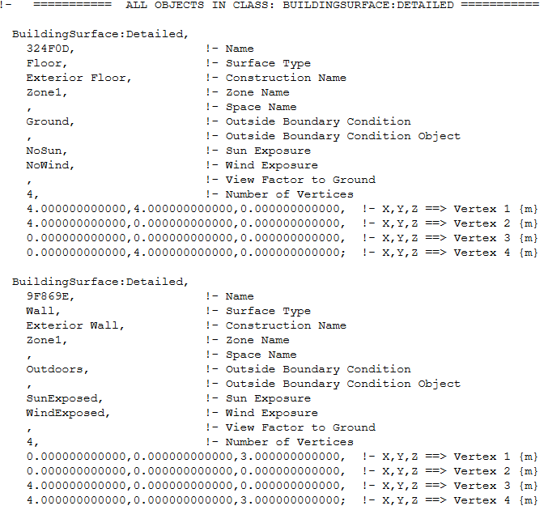
Inspecting IDF Objects
Identify Class
Identify Object
Identify Fields
Identify Object

Slide 11
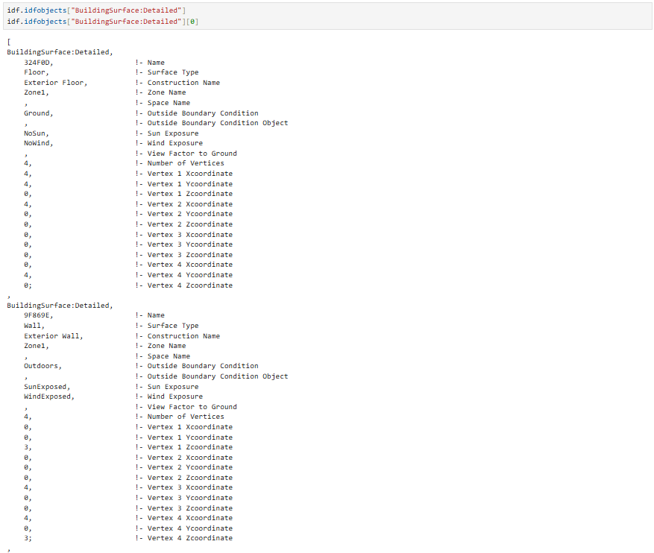
Classes & Objects vs. List-like & Dictionary-Style Objects
Python Output:
IDF opened in Notepad:
Notes:
As you may remember from the previous slide, the python output looks similar to IDF file that we opened using notepad.
Side note:
When we access idf.idfobjects['BuildingSurface:Detailed'], we're working with a list-like object that holds multiple EnergyPlus surfaces. This list is a special class in Eppy called Idf_MSequence.
Each element inside it — like the first surface idf.idfobjects['BuildingSurface:Detailed'][0] — is an object of another class called EpBunch, which represents one EnergyPlus item like a wall, window, or roof. These are just Python classes and objects, customized by Eppy for building simulation workflows.
Class is a template (blueprint) (defines attributes and behaviors ) while object is a real thing built from that blueprint with real values.

Slide 12
Hands-on Exercise: Window Retrofit Scenario
Objective: Simulate and analyze the impact of different window types (varying U-values and SHGC) on:
Annual energy consumption
Overheating hours
Participants are provided with:
A base IDF model with a default window construction (shoebox.idf)
Predefined scenarios with varying thermal properties:
Scenario | U-Value (W/m²·K) | SHGC | Description
lowSHGC | 1.4 | 0.30 | Standard insulated glazing with low solar gain
medSHGC | 1.4 | 0.50 | Standard insulated glazing with medium solar gain
highSHGC | 1.4 | 0.70 | Standard insulated glazing with high solar gain
lowU | 1.0 | 0.50 | High-performance low-conductivity glazing
highU | 2.5 | 0.50 | Poorly insulated glazing (high heat transfer)

Slide 13

References
Eppy’s Documentation:
https://eppy.readthedocs.io/en/latest/index.html
EnergyPlus Python API documentation:
https://nrel.github.io/EnergyPlus/api/python/
Workshop’s GitHub repository at this QR code:
Notes:
If you are an advanced python user, you can do the majority of eppy’s capabilities directly through Python without relying on eppy.

Slide 14
Thank you
Questions?
pedram.nojedehi@carleton.ca

