Slide 1
EnergyPlus Python API Workshop
Presented by: Zeinab Korasani Zadeh| Concordia University
Friday, July 18, 2025

Slide 2

About presenter
Zeinab Khorasani Zadeh
Concordia University | 2022-present PhD on occupant-centric demand response & adaptive thermostat controls | Supervised by Prof. Ouf & Prof. Gunay
Experience in building performance simulation, data analysis, and occupant behaviour modelling in buildings
Today’s focus: introducing the EnergyPlus Python API with hands-on examples
Concordia University, | 2020-2022 MSc in Building Engineering
🔗https://www.linkedin.com/in/zina-kh-zadeh/

Slide 3

Whole-Building Energy simulation tool
EnergyPlus
Open-source simulation engine for modelling whole-building energy performance
Developed by the U.S. Department of Energy, currently managed by NREL (National Renewable Energy Laboratory)
Widely used in research and industry for detailed modelling of energy systems and user-defined control strategies for HVAC, lighting, and renewables.
Key Features and Advantages
Detailed and summary output reports
Built-in control strategies for HVAC and lighting systems
Flexible user-defined schedules
Support for custom control logic via:
1- 💡 Energy Management System (EMS): scripting for rule-based control
2- 💻 Python API: for real-time, dynamic simulation control (covered in this workshop)
🔗 Extensibility
Compatible with tools like OpenStudio, DesignBuilder,…

Slide 4
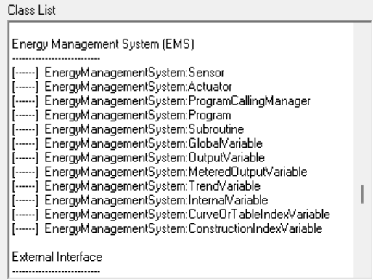
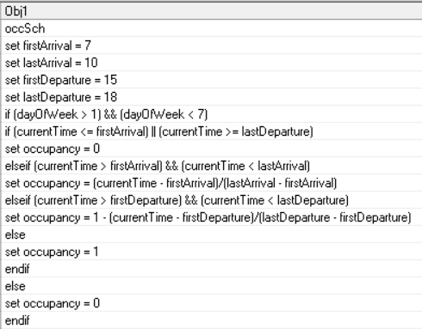
Energy Management System (EMS)
Rule-Based Control Engine
Uses EnergyPlus Runtime Language (ERL)
Executes control logic during simulation runtime
🔍 Capabilities
Access internal sensor data (e.g., temperature, indoor illuminance, occupancy)
Perform custom control logic (if–then–else structures)
Modify actuators (e.g., HVAC components, setpoints)
🔧 Use Cases
Adaptive schedules
Occupancy-based control
Thermostat reset or equipment control

Slide 5
Why use EnergyPlus Python API?
Dynamic Simulation Control
Exchange data during simulation runtime: eg, Import external data like weather, prices, or schedules
Manipulate internal variables using custom Python routines
Trigger routines at flexible simulation points (e.g., HVAC iteration, time step).
Leverage Python Ecosystem
Use control structures (loops, functions, conditionals)
Handle complex data via NumPy, Pandas, etc.
Store results for post-processing or adaptive logic
Advanced Capabilities
Integrate machine learning models (e.g., Scikit-learn, TensorFlow, PyTorch)
Enable adaptive, occupant-centric, or data-driven controls

Slide 6

Simulation Timeline without EMS
Fixed input only
Eg., Weather data, occupancy schedule
Results only reflect initial assumptions
No interaction or decision making
Preprocessing
Simulation Runtime
Outputs
Temperatures
Energy use
EnergyPlus Schedule
OR
No feedback, no learning, no real-time adaptation.
All control logic must be defined up front via IDF schedules or CSVs.

Slide 7

Simulation Timeline With EMS
Simulation timeline with EMS
Weather data
Preprocessing
Simulation Runtime
Outputs
Temperatures
Energy use
Read internal variables (e.g., zone temp)
Modify actuators (e.g., thermostat setpoint)
Control
Method using EMS logic
EMS can respond to conditions during simulation, but cannot access external data or store past results

Slide 8
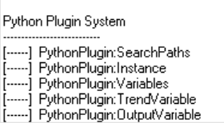
Modes of using the API
Call EnergyPlus as a Library
Run EnergyPlus from a standalone Python script
Gives you full control over simulation execution
Good for batch runs, parametric studies, and automation
Library: Your Python calls EnergyPlus
Run EnergyPlus normally (e.g., via EP-Launch or command line), and EnergyPlus calls your Python code
Your Python script runs inside the simulation
Suitable for: In-simulation control (e.g., rule-based HVAC strategies), Easy plug-in of Python logic into existing IDF workflows
Plugin : EnergyPlus calls your Python
Python Plugin

Slide 9
EnergyPlus Python API Key Functional Groups
1
Runtime API
Call your Python callbacks during simulation at specific point (e.g., timestep start, HVAC iteration)
2
Data-transfer API
Exchange data between EnergyPlus and Python, Read sensors (e.g., temperature, occupancy), Write to actuators (e.g., setpoint, availability)
3
Functional API
Fluid and refrigerant property methods

Slide 10
Examples of Call-back Registration Points
Example 1
Callback_after_new_environment_warmup_complete
Registers a function to be executed after the warmup period is complete, before normal simulation begins.
Example 2
Callback_begin_new_environment
Registers a Python function to be called at the beginning of each environment, such as a new simulation period (e.g., design day, run period).
Example 3
Callback_begin_system_timestep_before_predictor
register a function to be called back by EnergyPlus at the beginning of system time step
Example 4
Callback_end_system_sizing
Registers a function that is called at the end of the system sizing process, useful for post-sizing adjustments or logging.

Slide 11
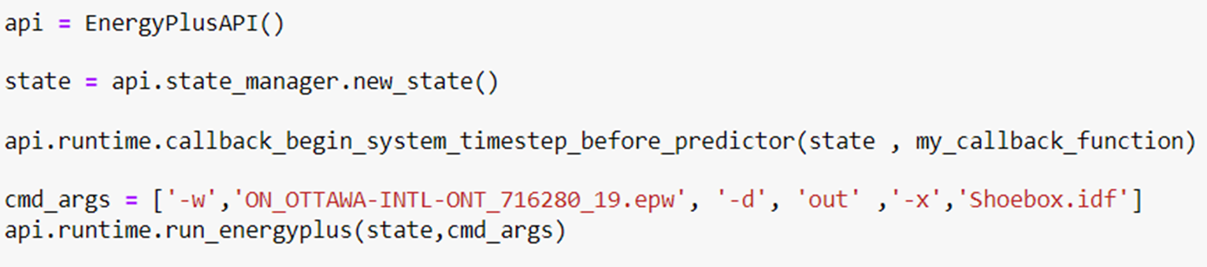
Initialization
(1)
(2)
(3)
(4)
(5)
01
Create the API instance: Create the main object to interact with EnergyPlus API
02
create a simulation state: an isolated session that stores everything about one simulation run; each simulation must be run in a distinct state
03
Tells EnergyPlus what function to run and when during the simulation.
04
Define simulation command argument: -w: Path to the EPW (weather) file.-d: Output directory.-x: Enables eXtended reporting (used when plugins are active).Last element: the IDF file (building model).
05
5- Runs the EnergyPlus simulation with the defined arguments using the custom state and registered callback logic

Slide 12

Opening Jupyter Notebook
Option 1: Anaconda Navigator
Open Anaconda Navigator.
Click "Launch" under Jupyter Notebook.
In the browser window, navigate to the folder where your notebook is saved.
Click the notebook file to open it.
Option 2: Using File Explorer + cmd
Go to the folder where your notebook (.ipynb) is saved.
Click the address bar in File Explorer, type cmd, and press Enter.
In the Command Prompt that opens, type: jupyter notebook.

Slide 13
Handles
Handles act as pointers that allow your script to access specific EnergyPlus variables, meters, and actuators during simulation.
Any variable or actuator you want to access must first be requested in the IDF file (via Output:Variable, Output:Meter, etc.).
Variable Handles
For real-time simulation variables (e.g., zone temperature)
1
2
Actuator Handles
To control components (e.g., thermostat setpoints).
3
Meter Handles
For energy and resource meters (e.g., electricity or heating energy).

Slide 14
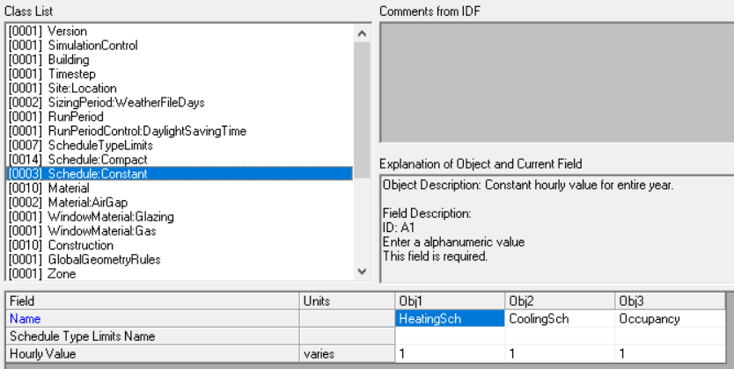
Actuator Handle-Example via schedule
Used to override schedule values (e.g., heating/cooling availability) at runtime
Requires a valid Schedule: Constant (or similar) defined in the IDF file
The schedule name in the code must match the IDF exactly
The schedule must be used in the model; otherwise, the handle will be -1
After getting the handle, you can use it to set new values dynamically:

Slide 15
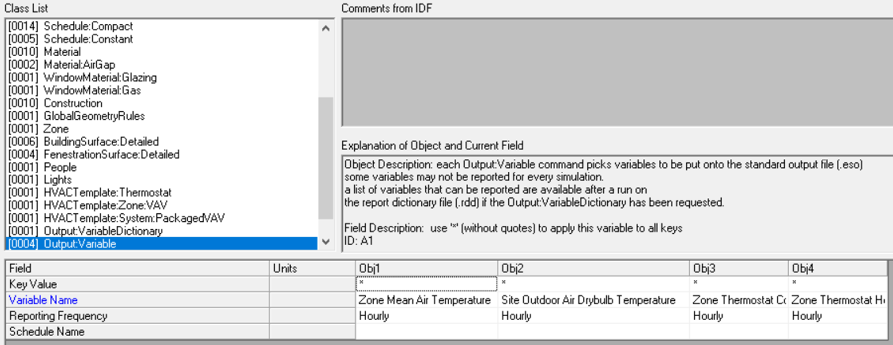
Variable Handles
Used to read simulation variables (e.g., zone temperature, occupancy, power demand)
The variable must be defined in the IDF file using Output:Variable
Requires:The variable name (must match EnergyPlus naming in .rdd file (Report Data Dictionary file)
The key value (e.g., zone name like "Zone1")
During simulation, read the current value using:

Slide 16
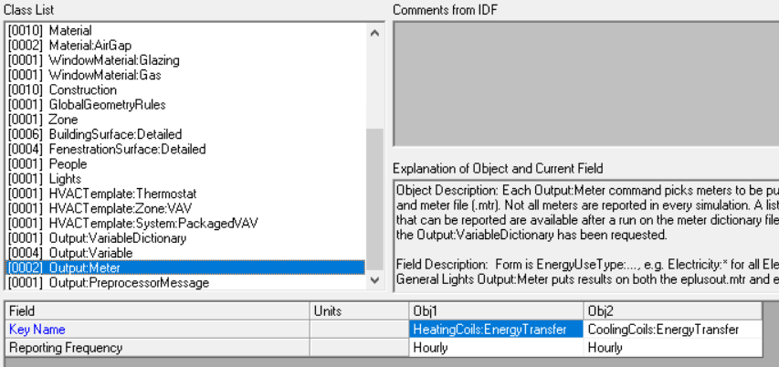
Meter Handles
Used to read energy/resource consumption data from meters (e.g., electricity, heating, cooling)
Meters must be requested in the IDF using the Output:Meter object
Requires the exact meter name as shown in the .mdd (MeterData Dictionary) file
To retrieve the meter value at each timestep:

Slide 17
Good Practices
Read handles only once, typically during initialization→ Avoid calling get_handle repeatedly in the simulation loop
Update each actuator only once per timestep→ Multiple updates to the same actuator within a timestep can cause unexpected results
Always check for invalid handles (-1) before using them→ Fail fast if a handle wasn’t found (typo, unused object, etc.) to avoid silent errors
Make sure any .csv output file is closed before starting a simulation → Running a simulation while the CSV is open in Excel or another program can cause file writing errors or simulation crashes

Slide 18
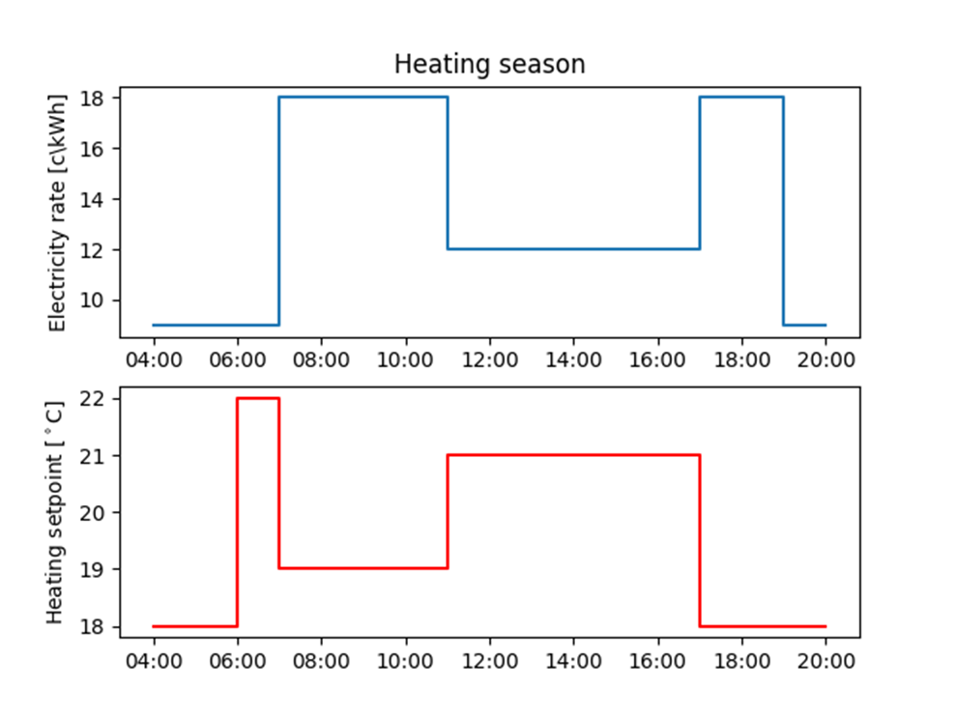
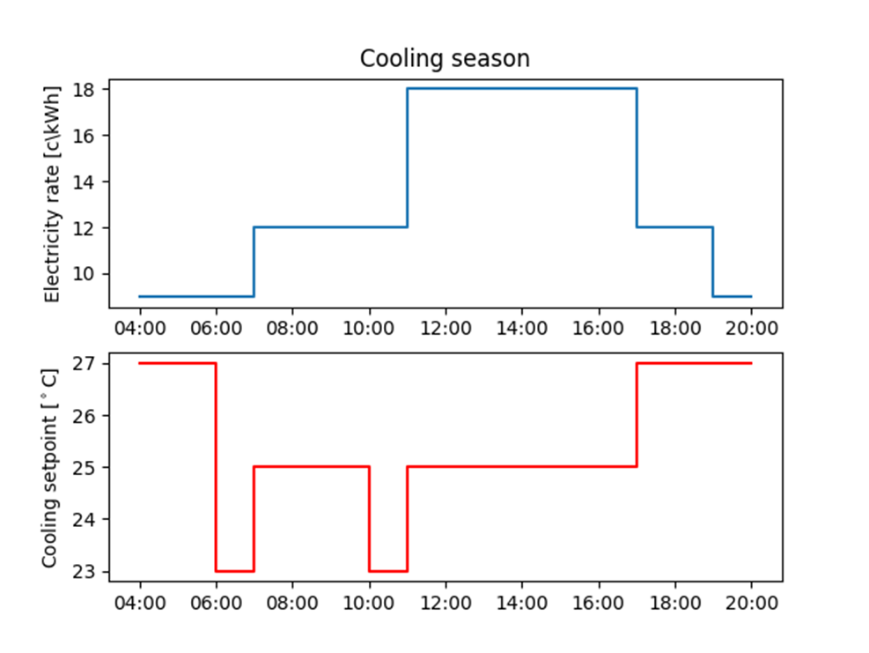
Hands on Exercise

Slide 19
Thank you
Questions?
Zeinab.khorasanizadeh@mail.concrodia.ca

Slide 20

References
EnergyPlus Python API documentation: https://nrel.github.io/EnergyPlus/api/python/
Github repository

