Slide 1
Case Study: FIFA-MoneyBall

Slide 2
Ironhack FC Scouting Team
Who we are?
We discover, evaluate,
and recruit promising
new players for Ironhack FC
We apply predictive models to identify the players, utilizing the
power of player data, to create a shortlist of players to select

Slide 3
Our goal
€100M
3
Budget
Players

Slide 4
Our approach
Exploring
Testing
Choosing
Exploring, understanding, handling and making necessary transformations to data
Testing and evaluating different models
Applying the best model to final dataset and finding the best solution

Slide 5
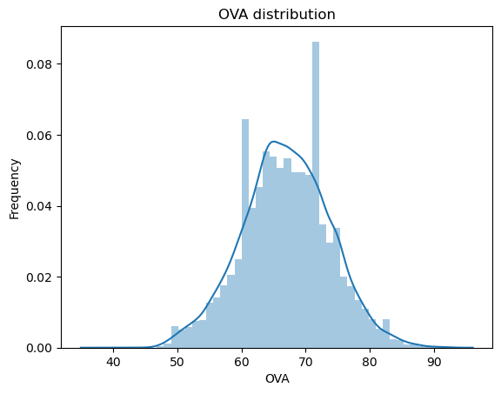
Exploring data
OVA
It’s a score for player’s overall ability
Best players
Have a overall score around 90

Slide 6
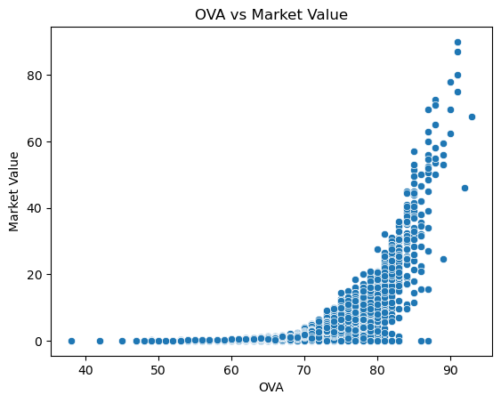
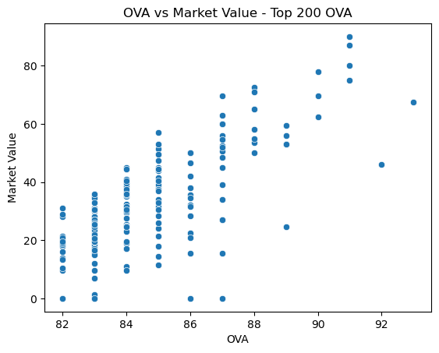
Exploring data
OVA vs Market Value
OVA vs Market Value
All players in dataset
TOP 200 best players

Slide 7
Testing
Correlations
Missing data
Normalization
Understanding what impacts on OVA and assessing multicolinearity
Handling NA’s
Checking whether normalization improves the model

Slide 8
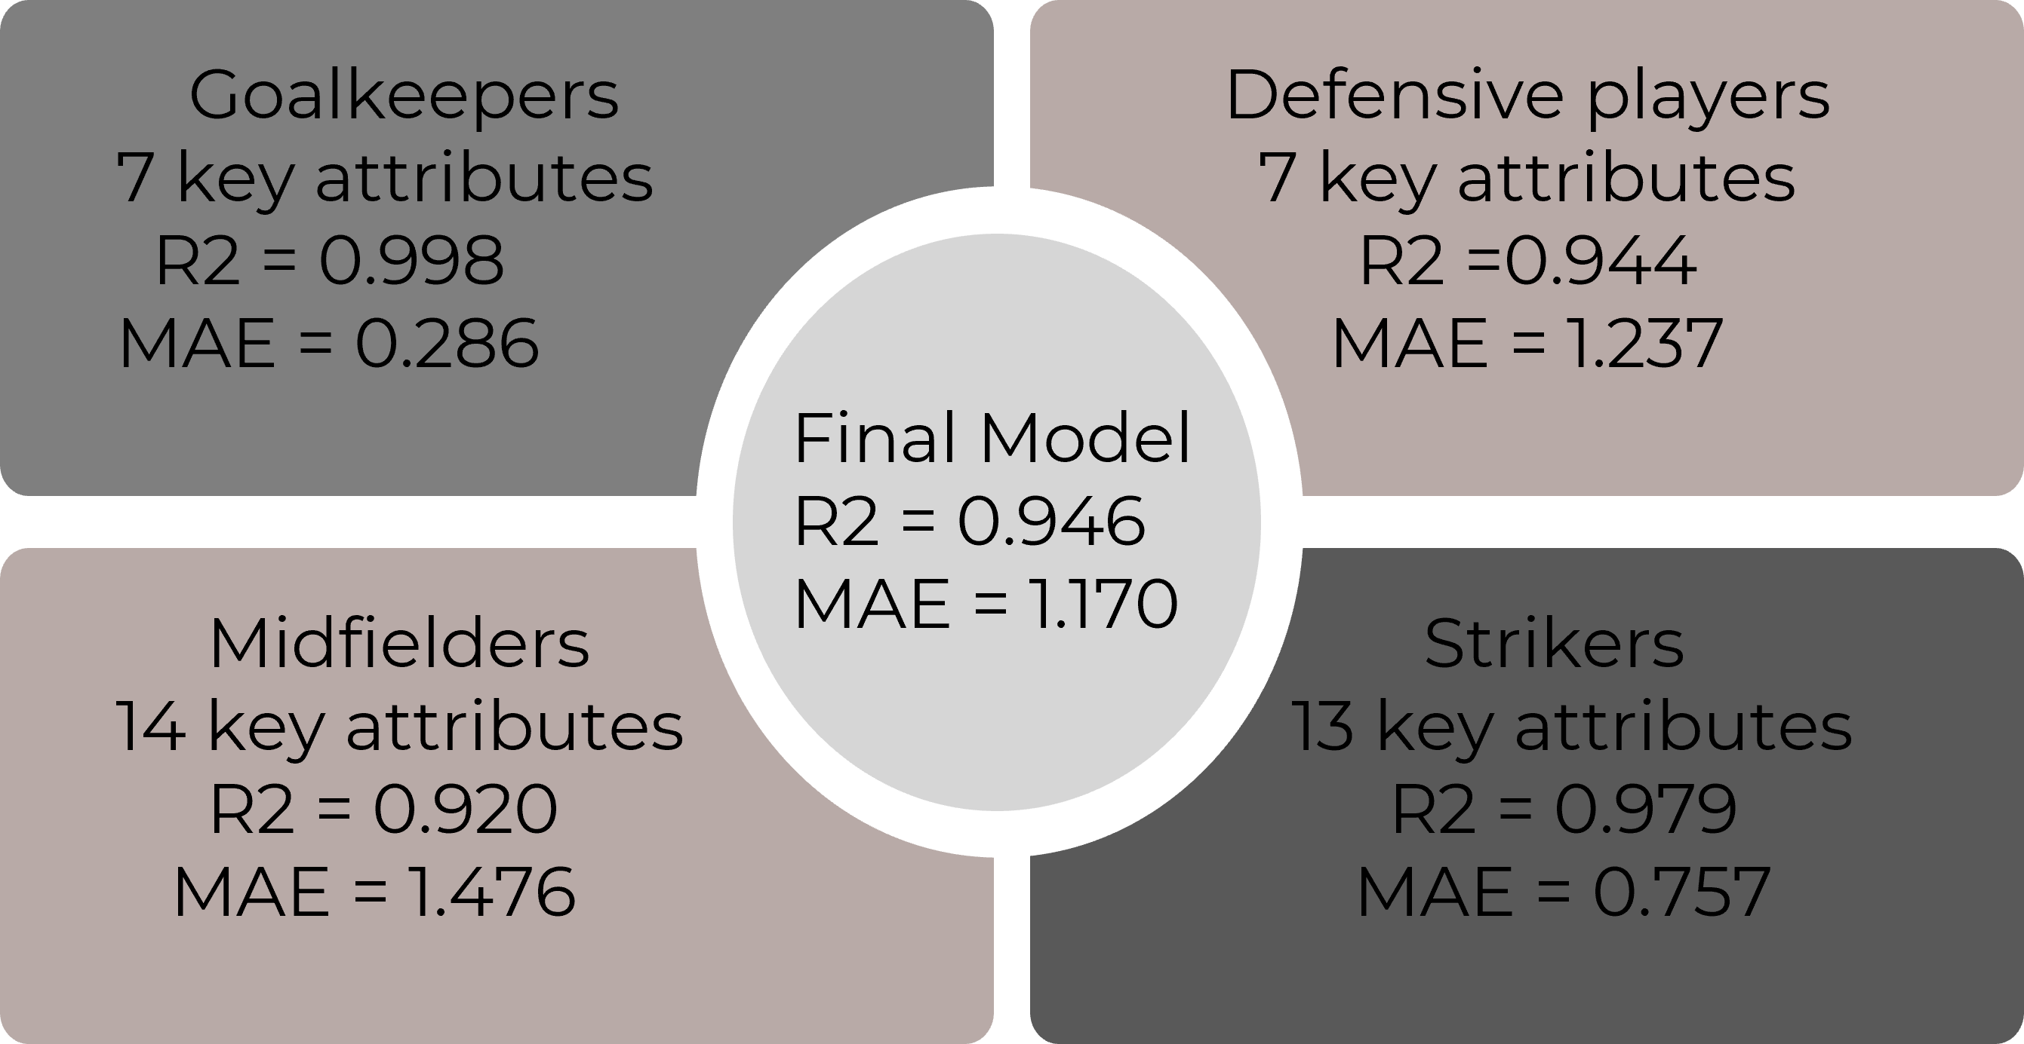
Analytical process

Slide 9
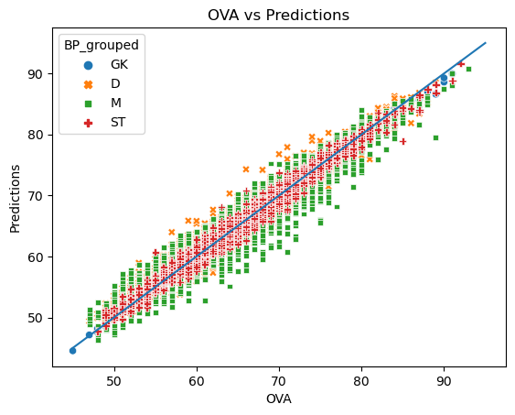
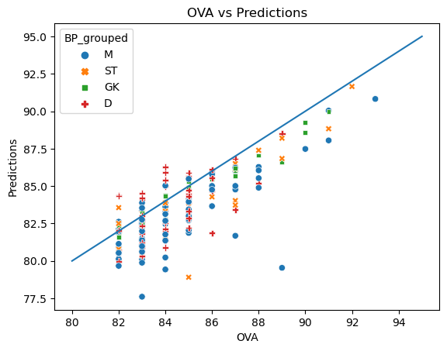
Visualizing predictions, by position
OVA vs Predictions
OVA vs Predictions
All players in dataset
TOP 200 best players

Slide 10
Finding the best solution
For each group summing the three individual predicted scores
01
02
03
Combining all possible groups of 3 palyers
Choosing the group with highest combined score

Slide 11
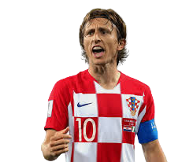
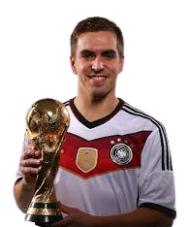
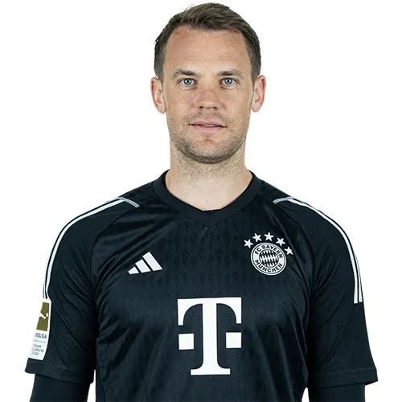
Total Investment €83M (+€1M Bonus for Scouting Team)
Luka Modric
Manuel Neuer
Philipp Lahm
€24.5M
Pred 88
€29M
Pred 89
€29.5M
Pred 90

Slide 12
Thanks!
Q&A

