Slide 1
NVIDIA Corporation
Financial Analysis Report
January 07, 2026

Slide 2
Executive Summary
Financial Health: N/A (Score: 0.0)
Risk Level: N/A

Slide 3
Financial Highlights

Slide 4
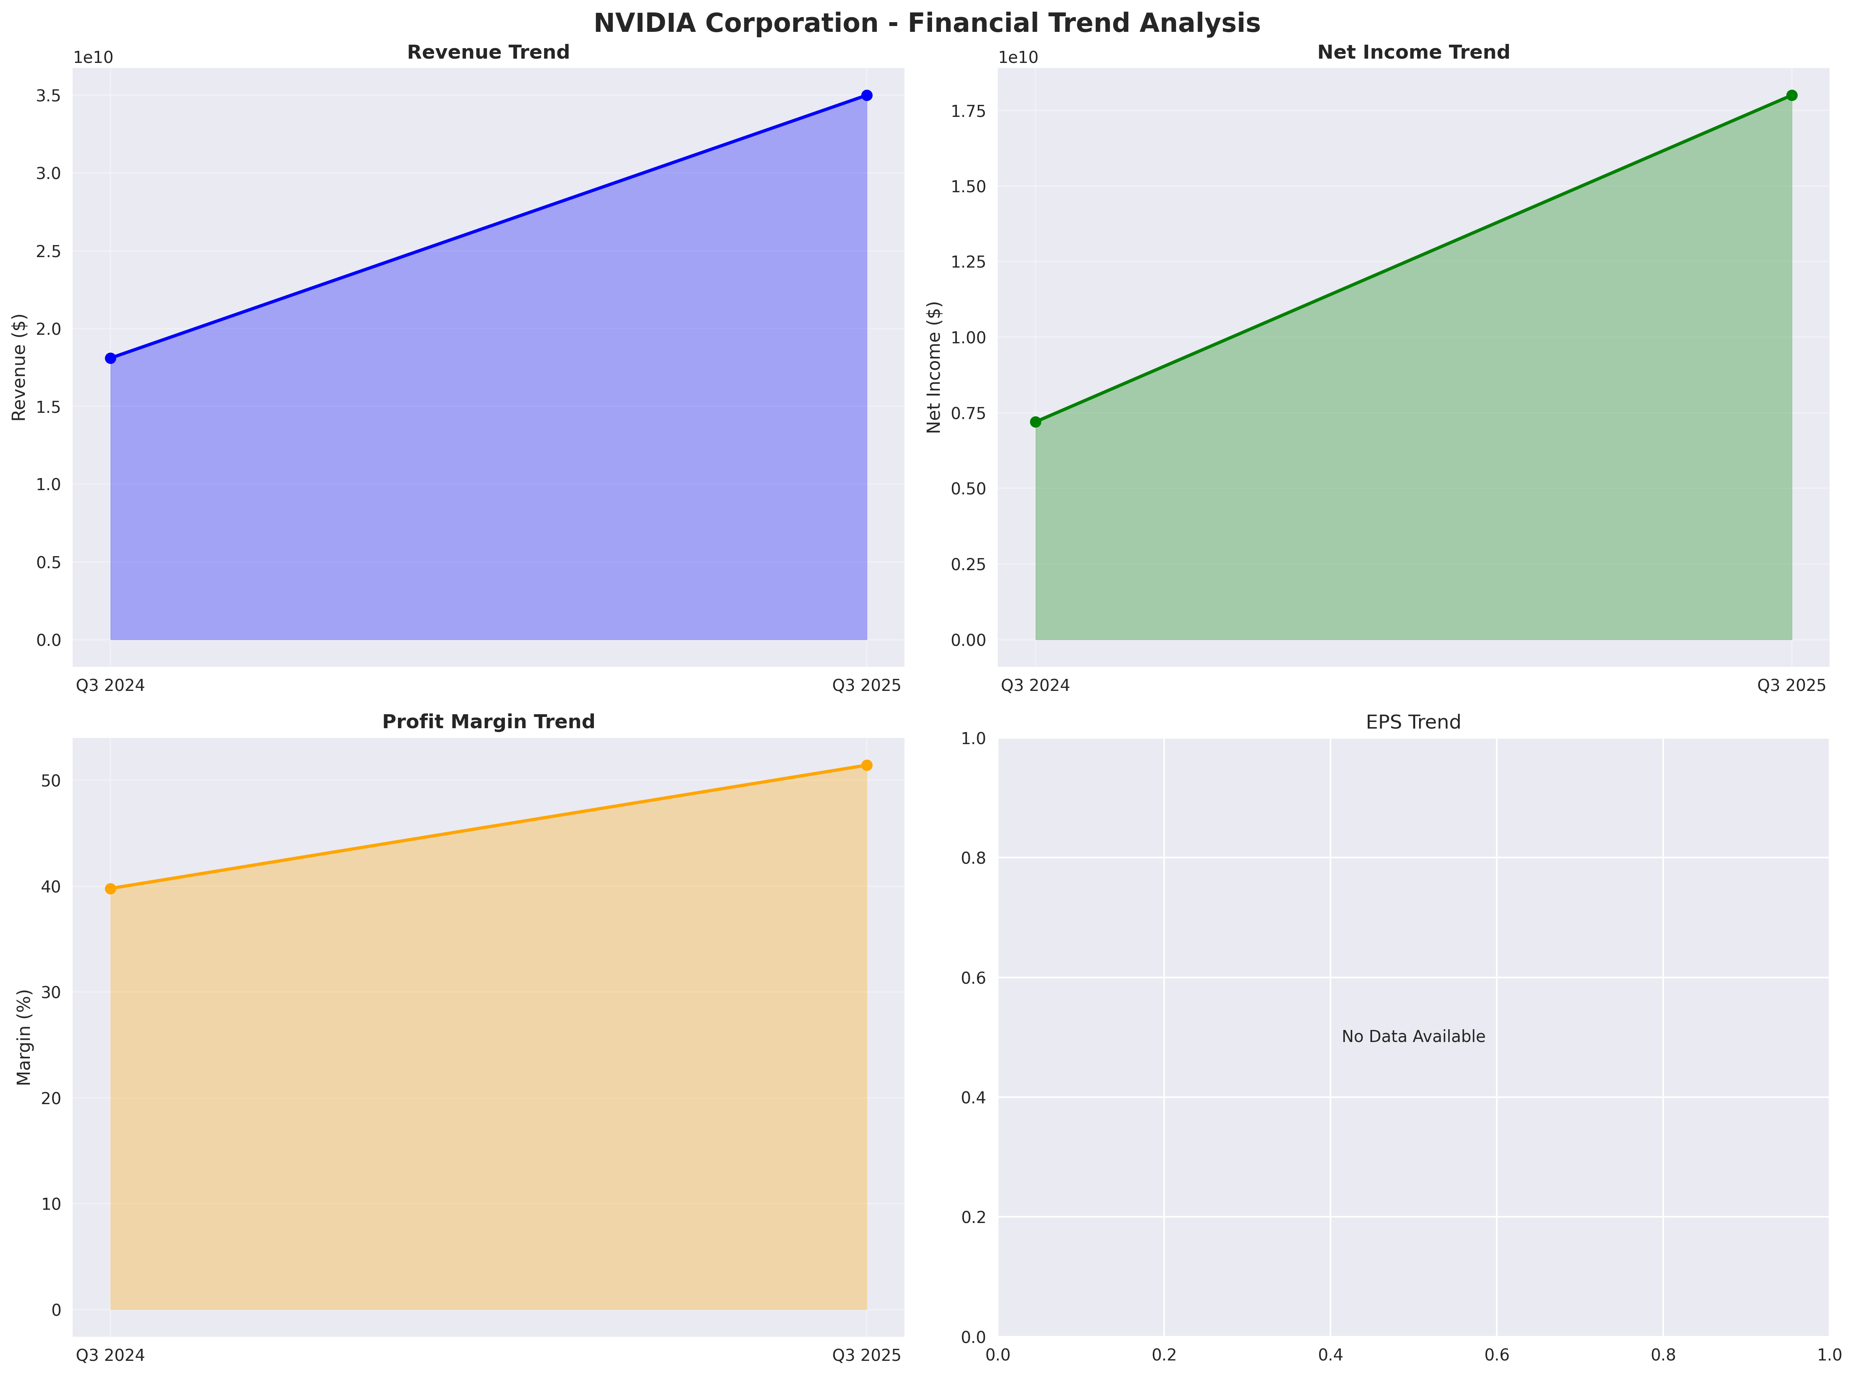
Trend Analysis

Slide 5
Risk Assessment
Overall Risk Level: N/A
Risk Score: N/A
Total Risks: N/A

Slide 6
Valuation Metrics

Slide 7
Investment Recommendations
SELL: Poor financial health with high risks

