Slide 1






FULLY FUNCTIONAL PROTOTYPE
Ana Rita Gonçalves – 86377
Francisco Santos Silva – 82516
Henrique Carvalho – 84724
Miguel Coelho – 84614
Pedro Rodrigues – 83548
Tomás Costa - 83570

Slide 2
CRITICAL TASKS
FIND MOST SUITABLE TRIP
PUBLISH TRIP
SEARCH TRIP
The user wants to publish a route he is going to provide as driver
The user wants to find a route that fulfills his needs as a passenger
The user wants to find the most suitable trip for him, considering driver rating, route taken, price and schedule

Slide 3
SECONDARY TASKS
EDIT PROFILE
GO TO THE CHAT
CHECK SCHEDULED TRIPS
The user wants to edit the profile with new informations
The user wants to go to the chat and read the last message received
The user wants to check the currently scheduled trips

Slide 4
RE-DESIGN
AUTO COMPLETE
COLORS
INTUITIVE SCROLL
Autocomplete system for addresses added
Colors well related with the choosen options
Scroll errors fixed to all options fit in the screen

Slide 5
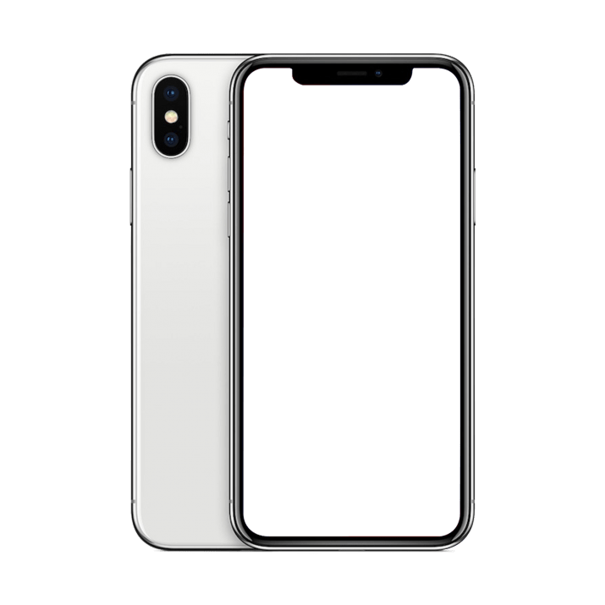
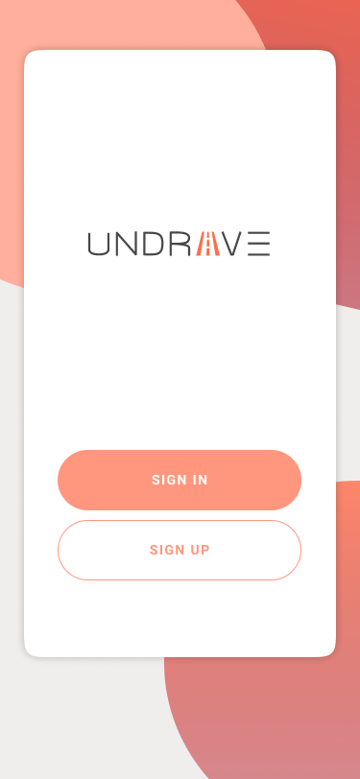
LIVE DEMO

Slide 6
Thanks!
Any Questions?

