Slide 1






PRIORITIZE
DEVELOPMENT
Ana Rita Gonçalves – 86377
Francisco Santos Silva – 82516
Henrique Carvalho – 84724
Miguel Coelho – 84614
Pedro Rodrigues – 83548
Tomás Costa - 83570

Slide 2


ETHNOGRAPHY
50% women
144
Survey Repondents
50% men

Slide 3
ETHNOGRAPHY
< 18
3
18 a 25
71
26 a 40
10
41 a 65
59
> 65
1
0
25
50
75
100

Slide 4


ETHNOGRAPHY
59 Students
70 Workers

Slide 5
MOBILITY
46%
30%
60%
Work/Study in different
county than residence
Take more than 30 minutes
to get to work/school
Use their car in daily commute

Slide 6
MAIN CLUSTERS
Working Survey Respondents that do not work in the same county of residence (by gender and age)
17
15
Female
10
8
Male
5
3
2
2
0
18 to 25
26 to 40
41 to 65

Slide 7
MAIN CLUSTERS
Student Survey Respondents that study in the same county of residence (by gender and age)
15
15
15
Female
10
Male
5
2
0
< 18
18 to 25

Slide 8
MAIN CLUSTERS
Importance of mobility factors in transportation for different age groups

Slide 9






BIO
Maria has been working as an English teacher for the last 20 years, and giving private classes after working hours in a study centre near her school. She lives in Loures with her husband and their two kids. At the moment she is teaching 7th to 9th grade at Escola D. Filipa de Lencastre, in Lisbon. Both of her children are attending the university, so they go together by car to the Nova SBE campus in Costa da Caparica daily. Since her husband works at a walking distance from their home, Maria takes their second car to work every day.
“
“I wish getting to work could be less stressful”
“
MOTIVATIONS
Price
Comfort
Security
Environment
Time
Reliability
PERSONALITY
GOALS
FRUSTRATIONS
Maria Ribeiro Azevedo
Outgoing
Strict
Caring
Protective
Spend more time with her family
Give her students the best education possible
Be less stressed during workdays
Time lost while stuck in traffic
Lack of parking spots near her workplace
Misbehaving students
50 years, Loures
English teacher
^{STATUS}
^{Married}
^{VEHICLES OWNED}
^{2 cars}
^{SALARY}
1600 € (classes) + 600€ (private classes)
^{LIVES WITH}
Her husband, their son (19) and their daughter(22)

Slide 10
SCENARIOS
Maria wakes up around 6:30 AM every day in order to get to work at 8 AM. She lives in Loures and after taking a shower and having breakfast with her husband she gets to her car and drives do Escola D. Filipa de Lencastre, in Lisbon. She leaves the house around 7:20 AM due to the traffic at that time in the morning. She always takes the car because it’s faster.

Slide 11
SCENARIOS
At 5:30 PM, after finishing giving classes at Escola D. Filipa de Lencastre, Maria walks to a study center where she gives English private classes. These private classes usually take place from 6 to 8 PM and after finishing the private classes Maria drives back home to have dinner with her family.

Slide 12
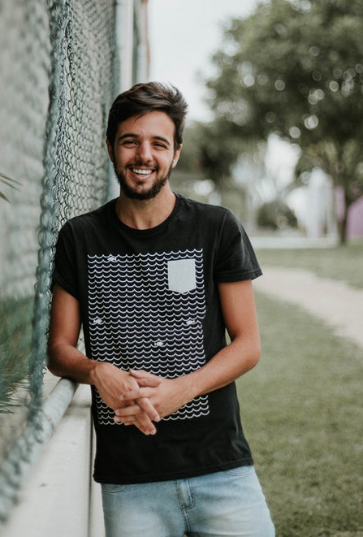
BIO
Rodrigo is an university student at Instituto Superior Técnico, but all of his lectures take place in the Tagus Park campus. Since Rodrigo is actually from Viseu, he is currently living with his uncles for the semester. His only income consists of the allowance that his parents give him, so saving money is really important to him. To attend lectures he has to take the train to get to the bus stop in Paço de Arcos where he can catch the bus to Taguspark.
“
I hope I don’t miss the bus
“
MOTIVATIONS
Price
Comfort
Security
Environment
Time
Reliability
PERSONALITY
GOALS
FRUSTRATIONS
Rodrigo Almeida Castro
Shy
Smart
Ambitious
Self-Critical
Get his degree
Make new friends
Have time to unwind every now and then
Not getting enough sleep
The train and/or bus being full during rush-hour
A possible train delay could make him miss the bus
19 years, Algés
University Student
^{STATUS}
^{Single}
^{VEHICLES OWNED}
^{None}
^{SALARY}
^{None}
^{LIVES WITH}
^{His aunt and uncle}

Slide 13
SCENARIOS
On Mondays and Thursdays, Rodrigo has lectures starting at 8 AM in Taguspark so he must wake up at 6:50 AM to leave the house at 7:20 AM and to be able to take the train at 7:25 AM in order to get to the bus station in time. In that day, the train workers are on a strike, which means that Rodrigo had to wake up earlier to try to get to Paço de Arcos. He only managed to get on the train at 7:55 AM, which means that, after a 19 minute bus ride, by the time he got to Taguspark he had already missed half of the first lecture.

Slide 14
SCENARIOS
On Tuesdays Rodrigo has lectures until 7 PM in Taguspark. In order to not get stuck in traffic for more than 1 hour, Rodrigo chooses to stay in Taguspark studying. He usually has dinner in campus and then studies until 11 PM. After finishing the study session, Rodrigo takes the bus at 11:15 PM to Paço de Arcos and the ride takes 14 minutes because there’s no traffic at all. Then he gets the train back to home so he can arrive before 12 AM.

Slide 15
How comfortable are people with sharing a car with new people
What is important when considering using a carpooling service
1
2
3
4
5
What is important when using a service provider mobile application
Which means to contribute to application developers do people find appropriate
Comissions
Premium
Paid App
Donations
Ads
Sponsorships
0
25
50
75
100

Slide 16
Prioritize Development
HIGH
Rating System
Single-trip service feature
User chat feature
Simple User Interface
MAYBE
YES
Route flexibility
Secure Payment
Finding partners for app related discounts
USER
VALUE
Implement comfort related features
Map Integration
NO
Implement car type related features
MAYBE
User matching personalization
Application Ads
LOW
HIGH
DEVELOPMENT EFFORT
LOW

Slide 17
Thanks!
Any Questions?

