Slide 1

Continuous SSL
1) Infinite data sources

Slide 2
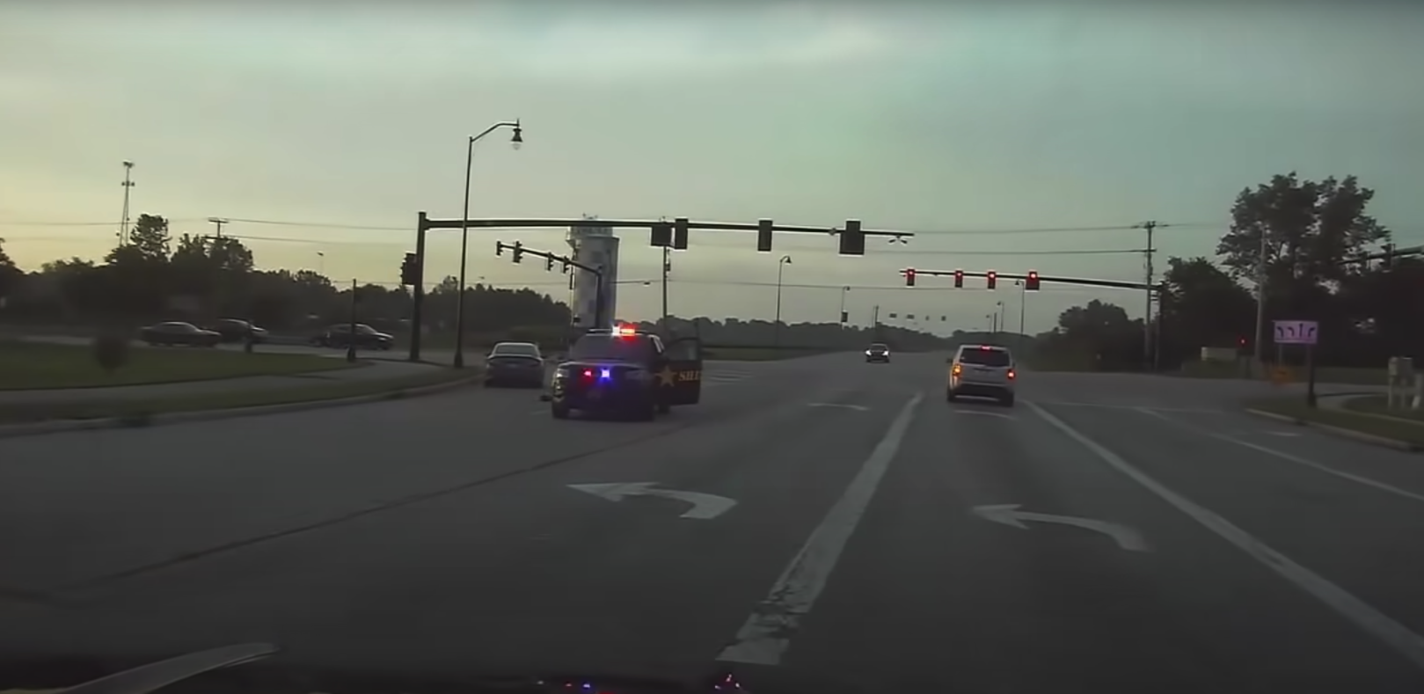
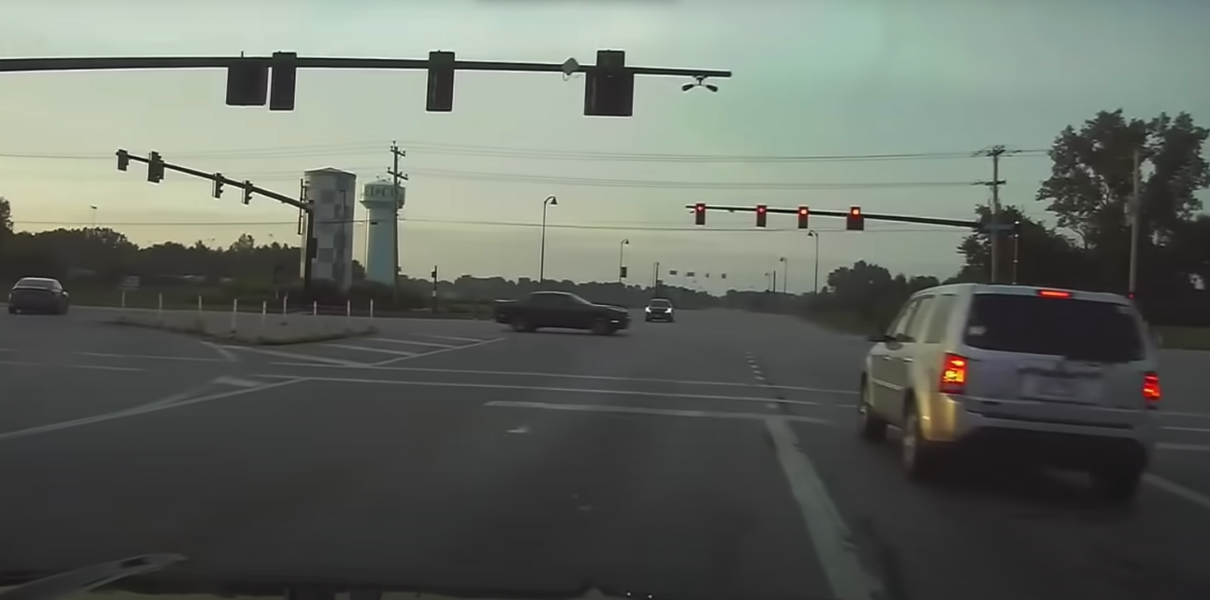
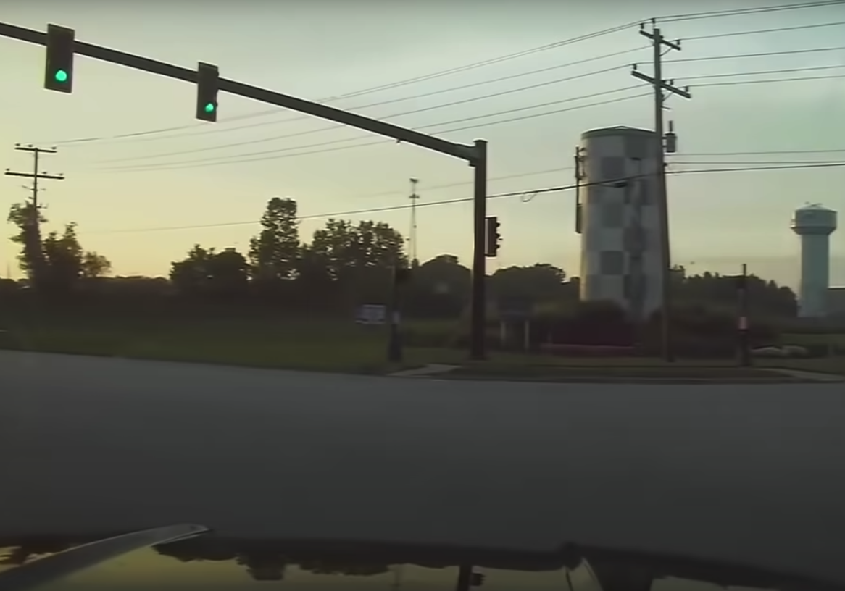
Continuous SSL
2) Correlated non-IID data

Slide 3




Continuous SSL
2) Non-stationary semantics

