Slide 1

Robot Quadruped
Keith Combs, Yash gujarati, Pedro urbina
ROBO 380: Mechatronics
Spring 2019

Slide 2
Goal
To write a program that will:
Output instructions to move each of 12 servo motors to the correct angle and in the appropriate sequence to make the robot walk
Receive input from a remote control to determine which direction the robot will move

Slide 3
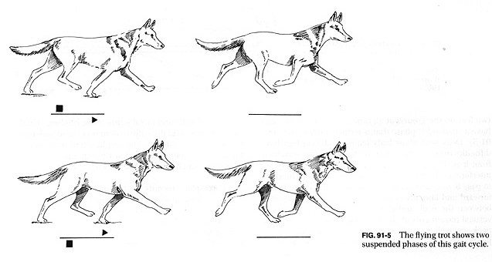
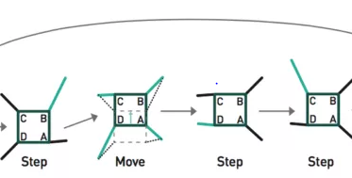
Gait Options
Trot gait
Two diagonally opposite legs are raised and moved forward at a time
Stability maintained by keeping center of mass close to the center of the body
Produces less stable and less efficient, but faster gait
Creep gait (selected)
Only one leg is raised and moved forward at a time, while the other legs move backward to move the body forward
Stability maintained by keeping center of mass within triangle formed by three grounded legs
Produces a slower but secure gait
http://cal.vet.upenn.edu/projects/saortho/chapter_91/91f5.jpg

Slide 4
Servo Position Control Methods
Inverse Kinematics
Uses mathematical relations to determine servo angles to reach desired position of body and leg tips
Allows greater flexibility and smoother movements, but requires complex algorithms
Trial and error (selected)
Servo angles are estimated and tweaked until desired movement is achieved
Easier to program, but requires a new set of instructions for each type of movement

Slide 5
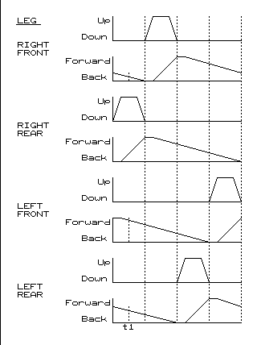
Creep Gait Timing Diagram
Creep gait works with 4-beat timing
Source: oscarliang.com

Slide 6
Code Overview
Main loop determines which direction the robot should move and calls the appropriate movement function (e.g. forward, backward)
Movement function defines the sequence of leg movement and calls appropriate servo function while passing arguments for the desired servo angles
Programmer can simply tweak the servo angle arguments until the robot walks properly

Slide 7

Challenges
Each type of movement required a separate function to define the sequence of leg movement
Defining a new sequence and calibrating servo angles was time consuming and limited the number of movement types that could be programmed by the project deadline

Slide 8
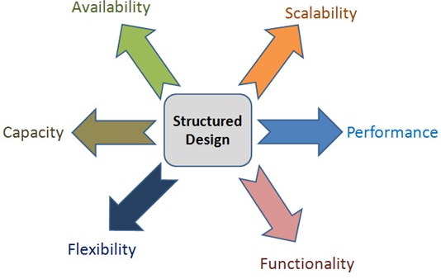
Design Consideration
The mechanical structure of robot body
leg architecture
max sizes
actuators and drive mechanisms
Cost

Slide 9
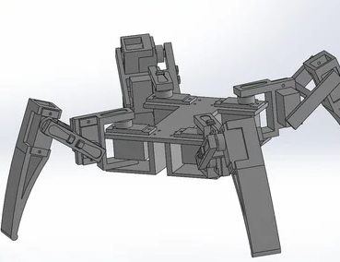
The mechanical structure
Walking Robots with multiple legs can be designed in many ways. The design for our project is the most simplest kind.
Each legs are placed 90 degrees apart. This provides maximum distant apart from the other.
Placing each leg farther apart makes the design easier to work with.
However, this is a trade-off solution between simpler design and compact design.
Solidworks

Slide 10
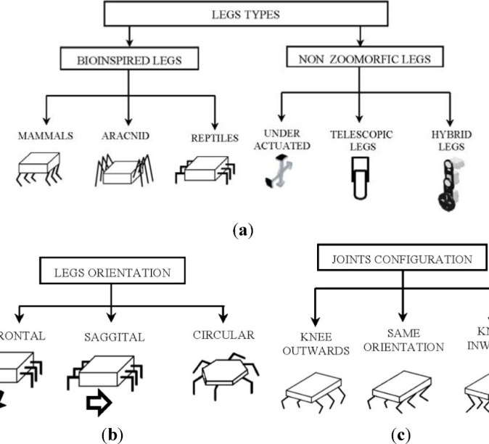
Leg architecture
The circular leg orientation allows the robot to move in any desired direction.
Each leg uses 3 servos to mimic human legs.
Hip, knee and ankle joints.
Our design relies on the mechanical properties of the 3d printed parts and Basswood.
https://res.mdpi.com/robotics/robotics-03-00181/article_deploy/html/images/robotics-03-00181-g005.png

Slide 11
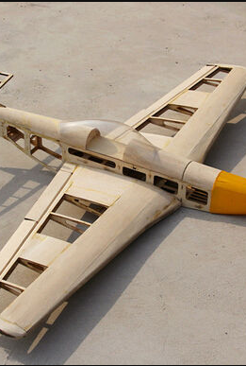
Robot body material
Basswood and 3D printed parts were used for our project.
The base body needed to be light, yet strong. Our research led us to the design of model airplanes.
Model airplanes use light weight Balsa wood, however, without proper structural design, balsa wood itself is week. On the other hand basswood is stronger, but weights 15% more than Balsa wood.
15% increase in weight wasn’t a big concern.

Slide 12
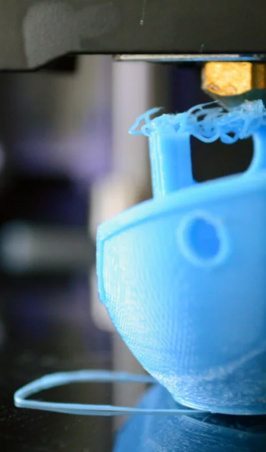
3D printed parts
More strength than Basswood (At least in our case).
Easy to design in CAD softwares.
Downside: Printing parts can take long time, if the printed parts don’t fit correctly, the design has to be changed again and re printed wasting material.
Hard time having access to 3D printer

Slide 13
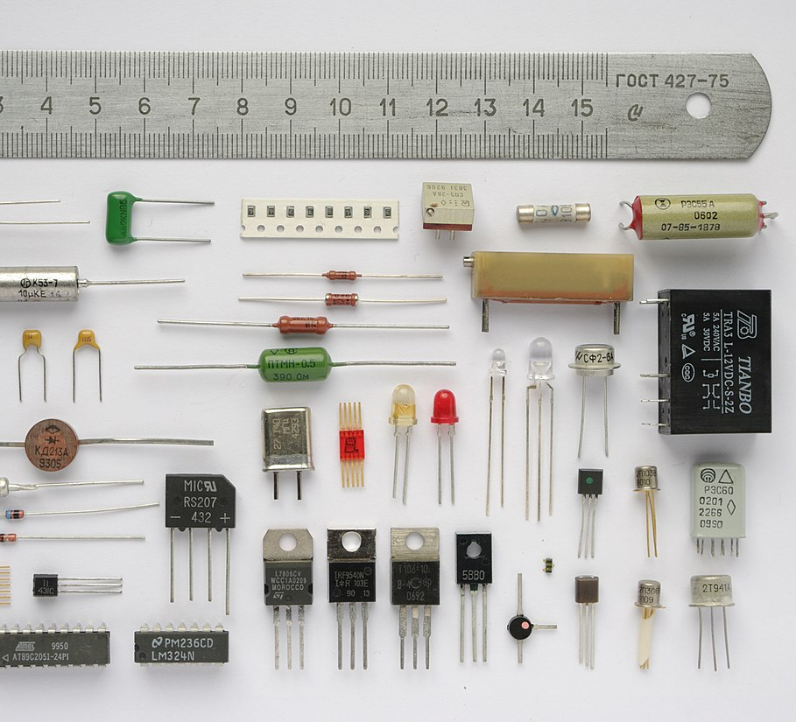
Electronics
Requirements
Design considerations
Availability
This Photo by Unknown Author is licensed under CC BY-SA

Slide 14
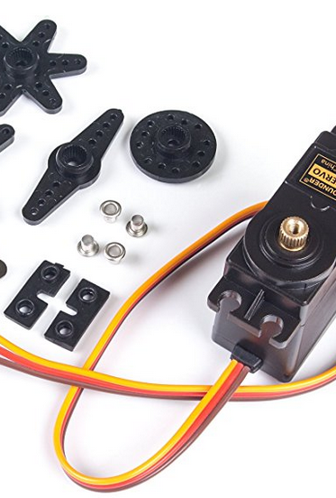
Servos specs:
SunFounder Metal Gear Digital RC Servo Motor High Torque
Overall weight: 55g
Limit angle: 240 degrees
300mm wire length (Our requirement)
Operating voltage 4.8V-6.0V

Slide 15

How to operate 12 servos at the same time?
Driving 12+ servos with an Arduino is easy, however, this can consume our precious pins, not to mention processing power.
Our options:
Pololu Mini Maestro 12-Channel USB Servo Controller
Fully assembled 12-channel drive for a quadruped robot
This can make our life easy, very very easy. Comes preprogramed to control a quadruped using a IR sensor.
Though this would be cheating.
Our next option( eventually our choice)…
This Photo by Unknown Author is licensed under CC BY-SA-NC

Slide 16
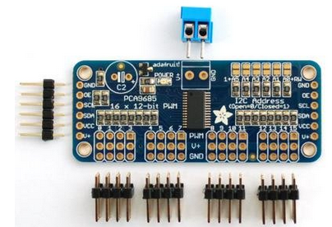
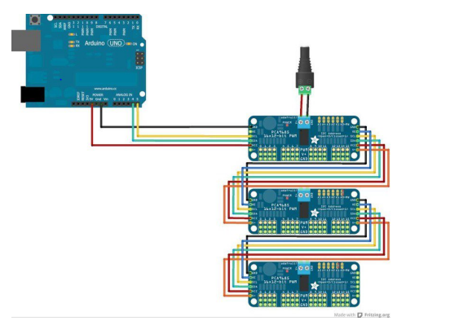
Servo Control Module
Adafruit 16-Channel 12-bit PWM Servo Driver with I2C Interface
Each board can operate up to 16 servos. What more, this board uses I2c interface, meaning multiple boards can be bused together to operate more than 16 servos.
This allows to use up to 992 servos using a single Arduino (For future upgrades). Thought this would require expert level coding, power, time and testing.
Adafruit also provides with example codes to teach getting around using the board.

Slide 17




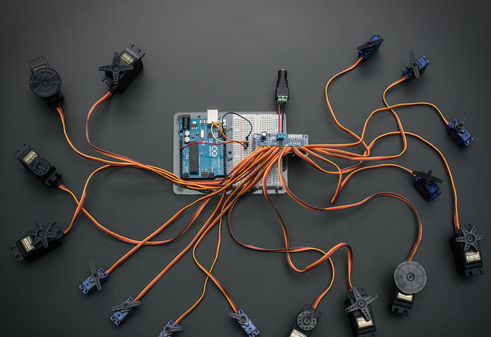

Cost analysis
This Photo by Unknown Author is licensed under CC BY-NC-ND
Parts List | Cost
12 Servos | $156
Servo Drive | $12
Arduino Uno | $27
Balsa Wood | $12
Effort | Price less
Total | $207
This Photo by Unknown Author is licensed under CC BY-SA-NC
This Photo by Unknown Author is licensed under CC BY-SA

Slide 18
Final Verdict and our learning outcome
To complete the project up to phase we brought it to, required us to use our knowledge and experienced not only learned in class but also from out of the class.
The project made us think and required good amount of effort
There were couple of challenges to physically create our project and to make it happen.
The major being to calculating the inverse kinematics for the robotic legs.
Our online research pointed us to PhD students work in inverse kinematics. Right at that point we realized how difficult this is going to be.
Yet we never looked back or change our project.

Slide 19

This Photo by Unknown Author is licensed under CC BY-NC-ND

