Slide 1
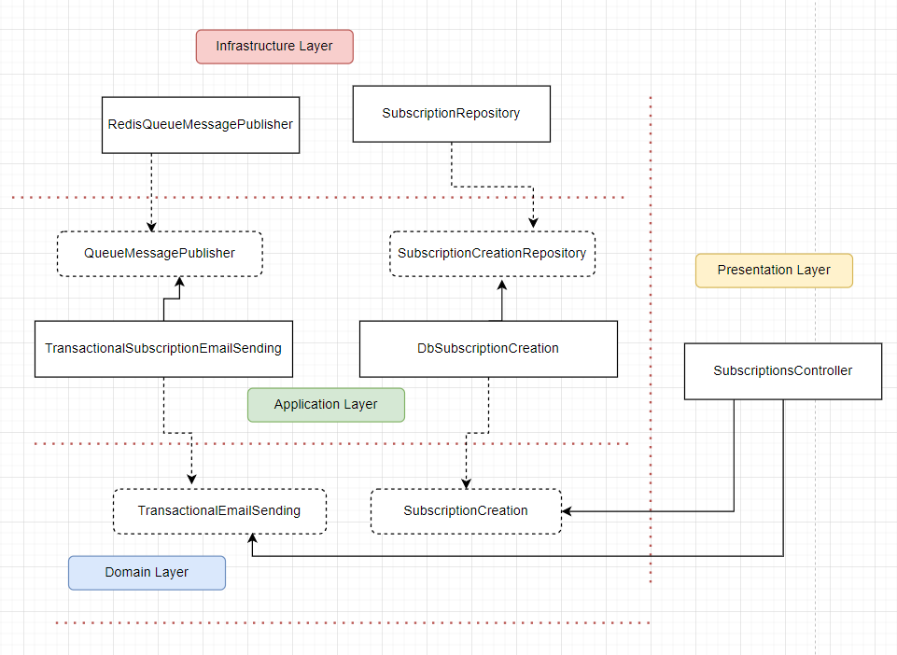
Architecture overview

Slide 2




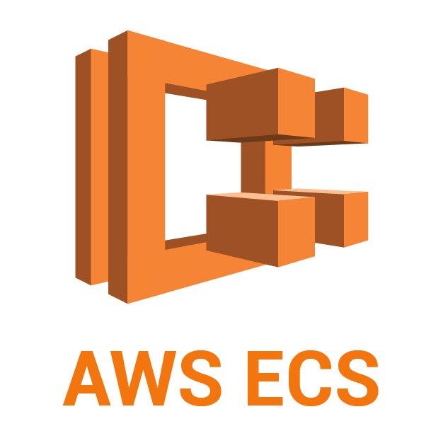
CI/CD Pipeline Proposal
Release a new version of the application on GitHub
Create Workflow that will be automatically triggered when a new version is released
Test and Build
Build Docker image
Push image to Docker Hub
Deploy to AWS ECS

