Slide 1



100% on the edge
GB10 Grace Blackwell
A private, on-device civic concierge →
Codeborough
Your voice-first guide to London's civic services, fully on-device.
BUILT WITH
NVIDIA Nemotron
ElevenLabs
OpenClaw
TEAM
EVENT
TRACK
BOUNTIES
Codeborough
NVIDIA Hack for Impact, London
Public Services
Nemotron · ElevenLabs
Notes:
Hi, we're Team Codeborough. Over the hackathon we built a private, on-device, voice-first civic concierge for London. You speak a question out loud, and it finds the right civic service near you, gets you there safely, and remembers your situation the whole way through. Everything but the voice runs on the box. It's built for NVIDIA Hack for Impact, on the Public Services track, and we're going for the Nemotron and ElevenLabs persistence bounties.

Slide 2
02
the gap we keep ignoring
Commercial maps skip the civic layer your council publishes
NOT A CAFÉ FINDER
THE CIVIC LAYER IS MISSING
SCATTERED ACROSS 33 PORTALS
Google and Apple already do shops, restaurants and big places well, libraries included. This was never about finding a café.
Where you vote, winter grit bins, emergency rest centres, council safety cameras, the access detail on a toilet. Councils publish it; commercial maps don't ingest it.
It's open data, but spread across 33 separate council portals and impossible to query in plain language.
THE EQUITY GAP
Hardest for the people who most need it: new arrivals, the elderly, the visually impaired, and the privacy-conscious.
the layer maps forget
codeborough
02 / 12
Notes:
Here's the gap. This isn't about finding a cafe. Google and Apple already do shops, restaurants and big places well, libraries included. What they don't ingest is the civic layer councils publish: where you vote, winter grit bins, emergency rest centres, council safety cameras, the access detail on a public toilet. It's open data, but it's scattered across 33 separate council portals and you can't query it in plain language. And that lands hardest on exactly the people who need it most: new arrivals, the elderly, the visually impaired, and the privacy-conscious.

Slide 3
03
what we built
A voice concierge that runs on the edge
Built on OpenClaw, grounded in real City of London open data, running entirely on an NVIDIA DGX Spark / ZGX Nano (GB10) .
VOICE
BRAIN
GROUNDING
MEMORY
ElevenLabs
Nemotron 3
civic-geo
One session
Speak naturally and hear a spoken answer back. Scribe STT in, Eleven v3 TTS out.
Reasons over your question and decides which civic tools to call.
Our plugin queries local London data. No guessing, no invented places.
A single long conversation that recalls your situation across earlier turns.
four parts, one box →
codeborough
03 / 12
Notes:
So here's our pitch in one breath: a voice agent we build on OpenClaw, grounded in real London open data, running entirely on an NVIDIA DGX Spark. Four pieces. Voice through ElevenLabs, the brain is Nemotron, grounding is our own civic-geo plugin over local data, and memory is one long session that actually recalls your earlier turns.

Slide 4
04
what it does
Three things it does
1
FIND WHAT MAPS MISS
2
GET ME THERE SAFELY
3
TELL ME ABOUT IT
The civic thing commercial maps skip
Routes over monitored, well-served streets
Hours, access, and what's there
Opening hours, step-free access and what a place actually offers, answered out loud, on the spot.
The nearest polling station, rest centre, library or accessible public toilet, and a route to it. Honest note: the nearest facility, not your assigned catchment yet.
Prefers busy roads with CCTV and grit bins. Honest note: this CCTV is mostly traffic / town cameras, busy roads, not crime surveillance.
codeborough
04 / 12
Notes:
It does three things. One, find the civic thing maps miss: the nearest polling station, rest centre, library or accessible public toilet, and a route to it. We're honest here, it's the nearest facility, not your assigned catchment yet, that's a postcode-lookup next step. Two, get me there safely: it prefers monitored, busy, well-served streets. That CCTV is mostly traffic and town cameras, so it's really a proxy for busy roads, not crime surveillance. Three, tell me about it: hours, step-free access, what's actually there.

Slide 5
05
why it runs on the box
Everything but the voice stays on the device
PRIVACY
RICHER ANSWERS
ANYWHERE
Your location never leaves
Detail a map app can't reach
Self-contained, no cloud needed
Queries and location stay on the device. Nothing about you goes to the cloud but the voice audio itself.
Local civic datasets surface accessibility, hours and coverage that generic map tools simply don't hold.
Brain, data and memory are all local, so it runs in a community centre or a kiosk with no connection.
The trust angle: for vulnerable users, "your data never leaves this box" is not a feature. It's the precondition for asking the question at all.
trust first
codeborough
05 / 12
Notes:
Why on-device? Three reasons. Privacy: your location and queries stay on the box. Richer answers: local civic data surfaces detail a map app simply doesn't hold. And anywhere: it's self-contained, no cloud dependency, it'll run in a community centre with no connection. For vulnerable users, that privacy isn't a nice-to-have, it's the precondition for them asking at all.

Slide 6
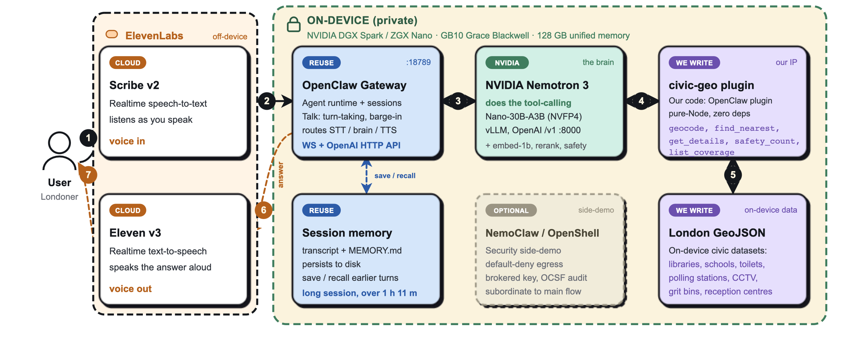
06
how it fits together
One device, one flow: voice in, grounded answer out
Reuse: OpenClaw
Nemotron: NVIDIA
We write: civic-geo + data
ElevenLabs: cloud voice
On-device boundary
1 speak 2 OpenClaw 3 Nemotron reasons 4 civic-geo call 5 GeoJSON lookup 6 answer back to Eleven v3 7 spoken back. Only the voice in/out leaves the device.
06 / 12
Notes:
This is the whole system on one device. You speak, ElevenLabs Scribe turns it to text, OpenClaw routes it to Nemotron, Nemotron reasons and calls our civic-geo plugin, which queries local London GeoJSON. The grounded answer comes back through OpenClaw to Eleven v3 and you hear it. Session memory saves and recalls every turn on the side. The dashed boundary is the device, and only the voice in and out ever leaves it.

Slide 7
07
honest engineering
We reused a platform and built one sharp thing
Reuse
OPENCLAW
We write
CIVIC-GEO
A proven agent platform, not reinvented
One OpenClaw plugin: pure-Node, zero deps
Gateway, sessions and persistent memory
geocode() find_nearest() get_details() safety_count() list_coverage()
Talk voice mode: turn-taking, barge-in
Plugin SDK for tool-calling
Smart scoping = a de-risked one-day build. We put our hours where the original value is, grounding the agent in real civic data, and stood on a platform for everything else.
built in a day
codeborough
07 / 12
Notes:
Honest engineering slide. We didn't reinvent an agent platform. We reuse OpenClaw for the gateway, sessions, memory, the Talk voice mode and the plugin SDK. Our original IP is one sharp thing: the civic-geo plugin, pure-Node, zero dependencies, five tools. geocode, find_nearest, get_details, safety_count, list_coverage. Scoping it that tightly is exactly what let us ship in a day.

Slide 8
08
real data, on the device
Real London open data, stored locally
DATASET
POINTS
BOROUGHS
Schools
1,000
4
COVERAGE
~8 of 33 London authorities
CCTV cameras
549
2
Partial by design: the demo focuses on Lambeth , the one borough with CCTV and every destination type.
Polling stations
464
7
Grit bins
376
4
PROVENANCE
Public toilets
216
5
Sources & licences documented
Reception centres
47
2
Every dataset traces to a published open-data source. Real, not mocked.
Libraries
42
4
codeborough
08 / 12
Notes:
And the data is real. Seven civic datasets stored locally as GeoJSON. A thousand schools, hundreds of CCTV points, polling stations, grit bins, toilets, reception centres, libraries. About 8 of London's 33 authorities, partial by design. The demo focuses on Lambeth because it's the one borough with CCTV and every destination type. Every source and licence is documented. This is real open data, not mocked.

Slide 9
09
best use of nemotron
A full Nemotron lineup on one box
Plus a supporting cast, all on-device:
THE BRAIN
embed-1b
RETRIEVAL
Nemotron-3-Nano-30B-A3B
Embeds civic data for grounded RAG lookups.
NVFP4, tool-calling, served locally via vLLM on an OpenAI-compatible /v1 endpoint.
rerank-1b
PRECISION
Reranks candidates so the right place wins.
~31 GB of 128 GB used
content-safety-4b
GUARD
Screens inputs and outputs as a safety guard.
Breadth is the point. Four Nemotron models cooperating on a single GB10 (reasoning, retrieval, reranking and safety) is our case for the Nemotron bounty.
codeborough
09 / 12
Notes:
On Nemotron, we're not running one model, we're running a whole lineup on a single GB10, about 31 gigs of the 128. The brain is Nemotron-3-Nano-30B in NVFP4, tool-calling, served through vLLM on an OpenAI-compatible endpoint. Plus embed-1b and rerank-1b for retrieval, and a content-safety guard. That breadth, four Nemotron models cooperating on one box, is our case for the bounty.

Slide 10
10
the persistence bounty
It remembers what you asked 40 minutes ago
SINGLE SESSION LENGTH
VOICE IN / OUT
1h 11m
Scribe v2 STT · Eleven v3 TTS
Talk mode with natural turn-taking and barge-in. Interrupt it and it listens.
PERSISTENCE
The "what did I ask earlier?" moment just works
One long-lived session, persisted to disk, recalling earlier turns across the whole conversation.
The session recalls your situation across ≥ 1 h 11 m. No re-stating, no re-uploading. Our case for the persistence bounty.
codeborough
10 / 12
Notes:
On ElevenLabs, voice in and out is Scribe v2 and Eleven v3 in Talk mode, with barge-in, so you can interrupt it. And the persistence piece: one long-lived session, persisted to disk, that recalls earlier turns across more than an hour and eleven minutes. The 'what did I ask forty minutes ago' moment just works. That's our persistence-bounty claim.

Slide 11
11
the three-minute demo
One family, one conversation, start to finish
1
THE FAMILY LEAD
"We just moved to Brixton. Where's the nearest primary school, and a safe walk there?"
→ Finds the nearest school, plots a safe route over monitored streets, reports the camera count, and flags an accessible toilet en route.
2
ELDERLY & VOTING · ~30S
"Where's my nearest polling station, and can I get there step-free?"
→ Returns the nearest polling station with a step-free route. A second persona, same agent.
3
THE BOUNTY MOMENT · ~40 MIN LATER
"Remind me which school, and when we should leave?"
→ Recalls the school and timing from earlier in the session, no re-asking. Persistence, live.
private access for the people who struggle most
11 / 12
Notes:
Let me show you. One family, one conversation. They've moved to Brixton, and they ask for the nearest primary school and a safe walk there. It finds the nearest school, plots a safe route over monitored streets, counts the cameras, flags an accessible toilet on the way. Then a quick second persona, an elderly voter asking for their nearest step-free polling station. And then the payoff, forty minutes into the same session: remind me which school and when to leave. And it just recalls it. Private, equitable access for the people who struggle most.

Slide 12
12
so what?
Equitable, private access to civic services, that runs anywhere.
EQUITY
PRIVACY
WHAT'S NEXT
Built for the people maps leave behind
Location and queries never leave the box
Assigned-catchment lookups, more boroughs, kiosks
TEAM
THE ONE-LINER
Codeborough
A private, on-device, voice-first civic concierge for London.
thank you!
Notes:
So, so what? It's equity: built for the people maps leave behind. It's privacy: your data never leaves the device. And it runs anywhere, brain, data and memory all local. Next is more boroughs, more datasets, and kiosk deployments out in the community. That's Codeborough, a private, on-device, voice-first civic concierge for London. Thank you.

