Slide 1

WIPE-OUT 2 · WORKSHOP ON MACHINE UNLEARNING AND PRIVACY PRESERVATION
SUPREME: A Multi-GPU Framework for Reproducible Image Unlearning Method Evaluation
Petros Andreou¹ · Jamie Lanyon¹ · Axel Finke¹ ² · Georgina Cosma¹
¹ Loughborough University, UK ² Newcastle University, UK
ECML PKDD 2026 · Naples, Italy · 7 September 2026
Paper ID: 125

Slide 2
Existing frameworks, and what was missing
Three stages: train, unlearn, evaluate against the retrained model.
Every stage is random, so each has a seed; one seed can mislead [1, 2].
Framework | Domain | Multi-seed | Multi-GPU | Multi-precision
OpenUnlearning [5] | LLMs
MUBox [4] | Image classification
ERASURE [3] | Image classification
Deep Unlearn [1] | Image classification
SUPREME (ours) | Image classification
✗
✓
✓
✗
✗
✗
✓
✗
✗
✓
✗
✗
✓
✓
✓
[1] Cadet et al.: Deep Unlearn: benchmarking machine unlearning for image classification. EuroS&P (2025)
[2] Lanyon, Finke, Andreou, Cosma: On the importance of multiple training seeds for evaluating machine unlearning. WIPE-OUT 2026, this workshop
[3] D’Angelo et al.: How to make reproducible research in machine unlearning with ERASURE. IJCAI (2025)
[4] Li et al.: MUBox: a critical evaluation framework of deep machine unlearning. SACMAT (2025)
[5] Dorna et al.: OpenUnlearning: accelerating LLM unlearning via unified benchmarking of methods and metrics. NeurIPS D&B (2025)
2

Slide 3
SUPREME framework
For each training seed s_{t}
For each forget target c
Stage 1: Training
For each unlearning seed s_{u}
For each unlearning method a
D
Stage 2: Unlearning
For each evaluation seed s_{e}
D
Stage 3: Evaluation
DataLoader
D
D′
split D into D_{f} and D_{r}
(targeted or random-sample scenario)
split D′ into D′_{f} and D′_{r}
(matching the forget target)
Device 1
DataLoader
Weights
Optimiser
Gradients
DataLoader
• • •
Device 1
Device 1
Device P
Weights
Optimiser
Gradients
M_{u}
M_{r}
Weights
Optimiser
Gradients
• • •
• • •
Device P
Device P
▽
▽
Weights
Optimiser
Gradients
M_{u}
M_{r}
Gradient synchronisation
▽
▽
▽
▽
Gradient synchronisation
All-gather
M_{o} ← Train(D, s_{t})
M_{u} ← a(M_{o}, D_{f}, D_{r}, s_{u})
R ← Evaluate(M_{u}, M_{r}, D′, E, s_{e})
M_{r} ← Train(D_{r}, s_{u})
3

Slide 4
SUPREME framework
For each training seed s_{t}
For each forget target c
Stage 1: Training
For each unlearning seed s_{u}
For each unlearning method a
D
Stage 2: Unlearning
For each evaluation seed s_{e}
D
Stage 3: Evaluation
DataLoader
D
D′
split D into D_{f} and D_{r}
(targeted or random-sample scenario)
split D′ into D′_{f} and D′_{r}
(matching the forget target)
Device 1
DataLoader
Weights
Optimiser
Gradients
DataLoader
• • •
Device 1
Device 1
Device P
Weights
Optimiser
Gradients
M_{u}
M_{r}
Weights
Optimiser
Gradients
• • •
• • •
Device P
Device P
▽
▽
Weights
Optimiser
Gradients
M_{u}
M_{r}
Gradient synchronisation
▽
▽
▽
▽
Gradient synchronisation
All-gather
M_{o} ← Train(D, s_{t})
M_{u} ← a(M_{o}, D_{f}, D_{r}, s_{u})
R ← Evaluate(M_{u}, M_{r}, D′, E, s_{e})
M_{r} ← Train(D_{r}, s_{u})
3

Slide 5
SUPREME framework
For each training seed s_{t}
For each forget target c
Stage 1: Training
For each unlearning seed s_{u}
For each unlearning method a
D
Stage 2: Unlearning
For each evaluation seed s_{e}
D
Stage 3: Evaluation
DataLoader
D
D′
split D into D_{f} and D_{r}
(targeted or random-sample scenario)
split D′ into D′_{f} and D′_{r}
(matching the forget target)
Device 1
DataLoader
Weights
Optimiser
Gradients
DataLoader
• • •
Device 1
Device 1
Device P
Weights
Optimiser
Gradients
M_{u}
M_{r}
Weights
Optimiser
Gradients
• • •
• • •
Device P
Device P
▽
▽
Weights
Optimiser
Gradients
M_{u}
M_{r}
Gradient synchronisation
▽
▽
▽
▽
Gradient synchronisation
All-gather
M_{o} ← Train(D, s_{t})
M_{u} ← a(M_{o}, D_{f}, D_{r}, s_{u})
R ← Evaluate(M_{u}, M_{r}, D′, E, s_{e})
M_{r} ← Train(D_{r}, s_{u})
3

Slide 6
Framework capabilities
What it supports
Datasets
5 datasets
Models
2 models
Unlearning methods
7 methods
Scenarios
3 scenarios
Registry-based: implement an interface, register it, select it at runtime.
Accelerators
4 types
Precision
14 modes
Distributed training
3 strategies
Runtime options provided through Lightning Fabric.
What it evaluates: 7 criteria, 20 metrics
Behavioural equivalence
3 metrics
Parametric equivalence
1 metric
Privacy
1 metric
Forgetting
5 metrics
Utility
7 metrics
Efficiency
1 metric
Resources
2 metrics
4

Slide 7
Framework in action
Dataset: Pins Face Recognition · Models: ResNet18, ViT · Scenario: full-class unlearning
Seeds: 10 training seeds, one unlearning seed each (mean ± std) · Reference: the retrained model
ResNet18
ViT
Finding 1: results vary across training seeds.
One seed is not enough.
Finding 2: different criteria disagree.
One metric is not enough.
5

Slide 8

Summary of contributions
1
2
3
Extensible framework
Multi-GPU, all stages
What it showed
Add your own method, metric, model or dataset without changing the framework’s code.
Training, unlearning and evaluation all distribute across GPUs.
Results shift from seed to seed, and metrics disagree. One seed and one metric are not enough.
paper · code · BibTeX
Petros Andreou · p.andreou2@lboro.ac.uk · pedroandreou.github.io/supreme-unlearning-page
6

Slide 9
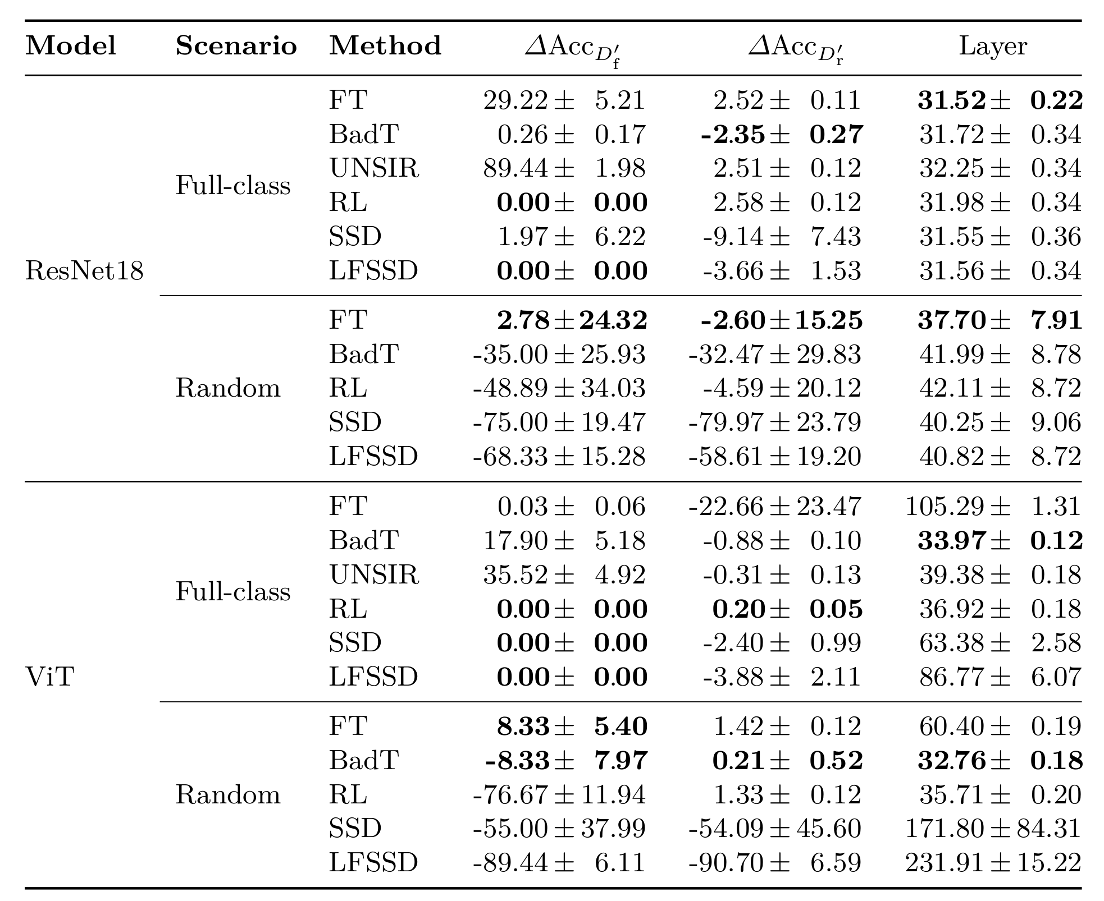
Backup: full results (1/2)
Accuracy differences and layer-wise distance · mean ± std across 10 seeds
7

Slide 10
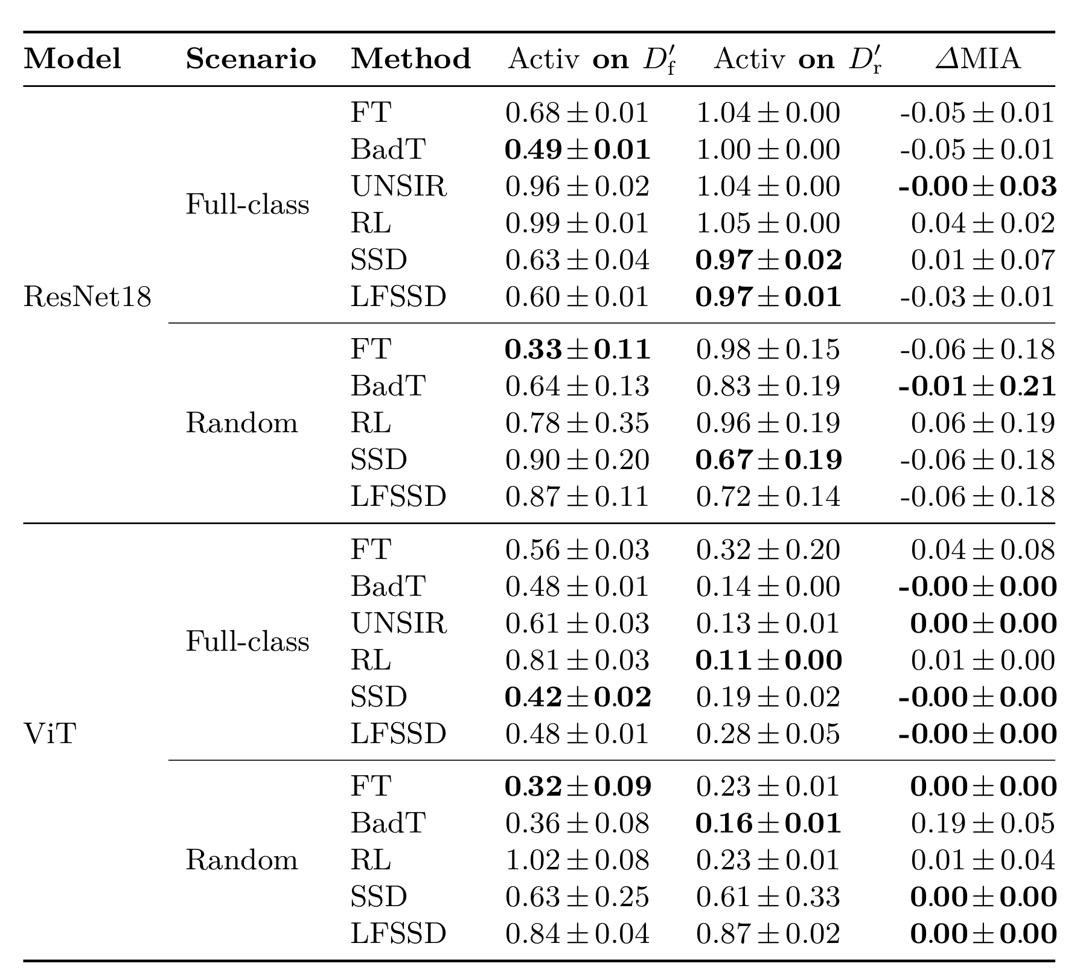
Backup: full results (2/2)
Activation distances and membership-inference difference · mean ± std across 10 seeds
8

