Slide 1
Python introductions
Thanks to all contributors:
Alison Pamment, Sam Pepler, Ag Stephens, Stephen Pascoe, Matt Pryor, Anabelle Guillory, Graham Parton, Esther Conway, Wendy Garland, Alan Iwi, Matt Pritchard and Tommy Godfrey.

Slide 2
BEFORE WE START (1)
We cannot teach you Python in a day...
...but hopefully we can show you that it is:
Human-readable (relatively)
Useful (even if you only know a bit)
Flexible (you can use it in many places/ways)

Slide 3
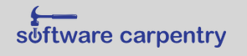
BEFORE WE START (2)
Teaching materials courtesy of:
http://www.software-carpentry.org/

Slide 4
Overview
Introduction – why we recommend Python
Basics and control flow
Lists, tuples and slicing
Input/output
Strings and text processing
Functions, libraries and scripts
Error handling and logging
Sets, dictionaries and OOP

Slide 5
What is Python?
A simple interpreted language
Very human-readable with clean syntax
Making it a very good "learn to programme" language

Slide 6
Why do we recommend Python?
It is open source and free
It is cross-platform (including Windows)
It can be used for simple scripting through to writing full-blown complex applications
Many libraries/tools to tackle all kinds of problems
In the environmental science community it continues to grow in popularity...so we can share code!

Slide 7

Python version?
Python has multiple personalities!
Python 3 – new; standard;
Most people updating old code to standard.
Used in this course!
Python 2.6+ – old; established;
Nearing end of life.
But what changed?
E.g. print changed from a statement to a function...
>>> print "hello" # in Python 2.* to...
>>> print ("hello") # in Python 3.*

Slide 8
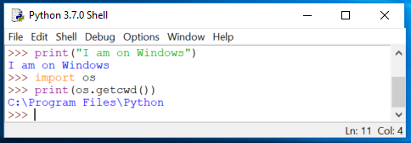
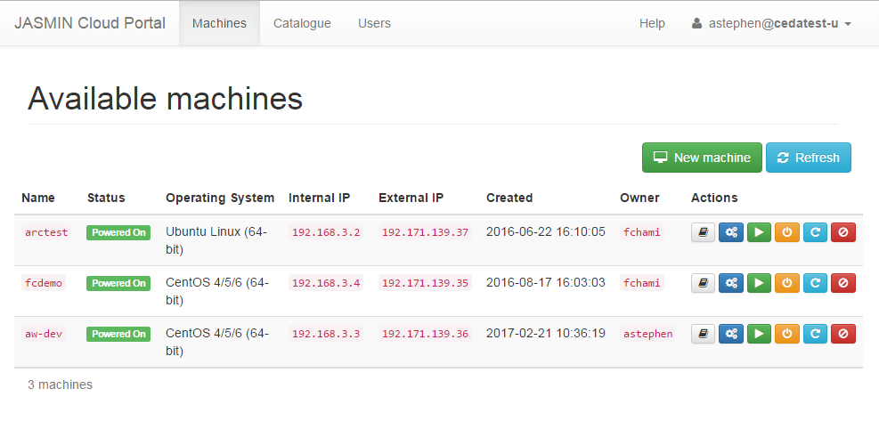
What can you do with python?
Interactive "shell": allows quick learning/testing/use.
Web-programming: frameworks make this easy.

Slide 9
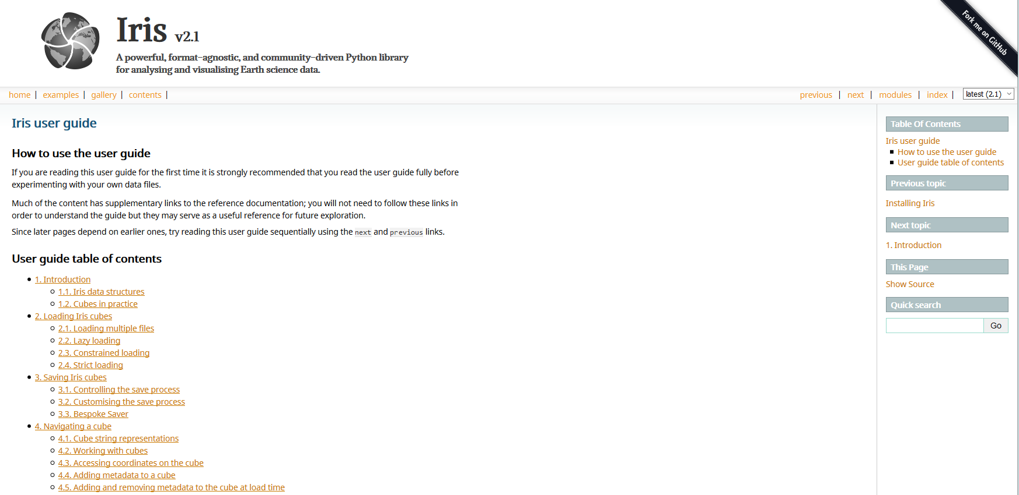
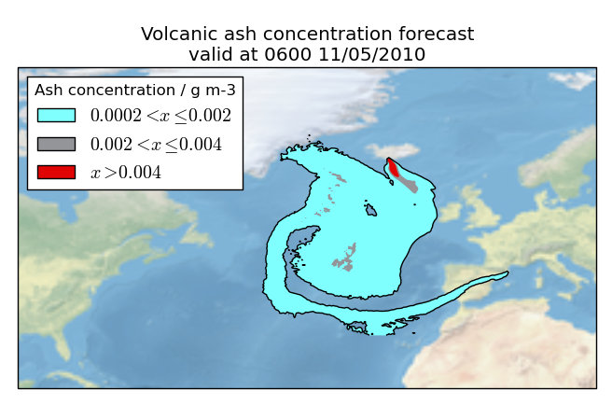
What can you do with python?
Open source packages for data analysis and visualisation.

Slide 10
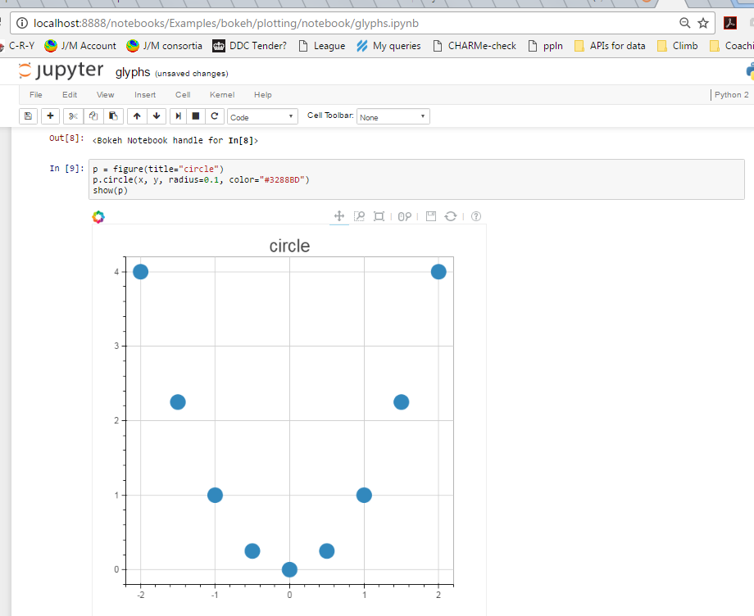
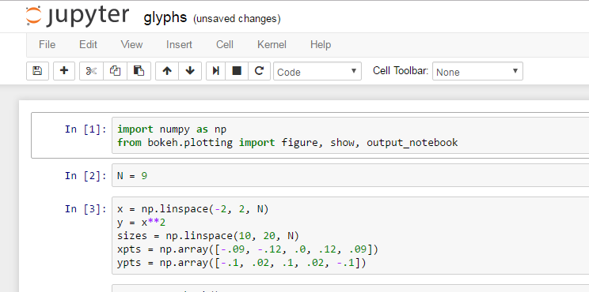
What can you do with python?
Jupyter Notebooks run interactively inside your browser!

Slide 11
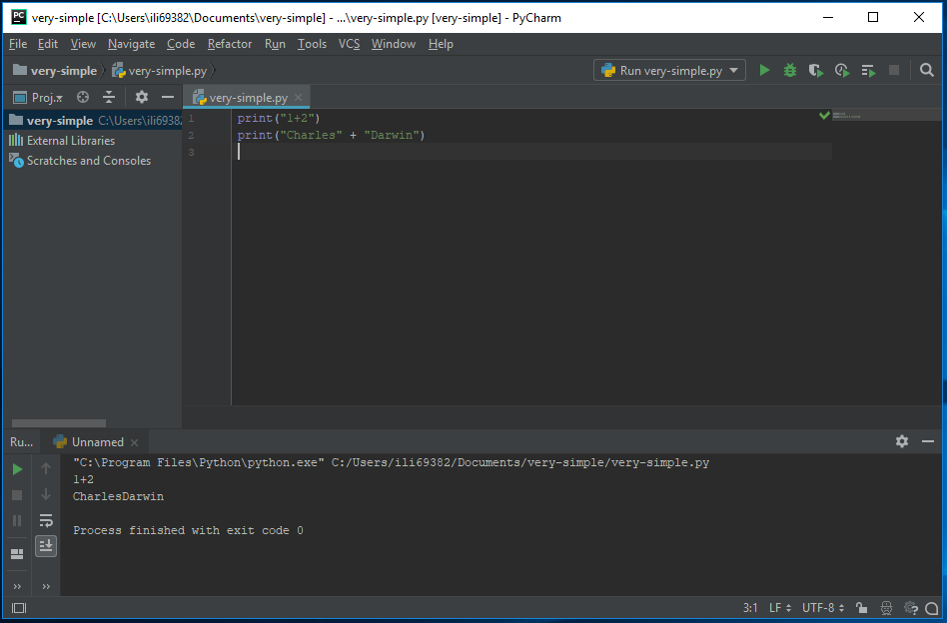
What can you do with python?
Integrated Development Environments (IDEs): help you learn/manage coding.

Slide 12
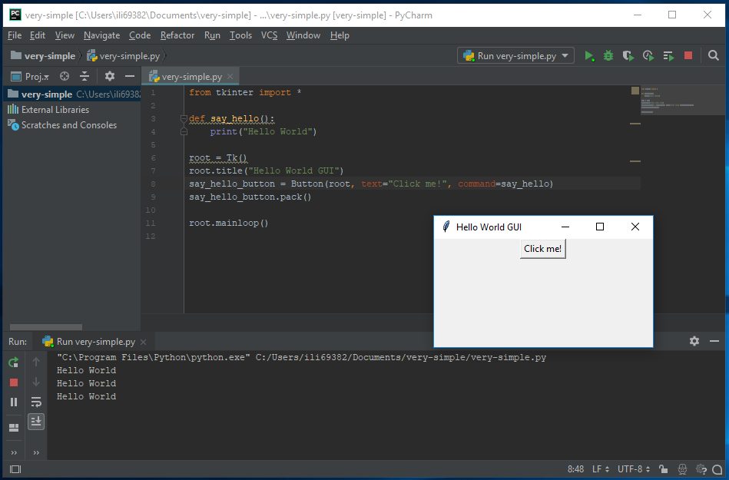
What can you do with python?
Tools for building GUIs: e.g. tkinter

Slide 13
Let's get to work...

