Slide 1
Python
Saving your code to a script

Slide 2
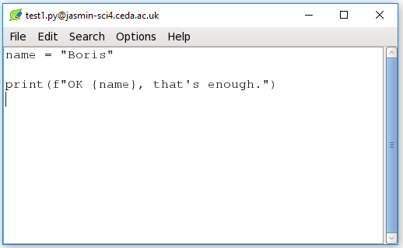
Open an editor (leafpad)
$ leafpad test1.py & # "&" means run in background
so you can still type here.
Opens an
editor
window...
make a
change...
and
Save!

Slide 3
Now run it
With...
$ python test1.py
...your output appears here...

Slide 4
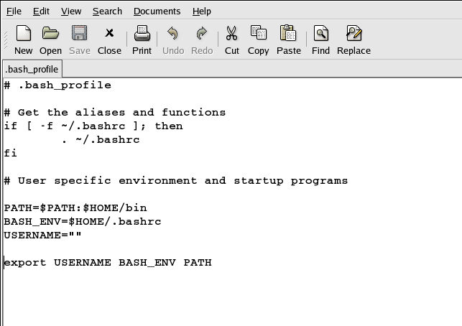
Open an editor (gedit)
$ gedit .bash_profile &
# "&" means run in background so you can still type here.
Opens an
editor
window...
make a
change...
and
Save!

