Slide 1
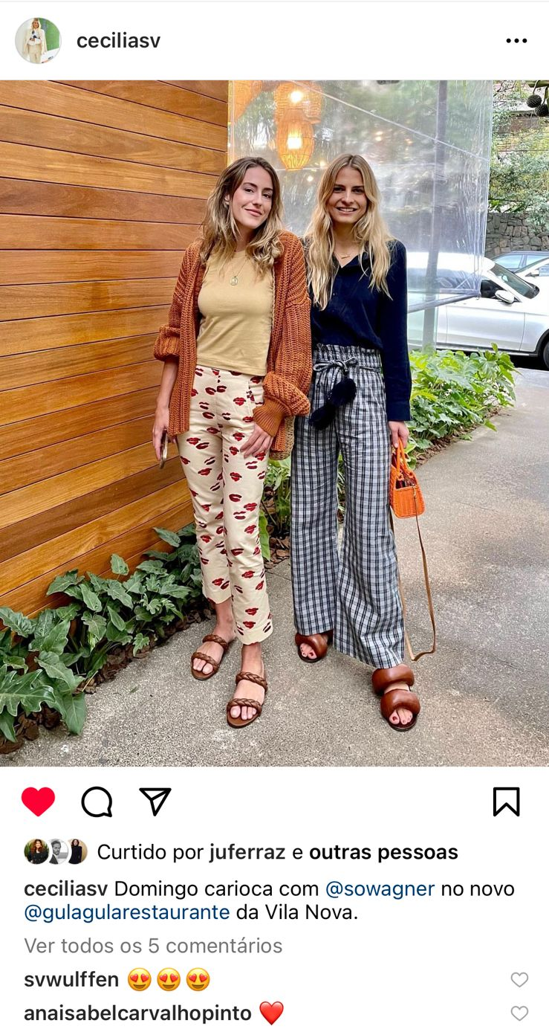
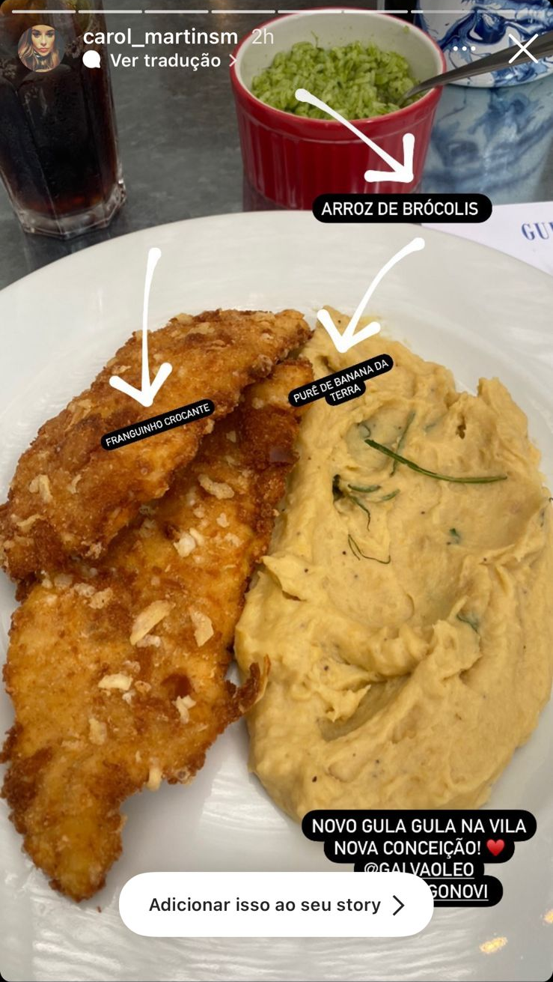

Cécilia Saint-Viteux
Head of Communications/Forbes BR
Carol Martins
Visual Arts

