Slide 1

Optimizations in GPGPU using Floyd-Warshall
Mestrado de Engenharia Informática Programação em Cluster e Multicore
Pedro Carrega, nº49480
Vasco Ferreira, nº49470

Slide 2
Motivations & Goals
Motivation:
Goals:
The lack of concise and simple introductions to GPGPU
The absence of content where it can be shown some of the improvements when using GPGPU
To provide an informative and educative introduction to GPGPU, using the Floyd Warshall algorithm in CUDA as an example
Notes:
Lack of good introductions to the topic of GPGPU
Provide an informative and educative introduction to GPGPU, using CUDA as an exemple

Slide 3
Approach
Incremental Development
Implemented the following
Sequential CPU
Sequential GPU
Parallel GPU
Synchronization GPU
Memory GPU
Notes:
We created multiple implementations of the FW algorithm, improving our solution with each implementation.
With each different solution we will be using more and more capabilities of the GPGPU and demonstrating how to use said capabilities.

Slide 4
Biggest Challenges
The chosen tools to present
How to explain them so that they can be interpreted and understood letting the reader with the capability to choose how and when to apply them
Notes:
How to use the GPU.
Due to the size of the FW problem, it’s not recommended to compute one position per thread (Speak of scheduler?). It was necessary to decide how to divide the work load on the GPU
The implementations.
CUDA is limited in some aspects, adding to that the poor feedback it provides when problems arise, debugging was a difficulty

Slide 5
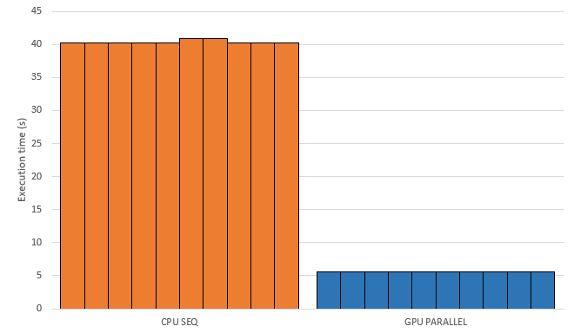
Results
Major speedup when running the algorithm in the parallel GPU
Speedup of around 7.2
Notes:
Should be straightforward enough

Slide 6
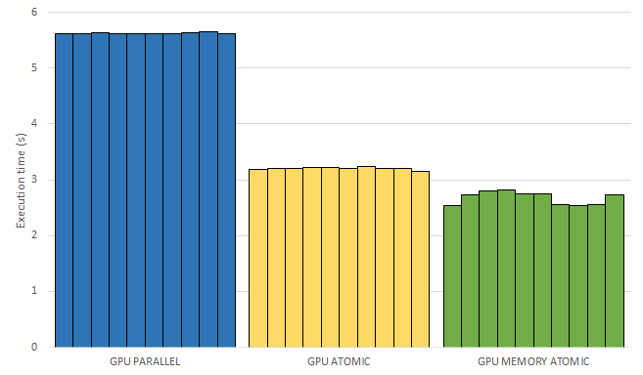
Results
Between implementations we can see a speedup of 1.76 and 1.19
Speedup can be improved to approximately 12.6 by adding atomic and to 15.1 by improving memory usage
Notes:
Should be straightforward enough

Slide 7
Conclusion & Future Work
Provided a succinct introduction to GPGPU
Displayed the some of the improvements that can be made
Compared the results in order to demonstrate the impact in the overall performance
Future Work
SIMD (Single Instruction Multiple Data)
Notes:
Conclusion:
Future Work:
Adapt the problem to use Short in order to be able to use SIMD (Single Instruction Multiple Data)

