Slide 1

ANCHOR
Leading Through Change
with Appreciative Inquiry
Holistic Leadership: From Purpose to Impact
IE Business School × Porto Business School | March 2026
Alejandra Matallana | Devin Davis | Dominik Wohr | Pedro Cunha | Teresa Torres
Notes:
Good afternoon. We are Group 3.
Our question this week: how can holistic leadership help organizations lead through constant change?
We didn't start with theory. We started with a real company. And we built a framework from what we found.

Slide 2
Imagine a company with around 100 people.
That means around 100 families.
Their children — some who could be our parents,
some who could be our children.
Growing at 40% per year. The founders realized they no longer
had the capacity or the knowledge to lead it.
They lowered their pride. Elevated their humility.
And started rebuilding everything.
How can holistic leadership help organizations lead through constant change?
2 / 11
Notes:
Imagine a company with 100 people. That means 100 families. Their children.
[Pause.]
Now imagine this company is growing at 40% per year. And its founders realize they can no longer lead it alone.
They did something rare. They lowered their pride. They elevated their humility. And they started rebuilding.
This is PORTILAME. Portuguese wood construction. 20 years of history. Our case study.

Slide 3
The World We Lead In
66%
70%
13%
of European workers
have experienced burnout
of change management
initiatives fail
of employees are
actively engaged
STADA 2025
McKinsey
Gallup Europe
Our approach: a real case study — PORTILAME — where culture was the DNA,
rapid growth fractured it, and the mission became recovering what was always there.
DISCOVER
DREAM
DESIGN
DESTINY
3 / 11
Notes:
66% of European workers have experienced burnout. 70% of change initiatives fail. Only 13% are truly engaged at work.
The world is changing faster than our organizations can keep up.
Our approach: use a real company where culture was the DNA, rapid growth broke it, and the mission became recovering what was always there.

Slide 4
Discover
What works when we lead at our best?
Trust First
Real trust is given before it is earned. It unlocks everything.
Flexibility
Adapting roles and systems to context creates resilience.
Communication
Transparent, consistent dialogue is the foundation of safety.
Proactive Support
Leaders who anticipate needs unlock team potential.
Shared Purpose
When people understand WHY, engagement follows naturally.
Source: Group 3 Peak Leadership Experiences + PORTILAME founding DNA
DISCOVER
DREAM
DESIGN
DESTINY
4 / 11
Notes:
We asked: when is leadership at its best?
Across five organizations, five answers kept coming back.
Trust comes first — always. Given before it is earned.
Flexibility unlocks people. Autonomy creates better solutions than any manual.
Open communication means being real — not performing confidence.
Support is built before crisis hits — not during.
And shared purpose reduces uncertainty. When people know why, they figure out how.
At PORTILAME, this was the DNA that built 20 years. 'Who likes, comes. Who loves, stays.'

Slide 5
Dream
We want every proud face of our people to tell us
that their children say:
“My hero is my father! When I grow up, I want to be like him: work at PORTILAME."
This culture was in PORTILAME's DNA from the beginning.
Rapid growth fractured it. The mission: recover, protect,
and systematize what was always there.
And from that journey, build a framework any organization can use.
DISCOVER
DREAM
DESIGN
DESTINY
5 / 11
Notes:
A child of an employee said this at a company event. And it stopped the room.
'My hero is my father. When I grow up, I want to be like him — work at PORTILAME.'
That is the dream. Not metrics. Not awards. Children who see their parents come home proud and fulfilled.
PORTILAME had this culture from day one. Growth fractured it. The mission now: recover it, protect it, and build a framework any organization can use.
A framework so light that people carry it like identity — not obligation.

Slide 6




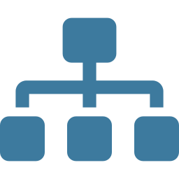

Design: The ANCHOR Framework
A
Awareness
N
Narrative
C
Cadence
(Being)
(Trust)
(Health)
Know yourself, your strengths, your biases
Stories that create trust and meaning
Rhythms and rituals that sustain energy
H
Humanity
O
Organization
R
Resilience
(Belonging)
(Growth)
(Mindfulness)
Psychological safety and belonging
Structure that enables, not constrains
Sustainable energy and self-compassion
Inner Game (A+N) · Outer Game (C+H+O) · Long Game (R)
DISCOVER
DREAM
DESIGN
DESTINY
6 / 11
Notes:
From real organizational pain, we built ANCHOR. Six dimensions. Three games. One anchor.
Awareness — know yourself. Your strengths. Your biases. Your limits.
Narrative — tell the real story. Stories change brain chemistry. Oxytocin up, cortisol down.
Cadence — protect your rhythm. Digital discipline. Weekly rituals. Quarterly reviews.
Humanity — create belonging. Permission to fail. Permission to be real.
Organization — build structure that frees people, not traps them.
Resilience — protect your energy. Recovery is not weakness. It is strategy.
The Cisco case study proved this: when you stop fixing problems and start building on strengths, performance becomes sustainable — and human.

Slide 7
The Calibration Engine
ANCHOR measures who we are. HORIZON measures where the world is going.
Radar Score
Universal KPI
Galactic KPI
Internal Health
Industry Benchmark
Visionary Target
How healthy is each
dimension right now?
How do we compare
to the best?
Where should we be
in 3–5 years?
Self-assessment + 360º
Peer calibration
Aspirational
INTERNAL → BENCHMARK → VISIONARY
The framework self-calibrates over time.
DISCOVER
DREAM
DESIGN
DESTINY
7 / 11
Notes:
Six dimensions tell you who you are. But you also need to know where the world is going.
The Radar has three layers.
Radar Score — how healthy is each dimension right now? Your internal truth.
Universal KPI — how do you compare to the best? Your external benchmark.
Galactic KPI — where should you be in 3 to 5 years? Your ambition.
You are never finished. You are always recalibrating.

Slide 8
Every session shaped a dimension
Centeno — Well-being as Strategy
A + R
Hurtado — Character Strengths
A
Aguirre — Values & Purpose
N + R
Reina — Science of Attention
A + C
Maguire — Psychological Safety
H
Ferrari — Critical Thinking
A + O
Gay Zaragoza — Leader's Narrative
N
De la Serna — Circadian Rhythms
C
Sebastián — Cisco Case Study
O + H
O'Connor — Mindfulness (daily)
R
DISCOVER
DREAM
DESIGN
DESTINY
8 / 11
Notes:
Every session this week shaped a dimension of ANCHOR.
This is not a retrospective exercise. It is proof that the framework emerged naturally from the programme itself.
From character strengths to psychological safety. From attention science to circadian rhythms. From critical thinking to the Cisco case. Every insight found its place.

Slide 9
Leadership Tools
Practical rituals that make the framework live in daily practice
Peer Pulse Check
A
Recognition Rituals
N
Weekly micro-feedback on strengths
Monthly values-aligned celebrations
Cadence Reviews
C
Appreciative Problem-Solving
H
Weekly rhythm + quarterly radar
Solution-focused, not deficit-focused
Initiative Ownership Cards
O
Weekly Reflection Ritual
R
Each person chooses one improvement
15 min: what went well, what I learned
Every tool maps to an ANCHOR dimension. Not bureaucracy — organic rituals people want to practice.
DISCOVER
DREAM
DESIGN
DESTINY
9/ 11
Notes:
A framework without practice is just theory.
These are six tools — organic, simple, human.
Peer Pulse Check: two minutes, one strength, one growth area. Weekly.
Recognition Rituals: monthly spotlight on who lived the values.
Cadence Reviews: weekly rhythm checks. Are we sustainable?
Appreciative Problem-Solving: when did we solve something like this well? What worked?
Initiative Ownership: each person picks one improvement per quarter. Not assigned — chosen.
Weekly Reflection: fifteen minutes. What went well? What did I learn?
Not bureaucracy. Rituals people want to do.

Slide 10
Destiny
From insight to action
PHASE 0 · DIAGNOSE
Run the 6 Diagnostic Rules first: DNA clarity · growth vs. structure · leadership bottleneck · cultural transmission · knowledge systems · people investment
↓
30 Days
→
90 Days
→
12 Months
Radar baseline
Strengths mapping
First narrative act
Cadence installation
Governance clarity
Safety training
Career architecture
Universal KPI benchmark
Full ANCHOR deploy
Galactic KPI targets
Succession depth
HORIZON recalibration
Not a project. A permanent operating system for holistic leadership.
DISCOVER
DREAM
DESIGN
DESTINY
10/ 11
Notes:
Before you implement, diagnose. Six rules. DNA clarity. Growth versus structure. Leadership bottleneck. Cultural transmission. Knowledge systems. People investment.
Then act.
30 days: listen, map strengths, set the baseline.
90 days: install cadence, build safety, clarify governance.
12 months: full deployment. Measure. Recalibrate.
This is not a project with an end date. It is a permanent operating system.
PORTILAME already lives this — sports programmes, weekly knowledge sharing, annual reconnection to DNA, structural equity. Not plans. Reality.

Slide 11

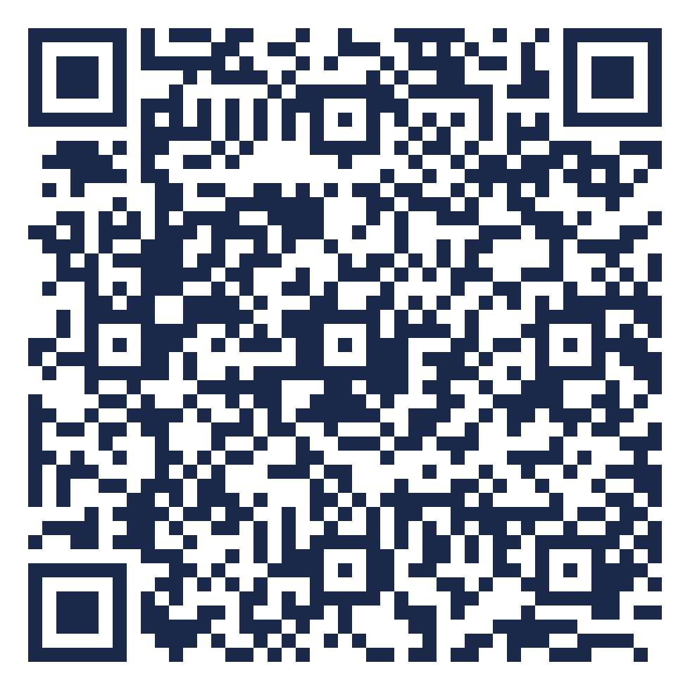
An anchor doesn't resist the storm.
It holds the ship steady
so the crew can navigate.
Scan to explore the full project
(password: anchor2026)
Alejandra Matallana | Devin Davis | Dominik Wohr | Pedro Cunha | Teresa Torres
Group 3 · Holistic Leadership Programme · IE × PBS · March 2026
Notes:
An anchor doesn't fight the storm. It holds the ship steady so the crew can navigate.
[Point to QR code]
Scan this to explore the full project. Everything is there.
Thank you.

