Slide 1

TECHNICAL DISCOVERY
Veridian Global Bank
KYC Agent MVP
A hypothesis-led discovery plan grounded in real cases, regulatory controls, technical feasibility and measurable business impact.
REAL CASES
HUMAN CONTROL
MVP FIRST
Singapore | Periodic KYC reviews | Analyst-assist POC
Notes:
[Sources]
Presentation2.pptx, technical discovery class notes.
Visual on this slide was generated with Microsoft Copilot.

Slide 2
ENGAGEMENT CONTEXT
What is known, and what still needs to be proven
The handover identifies urgency and stakeholders, but not yet a buildable MVP.
Business pressure
Executive expectation
Current uncertainty
Critical dependency
MAS flagged a backlog of periodic KYC reviews. The backlog exposes VGB’s growth plans to further scrutiny.
Grace wants a working proof of concept that can be demonstrated to leadership and open a larger engagement.
The requested “agent” is not defined. Stakeholders did not agree on the target capability, scope or proof.
Data access is only described as possible. Runtime, region, security and integration constraints remain unknown.
Discovery outcome: one jointly agreed MVP with explicit value, control boundaries, technical dependencies and success gates.
Notes:
[Sources]
User-provided Veridian Global Bank project handover.

Slide 3
CLASS METHOD APPLIED
Run discovery as a correction loop
Do not gather opinions in isolation. Start with a hypothesis, inspect an actual case, then play it back.
1 Start with what you know
2 Dig until you get a real example
3 Play it back and invite correction
State the current understanding and the hypothesis being tested.
Ask “show me,” “walk me through it,” and “what happened next?”
Summarize the process, bottleneck and control boundary. Let corrections determine the next question.
The correction identifies where to dig next
Recommended opening playback
“Our hypothesis is that the bottleneck may be evidence collection, comparison and narrative preparation rather than the final compliance decision. What have we misunderstood?”
Notes:
[Sources]
Presentation2.pptx, slides 4–5 and 8: three-step technical discovery loop, good vs. bad discovery, and question-bank guidance.

Slide 4
ANCHOR THE INTERVIEWS
Use one recent KYC case as the backbone
The real case reveals actual work, wait states, workarounds, evidence, decisions and controls.
1
2
3
4
5
6
Review enters queue
Retrieve customer and prior KYC
Collect evidence
Compare and identify changes
Draft and recommend
QA / approve / escalate
Ask for evidence
Follow the exception
Capture the boundary
Show the case, systems opened, source records, final narrative and QA feedback.
Ask about the last slow case, returned case, conflicted source or compliance escalation.
Identify what was deterministic, what required judgment, and who owned the decision.
Notes:
[Sources]
Presentation2.pptx, slides 4–5 and 8: use recent concrete examples and follow the discovery loop.
The KYC process sequence shown is a discovery hypothesis to be validated with VGB.

Slide 5
FUNCTIONAL DISCOVERY
Discover the job before designing the agent
Each capability must be tied to a real analyst task and a specific control boundary.
Evidence collection
Which sources were used? How did the analyst know where to look? What was copied or reconciled manually?
Change detection
Show a case with a material change. Which differences mattered and how was materiality determined?
Narrative preparation
Show the source material and final narrative. Which sections required judgment and what causes QA rejection?
Risk recommendation
Show a difficult recommendation. Which policy and evidence supported it? What required escalation?
Exception handling
What happened when data was missing, sources conflicted, or a tool was unavailable?
Avoid asking “Would an agent help?” before the real task, evidence and failure modes are understood.
Notes:
[Sources]
Presentation2.pptx, slide 5: stronger discovery technique asks about what actually happened rather than proposing a solution.

Slide 6
CONTROL BOUNDARY
Classify every capability by authority
A regulated agent must be explicit about what Claude may do, what needs confirmation and what remains human-only.
RETRIEVE
COMPARE
SUMMARIZE
RECOMMEND
WRITE
EXECUTE
APPROVE
AI may perform
Human confirmation
Human-only / prohibited
Read-only retrieval
Comparison
Draft summaries
Recommendations
Draft narrative
Selected write actions
Final disposition
Risk-rating changes
Case closure unless approved
Discovery question: “In the case you showed us, which steps could a system complete without analyst judgment?”
Notes:
[Sources]
User-provided project context: regulated KYC process under MAS scrutiny.
The authority classification is a proposed discovery device, not a confirmed VGB policy.

Slide 7
ANTHROPIC ARCHITECTURE LENS
Use the simplest architecture that meets the requirement
Move from deterministic patterns to agentic autonomy only when the observed workflow needs adaptive decision-making.
Working hypothesis for VGB: deterministic KYC workflow + one constrained Claude reasoning component + human approval checkpoints.
Multi-agent system
Single agent + constrained tools
Only when specialization is proven
Workflow + Claude steps
Dynamic investigation within limits
Prompt + retrieval
Predictable process with language tasks
Known information need
Increasing flexibility, cost, latency and operational variability →
Notes:
[Sources]
Anthropic, “Building Effective AI Agents”: start with the simplest solution; workflows provide predictability while agents provide model-directed flexibility.
https://www.anthropic.com/engineering/building-effective-agents

Slide 8
TECHNICAL AND NON-FUNCTIONAL DISCOVERY
Tie every constraint to a demonstrated use case
The goal is a buildable boundary, not a generic NFR checklist.
Data & tools
Runtime & cloud
Source owner, API or UI, test data, read/write scope, lineage and reliability
Approved hosting, direct Anthropic or cloud path, container platform and internet access
Region & residency
Identity & authorization
Where prompts, inference, embeddings, traces and evaluations may be processed or retained
User versus service identity, RBAC, case entitlements and downstream authorization
Security & audit
Performance & resilience
Secrets, encryption, redaction, immutable records, model/prompt/tool version and kill switch
Interactive versus batch, peak volume, retries, resumability, fallback to manual review
Ask: “What would need to be established before this specific data flow or tool action could be approved?”
Notes:
[Sources]
User requested functional and non-functional discovery including ownership, runtime, cloud allowance, locations and country/region constraints.

Slide 9
STAKEHOLDER PLAN
Use each interview to resolve a different decision
All interviews use the same discovery loop, but each stakeholder owns a different part of the MVP boundary.
Victor Ong
What result justifies expansion? What risk stops the project? Who owns the production decision?
Executive outcome
Grace Lim
Show a recent review. Where is effort spent? What leadership demonstration would be credible?
Operations and demo
Raj Menon
Show a difficult case. What evidence, escalation and human accountability are mandatory?
Compliance and control
Ben Tan
Show how required sources are accessed, authorized, hosted, logged and supported.
Data and feasibility
Anna Cruz
Walk through current cost per review, internal effort, rework and contract constraints.
Commercial baseline
Also request interviews with KYC analysts, QA reviewers, security, architecture, model risk and platform operations.
Notes:
[Sources]
User-provided project handover identifies Victor Ong, Grace Lim, Raj Menon, Ben Tan and Anna Cruz and their roles.

Slide 10
EVALUATION DISCOVERY
Define “good enough” from actual historical cases
The MVP needs an agreed evidence set, component-level measures and hard stop conditions.
CASE SET
Evidence
Source selection, retrieval and extraction
• Strong review
• Weak / returned review
• Difficult recommendation
• Missing information
• Conflicting sources
• Required escalation
• Unauthorized-action attempt
Reasoning
Material-change detection and policy adherence
Output
Narrative completeness, grounding and citations
Control
Escalation behavior and authorization
Acceptance
Analyst / QA approval and override reasons
Success gate: jointly agreed thresholds for analyst-assisted use, plus explicit conditions that stop rollout.
Notes:
[Sources]
Anthropic planning-to-production guidance: establish measurable success criteria, evaluate thoroughly and scale gradually.
User-provided VGB scenario and proposed real-case discovery method.

Slide 11
DECIDE WHAT TO BUILD
Prioritize opportunities by impact and feasibility
The room decides. Operations assesses impact, Compliance sets control limits, and Engineering assesses near-term feasibility.
BIG BETS
NO-BRAINERS
High impact, harder now
High impact, feasible now
Cross-system orchestration
Evidence retrieval
Autonomous closure
Narrative draft
IMPACT
HARD PASSES
DISTRACTIONS
Low impact, hard now
Easy, but lower impact
General KYC chatbot
FEASIBILITY
Notes:
[Sources]
Presentation2.pptx, slides 6 and 10–11: prioritize opportunities on impact and feasibility, and let the room decide ordering.
Candidate sticky notes are working hypotheses, not confirmed VGB findings.

Slide 12
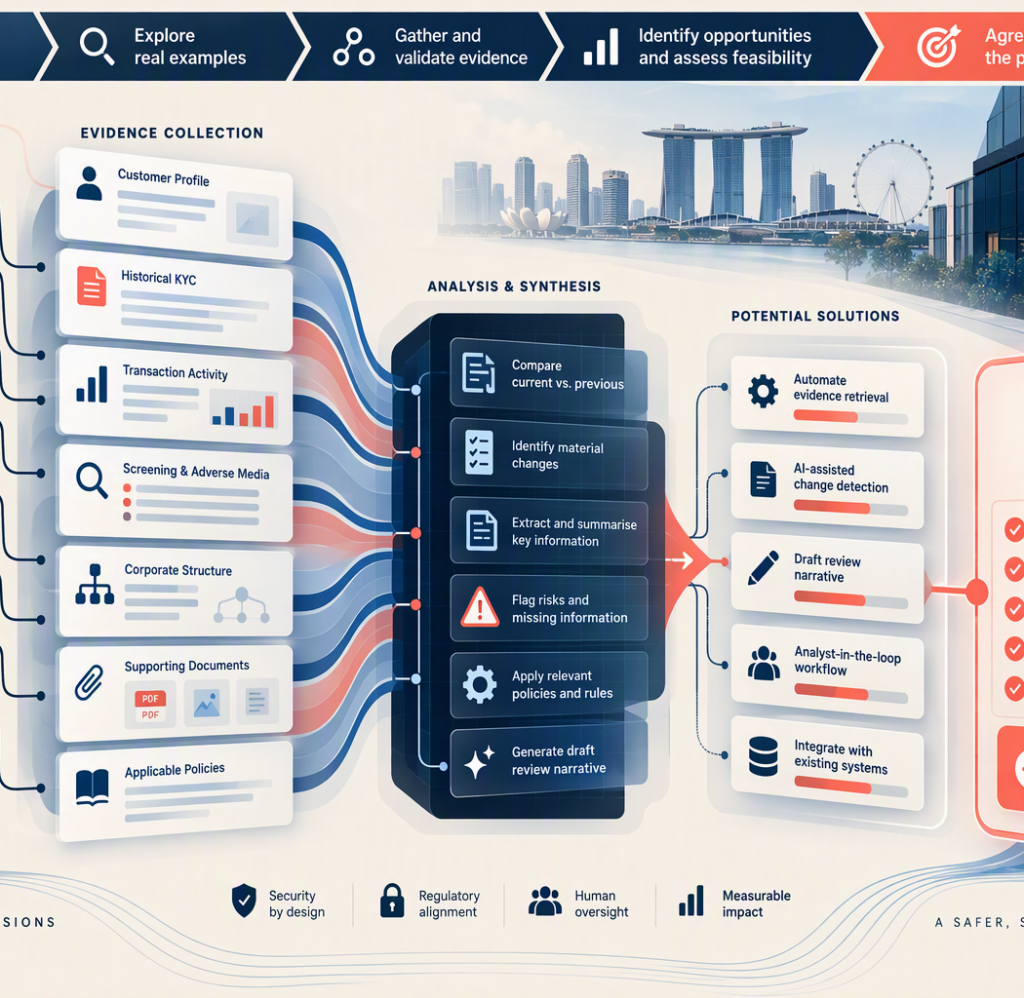
WORKING MVP HYPOTHESIS
A controlled analyst-assist workflow
This is the starting hypothesis to validate, not a predetermined solution.
Retrieve permitted KYC information, compare it with the prior review, identify material changes and missing evidence, then draft an evidence-grounded recommendation for human approval.
Likely in scope
Likely out of scope
Read-only sources
Current vs. prior comparison
Evidence-linked summary
Missing-information flags
Draft narrative
Human approval
Autonomous closure
Risk-rating changes
Unrestricted web research
Broad production write-back
All jurisdictions
Unproven multi-agent design
Next decision: which real case best proves backlog reduction safely?
Notes:
[Sources]
Anthropic-aligned working hypothesis based on the user-provided VGB scenario.
Visual on this slide was generated with Microsoft Copilot.

