Slide 1
Physical Analyst
Wordalization of SkillCorner Physical Data
Speed · Acceleration · Agility · Endurance
Context Engineering for Football · Twelve Football · 2026

Slide 2
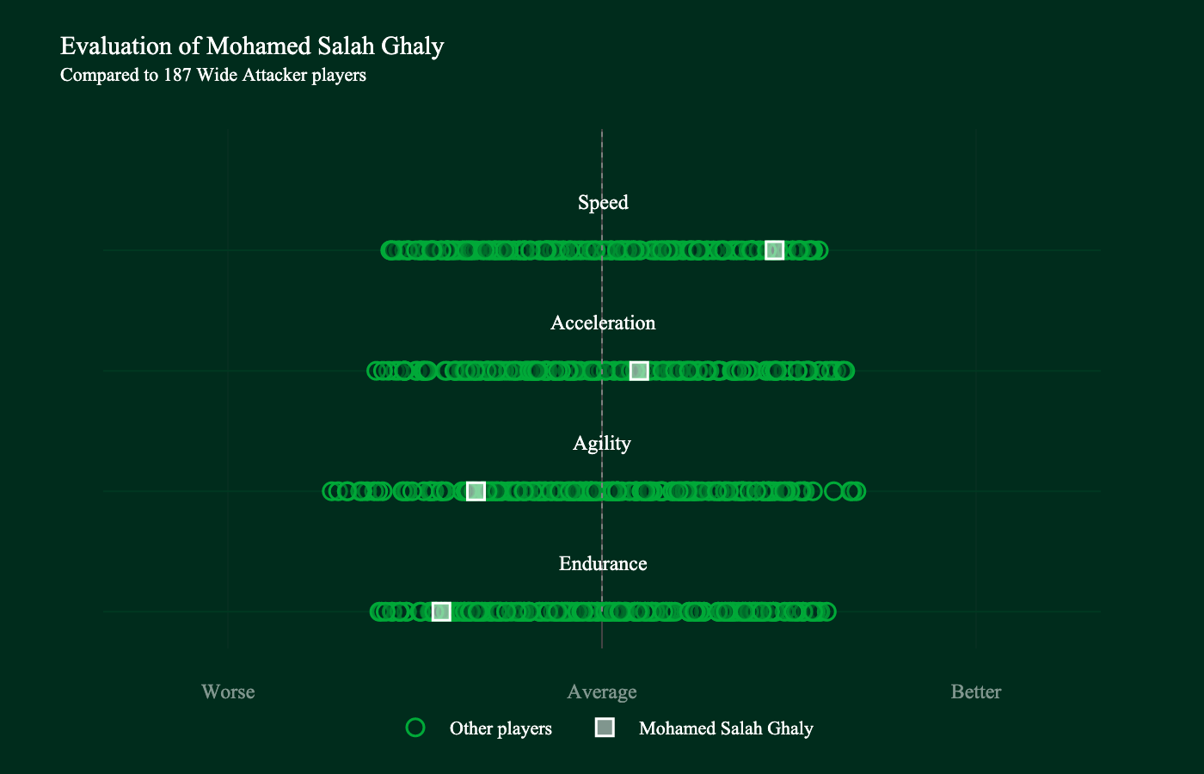
Mohamed Salah
Wide Attacker · Liverpool · Premier League
Speed
Excellent
Acceleration
Average
Agility
Poor
Endurance
Poor
LLM Output
In the Premier League this season, Mohamed Salah Ghaly shows elite Speed for Liverpool among Wide Attackers, with average Acceleration and weaknesses in Agility and Endurance. His top speed is excellent, and his average top speed is also excellent, reinforcing his ability to hit and sustain sprinting in behind. However, his change of direction frequency is below average, and his metres per minute and total distance are poor, with running distance and high-speed running distance below average. Overall, this profile describes a player whose physical impact is concentrated in short, high-speed moments rather than sustained output, making him a devastating threat in wide areas when space is available but less suited to constant high-pressing or lengthy, volume-based running.

Slide 3
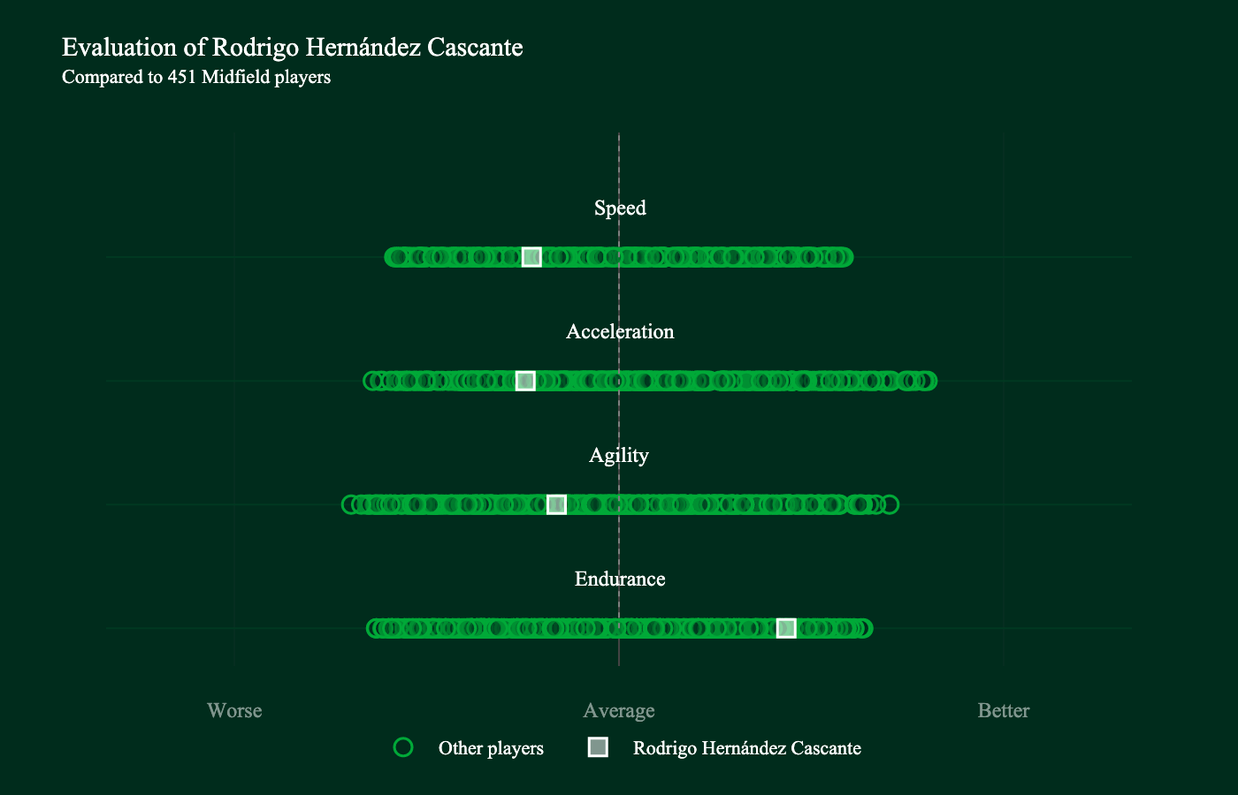
Rodri
Midfield · Manchester City · Premier League
Speed
Below average
Acceleration
Below average
Agility
Average
Endurance
Excellent
LLM Output
In the Premier League this season, Rodri presents an endurance-focused profile for Manchester City, with below-average Speed and Acceleration, average Agility, and excellent Endurance. That endurance is reflected in standout work-rate metrics: metres per minute and total distance are excellent, with running distance also well above peers. On the flip side, pace and explosive actions are weaker: top speed is below average, explosive sprint bursts and high-speed running bursts are below average to poor, and 180-degree turning speed is poor. Overall, this profile describes a midfielder whose strengths lie in sustained movement and game coverage, able to contribute through constant pressing and distribution, while pace and rapid-change abilities are limited and the role leans toward control and energy management rather than direct acceleration.

Slide 4
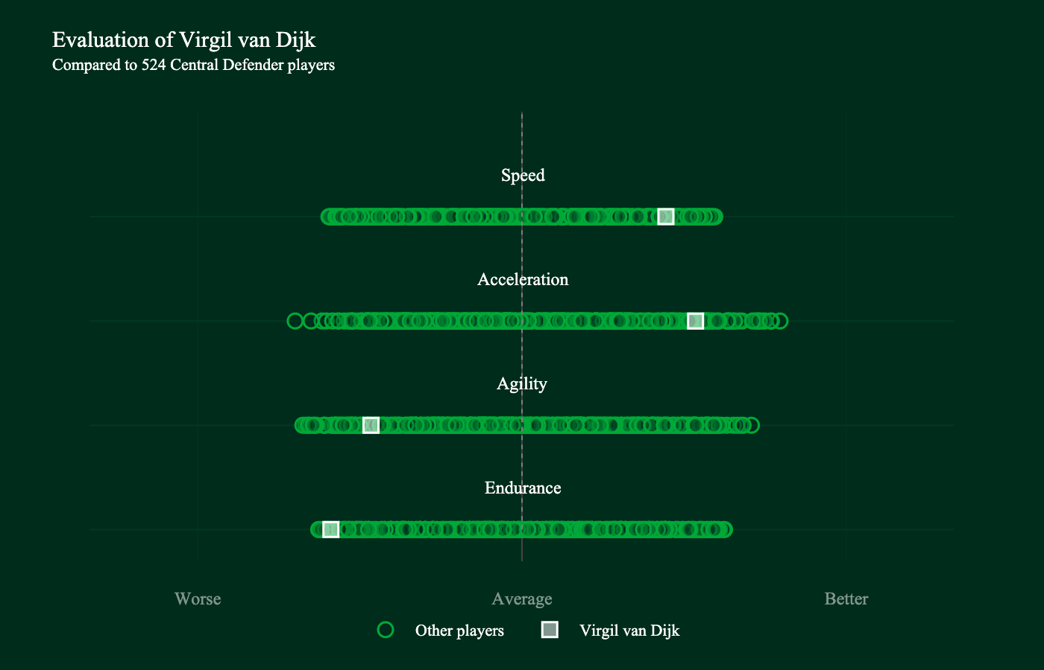
Virgil van Dijk
Central Defender · Liverpool · Premier League
Speed
Excellent
Acceleration
Outstanding
Agility
Poor
Endurance
Poor
LLM Output
In the Premier League this season, Virgil van Dijk has shown elite pace and acceleration for a central defender at Liverpool. His strengths lie in Speed and outstanding Acceleration, with top-end speed and explosive sprint bursts that enable rapid transitions and recoveries. However, Agility and Endurance are poor, and several movement metrics are well below peers, including metres per minute, total distance, running distance, high-speed running distance, as well as low 90-degree turning speed and change-of-direction frequency. Overall, this profile describes a defender whose value is driven by pace and explosive power, enabling effective stand-up defending and quick recoveries, but with notable constraints in multi-directional movement and sustained high-intensity running.

Slide 5
Step 1: Tell It Who It Is
The system prompt defines the persona
System Prompt
"You are an experienced physical performance analyst working in elite football.
You write concise physical profiles for coaching staff and recruitment departments.
You focus on what physical data means for how a player actually performs on the pitch —
not just reciting numbers, but interpreting what those numbers imply about playing style,
tactical suitability, and areas for physical development.
You write in British English and refer to the sport as football."
This sets the tone for every response. The LLM writes as a performance analyst briefing coaching staff — professional, evidence-based, and focused on what the data means on the pitch.

Slide 6
Step 2: Tell It What It Knows
49 Q&A pairs teaching the LLM about physical performance data — examples below
Q: What does the Speed attribute measure?
The Speed attribute captures a player's peak velocity capability — how fast they can run at maximum effort. It is built from two metrics: PSV-99 (weighted 55%) and TOP 5 PSV-99 (weighted 45%).
Q: What does it mean if a player has elite Speed but low Acceleration?
This profile suggests a player with a high top-end speed who takes longer to get there. They are fast once they hit their stride but lack explosive initial bursts.
Q: What physical profile suits a box-to-box midfielder?
A box-to-box midfielder requires elite Endurance to cover large distances in both directions. Good Acceleration helps them burst forward and recover defensively.
These Q&A pairs are just examples — swap them for any domain knowledge you want the LLM to learn. Categories: metric definitions (16) · attribute meaning (8) · attribute combinations (12) · position-group context (5) · interpretation guidance (8)

Slide 7
Step 3: Tell It What Data To Use
Convert z-scores into word labels — the normative model
Z-Score → Word Label
Example: Synthesized Text for Salah
> 1.5
outstanding
He was excellent in Speed compared to other
players in the same position group.
He was average in Acceleration compared to
other players in the same position group.
He was poor in Agility compared to other
players in the same position group.
He was poor in Endurance compared to other
players in the same position group.
His top speed was excellent.
His metres per minute was poor.
His total distance covered was poor.
1.0 to 1.5
excellent
0.5 to 1.0
good
-0.5 to 0.5
average
-1.0 to -0.5
below average
< -1.0
poor
Standout and concern metrics use friendly names (e.g. 'top speed' not 'PSV-99') and are only included when excellent/outstanding or below average/poor.

Slide 8
Step 4 — Example 1: Salah
Synthesized Data (Boring Text)
Our Hand-Written Output
Here is a physical profile of Mohamed Salah Ghaly, who plays as a Wide Attacker for Liverpool Football Club in the ENG - Premier League. All ratings are compared against 187 Wide Attacker players. He was excellent in Speed compared to other players in the same position group. He was average in Acceleration compared to other players in the same position group. He was poor in Agility compared to other players in the same position group. He was poor in Endurance compared to other players in the same position group. His top speed was excellent. His average top speed was excellent. His change of direction frequency was below average. His metres per minute was poor. His total distance covered was poor. His running distance was below average. His high-speed running distance was below average.
In the Premier League this season, Mohamed Salah has showcased his elite speed, consistently ranking among the top wide attackers. His above average acceleration adds a valuable dimension to his attacking play, particularly in reaching sprint speed and recovering pace after changes of direction. While he maintains below average agility and struggles with endurance metrics, his outstanding speed capabilities highlight his potential as an explosive wide attacker who excels in decisive moments.

Slide 9
Step 4 — Example 2: Gvardiol
Synthesized Data (Boring Text)
Our Hand-Written Output
Here is a physical profile of Josko Gvardiol, who plays as a Central Defender for Manchester City in the ENG - Premier League. All ratings are compared against 524 Central Defender players. He was excellent in Speed compared to other players in the same position group. He was outstanding in Acceleration compared to other players in the same position group. He was outstanding in Agility compared to other players in the same position group. He was excellent in Endurance compared to other players in the same position group. His top speed was excellent. His average top speed was excellent. His time to reach sprint speed was outstanding. His time to reach high-speed running was excellent. His time to sprint after changing direction was excellent. His time to reach high-speed running after changing direction was outstanding. His explosive sprint burst volume was outstanding. His explosive high-speed running burst volume was outstanding. His change of direction frequency was outstanding. His running distance was excellent. His high-speed running distance was outstanding.
Gvardiol has been a standout physical performer for Manchester City this season, showcasing exceptional capabilities across all four key attributes. He excels in both speed and endurance at an elite level, while also demonstrating exceptional acceleration and agility. His outstanding explosive burst volume and change of direction frequency add a valuable dimension to his defensive play. Overall, he's performed at an outstanding level, demonstrating the qualities of a physically complete central defender with the rare ability to sustain high-intensity output across the full match.

Slide 10
Step 4 — Example 3: Rodri
Synthesized Data (Boring Text)
Our Hand-Written Output
Here is a physical profile of Rodrigo Hernández Cascante, who plays as a Midfield for Manchester City in the ENG - Premier League. All ratings are compared against 451 Midfield players. He was below average in Speed compared to other players in the same position group. He was below average in Acceleration compared to other players in the same position group. He was average in Agility compared to other players in the same position group. He was excellent in Endurance compared to other players in the same position group. His metres per minute was excellent. His total distance covered was excellent. His running distance was outstanding. His average top speed was below average. His explosive sprint burst volume was below average. His explosive high-speed running burst volume was poor.
In the Premier League this season, Rodri has showcased his elite endurance capabilities, consistently ranking among the top midfielders in distance covered and metres per minute. His outstanding running distance highlights his sustained physical output across matches. While he maintains below average performance levels in speed, acceleration, and agility, his exceptional endurance contributions are notable, making him a player whose physical profile is centred around sustained effort rather than explosive actions.

Slide 11
Step 4 — Example 4: Van Dijk
Synthesized Data (Boring Text)
Our Hand-Written Output
Here is a physical profile of Virgil van Dijk, who plays as a Central Defender for Liverpool Football Club in the ENG - Premier League. All ratings are compared against 524 Central Defender players. He was excellent in Speed compared to other players in the same position group. He was outstanding in Acceleration compared to other players in the same position group. He was poor in Agility compared to other players in the same position group. He was poor in Endurance compared to other players in the same position group. His average top speed was outstanding. His time to reach high-speed running was excellent. His time to reach high-speed running after changing direction was excellent. His explosive sprint burst volume was excellent. His change of direction frequency was poor. His metres per minute was poor. His total distance covered was poor. His running distance was poor. His high-speed running distance was poor.
Van Dijk has been a physically impressive performer for Liverpool this season, showcasing elite speed and acceleration capabilities among central defenders. His outstanding top speed and excellent ability to reach high-speed running, including after changes of direction, add a valuable dimension to his defensive play. While he maintains well below average agility and struggles with endurance metrics across distance, running output, and metres per minute, his exceptional speed and explosive acceleration highlight his qualities as a physically dominant central defender.

Slide 12
Step 4 — Example 5: Kane
Synthesized Data (Boring Text)
Our Hand-Written Output
Here is a physical profile of Harry Kane, who plays as a Center Forward for FC Bayern Munchen in the GER - Bundesliga. All ratings are compared against 278 Center Forward players. He was poor in Speed compared to other players in the same position group. He was poor in Acceleration compared to other players in the same position group. He was poor in Agility compared to other players in the same position group. He was good in Endurance compared to other players in the same position group. His metres per minute was excellent. His total distance covered was excellent. His top speed was poor. His average top speed was poor. His time to reach sprint speed was poor. His time to reach high-speed running was poor. His time to reach high-speed running after changing direction was below average. His explosive sprint burst volume was poor. His explosive high-speed running burst volume was poor. His change of direction frequency was poor. His high-speed running distance was poor.
Kane has shown notable endurance qualities for Bayern Munich this season, showcasing excellent distance covered and metres per minute output among centre forwards. While he struggles with speed, acceleration, and agility metrics, maintaining very poor and well below average performance levels respectively, his sustained physical output highlights his capacity to contribute across the full match. His overall physical profile suggests a player whose contributions are built around consistent effort rather than explosive actions.

Slide 13
The Pipeline
SkillCorner Tracking Data
Statistical Model
Normative Model
Wordalization
17 raw metrics: speed, distance, acceleration times, direction changes...
Z-scores computed within position group → 4 quality scores
Z-score thresholds convert to words: outstanding, excellent, good, average, poor
LLM transforms boring text into natural language performance reports
→
→
→
Key Decisions
• Z-scores within position group — a fast centre-back is compared to centre-backs, not wingers
• Friendly metric names — 'top speed' not 'PSV-99' — so the output reads naturally
• Only call out standout/concern metrics — don't list everything, highlight what matters

