Slide 1

CONTEXT ENGINGEERING · 2026
MAY 2026
TWELVE
CONTEXT ENGINEERNG
From metrics to intelligence.
PEDRO CARVALHO
LIAM HENSHAW

Slide 2
02 / 14
OVERVIEW
A MAP OF THE TALK
Three sections, one product story.
01
02
03
THE PRODUCT VISION
DEFINING THE LANGUAGE
THE CONTEXT LAYER
Model Qualities
RAG System
Storyboard
The four physical pillars that turn SkillCorner tracking rows into an analytical vocabulary the system — and the user — can reason about.
How a question becomes an answer: intent classification, retrieval of definitions and player context, prompt assembly, grounded narrative output.
Three domains, two depths each — the sporting director's loop from a brief, into a profile, out to alternatives. A working assistant, not a dashboard.
INTENT
RETRIEVE
WORDALISE
REFUSE
THE MODEL IS THE FOUNDATION. CONTEXT IS THE PRODUCT.
02 / 15

Slide 3
SECTION 01 — MODEL QUALITIES
01
Model Qualities.
Four percentile-based physical dimensions derived from SkillCorner tracking data — transforming raw telemetry into interpretable player profiles.
SPEED
ACCELERATION
AGILITY
ENDURANCE
03 / 14

Slide 4
SECTION 01 — MODEL QUALITIES
THE FOUR PILLARS
Speed · Acceleration · Agility · Endurance.
Q1
Q2
EXPLOSIVE · 0→SPRINT
Q3
Q4
Speed
Acceleration
Agility
Endurance
Peak sprint velocity. Captures both absolute top speed and the ability to sustain it.
How quickly a player reaches high speed. Time-to-sprint, time-to-HSR, post-COD acceleration, explosive counts.
Change of direction. Frequency in match plus 505-test times at 90° and 180°.
Sustained output over a match. Metres per minute, total distance, running and high-speed running.
PSV-99 (Peak Sprint Velocity)
55%
Top 3 Time to Sprint
30%
Change of Direction Count P90
50%
Metres per Minute
30%
Top 5 PSV-99
45%
Top 3 Time to HSR
20%
Top 3 Time to 505 @ 90°
25%
Total Distance P90
25%
Top 3 Time to Sprint (post-COD)
20%
Top 3 Time to 505 @ 180°
25%
Running Distance P90
25%
Top 3 Time to HSR (post-COD)
10%
HSR Distance P90
20%
Explosive Accel to Sprint P90
10%
Explosive Accel to HSR P90
10%
= LOWER-IS-BETTER METRICS INVERTED IN SCORING · ALL METRICS COMPUTED WITHIN POSITION GROUP
04 / 14

Slide 5
SECTION 01 — MODEL QUALITIES
THE FOUR PILLARS
The Physical Scoring Pipeline
Aggregate
01
Per‑90 rates, peak metrics and top‑N means rolled up across a full season — never a single match.
INPUTS · ~3,200 ROWS / MATCH FLOOR · 450 MIN
02
Normalise
Each pillar is computed from aggregated tracking metrics, normalised within position groups, weighted transparently, and converted into percentile-based player profiles.
Z‑scored within position group. Wide attackers vs wide attackers — never against centre‑backs.
COHORTS · 7 GROUPS METHOD · ROBUST Z
Weight
03
Each pillar is a transparent weighted sum of metric z‑scores. No black‑box ML, every term is auditable.
FORM · LINEAR SUM / AUDIT · OPEN WEIGHTS
04
Percentile
Output 0–100 percentiles inside the position group. Built to be quoted in a sentence by a human.
SCALE · 0 — 100 USE · CITE DIRECTLY
SOURCE: SKILLCORNER PHYSICAL DATA — PREMIER LEAGUE 2024/25
05 / 14

Slide 6
SECTION 02 — RETRIEVAL & CONTEXT
02
Retrieval & Context.
A retrieval-augmented reasoning layer that combines player context, metric definitions, and domain knowledge to generate grounded, explainable football intelligence.
06 / 14

Slide 7





SECTION 02 – RETRIEVAL & CONTEXT
THE FOUR PILLARS
LLM Pipeline
System Prompt
Who the LLM is.
“You are a physical data analyst...”
Before the LLM sees the player’s data, it reads a curated knowledge base – a set of Q&Q pairs loaded directly into the conversation history.
2. Q&A Pairs
What the LLM knows.
Q: ”What is PSV-99?”
Q: “What means endurance?”
3. Output Format
How to write the summary.
“Write concise, professioal, player sumaries that...”
System Prompt
Q&A
Pairs
Output Format
Examples
Player
Data
4. Examples
What a good output looks like.
Salah exemple: (...)
Van Dijk exemple: (...)
5. Player Data
The player’s summary data.
PSV-99: 91th (33.4km/h)
HSR Distance: 75th (700m)
07/ 14

Slide 8
SECTION 02 – RETRIEVAL & CONTEXT
LLM STUDY BASE
54
Q&A PAIRS
16
METRICS
DEFINITIONS
What do PSV-99, COD, HSR, Sprint, etc.. actually measure...
X
8
ATTRIBUTE
MEANING
What Speed, Acceleration, Agility, etc... imply.
8
ATTRIBUTE
COMBINATIONS
How pairs of attributes interact (e.g. fast but low endurance)
9
POSITION
CONTEXT
What physical profile suits each position group.
Before the LLM sees the player’s data, it reads a curated knowledge base – a set of Q&Q pairs loaded directly into the conversation history.
13
INTERPRETATION
GUIDANCE
How to read outiers, inverted metrics, thresholds, etc..
08 / 14

Slide 9
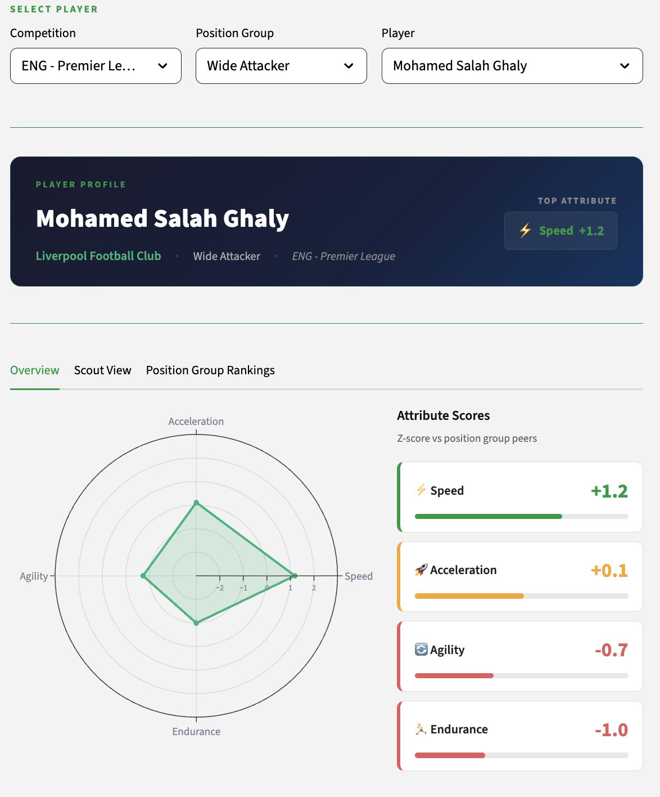
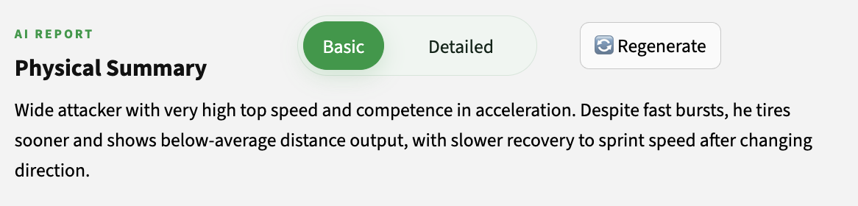
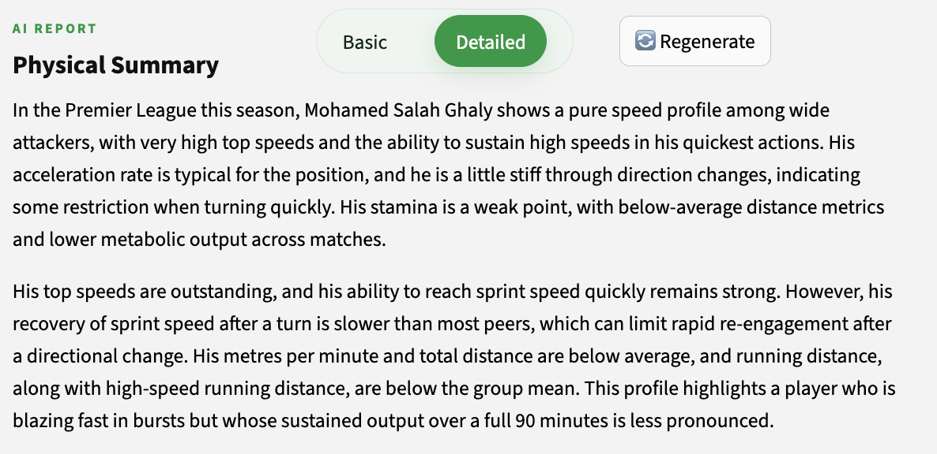
SECTION 02 – RETRIEVAL & CONTEXT
EXAMPLE 01
PLAYER
PROFILE
The player profile page displays not only the underlying data — both raw values and percentile-based metrics — but also automatically generated summaries, available in either short or detailed formats.
09 / 14

Slide 10
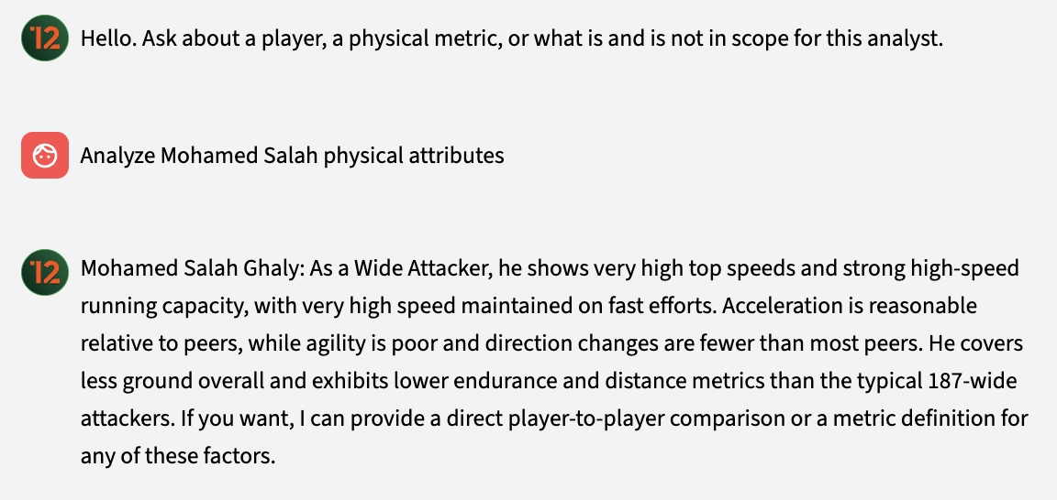
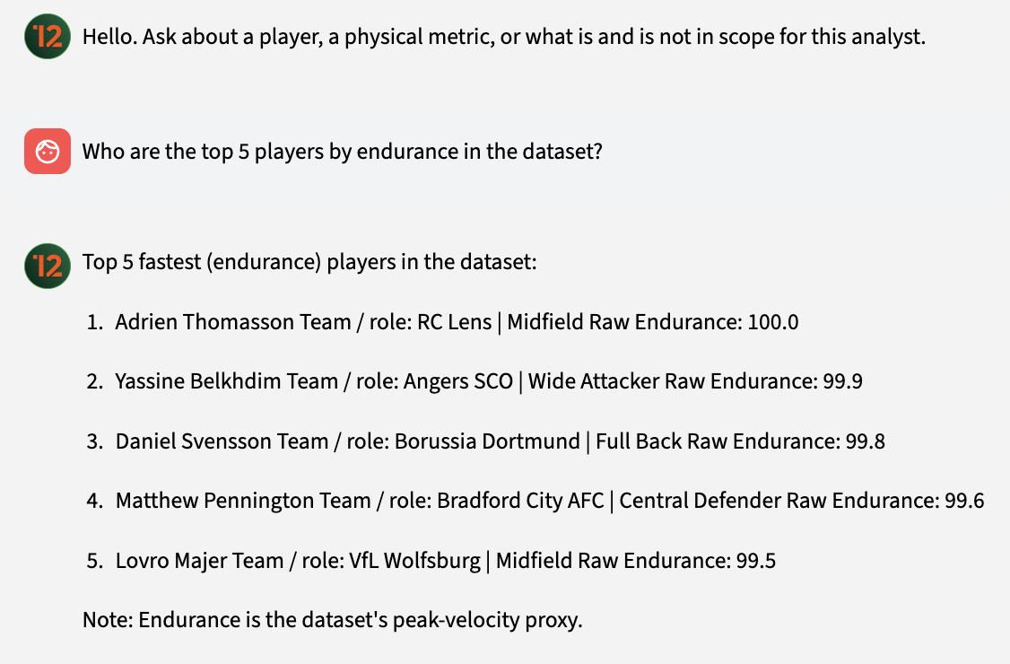
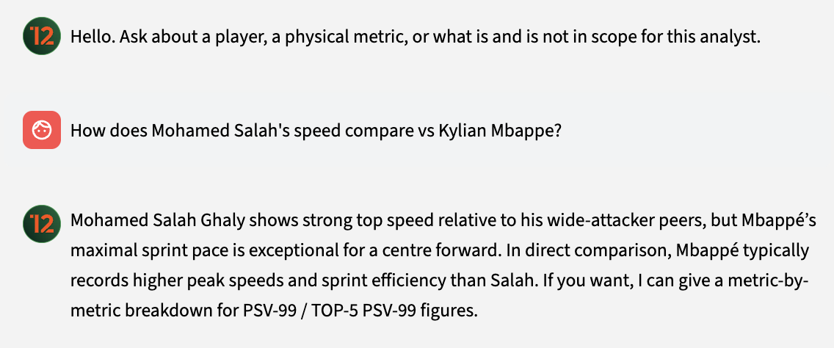
SECTION 02 – RETRIEVAL & CONTEXT
EXAMPLE 02
AI PHYSICAL ANALIST
The analyst isn't just a report generator, it's a chat interface. You can ask follow-up questions, compare players, or query the whole dataset. The model routes every question before answering.
10 / 14

Slide 11
SECTION 03
STORYBOARD
11 / 14
Future Vision
Storyboard.
03
SIX FUNCTIONS · ONE ASSISTANT
BRIEF → TARGET → ALTERNATIVES

Slide 12
SECTION 03 – FUTURE VISION STORYBOARD
The receptionist routes to six functions
DOMAIN 1 · PROFILE
DOMAIN 2 · SIMILARITY / COMPARE
DOMAIN 3 · SHORTLIST
Who is this player physically
Player ↔ others
Brief → candidates
SUMMARY
SUMMARY
SUMMARY
getPhysicalProfile(player)
findSimilarOrCompare(mode, A, B?)
shortlistByAttribute(metric, pos, league, n)
Deterministic. Fixed shape.
Deterministic. Fixed shape.
Deterministic. Fixed shape.
ASK
ASK
ASK
askAboutProfile(player, q)
askAboutSimilarity(q)
askShortlistQuestion(brief)
Intent-driven. Receptionist filters off-scope upstream.
Intent-driven. Receptionist filters off-scope upstream.
Intent-driven. Receptionist filters off-scope upstream.
12 / 14

Slide 13
SECTION 03 – FUTURE VISION STORYBOARD
One loop, three entry points
STEP 1
STEP 2
STEP 3
SHORTLIST
PROFILE
SIMILAR / COMPARE
Start from a brief
Describe a known player
Pivot to alternatives
"Top 5 quickest CBs in the PL"
"Quick LB under 24 with endurance"
"What's Gvardiol's profile?"
"Is Kane still fit enough?"
"Who could replace him in the Bundesliga?"
"Compare Saliba vs Konaté"
WHY THIS SHAPE
Three domains cover a sporting director's real-world loop: brief → target → alternatives.
Each domain answers at two depths — a fixed summary for the obvious question, an ask-question
function for the nuanced one. Same knowledge base underneath, different prompt on top.
Entry is pure chat — player, league, position extracted from natural language, no UI dropdowns.
13 / 14

Slide 14

14 / 14
CLOSING
TWELVE
CONTEXT ENGINEERING
PEDRO CARVALHO
LIAM HENSHAW
TWELVE · CONTEXT ENGINEERING · 2026

