Slide 1

Network and Computer Security GrooveGalaxy Project
André Torres - 99053
Gonçalo Nunes - 99074
Pedro Lobo - 99115
GROUP 52

Slide 2
Outline
Secure Document Format
Infrastructure
Secure Channels and key distribution
Security Challenge
Playback in the middle of an audio stream
Family Sharing
Live Demo
Conclusion

Slide 3
Outline
Secure Document Format
Infrastructure
Secure Channels and key distribution
Security Challenge
Playback in the middle of an audio stream
Family Sharing
Live Demo
Conclusion

Slide 4
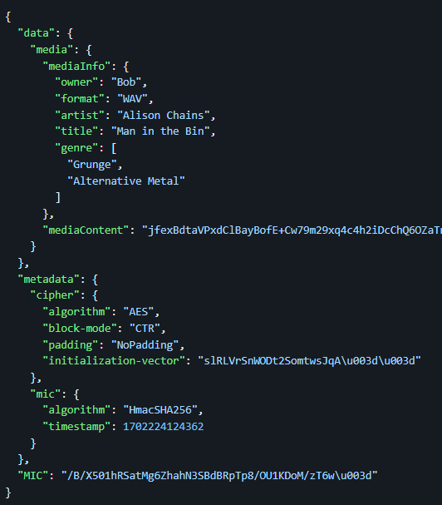
Secure Document Format
Our cryptographic library supports three main operations: protect(), check() and unprotect().
To ensure confidentiality, the application ciphers the song’s data with the shared key.
To achieve authenticity, an HMAC-SHA256 is computed over the song data and metadata, using the shared secret key. A timestamp is added to the message to guarantee freshness.

Slide 5
Outline
Secure Document Format
Infrastructure
Secure Channels and key distribution
Security Challenge
Playback in the middle of an audio stream
Family Sharing
Live Demo
Conclusion

Slide 6
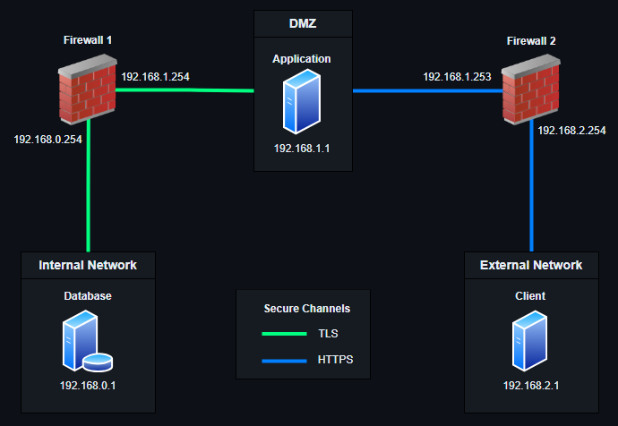
Infrastructure
Consists of a set of main machines, in three distinct networks, and two firewall machines.
The main machines include a database machine, an application machine and a client machine that interacts with the application through a command-line interface.

Slide 7
Outline
Secure Document Format
Infrastructure
Secure Channels and key distribution
Security Challenge
Playback in the middle of an audio stream
Family Sharing
Live Demo
Conclusion

Slide 8
Secure Channels and Key Distribution
The communication between the internal network (the database server) and the DMZ (the application server) is secured by TLS.
To secure the communication between the external network (the client) and the DMZ (the application server), HTTPS (HTTP over TLS) was used.
The keys necessary for the TLS/HTTPS configuration are generated while setting up the machines. The generated keys on the three machines are RSA key pairs. The keys are used to generate a certificate sign request and, in the case of the application server, a self-signed certificate. The certificate requests and copies are then distributed using scp.

Slide 9
Outline
Secure Document Format
Infrastructure
Secure Channels and key distribution
Security Challenge
Playback in the middle of an audio stream
Family Sharing
Live Demo
Conclusion

Slide 10
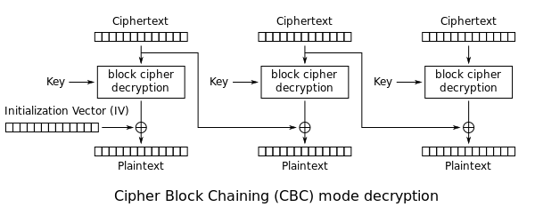
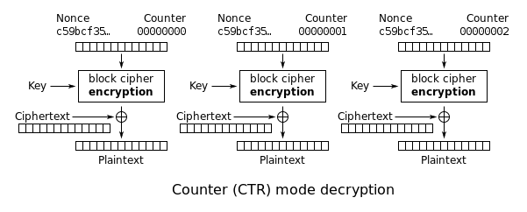
Security Challenge: Playback in middle of a stream
The first security challenge consisted of allowing playback to quickly start in the middle of an audio stream.
The solution is achieved by using CTR cipher mode which allows for random access, unlike in the original implementation which used CBC.

Slide 11
Security Challenge: Family Sharing
Dynamic key distribution.
Modifications to cryptographic tool to support this feature:
Three new operations were added: protect_key(), check_key(), unprotect_key(), generate_key().

Slide 12
Security Challenge: Family Sharing
Client 1
Key | Session Key
Application
Client 2
Key | Session Key
User | Key | Session Key
Client 1
Client 2

Slide 13
Security Challenge: Family Sharing
Client 1
Key | Session Key
Request Session Key
Application
Client 2
Key | Session Key
User | Key | Session Key
Client 1
Client 2

Slide 14
Security Challenge: Family Sharing
Client 1
Key | Session Key
Request Session Key
Application
Client 2
Key | Session Key
User | Key | Session Key
Client 1
Client 2

Slide 15
Security Challenge: Family Sharing
Client 1
Key | Session Key
Request Session Key
Application
Client 2
Key | Session Key
User | Key | Session Key
Client 1
Client 2

Slide 16
Security Challenge: Family Sharing
Client 1
Key | Session Key
Application
Client 2
Key | Session Key
User | Key | Session Key
Client 1
Client 2

Slide 17
Security Challenge: Family Sharing
Client 1
Key | Session Key
Request my Song
Application
Song
Client 2
Key | Session Key
User | Key | Session Key
Client 1
Client 2

Slide 18
Security Challenge: Family Sharing
Client 1
Key | Session Key
Application
Client 2
Key | Session Key
User | Key | Session Key
Client 1
Client 2

Slide 19
Security Challenge: Family Sharing
Client 1
Key | Session Key
Application
Request Session Key
Client 2
Key | Session Key
User | Key | Session Key
Client 1
Client 2

Slide 20
Security Challenge: Family Sharing
Client 1
Key | Session Key
Application
Client 2
Key | Session Key
User | Key | Session Key
Client 1
Client 2

Slide 21
Security Challenge: Family Sharing
Client 1
Key | Session Key
Add client 2 to my family
Application
Client 2
Key | Session Key
User | Key | Session Key
Client 1
Client 2

Slide 22
Security Challenge: Family Sharing
Client 1
Key | Session Key
Add client 2 to my family
Application
Client 2
Key | Session Key
User | Key | Session Key
Client 1
Client 2

Slide 23
Security Challenge: Family Sharing
Client 1
Key | Session Key
Application
Client 2
Key | Session Key
User | Key | Session Key
Client 1
Client 2

Slide 24
Security Challenge: Family Sharing
Client 1
Key | Session Key
Request client 2’s song
Application
Client 2
Key | Session Key
User | Key | Session Key
Client 1
Client 2

Slide 25
Security Challenge: Family Sharing
Client 1
Key | Session Key
Request client 2’s song
Application
Song
Client 2
Key | Session Key
User | Key | Session Key
Client 1
Client 2

Slide 26
Security Challenge: Family Sharing
Client 1
Key | Session Key
Application
Client 2
Key | Session Key
User | Key | Session Key
Client 1
Client 2

Slide 27
Security Challenge: Family Sharing
Client 1
Key | Session Key
Application
Request family Key
Client 2
Key | Session Key
User | Key | Session Key
Client 1
Client 2

Slide 28
Security Challenge: Family Sharing
Client 1
Key | Session Key
Application
Request family Key
Client 2
Key | Session Key
User | Key | Session Key
Client 1
Client 2

Slide 29
Security Challenge: Family Sharing
Client 1
Key | Session Key
Application
Client 2
Key | Session Key
User | Key | Session Key
Client 1
Client 2

Slide 30
Security Challenge: Family Sharing
Client 1
Key | Session Key
Application
Request client 1’s song
Client 2
Key | Session Key
User | Key | Session Key
Client 1
Client 2

Slide 31
Security Challenge: Family Sharing
Client 1
Key | Session Key
Application
Request client 1’s song
Client 2
Key | Session Key
User | Key | Session Key
Client 1
Client 2
Song

Slide 32
Security Challenge: Family Sharing
Client 1
Key | Session Key
Application
Client 2
Key | Session Key
User | Key | Session Key
Client 1
Client 2

Slide 33
Security Challenge: Family Sharing
Client 1
Key | Session Key
Remove client 2 from family
Application
Client 2
Key | Session Key
User | Key | Session Key
Client 1
Client 2

Slide 34
Security Challenge: Family Sharing
Client 1
Key | Session Key
Application
Client 2
Key | Session Key
User | Key | Session Key
Client 1
Client 2

Slide 35
Security Challenge: Family Sharing
Client 1
Key | Session Key
Application
Get updated key
Client 2
Key | Session Key
User | Key | Session Key
Client 1
Client 2

Slide 36
Security Challenge: Family Sharing
Client 1
Key | Session Key
Application
Get updated key
Client 2
Key | Session Key
User | Key | Session Key
Client 1
Client 2

Slide 37
Security Challenge: Family Sharing
Client 1
Key | Session Key
Application
Client 2
Key | Session Key
User | Key | Session Key
Client 1
Client 2

Slide 38
Outline
Secure Document Format
Infrastructure
Secure Channels and key distribution
Security Challenge
Playback in the middle of an audio stream
Family Sharing
Live Demo
Conclusion

Slide 39
Outline
Secure Document Format
Infrastructure
Secure Channels and key distribution
Security Challenge
Playback in the middle of an audio stream
Family Sharing
Live Demo
Conclusion

Slide 40
Conclusion
We implemented a cryptographic library to protect, unprotect and check the integrity of Json documents.
We built our own infrastructure that best suited our needs. Having to configure firewalls and networks.
Secured channels and communication assured by using HTTPS and TLS.
Learnt about different cypher modes and which one to choose according to our needs.
Implemented dynamic key distribution to help solve the family sharing challenge.

