Slide 1
eCourse
Pedro Mesquita 1211171
Luís Monteiro 1211250
Miguel Marques 1201078
Tiago Afonso 1201305
A new fast and easy solution for remote learning.
A look into the main features of eCourse, a remote learning platform developed using a Minimum Viable Product (MVP) approach by a team for Learning Systems, an IT company specialized in the development of learning solutions.

Slide 2

Automated Exams
eCourse has a fully automated approach for exams and evaluation.
Teachers can design exams using a simple and intuitive language for students to take.
Students receive feedback and grades automatically after submitting their exams.
Dashboards are available for both students and teachers to view exam results.

Slide 3
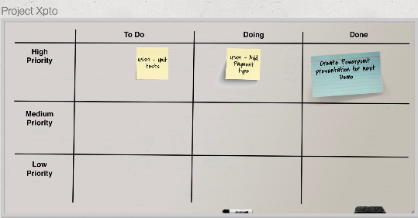
Shared Boards
A tool used to share and organize ideas and data, crucial for managing projects.
Users can create boards, share them, create post-its and edit them as they like.
Allows the validation of ideas on a board and view board history and archive.

Slide 4

Meetings
Users have the ability to schedule meetings and choose participants.
Users can cancel, accept/reject invitations and view the list of participants.

Slide 5
Other Functionalities/Information
The system has a authentication and authorization for all its users.
Courses can be created, opened/closed, listed, have students enrolled in them, schedule classes for said course.
The main language used is Java.

