Slide 1






Robustness Analysis and
Enhancement Strategies for
Quantum-dot Cellular Automata Structures
MSc. Candidate: Dayane Alfenas Reis
Advisor: Frank Sill Torres
Masters Thesis Final Presentation
February, 25th 2016

Slide 2
Agenda
Motivation
Background
Methodology
Simulations and results
Conclusions

Slide 3
Motivation - CMOS Limits about to be reached
High performance requirements
Integration density
High power consumption
Scaling
Leakage
Nano technologies as QCA have been emerging as possible CMOS successors.
Notes:
High power dissipation (OFF leakage currents due to quantum effects) comes with scaling.

Slide 4
Background – Quantum-dot Cellular Automata (QCA)
QCA: A new computation paradigm.
QCA cell (basic unit)
Polarization +1
Logic state 1
Polarization -1
Logic state 0
QCA wire
Notes:
QCA: computation paradigm whose working principle is based on Coulomb interactions between electrons.

Slide 5
Background – Quantum-dot Cellular Automata (QCA)
OR
Majority gate
AND
FIXED
IN1
FIXED
IN1
OUT
IN2
OUT
IN1
OUT
IN2
IN3
IN2
Inverter
Any logic can be created.
More complex circuits feasible.
IN
OUT

Slide 6
Background – Quantum-dot Cellular Automata (QCA)
QCA Pros
Very high theoretical speeds achieved (within THz range);
Low power consumption (information is transported with no electric current flow);
Small dimensions (a molecular QCA cell should be 2x2 nm).
QCA Cons
Extremely difficult physical implementation.

Slide 7
Background – Defects and Errors in QCA circuits
Defects: flaws of the cells of a circuit.
Affect directly the interaction between cells.
QCA Defects Modeling
Dopant
Dislocation
Vacancy
Interstitial
IN1
IN1
IN1
IN1
IN2
OUT
IN2
OUT
IN2
OUT
IN2
OUT
IN3
IN3
IN3
IN3

Slide 8
Methodology – Fault Simulation Flow
A new methodology for error exploration in QCA circuits which aims to be:
Extensive
Four classes of defects + Three probability models
Flexible
Operation under different conditions can be verified;
Parameter-based approach
Innovative
Easy to interpret and visualize the results
Error-free simulations calculation (%)
Heat map

Slide 9
Methodology – Fault Simulation Flow
Repeat for all iterations
After all iterations
Intermediate procedures
Circuit selection
Parameters choice
Error-free reference simulation
Defect insertion
Fault simulation
Comparison (Error-free x defective)
Result analysis
Error-free simulations percent calculation
Design heat map
Final procedures
Initial procedures

Slide 10
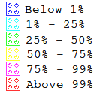
Methodology – Heat map
Map the defective cells leading the outputs to an error.
A visual resource for results analysis
Colors used
Example
Pink cells are more likely to cause defects
Yellow cells are majorly related to defects.
Given an error event, these cells have ________ of probability to be defective.
50-75%
75-99%

Slide 11
Methodology – Pros and Cons
Methodology Pros
Extensive defect modeling applied;
Allows flexibility for defects insertion by means of probability models;
Parameters are totally user-set;
Presents the results by a heat map of the circuit;
Provides the error-free simulations percent along all iterations.
Methodology Cons
Simulation-based: May be a computational costly approach depending on the circuit size/ complexity.
Notes:
Extensive defect modeling applied: It is possible to verify the circuit behavior under several defective conditions;

Slide 12
Simulations and results
Error-Free Simulations (%)
 | INVERTER |  | 3-INPUT MAJORITY |  | FULL ADDER
 | INV1 | INV2 | MJ1 | MJ2 | FA1 | FA2
Vacancy | 74.6 | 86.1 | 60.6 | 30.3 | 2.8 | 16.2
Interstit. | 97.4 | 99.9 | 94.3 | 87.9 | 54.9 | 76.0
Dopant | 83.7 | 88.6 | 75.8 | 31.1 | 3.7 | 26.2
Dislocat. | 88.6 | 93.9 | 78.5 | 67.2 | 25.9 | 51.0
Probability model = Assignable;
Number of iterations = 1.000;
Probability value for individual defect classes = 5%;
Sample Interval = 10% and LOW/HIGH Threshold = 80%.
Notes:
Extensive defect modeling applied: It is possible to verify the circuit behavior under several defective conditions;

Slide 13
Simulations and results
Two inverter (A) and (B) for 1.000 tests under vacancy defects.
Probability model “Assignable”.

Slide 14
Simulations and results
Reliable majority cell for 1.000 tests under dopant defects (A) and interstitial defects (B). Probability model “Assignable”.

Slide 15
Conclusions
The new methodology presented is useful to:
Design more reliable QCA circuits/ structures;
Compare QCA circuits in terms of robustness;
Verify the reliability of a QCA circuit undo different test conditions;
Simulation results proved the feasibility of the methodology.

Slide 16

See you in Belo Horizonte...
Chip on the Mountains 2016
Thank you!
Questions?

Slide 17
EXTRA

Slide 18
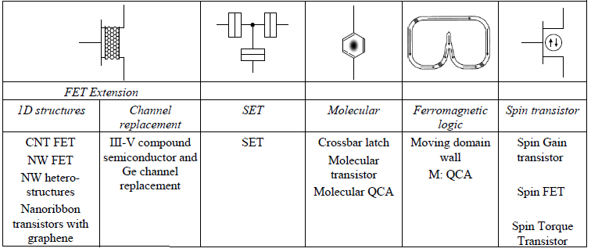
Emerging nanotechnologies

Slide 19
Methodology – Fault Simulation Flow
Parameters list
Sample interval;
HIGH/LOW thresholds;
Defect classes (As defect modeling previously exposed);
Number of iterations;
Probability model
Sequential: P=1 for each cell of the design at sequential moments
Assignable: Any value between 0 and 1 may be assigned as defect probability for each design cell
Uniform: P=1/(Total of cells) for each cell of the design

Slide 20
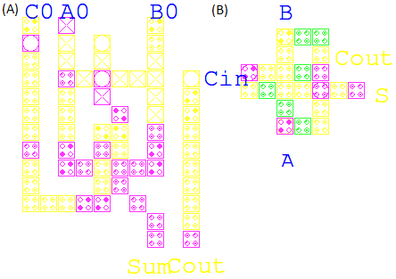
Simulations and results
Two full adder (A) and (B) for 1.000 tests under dislocation defects. Probability model “Assignable”.

Slide 21
Simulations and results
Tables 1 and 2 - Error-Free Simulations (%)*
 | INVERTER |  | 3-INPUT MAJORITY |  | FULL ADDER
 | INV1 | INV2 | MJ1 | MJ2 | FA1 | FA2
Vacancy | 74.6 | 86.1 | 60.6 | 30.3 | 2.8 | 16.2
Interstit. | 97.4 | 99.9 | 94.3 | 87.9 | 54.9 | 76.0
Dopant | 83.7 | 88.6 | 75.8 | 31.1 | 3.7 | 26.2
Dislocat. | 88.6 | 93.9 | 78.5 | 67.2 | 25.9 | 51.0
*Probability model=Assignable; Number of iterations=1000; Probability value for individual defect classes=5%; Sample Interval=10% and LOW/HIGH Threshold=80%.
 | INVERTER |  | 3-INPUT MAJORITY |  | FULL ADDER
 | INV1 | INV2 | MJ1 | MJ2 | FA1 | FA2
Vacancy | 60.0 | 83.3 | 11.1 | 89.9 | 26.6 | 0.0
Interstit. | 96.0 | 100 | 87.8 | 98.9 | 50.9 | 83.9
Dopant | 69.0 | 80.8 | 42.2 | 85.2 | 0.0 | 37.4
Dislocat. | 88.0 | 90.8 | 61.1 | 95.2 | 77.2 | 39.0
*Probability model=Sequential; Number of iterations=10 for interstitial, dopant and dislocation defect classes. 1 for vacancy defect class. Sample Interval=10% and LOW/HIGH Threshold=80%.
Notes:
Extensive defect modeling applied: It is possible to verify the circuit behavior under several defective conditions;

Slide 22
Simulations and results
MJ2 for 1.000 tests under dopant defects (A) and interstitial defects (B). Probability model “Assignable”.
INV1 (A) and INV2 (B) for 1000 tests under vacancy defects. Probability model “Assignable”.

