Slide 1
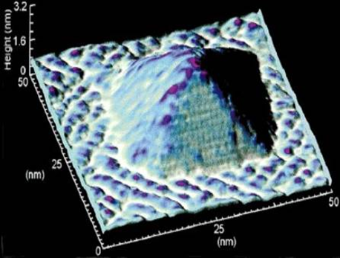
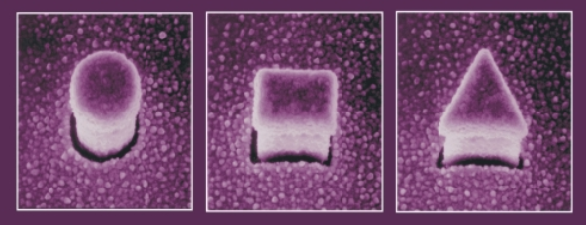




Figure 1 – Quantum dot examples
(a) An InAs quantum dot structure grown on GaAs substrate (NSTC, 1999).
(b) The quantum dot shape may vary depending on the process and application requirements (LIANG; XIE, 2015).

Slide 2
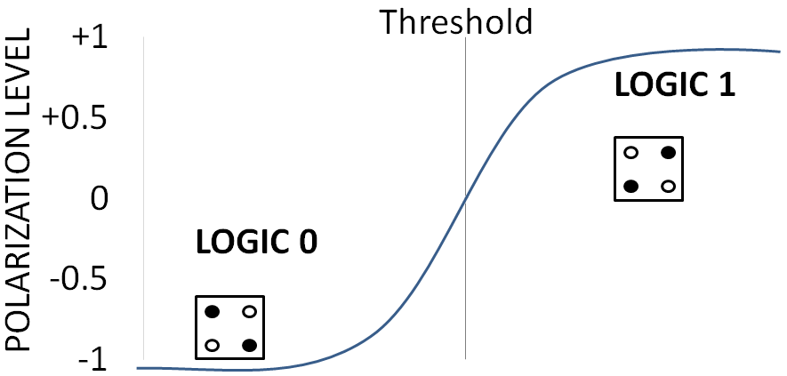
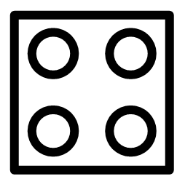
Figure 2 – A QCA cell and its two possible logic states
(a) The representation of a four-dot QCA cell.
(b) The QCA cell logic state interpretation depends on the threshold of the polarization level. In the figure, a fulffiled circle represents a trapped electron.

Slide 3
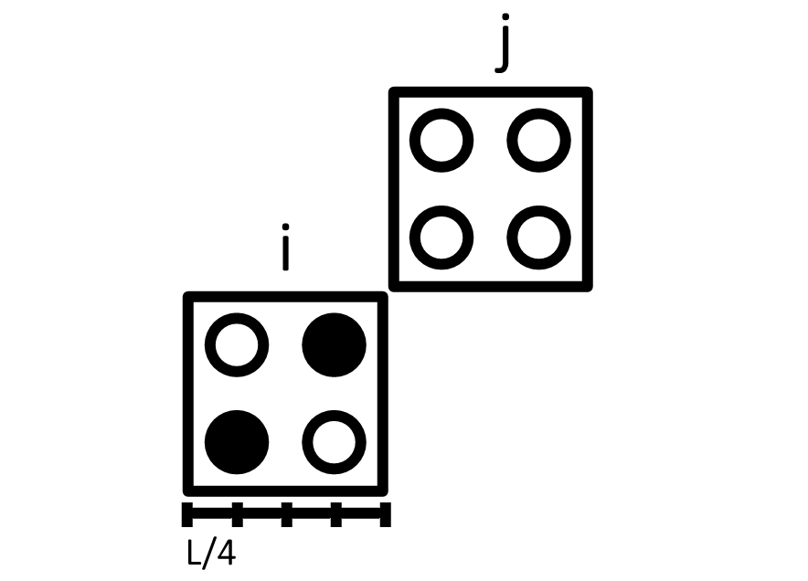
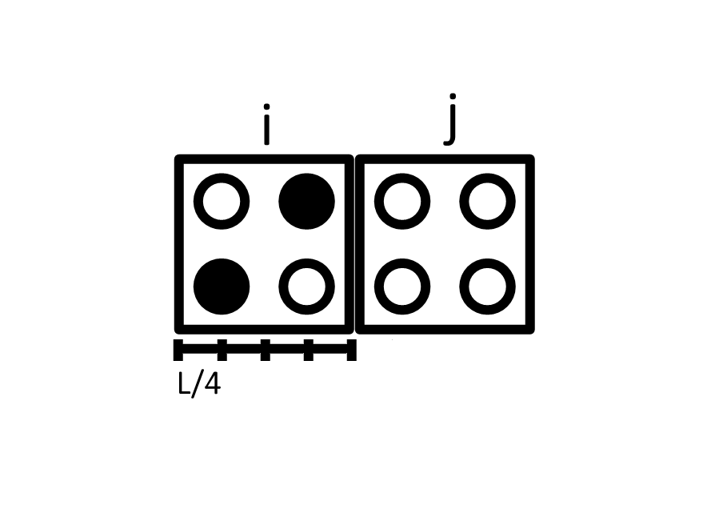
Figure 3 – Two different arrangements for the cells i and j. A fulfilled dot represent a trapped eletron. The polarization of the cell i is arbitrarily established as +1.
(a) Cells i and j positioned in line.
(b) Cells i and j positioned in diagonal.

Slide 4
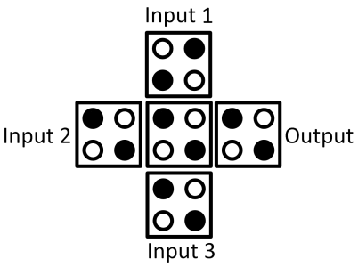
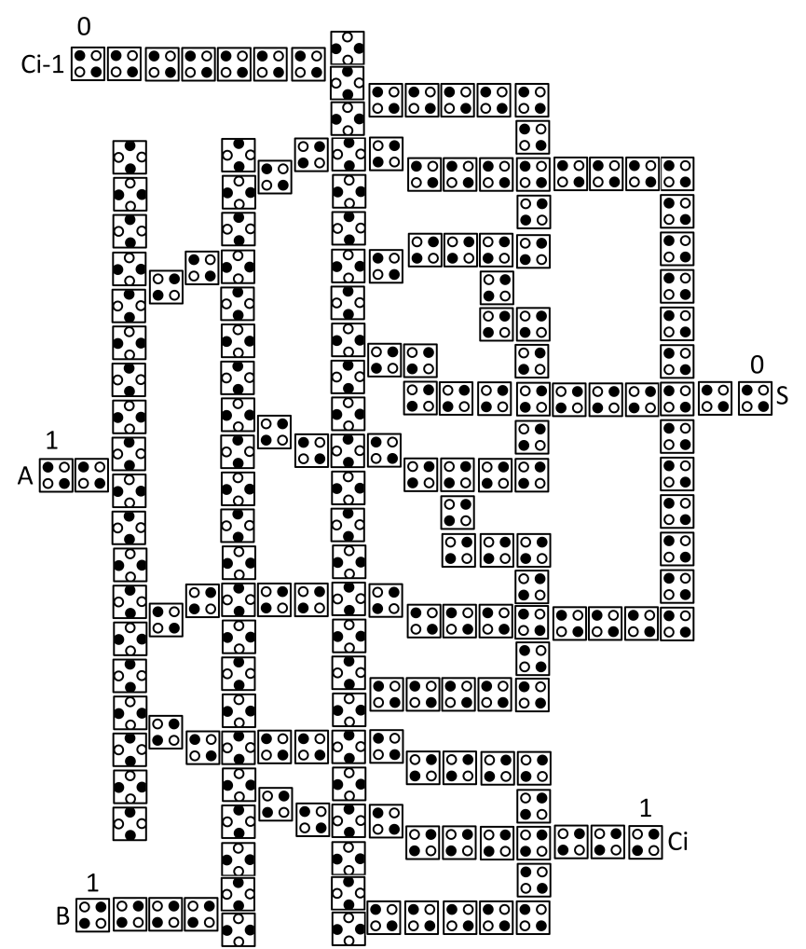
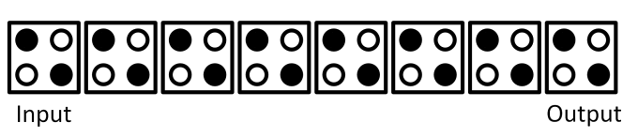
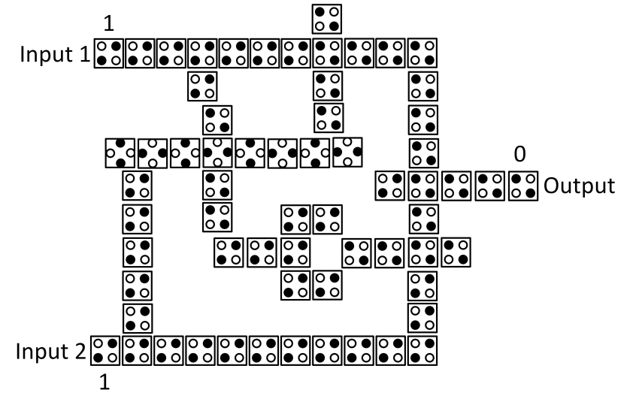
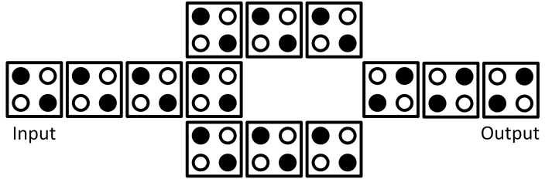
Figure 4 – The four components and one circuit reported in (TOUGAW; LENT, 1994).
(a) A wire.
(c) A three-input majority gate.
(b) An inverter.
(d) A XOR.
(e) A full adder.

Slide 5
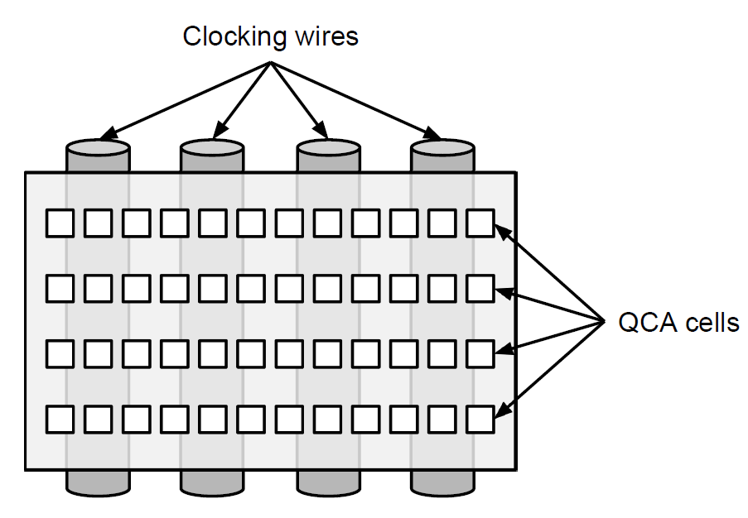
Figure 5 – Interconnects from the external clock circuit, i.e. clocking wires, underneath the QCA layer (CAMPOS, 2015).

Slide 6
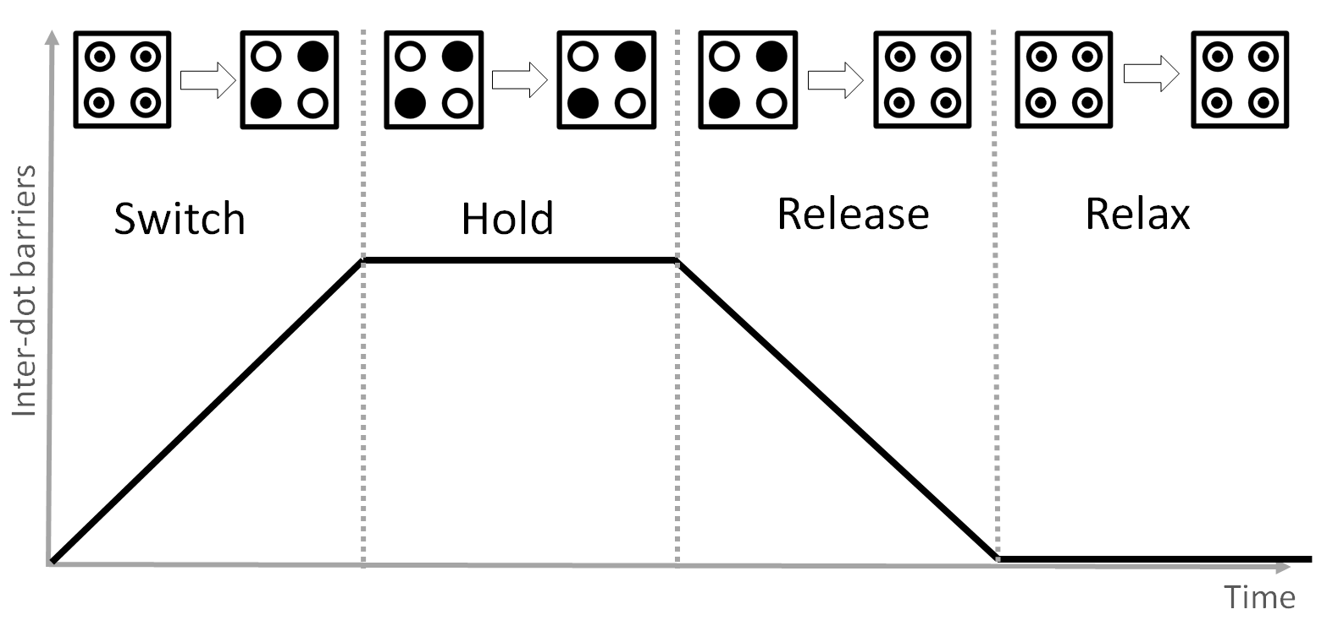
Figure 6 – The cell inter-dot potential barrier behavior at the four distinct clock phases.

Slide 7
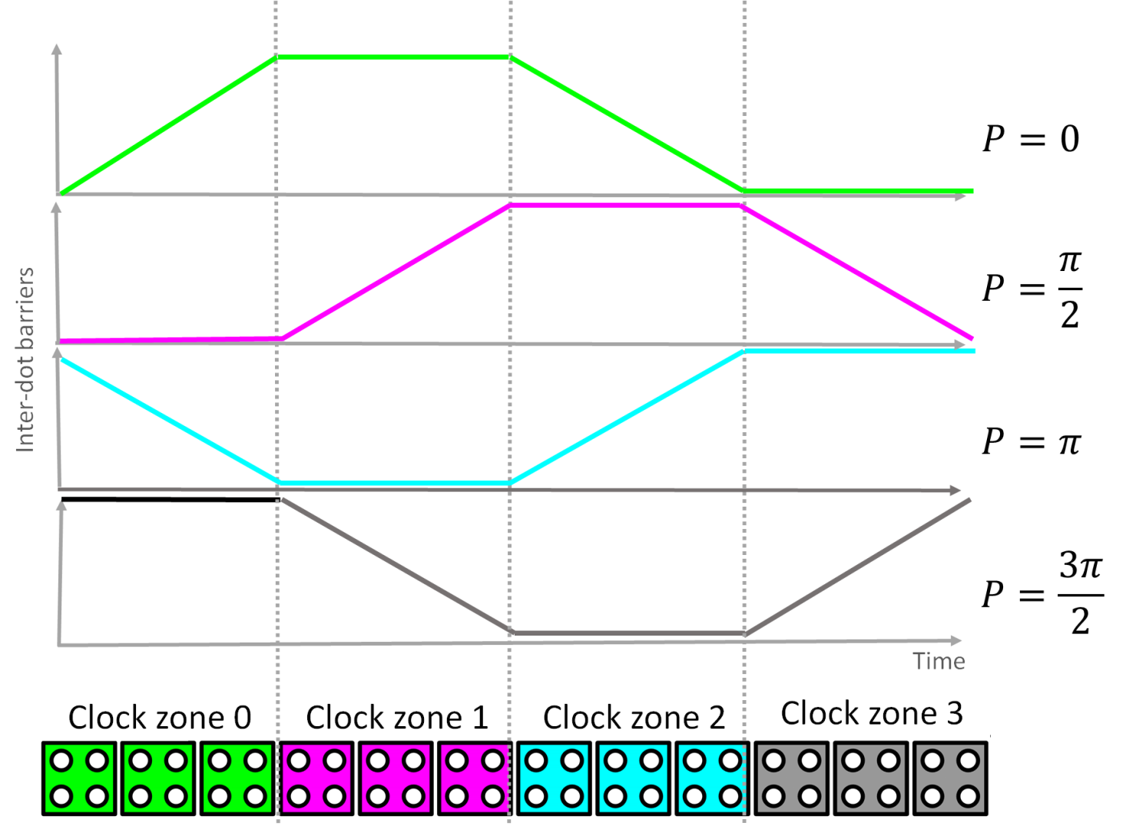
Figure 7 – A QCA wire divided into four zones and their respective clock signals (depicted in the same colors). The phase shifts are indicated next to the graphs.

Slide 8
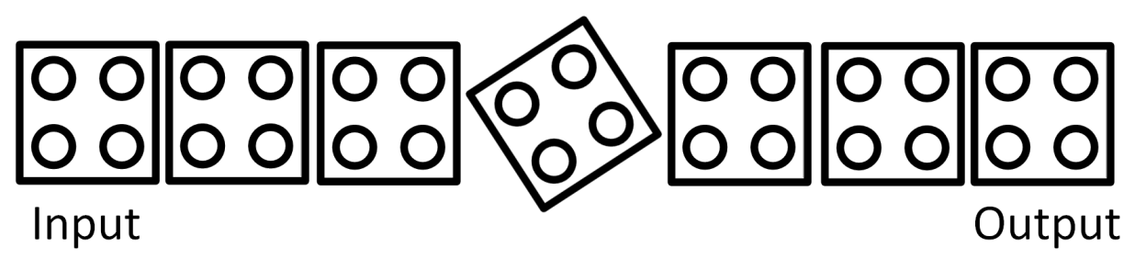
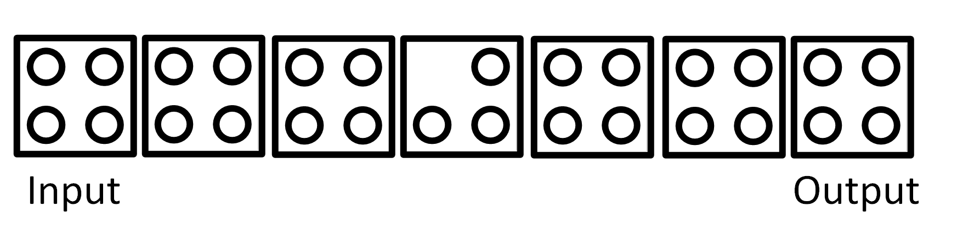
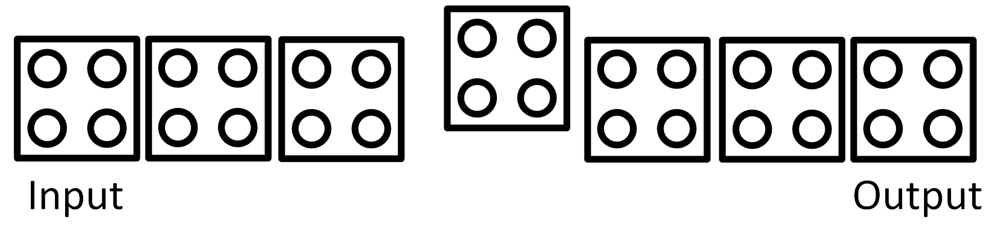
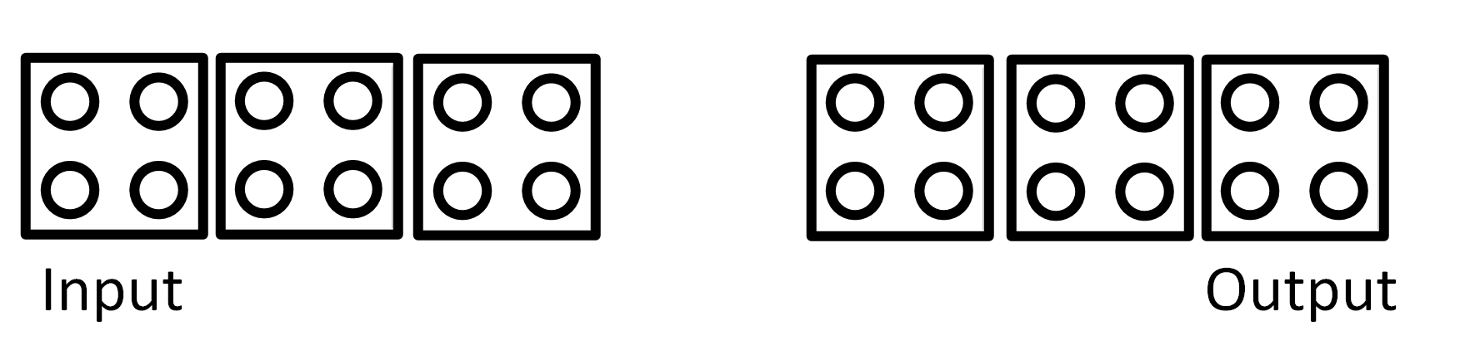
Figure 8 – The four defect classes (dislocation, dopant, interstitial and vacancy) used in this work. They are exemplified through a wire in which the fourth (middle) cell is always defective.
(a) Dislocation
(b) Dopant
(c) Interstitial
(d) Vacancy.

Slide 9
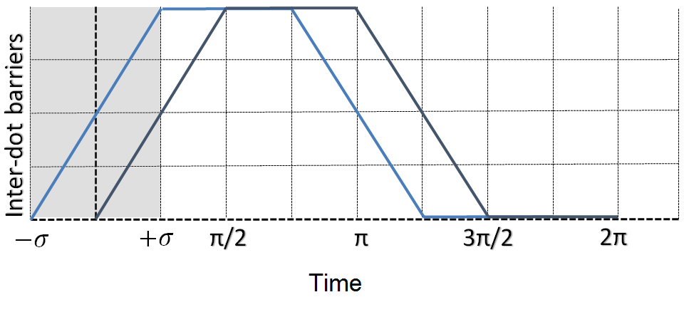
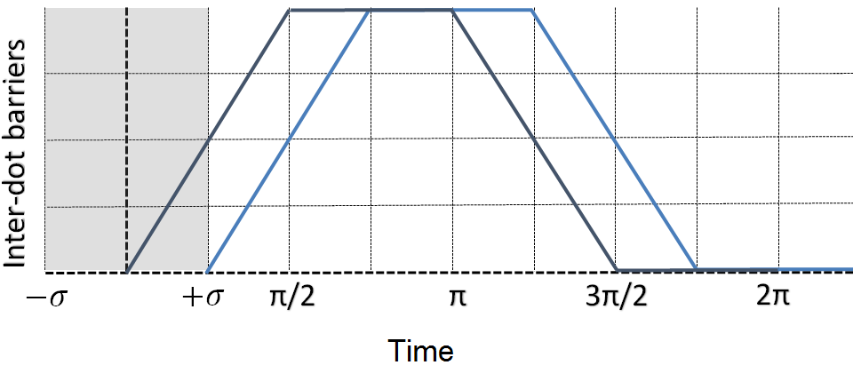
Figure 9 – The boundaries for the standard deviation in the clock signal phase.
(a) A clock signal, depicted in blue, whose phase is advanced by /4rad relative to the reference signal, shown in black.
(b) A clock signal, depicted in blue, whose phase is delayed by /4rad relative to the reference signal, shown in black.

Slide 10
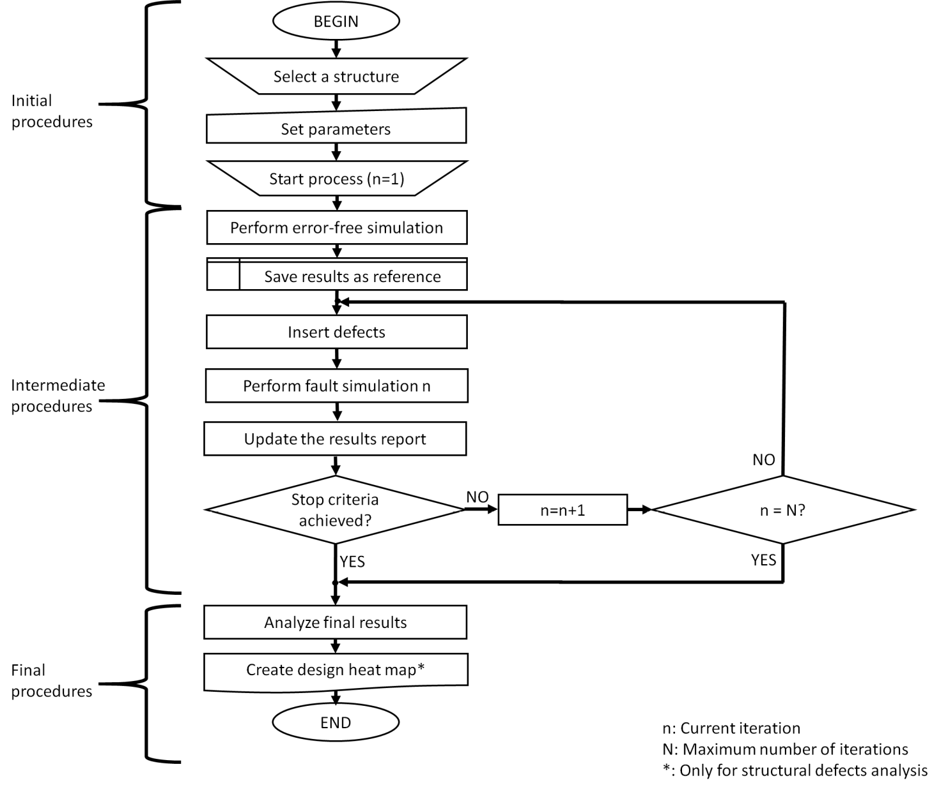
Figure 10 – Methodology flow chart.

Slide 11
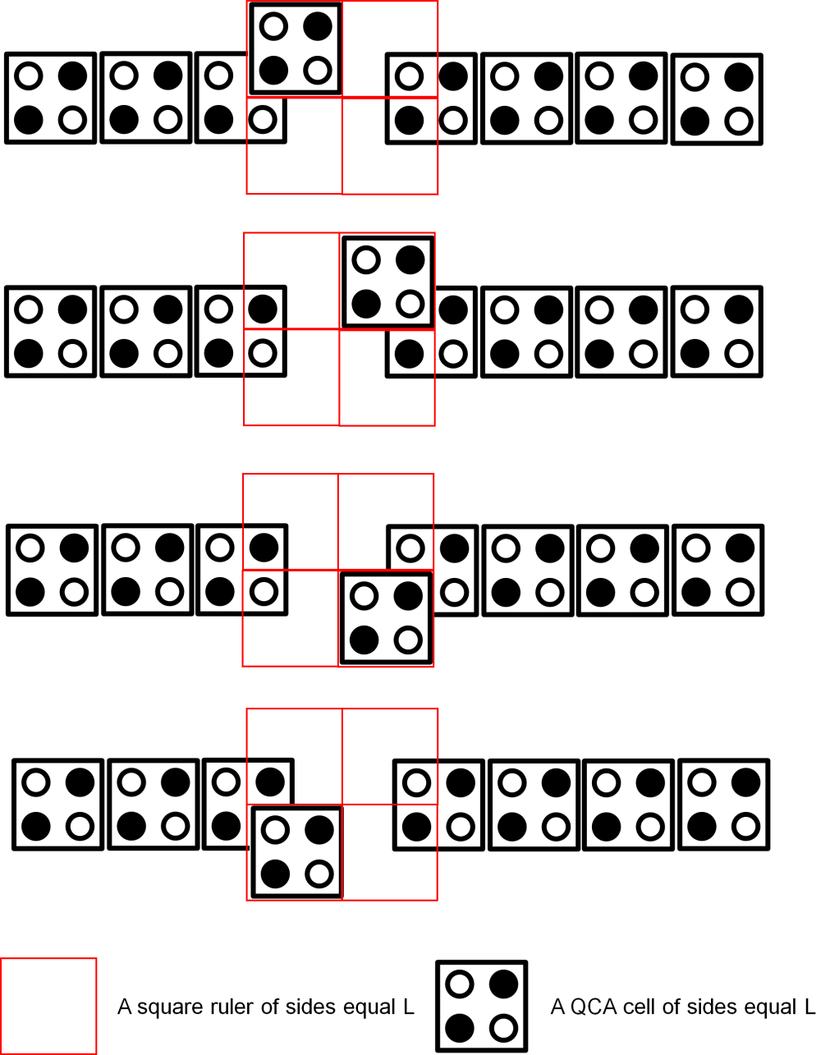
Figure 11 – The boundaries for displacement/misalignment of a cell in the QCA Defects Simulator. The cell is allowed to occupy any position within the limits of the square ruler. Four extreme placements for a defective cell are shown through the QCA wire example.

Slide 12
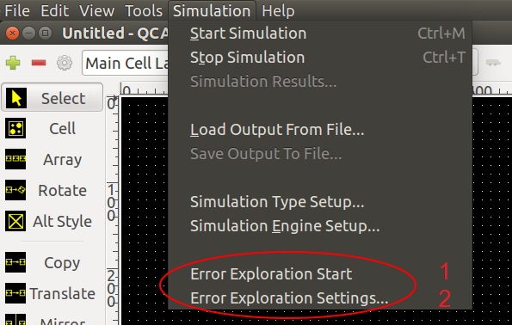
Figure 12 – The two error analysis module interfaces may be accessed through the shortcuts highlighted in red, which were integrated in the QCADesigner main menu.

Slide 13
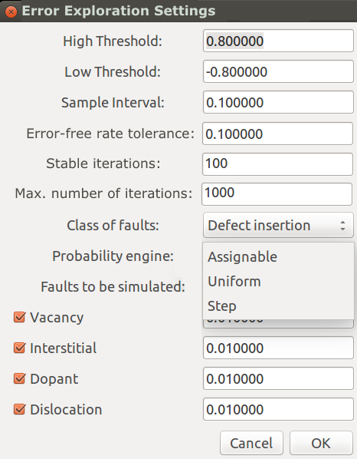
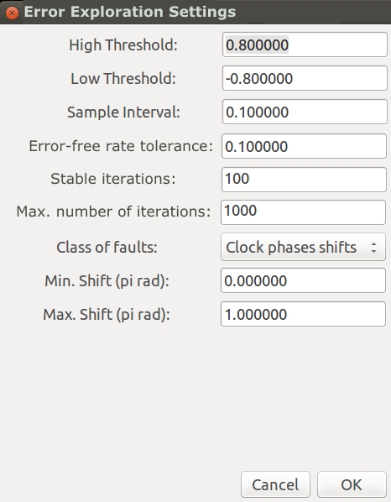
Figure 13 – The two distinct perspectives for the ‘Error Exploration Settings’ window.
(a) The parameter setting window opened
under the insertion of ‘Structural Defects’
perspective.
(b) Cells i and j positioned in diagonal.

Slide 14
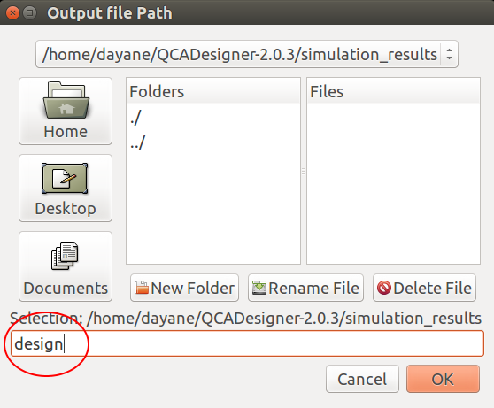
Figure 14 – The error analysis module interface for output files setting and characterization round starting. The basis name field is highlighted by a red circle. Here, the name ‘design’ was used as an example.

Slide 15
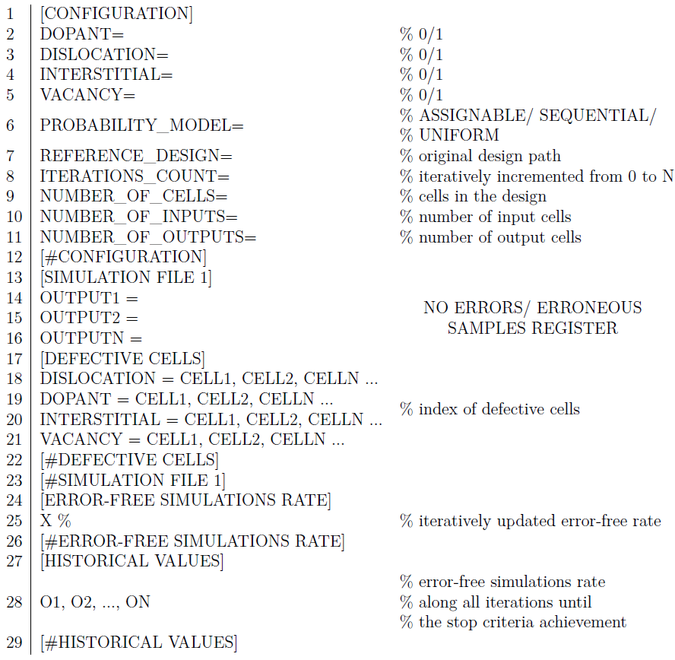
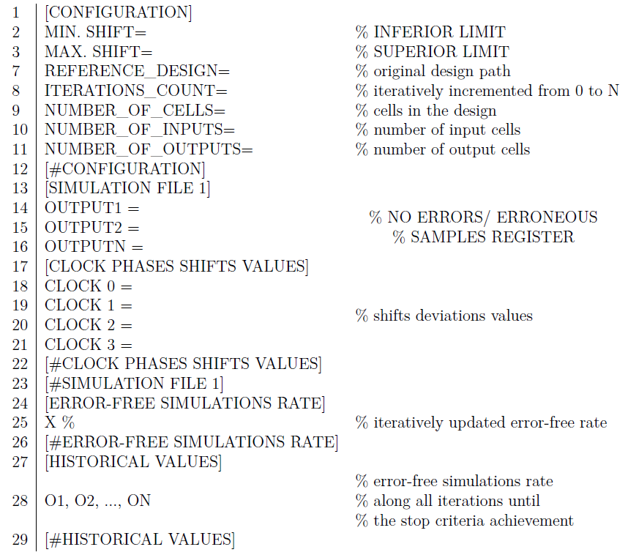
Figure 15 – File results templates.
(a) Structural defects result file.
(b) Clock phase shifts result file.

Slide 16
Figure 16 – The range of color used in the creation of a heat map.

Slide 17
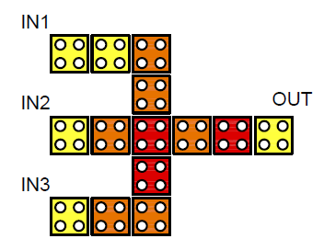
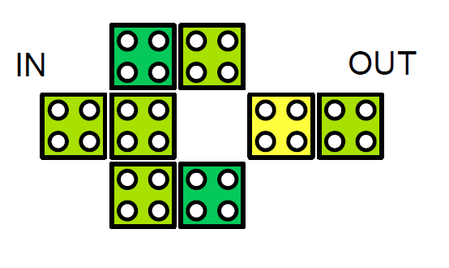
Figure 17 – Examples of heat maps.
(a) A heatmap for a NOT gate tested
against all structural defect classes with
an uniform probability.
(b) A heatmap for a majority gate tested against dopant structural defects with an uniform probability.

Slide 18
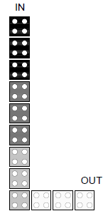
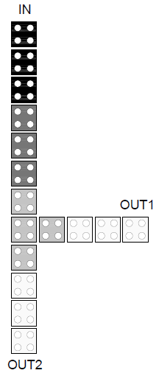
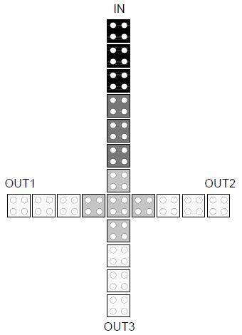

Figure 18 – The four fundamental components selected for undergo defects testing.
(a) A regular wire.
(b) A regular bent wire.
(c) A regular fanout of 2.
(d) A regular fanout of 3.

Slide 19




Figure 19 – The heat maps for the regular wire submitted to every four classes of defects in the sequential structural defects testing. The gray shadows highlight the weakest polarization regions of the structure.
(a) A regular wire tested under sequential dislocation defects..
(b) A regular wire tested under sequential dopant defects.
(c) A regular wire tested under sequential interstitial defects.
(d) A regular wire tested under sequential vacancy defects.

Slide 20
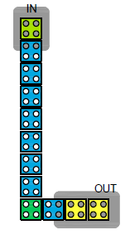
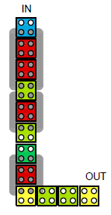
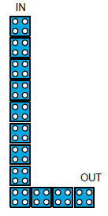
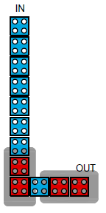
Figure 20 – The heat maps for the bend wire submitted to every four classes of defects in the sequential structural defects testing. The gray shadows highlight the weakest polarization regions of the structure.
(a) A regular bend wire
tested under sequential
dislocation defects.
(b) A regular bend wire
tested under sequential
dopant defects.
(c) A regular bend wire
tested under sequential
interstitial defects.
(d) A regular bend wire
tested under sequential
vacancy defects.

Slide 21
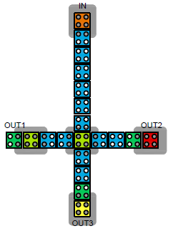
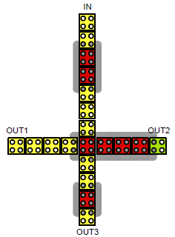
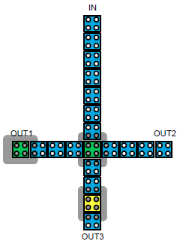
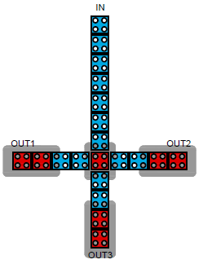
Figure 21 – The heat maps for the fanout of 3 submitted to every four classes of defects in the sequential structural defects testing. The gray shadows highlight the weakest polarization regions of the structure.
(a) A regular fanout of 3 tested under sequential
dislocation defects.
(b) A regular fanout of 3 tested under sequential
dopant defects.
(c) A regular fanout of 3 tested under sequential
interstitial defects.
(d) A regular fanout of 3 tested under sequential
vacancy defects.

Slide 22
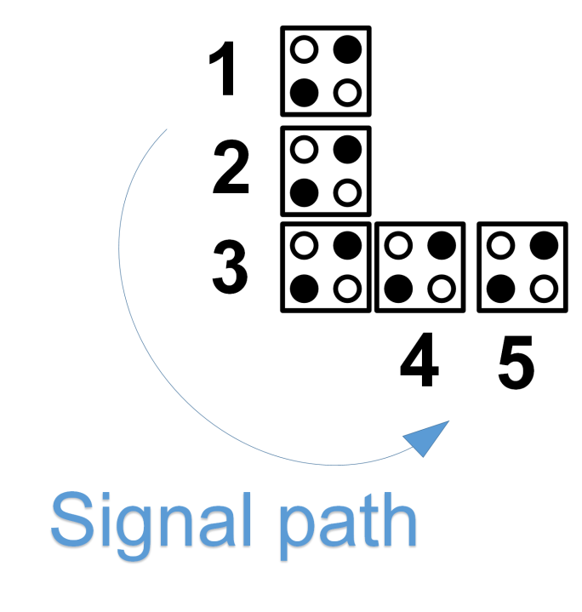
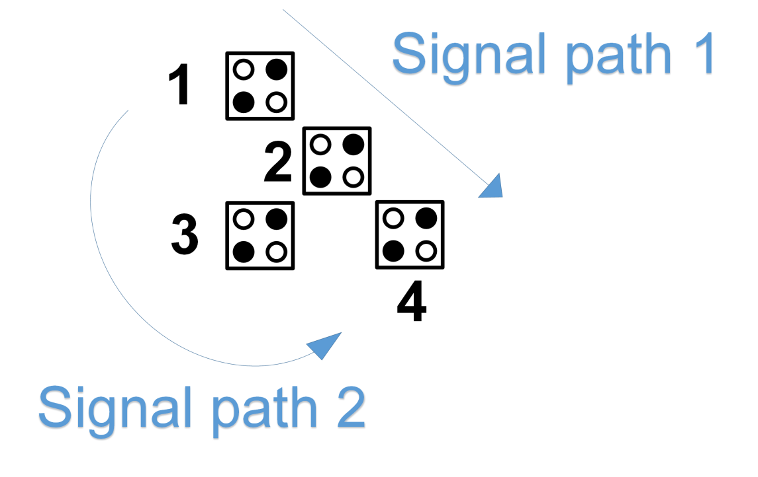
Figure 22 – The structural modifications in a ‘L’ shaped turning region.
(a) A regular 5-cell ‘L-shaped’ turning.
The arrow in blue represents
the only one possible path for signal
routing within the structure.
(b) A modified 4-cell ‘L-shaped’ turning. The two arrows in blue represent the redundant paths for signal routing within the structure. Note that the path 1 is based on successive inversions of the logic state promoted by three diagonallypositioned cells placed in row.

Slide 23
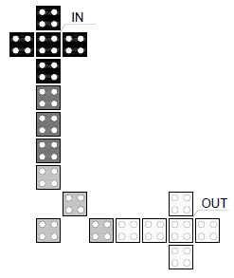
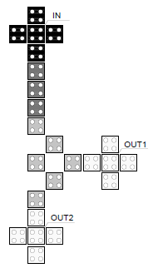
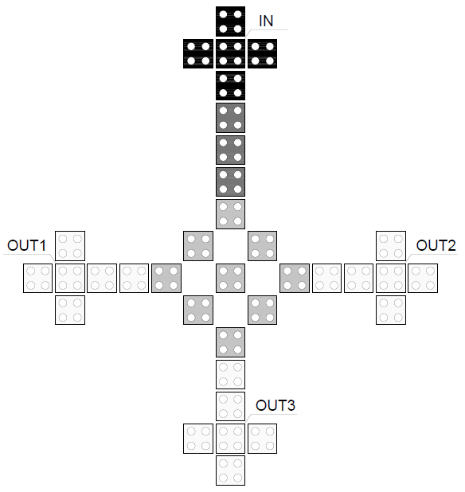
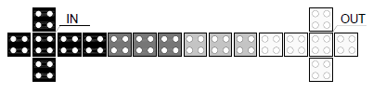
Figure 23 – The four modified fundamental components.
(a) A modified wire.
(b) A modified bend wire.
(c) A modified fanout of 2.
(d) A modified fanout of 3.

Slide 24
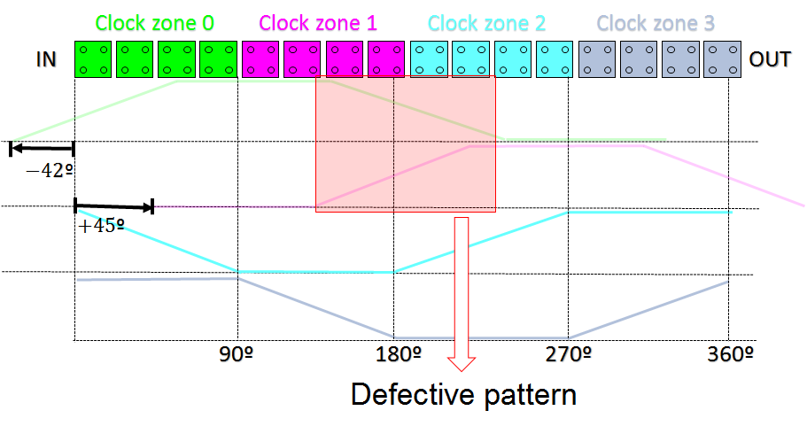
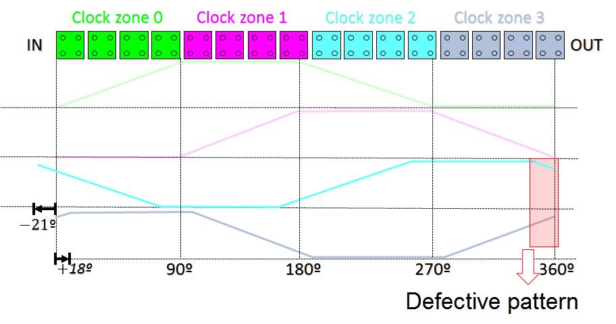
Figure 24 – Two possible waveforms of shifted clock shifts that might lead the QCA wire to propagate an unexpected logic state.
(a) A wire where 2 out of 4 clock signals phases were shifted. The shifts were
within the range of 18.75º to 22.5º .
(b) A wire where 2 out of 4 clock signals phases were shifted. The shifts were
within the range of 41.25º to 45.0 º

Slide 25
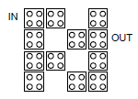


Figure 25 – The three inverters submitted to structural defects testing.
(a) INV1
(b) INV2
(c) INV3

Slide 26



Figure 26 – The heat maps of the three inverters under structural combined defects and sequential probability model.
(a) INV1 under combined defects.
(b) INV2 under combined defects.
(c) INV3 under combined defects.

Slide 27



Figure 27 – The three majority gates submitted to structural defects testing.
(a) MAJ1
(b) MAJ2
(c) MAJ3

Slide 28



Figure 28 – The heat maps of the three majority gates under structural combined defects and sequential probability model.
(a) MAJ1 under combined defects.
(b) MAJ2 under combined defects.
(c) MAJ3 under combined defects.

Slide 29



Figure 29 – The three full adders submitted to structural defects testing.
(a) ADD1
(b) ADD2
(c) ADD3

Slide 30



Figure 30 – The heat maps of the three full adders under structural combined defects and sequential probability model.
(a) ADD1 under combined defects.
(b) ADD2 under combined defects.
(c) ADD3 under combined defects.

Slide 31

Figure 31 – The three RCAs submitted to structural defects testing.
(a) RCA1

Slide 32

Figure 31 – The three RCAs submitted to structural defects testing.
(b) RCA2

Slide 33

Figure 31 – The three RCAs submitted to structural defects testing.
(c) RCA3

Slide 34

Figure 32 – The heat maps of the three RCAs under structural combined defects and uniform probability model.
(a) RCA1 under combined defects.

Slide 35

Figure 32 – The heat maps of the three RCAs under structural combined defects and uniform probability model.
(b) RCA2 under combined defects.

Slide 36

Figure 32 – The heat maps of the three RCAs under structural combined defects and uniform probability model.
(c) RCA3 under combined defects.

