Slide 1






Robustness Analysis and
Enhancement Strategies for
Quantum-dot Cellular Automata Structures
MSc. Candidate: Dayane Alfenas Reis
Advisor: Frank Sill Torres
Masters Thesis Final Presentation
February, 25th 2016

Slide 2
Agenda
Introduction
Background
QCA Defects Simulator
Robustness Enhancement Strategies
Results
Conclusions

Slide 3
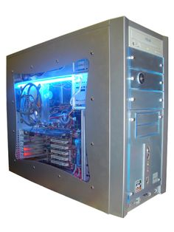
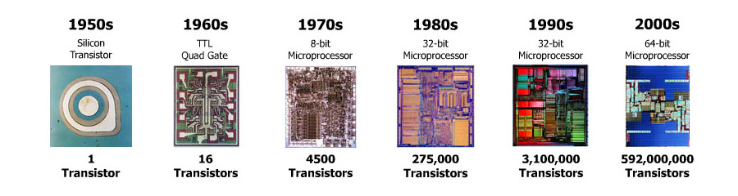
Introduction
The current technology for computer design
CMOS – Complementary Metal-Oxide Semiconductor
Silicon transistors
Widely used since the late 1960s
Highly mature manufacturing process
Reliable
Notes:
High power dissipation (OFF leakage currents due to quantum effects) comes with scaling.

Slide 4
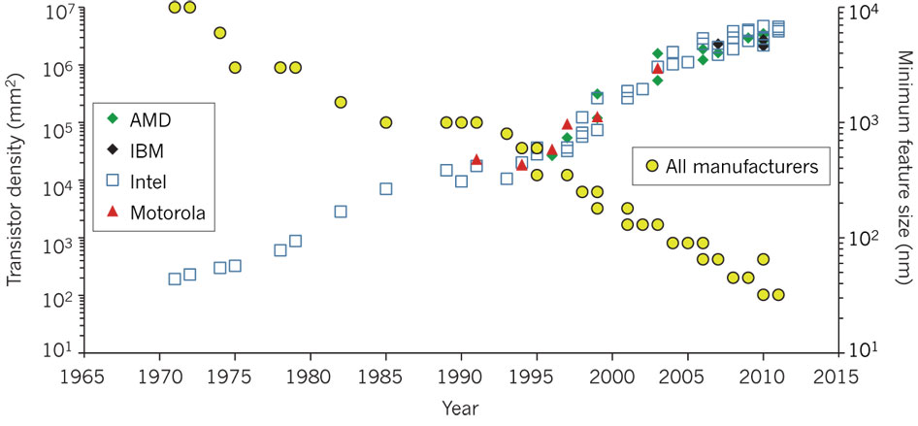
Moore’s Law and CMOS devices scaling
2x number of transistors every twenty four months.
Source: Ferain et al, 2011.
Notes:
High power dissipation (OFF leakage currents due to quantum effects) comes with scaling.

Slide 5
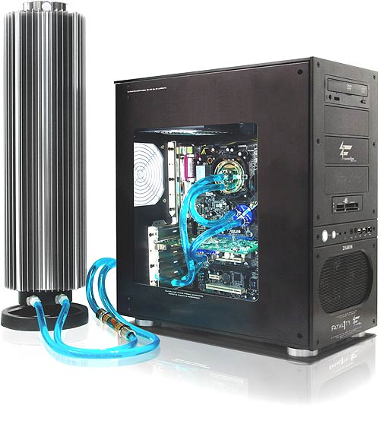

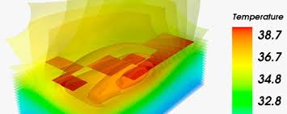
Consequences of CMOS devices scaling
Transistor count still rising
Moore’s Law still sustains
Power reaches limits
Clock speed flattening sharply
Multi-core processors
High efforts for cooling
Increasing operational costs
Reduced reliability
Notes:
High power dissipation (OFF leakage currents due to quantum effects) comes with scaling.

Slide 6
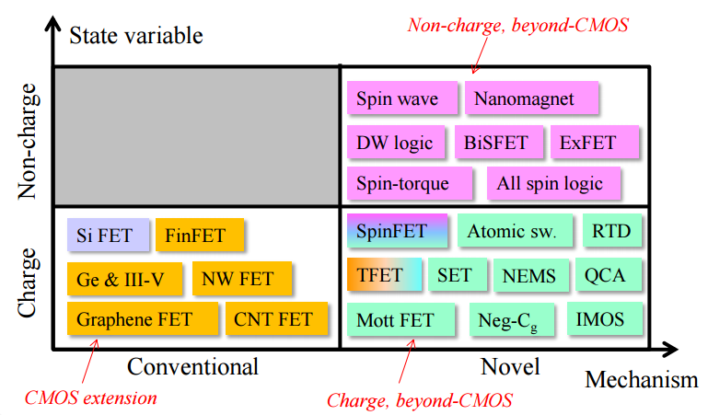
What’s next?
Nanoelectronics: The use of nanotechnology in electronic components.
Nanotechnology exploits:
Material quantum mechanical properties;
Inter-atomic level interactions.
Notes:
High power dissipation (OFF leakage currents due to quantum effects) comes with scaling.

Slide 7
Background
QCA - Quantum-dot Cellular Automata
A new computation paradigm based on electrostatic interactions.
QCA cell (basic unit)
Polarization +1
Logic state 1
Four possible places for two trapped electrons
Polarization -1
Logic state 0
Notes:
QCA: computation paradigm whose working principle is based on Coulomb interactions between electrons.

Slide 8
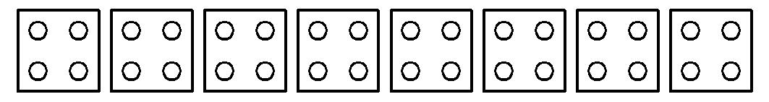
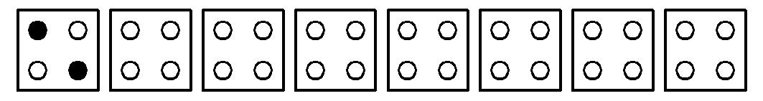
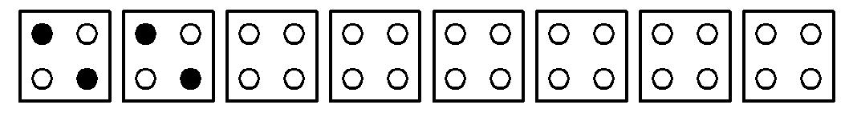
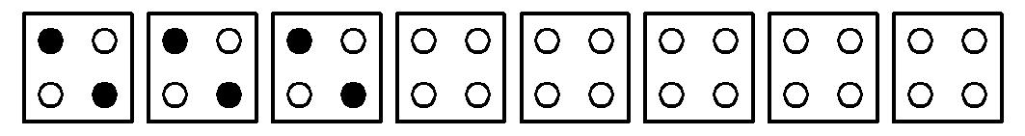
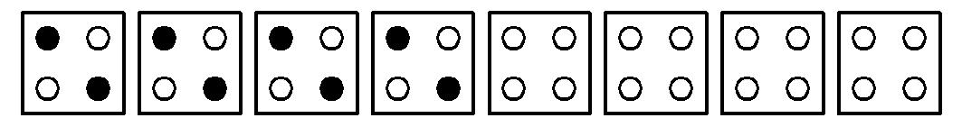
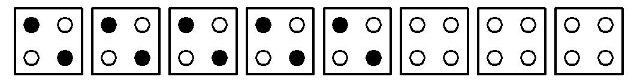
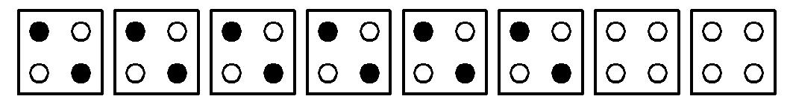
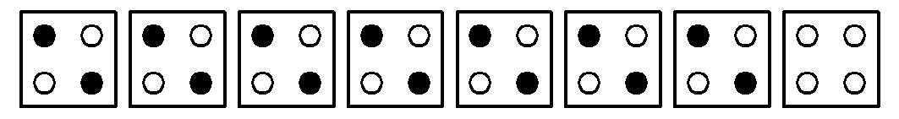
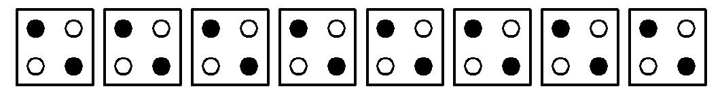
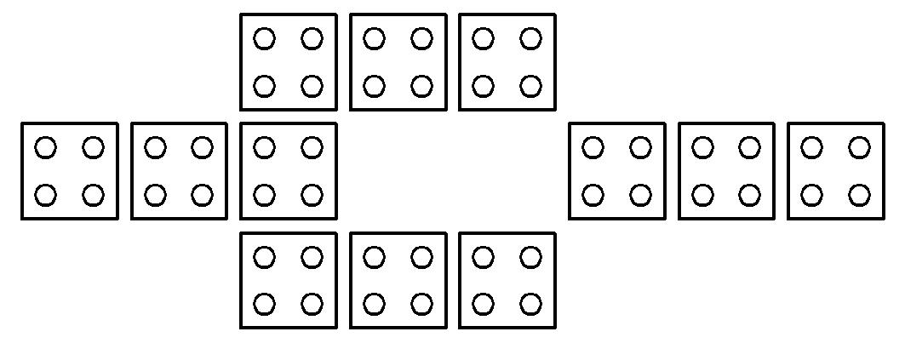
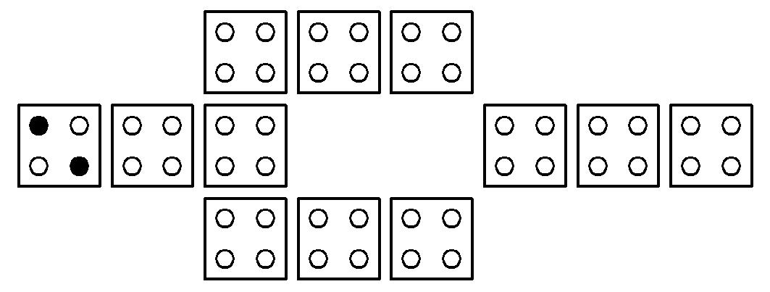
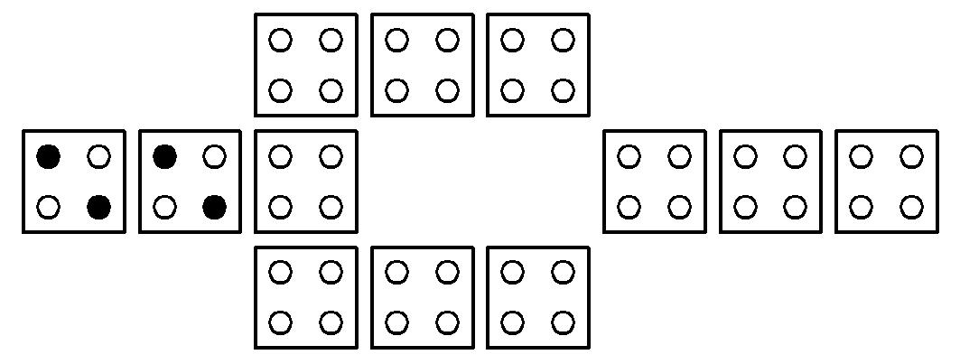
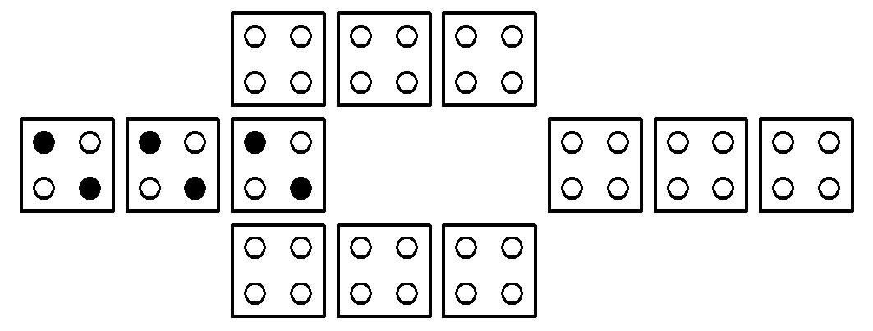
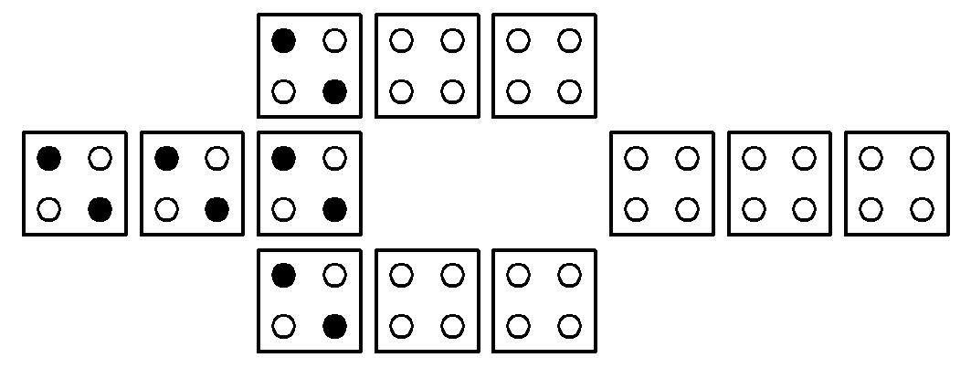
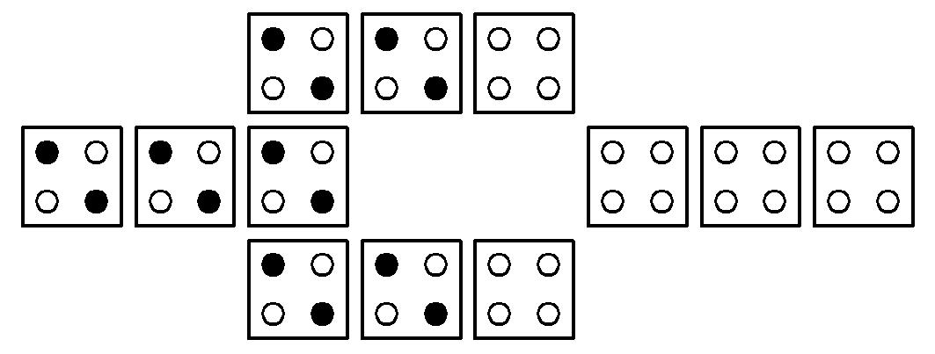
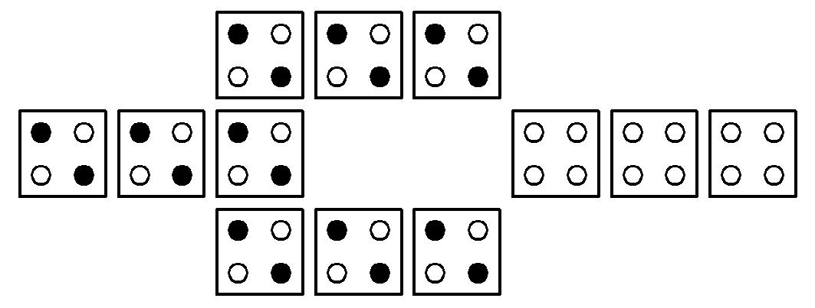
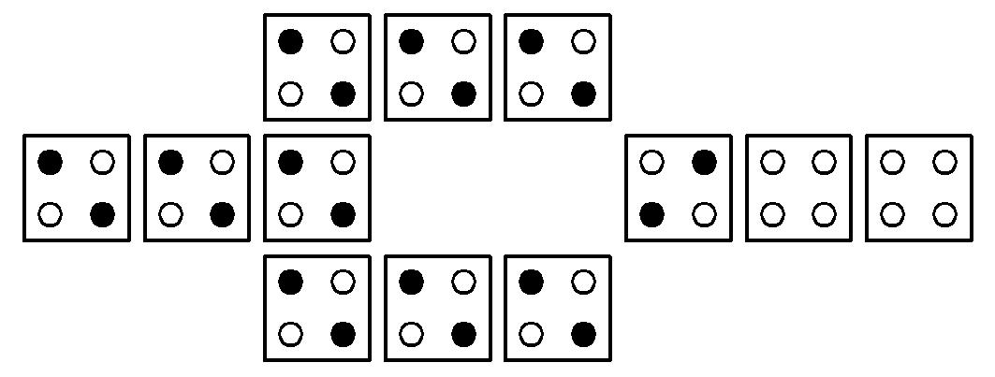
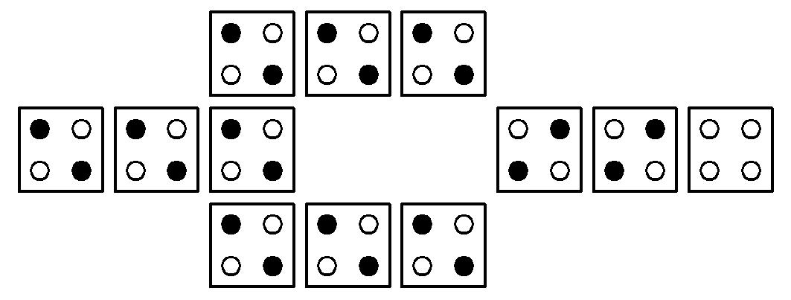
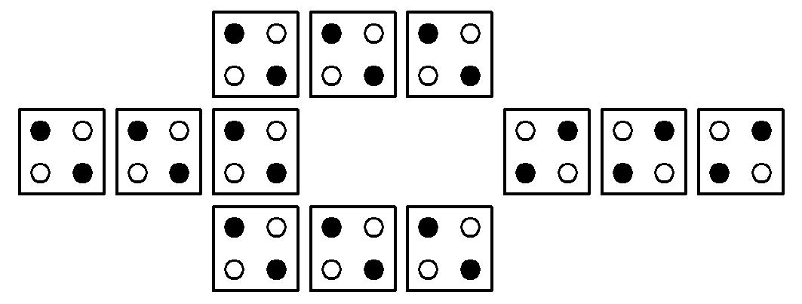
QCA Components
QCA wire
Any logic can be created.
More complex circuits are feasible.
Coulombic Interaction
IN
OUT
Inverter
IN
OUT

Slide 9
QCA Pros and Cons
QCA Pros
Very high theoretical speeds achieved (within THz range);
Low power consumption (information is transported with no electric current flow);
Small dimensions (a molecular QCA cell should be 2x2 nm).
QCA Cons
Extremely difficult physical implementation.

Slide 10
Defects and Errors in QCA circuits
This work considers as:
Defects
Flaws of the cells of a structure;
Phase shifts of the clock signals.
Errors
Consequences of defects to the output signals.
Manifest themselves as:
Excessive delay;
Wrong logic state (signal inversion).

Slide 11
Structural defects modeling
Dopant:
IN
OUT
Dislocation:
IN
OUT
Interstitial:
IN
OUT
Vacancy:
IN
OUT

Slide 12
Errors in QCA circuits
Unexpected deviations in the behavior of a system.
Example
In1
Out
Out - Expected
AND
In1
In2
+1
High threshold
+1
High threshold
Low threshold
-1
Low threshold
-1
Out – Stuck-at 1
In2
+1
+1
High threshold
High threshold
Low threshold
Low threshold
-1
-1
Out – Signal degradation
Likely to occur due to defects.
+1
High threshold
Major consequence: Reliability decreased.
Low threshold
-1

Slide 13
Motivation
Introducing a methodology for QCA robustness analysis
Extensive
Four classes of defects + Three probability models
Flexible
Parameter-based approach
Operates under different conditions
Innovative
Easy to interpret and visualize the results
Error-free simulations calculation (%)
Heat map

Slide 14
Methodology Characterization Round
Repeat for all iterations
After all iterations
Circuit selection
Parameters setting
Step II
Error-free reference simulation
Defect insertion
Fault simulation
Comparison (Error-free x defective)
Error-free simulations percent calculation
Result analysis
Design heat map
Step I
Step III

Slide 15
Step I
Parameters to be set - basics
Number of iterations;
Round stop criteria:
Number of stable iterations required.
Maximum error-free simulation rate variation allowed
Sample interval;
HIGH/LOW thresholds.

Slide 16
Output :
+1
2
High threshold
Pol.
-1
3
Low threshold
hold
Clock :
Barriers
release
1
Time
Sample interval

Slide 17
Parameters to be set – defect classes and probabilities
Test framework: structural defects/ clock phase shifts
Define the defect classes:
Dislocation
Dopant
Interstitial
Vacancy
Probability model
Sequential
Assignable
Uniform

Slide 18
Sequential Probability
IN
OUT
1
2
3
4
5
6
7
8

Slide 19
Sequential Probability
IN
OUT
1
2
3
4
5
6
7
8
Cell 1 shall be defective!
Which defect should be inserted?
It is randomly chosen among the defined (checked) classes.
Dislocation
Dopant
Interstitial
Vacancy

Slide 20
Sequential Probability
IN
OUT
1
2
3
4
5
6
6
7
7
8
2
3
4
5
8
The defect insertion process is repeated until it reaches the last cell…

Slide 21
Assignable Probability
IN
OUT
1
2
3
4
5
6
7
8
Cell 1 may or may not be defective.
It depends on an user-set probability parameter (between 0 and 1)
Which defect should be inserted?
It is randomly chosen among the defined (checked) classes.
Dislocation
Dopant
Interstitial
Vacancy

Slide 22
Assignable Probability
IN
OUT
1
2
3
4
5
6
6
7
7
8
2
3
4
5
8
The defect insertion process is repeated until it reaches the last cell…

Slide 23
Uniform Probability
IN
OUT
1
2
3
4
5
6
7
8
Cell 1 may or may not be defective.
It depends on the fixed probability value P=1/N.
N= number of cells
Which defect should be inserted?
It is randomly chosen among the defined (checked) classes.
Dislocation
Dopant
Interstitial
Vacancy

Slide 24
Uniform Probability
IN
OUT
1
2
3
4
5
6
6
7
7
8
2
3
4
5
8
The defect insertion process is repeated until it reaches the last cell…

Slide 25
Step II
Simulations and defect insertion
Error-free reference simulation;
Results stored
Defect insertion;
According to the probabilities
Simulation of the defective structure;
Comparison (Error-free x defective);
Error detection
Error-free simulations rate updated;
Results file are saved.
Repeat until the round stop criteria achievement

Slide 26
Step III
Results analysis
Design heat map creation (structural defects testing);
Final update of the results file.

Slide 27
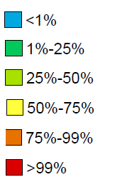
Heat map
Mapping criticality of defective cells.
How often it provokes an error?
A visual resource for results analysis
Yellow cells are majorly related to defects.
Colors used
Given an error event, these cells have ________ of probability to be defective.
50-75%

Slide 28
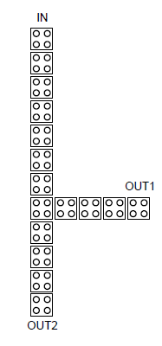
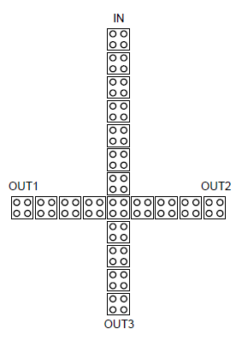
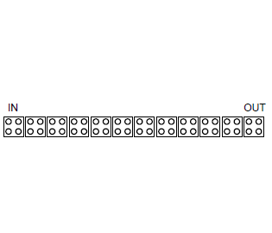
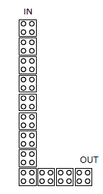
Robustness Enhancement Strategies
Fundamental components tests set up
Wire
Bend Wire
Fanout of 2
Fanout of 3
Sequential probability;
16 defect insertion per cell in each component;
All the four defect classes defined separately.
Notes:
Extensive defect modeling applied: It is possible to verify the circuit behavior under several defective conditions;

Slide 29
Proposal of Robust Components
The robust components were proposed based on:
Analysis of the heat maps:
Considers all the defect classes;
Identifies possible polarization weaknesses;
Inputs, Outputs and Turnings are vulnerable.
The robustness enhancement strategy consists of:
Applying redundancy within the structures;
Perform strategic structural modifications.
Examples:
(a) Fanout of 2 under dislocation defects
(b) Fanout of 2 under vacancy defects
Notes:
Extensive defect modeling applied: It is possible to verify the circuit behavior under several defective conditions;

Slide 30
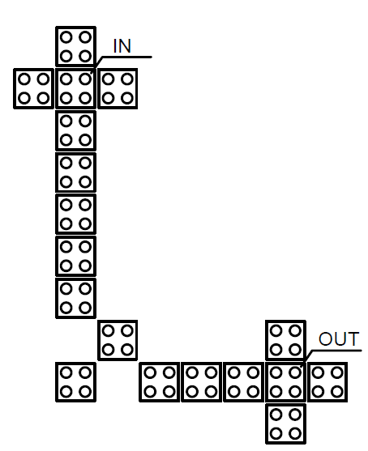
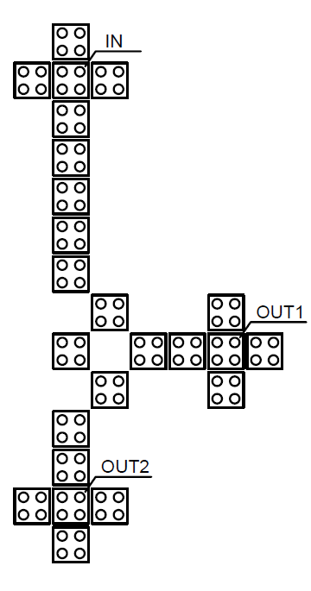
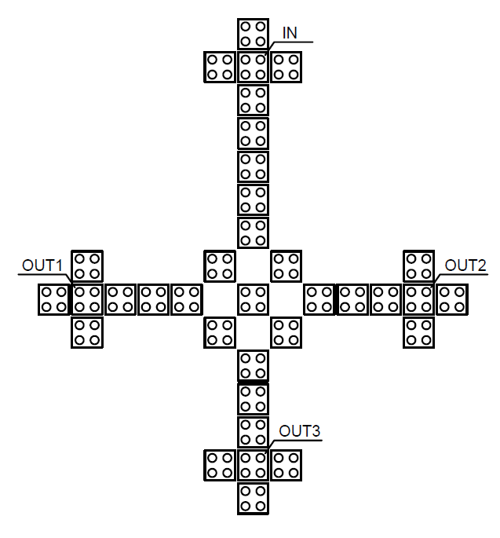
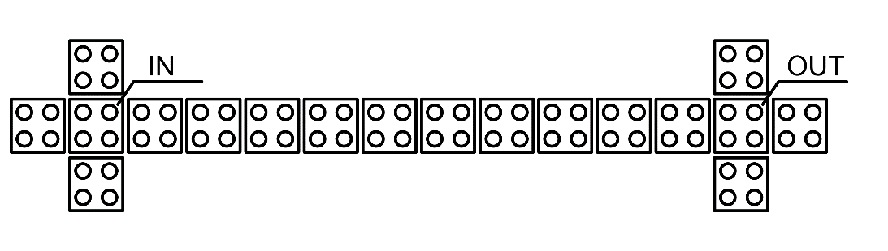
Components Proposed
Modified Wire
Modified Bend Wire
Modified Fanout of 2
Modified Fanout of 3
Notes:
Extensive defect modeling applied: It is possible to verify the circuit behavior under several defective conditions;

Slide 31
Regular x Modified Robustness Verification
Sequential probability;
4 defect insertion per cell in each component;
All the four defect classes simultaneously defined.
 | Error-free simulations rate (%)
 | Regular Component | Modified Component | Rate Variation
Wire | 72.40 % | 86.46 % | +14.06 %
Bend Wire | 70.83 % | 87.85 % | +17.02 %
Fanout of 2 | 72.27 % | 85.16 % | +12.89 %
Fanout of 3 | 64.38 % | 88.75 % | +24.37 %
Notes:
Extensive defect modeling applied: It is possible to verify the circuit behavior under several defective conditions;

Slide 32
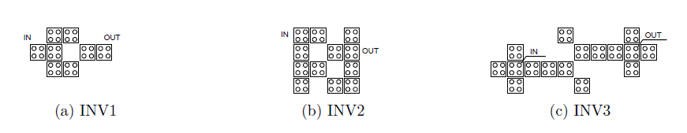
Proposed circuits
Comparison between:
Regular structure
A robust structure already reported in the literature
The proposed structure (built with the modified fundamental components)
Inverters
(a) INV1 - Regular inverter
(b) INV2 - Robust Inverter (Beard, 2006)
(c) INV3 - The proposed inverter
Notes:
Extensive defect modeling applied: It is possible to verify the circuit behavior under several defective conditions;

Slide 33
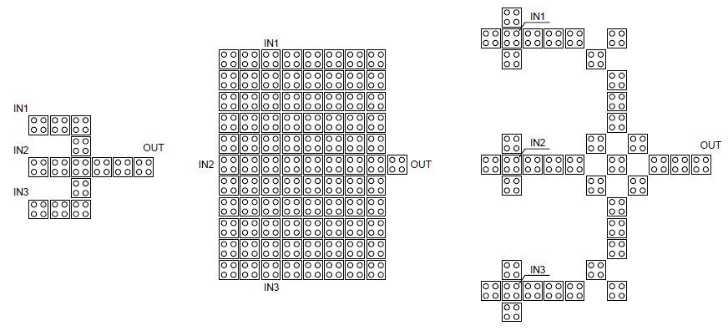
Proposed circuits
3-input majority gates
(a) MAJ1 - Regular majority gate
(b) MAJ2 - Robust majority gate (Fijany et al, 2001)
(c) MAJ3 - The proposed majority gate
Notes:
Extensive defect modeling applied: It is possible to verify the circuit behavior under several defective conditions;

Slide 34
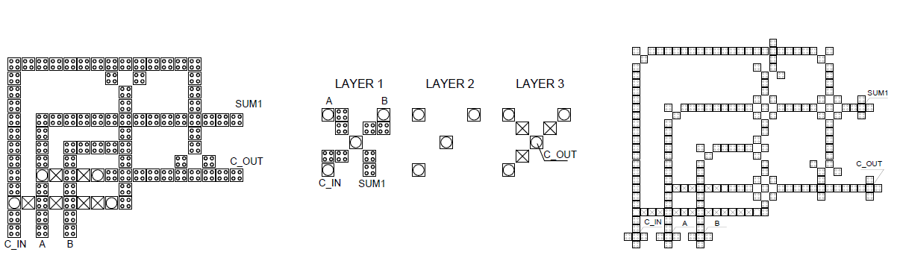
Proposed circuits
Full adders
(a) ADD1 - Regular full adder (Bruschi et al, 2001)
(b) ADD2 – Compact and robust full adder (Roohi et al, 2015)
(c) ADD3 - The proposed full adder
Notes:
Extensive defect modeling applied: It is possible to verify the circuit behavior under several defective conditions;

Slide 35
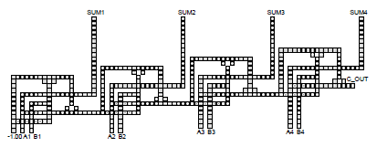
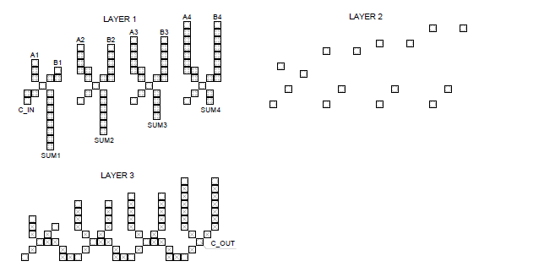
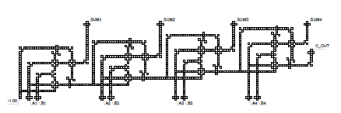
Proposed circuits
4-bit RCAs
(a) RCA1 - Regular RCA (Bruschi et al, 2001)
(c) RCA3 - The proposed full adder
(c) RCA2 – Compact and robust RCA (Roohi et al, 2015)
Notes:
Extensive defect modeling applied: It is possible to verify the circuit behavior under several defective conditions;

Slide 36
Results - Error-free simulations rates
4 defect insertion per cell in each component;
All the four defect classes simultaneously defined.
Notes:
Extensive defect modeling applied: It is possible to verify the circuit behavior under several defective conditions;

Slide 37
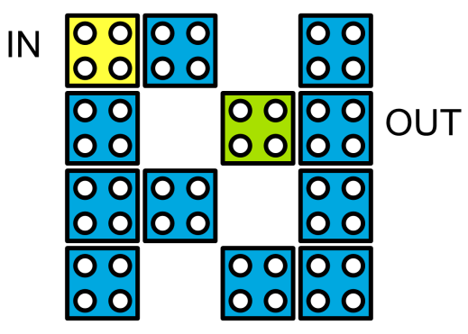
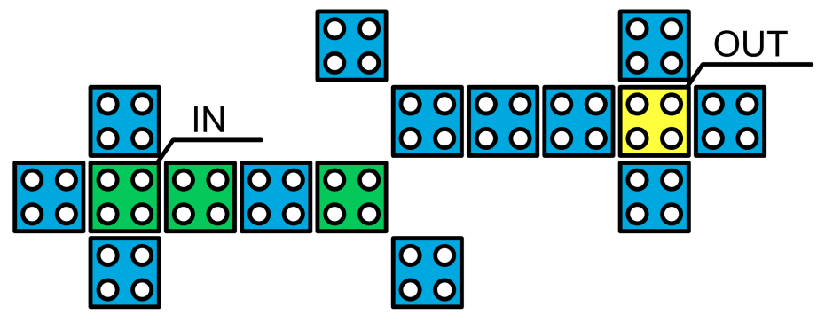
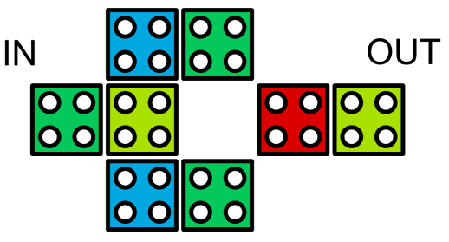
Heat maps
Inverters
(a) INV1 under combined defects
(b) INV2 under combined defects
(c) INV3 under combined defects
Notes:
Extensive defect modeling applied: It is possible to verify the circuit behavior under several defective conditions;

Slide 38
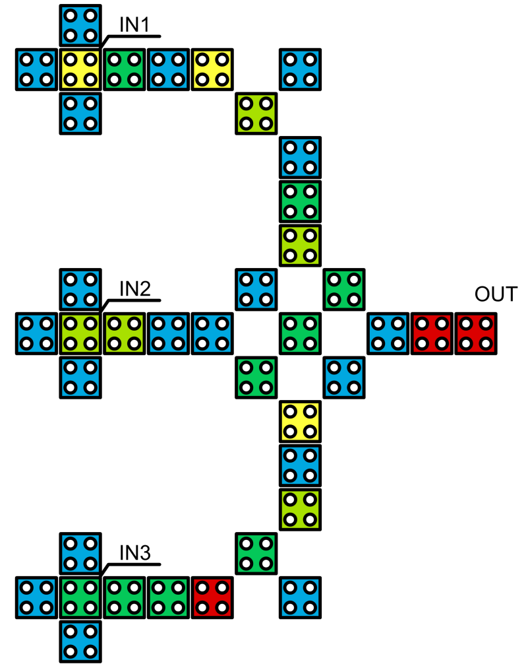
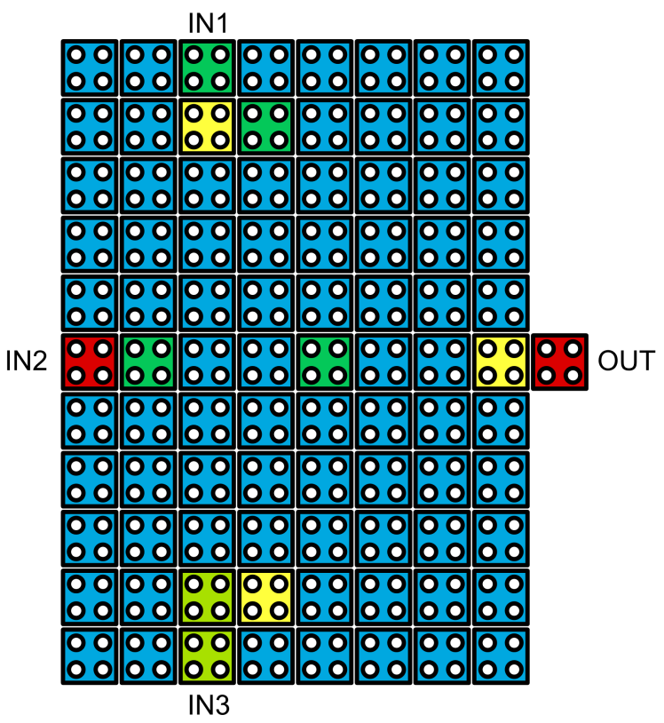
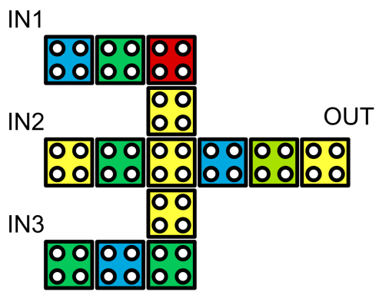
3-input majority gates
(a) MAJ1 under combined defects
(b) MAJ2 under combined defects
(c) MAJ3 under combined defects
Notes:
Extensive defect modeling applied: It is possible to verify the circuit behavior under several defective conditions;

Slide 39
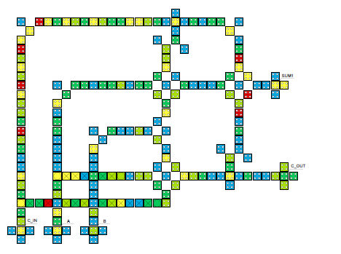
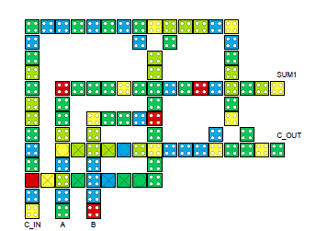
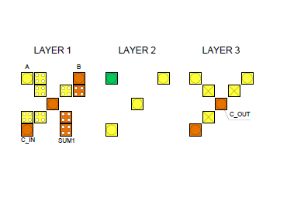
Full adders
(a) ADD1 under combined defects
(b) ADD2 under combined defects
(c) ADD3 under combined defects
Notes:
Extensive defect modeling applied: It is possible to verify the circuit behavior under several defective conditions;

Slide 40
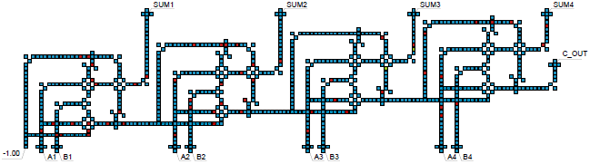
RCA
RCA3 under combined defects
Notes:
Extensive defect modeling applied: It is possible to verify the circuit behavior under several defective conditions;

Slide 41
Remaining results
Phase-shifted clocking circuits
 | Shifts Range (Synchronous Clock) |  |  | Shifts Range (Asynchronous Clock)
Component | 0 to 45º | 45 to 90º | 0 to 90º | 0 to 45º | 45 to 90º | 0 to 90º
Wire | 92.4% | 72.3% | 84.4% | 99.9% | 71.7% | 85.8%
Bend Wire | 96.8% | 50.2% | 73.5% | 99.9% | 44.8% | 72.3%
Fanout of 2 | 96.1% | 50.0% | 73.0% | 94.9% | 48.7% | 72.0%
Fanout of 3 | 95.6% | 50.5% | 73.1% | 93.9% | 50.6% | 72.2%

Slide 42
Publications
Journal paper (under review)
Reis, D. A., Sill Torres, F. Robustness analysis of structures and clocking for QCA devices. – under review in JICS (Journal of Integrated Circuits and Systems)
Conference papers
Reis, D. A., Sill Torres, F. A novel methodology for robustness analysis of QCA circuits. In Proceedings of the 28th Symposium on Integrated Circuits and Systems Design (SBCCI '15). 2015. ACM, New York, NY, USA. DOI=http://dx.doi.org/10.1145/2800986.2800995
Reis, D. A., Sill Torres, F. O uso do clock assíncrono para aumento da confiabilidade de circuitos QCA. In Proceedings of the 2nd NaCoWo – Nanocomputing Workshop. Belo Horizonte, Brazil, 2015. ISSN 2447-9101
Conference paper (accepted)
Reis, D. A., Campos, C. A., Soares, T. R., Vilela Neto, O. P., Sill Torres, F. A Methodology for Standard Cell Design for QCA. – under review at IEEE Symposium on Circuits and Systems (ISCAS), Montreal, Canada, 2016

Slide 43
Conclusions
The QCA Defects Simulator presented allows to:
Design more robust QCA circuits/ structures;
Compare QCA circuits in terms of robustness;
Verify the reliability of a QCA circuit undo different test conditions;
The tests performed allow to:
Identify polarization weak regions within the structures;
Prove the robustness of the proposed components/ circuits.

Slide 44
Thank you!
Questions?

