Slide 1
ACQUISITION AND TRANSMISSION OF TB DRUG RESISTANCE IN CHINA
Fang Zhang
Simon Fraser University
July 5th, 2016

Slide 2
Tuberculosis(TB)
9 million people developed TB and 1.5 million died from TB worldwide in 2013.
Efficient human-to-human transmission by aerosol route.
Effective treatment and control of TB are complicated by the emergence and spread of drug-resistant, multidrugresistant (MDR) and extensively drug-resistant (XDR) TB.

Slide 3
Evolution of TB
Mycobacterium tuberculosis has 7 lineages [1]:
3 ancient lineages: lineage 1 and two Mycobacterium africanum lineages.
3 modern lineages: lineage 2, 3, 4
1 intermediate lineage: lineage 7
The lineages may vary in propensity in transit and cause disease.

Slide 4
Lineage 2 (Beijing)
Strains from the Beijing lineage have been associated with large MDR tuberculosis outbreaks elsewhere.
appear to be rapidly expanding in population size in settings with contrasting tuberculosis incidence levels.
possess selective advantages in comparison to strains from other MTBC lineages, comprising an increased capacity to acquire drug resistance.
increase transmissibility, hypervirulence and/or more rapid progression to disease after infection.

Slide 5
Beijing lineage data set
110 strains
154 sequences
35 strains have 2 or more sequences

Slide 6
Difficulties in calling SNPs
Experiments reproducibility [2]
Bwa mem as mapper, GATK unifiedgenotype and samtools mpileup as SNPs callers.
Bwa mem as mapper, GATK unifiedgenotype, samtools mpileup and FreeBayes as callers.
mrFast as mapper, GATK unifiedgenotype and samtools mpileup as SNPs callers.

Slide 7
Difficulties in calling SNPs
Remove SNPs in Repetitive regions
Remove resistant SNPs.
The main reason is to exclude homoplastic positions for the phylogeny.
Remove SNPs frequency lower than 2.
SNPs with single occurrence will not carry any information regarding the phylogeny.
4415 SNPs in total.

Slide 8
Constructing the phylogenetic trees
Using the SNPs, infer the best fit model of nucleotide substitution using jModelTest
Construct the phylogenetic tree:
Neighbor-joining (MEGA)
Maximum Likelihood (MEGA)
Bayesian Inference (BEAST 2)
Extra step for BEAST: Find the consensus tree using TreeAnnoator (since Bayesian Inference outputs the optimal tree distribution)
TreeAnnotator and MEGA outputs optimal tree in NEWICK format – visualize NEWICK tree using Dendroscope or other tools

Slide 9
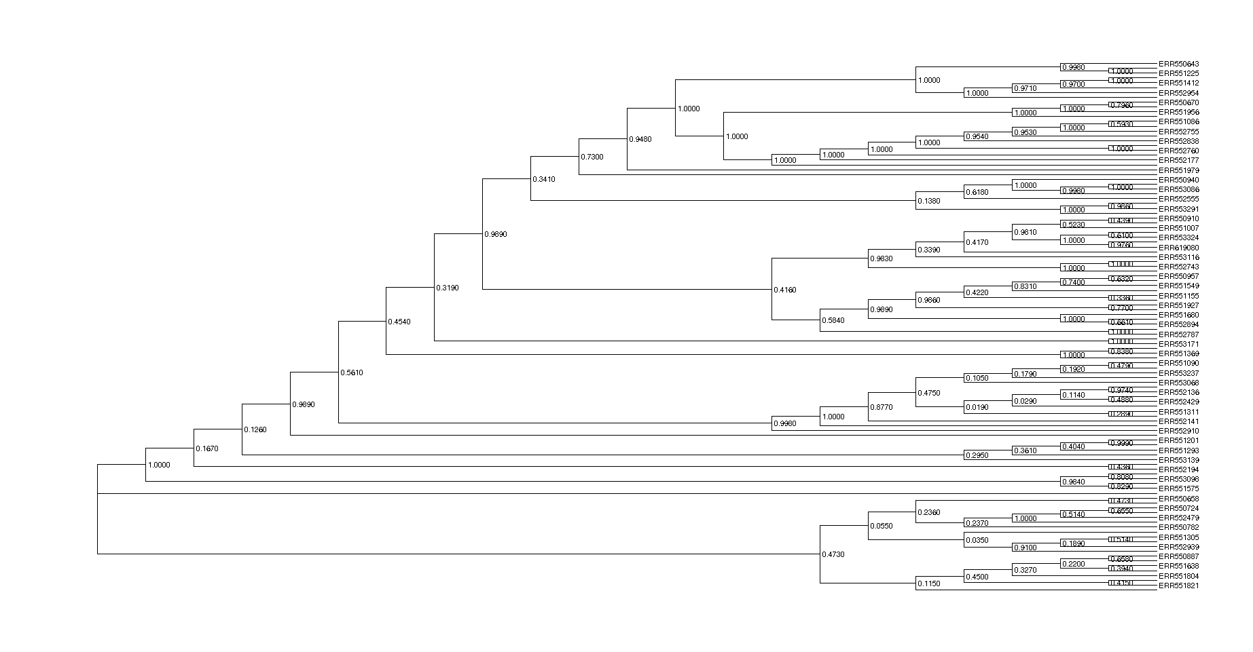
Example: Neighbor-joining tree

Slide 10
Simulation
The process of simulation is below:
Simulate the development of the single ancestor TB sequence to an initial population (Mutate once for each generation).
Model its evolution in time using discrete events, such as mutation, transmission, and resistance acquisition during treatment; after a chosen time horizon, sample a random fraction of the strains.

Slide 11
Simulation
The process of simulation is below:
Repeat step 2 for a number of time horizons and sampling fractions, as well as enough times for each setting to get a distribution.
Use these simulated data as the basis of an evaluation of any classification algorithm.

Slide 12
Details of Simulation Process
Download the Beijing data.
Reconstruct the ancestor of each linage by using phylogenetics tools.
Generate a list of events:
n₁ mutation (n= m ∗ μ ∗ τ ), where μ is mutation rate and τ is time span.
n₂ transmission (n₂ = m ∗ β ∗ τ ), where β is contact/reinfection rate and τ is time span.
n₃ resistance acquisition (n₃ = m ∗ α ∗ P_{T} ∗ P_{R} ∗ τ ), where α is rate of breakdown, P_{T} is probability of seeking for treatment, P_{R} is resistance rate and τ is time span.
n₄ death/removal m ∗ γ ∗ τ , where γ is rate of death/removal and τ is time span.
N = n₁ + n₂ + n₃ + n₄, total events

Slide 13
Details of Simulation Process
Produce the events and make changes in the matrices.
decide which event, P[mutation] = n₁/N etc.
Randomly decide which unremoved patient/strain it applies to
mutation: select patient i and SNP k. No mutation at this position anymore and cannot mutate back.
transmission: from i to j, replace strain j by strain i and transmission overrules acquisition. I and j should both be unremoved.
acquisition: like mutation but k has to be a resistant SNP.
death/removal: mark this sequence as removal.
sampling: all alive patients, probability = κ

Slide 14
Simulation example
Develop
Breakout
mutation
resistant
resistance aquisition
transmission
removed

Slide 15
Reference
Guerra-Assunção J A, Crampin A C, Houben R, et al. Large-scale whole genome sequencing of M. tuberculosis provides insights into transmission in a high prevalence area[J]. Elife, 2015, 4: e05166.
Firtina C, Alkan C. On genomic repeats and reproducibility[J]. Bioinformatics, 2016: btw139.

