Slide 1
Transport Layer Security
Pedro Félix, José Simão

Slide 2
Some history
SSL - Secure Sockets Layer
Proprietary specification done by Netscape
1994, v1.0 – not released
1994, v2.0 – critical weaknesses
1995, v3.0 – widely used, IETF draft
TLS – Transport Layer Security
1999, IETF RFC 2246
Very similar but incompatible with SSL v3.0
Version value is 3.1
This presentation
General concepts: valid on both SSL v3.0 and TLS
Details specific to TLS

Slide 3
SSL/TLS Goals
Creation, management and operation of a secure connection
Creation and management
Endpoint authentication
Key and parameters establishment
Parameter reuse
Operation
Message confidentiality
Message authentication
Secure Connection
Endpoint
Endpoint
client
server

Slide 4
Sub-protocols
Divided in two major sub-protocols
Record Protocol
Handles data fragmentation, compression, confidentiality and message authentication
Requires a reliable transport protocol
Handshake Protocol
Handles the secure connection creation and management, namely the secure establishment of the record protocol cryptographic parameters
Application
Data
Alert
CCS
Handshake
Cryptographic
parameters
Record Protocol

Slide 5
Record Protocol
Fragment, Compress, Authenticate (MAC) then Encrypt
Two independent connection directions
Separate keys, IVs and sequence number (client write and server write)
byte stream
byte stream
Fragment
Recombine
Compression
Decompression
MAC generation
Client write MAC Key
+ Seq.
Client write MAC Key
+ Seq.
MAC verification
Encryption
Client write Key
+ IV
Client write Key
+ IV
Decryption

Slide 6
Record Protocol: authentication and encryption
The MAC protects the: seq. no. + packet type + version + payload
TLSCompressed
||
Seq. No
MACGen
MAC Key
TLSCompressed
MAC tag
Pad.
only if block operation mode
Encryption Key
+
IV
Encrypt
TLSCipherText

Slide 7
Remarks
Message replays
Detected by the sequence number
Message reflection
Separate MAC keys for each direction
Keystream reuse (stream based symmetric encryption)
Separate encryption keys and IVs for each direction
Traffic analysis
Separate encryption keys
Variable padding length

Slide 8
Cryptographic schemes
The cryptographic schemes used depend on the agreed cipher suite
The cipher suite and compression algorithms are negotiated by the handshake protocol
Examples
TLS_NULL_WITH_NULL_NULL
TLS_RSA_WITH_3DES_EDE_CBC_SHA
TLS_RSA_WITH_RC4_128_SHA
A cipher suite defines
The hash function used by the HMAC (e.g. SHA)
The symmetric encryption scheme (e.g. 3DES_EDE_CBC or RC4_128)
Supports both block and stream schemes
Key establishment scheme (RSA or DH)

Slide 9
Handshake protocol
Responsible for
Negotiation of the operation parameters
Endpoint authentication
Secure key establishment
Endpoint authentication and key establishment
Authentication is optional on both ends
Supports several cryptographic techniques, namely:
Key transport (e.g. RSA)
Key agreement (e.g. DH)
Typical scenario on the internet (HTTPS)
RSA based key transport using X.509 certificates
Mandatory server authentication
Optional client authentication

Slide 10
Handshake Protocol: sketch
If based on RSA key transport
C ↔ S: negotiation of the algorithms to be used
C ← S: server certificate
C → S: random secret encrypted with the server public key
C ← S: proof of possession of the random secret
If client authentication is required
C ← S: Server requests the client certificate
C → S: client certificate
C → S: proof of possession of the private key, done by signing the handshake messages

Slide 11
Handshake Protocol (1): RSA based
ClientHello | C → S: client capabilities
ServerHello | C ← S: parameter definitions
Certificate | C ← S: server certificate (KeS)
CertificateRequest(*) | C ← S: Trusted CAs
ServerHelloDone | C ← S: synchronization
Certificate(*) | C → S: client certificate (KvC)
ClientKeyExchange | C → S: Enc(KeS: pre_master_secret)
CertificateVerify(*) | C → S: Sign(KsC: handshake_messages)
ChangeCipherSpec | C → S: record protocol parameters change
Finished | C → S: {PRF(master_secret, handshake_messages)}
ChangeCipherSpec | C ← S: record protocol parameters change
Finished | C ← S: {PRF(master_secret, handshake_messages)}
(*) optional

Slide 12
Handshake Protocol (2): RSA-based
ClientHello – supported cipher suites and compression algorithms + proposed session identifier + client random value (!)
ServerHello – Chosen cipher suite and compression algorithm + chosen session identifier + server random value (!)
Certificate – certificate with the server public key (this key should support the agreed key establishment algorithm)
CertificateRequest – client authentication request, containing:
List of the public key types supported by the server
List of the trust anchors trusted by the server
ServerHelloDone – end of response

Slide 13
Handshake Protocol (3): RSA based
Certificate – client certificate
ClientKeyExchange – establishment of the premaster secret.
RSA - premaster secret is encrypted with the server public key
CertificateVerify – Private key proof of possession
Done via the signature of all the previous protocol messages
ChangeCipherSpec – Signalization that the next message is going to use the negotiated keys and settings
Finished – Signalization of the end of the handshake.
Includes the PRF of all the messages, using the master secret
All handshake messages (except ClientKeyExchange) and are sent unprotected by the record protocol (null cipher suite)

Slide 14
Yet another one
KsC
Trust
KvC
C → S: capabilities
KeS
KdS
Trust
C ← S: definition
CVer
C ← S: SC (KeS)
C ← S: CAs
KeS
C ← S: synchronization
C → S: CC (KvC)
CVer
K
Enc
C → S: Enc(KeS: K)
Dec
C → S: Sign(KsC: msg)
KvC
Sign
C → S: Change
Verify
C → S: {PRF(ms,msg)}
K
C ← S: Change
C ← S: {PRF(ms,msg)}

Slide 15
A schematic view
Client
Server
Key Exchange
Trust
KeS
KdS
Certificate
KeS
CVer
ClientKeyExchange
K
Enc
Dec
K
Client Authentication
KsC
KvC
Trust
ClientCertificate
CVer
KvC
CertificateVerify
Sign
Verify

Slide 16
Key derivation
ClientHello.random
premaster secret
ServerHello.random
PRF
master secret
PRF
Keys and IVs

Slide 17
Handshake tampering and replay
Handshake tampering is detected using the Finished message
The Finished message ensures both endpoints that the messages received are the same
Handshake message replay
ClientHello and ServerHello contains random values (nounces), different for each handshake
Implies that the Finished message is different for each handshake

Slide 18
Endpoint authentication
The endpoint authentication uses different techniques for the client and the server
Client authentication
Client certificate binds an identity (X500/DNS) to a public key
CertificateVerify proves the possession of the associated private key - signature of the handshake messages
Server authentication
Server certificate binds an identity (X500/DNS) to a public key
Finished message proves that the server knows the master secret, implying that he was able to decrypt the premaster secret, implying that he has the associated private key

Slide 19
Connections and Sessions
Connection
transport protocol connection
E.g. TCP connection
Session
Association between the client and the server, containing the cryptographic parameters negotiated by the handshake protocol
Sharing of a session between multiple connections
Due to the computational cost of the handshake protocol
E.g.: browser with multiple connections to the same server
Different connections with the same session use different keys
Session defines a master secret
Each connection derives its key based on this master secret
connection
connection
session
connection
connection
session
connection

Slide 20
Session and connection state
Session
Session identifier
Peer certificates – identity of the endpoints
Compression method and cipher suite
Master secret – seed for the key derivation process
Is resumable – boolean indicating if the session can be used on several connections
Connection state
Sequence numbers
MAC keys
Encryption Keys
Encryption Initialization Vectors (IV)
The keys and IVs are created based on the master secret
However, different keys are create for each connection, even if based in the same session

Slide 21
Session reuse
Each handshake is associated with a session
The ClientHello has ID
New one
Of another connection
The goal is to establish a new connection using the same session
Minimize the connection establishment overhead
ClientHello | C → S: Session ID of a anterior session
ServerHello | C ← S: ID received ClientHello
ChangeCipherSpec | C ← S: Change Cipher Spec
Finished | C ← S: {PRF(ms,handshake_messages)}
ChangeCipherSpec | C → S: Change Cipher Spec
Finished | C → S: {PRF(ms,handshake_messages)}

Slide 22
Handshake request
The HelloRequest message can be sent by the server at any time
It’s goal is to force a new handshake
The client responds to this message with a ClientHello message
HelloRequest | C ← S: Request for a new handshake
ClientHello | C → S: ...
ServerHello | C ← S: ...
... | ...

Slide 23
Attacks
RSA timing attacks
D. Boneh, D. Brumley, Remote timing attacks are practical, 2th Usenix Security Symposium
PKCS #1 v1.5 attacks
D. Bleichenbacher, A chosen ciphertext attack against protocols based on the RSA encryption standard RSA PKCS #1, Crypto’98
V. Klima, O. Pokorny and T. Rosa, Attacking RSA-based Sessions in SSL/TLS, CHES’03
CBC/Authenticate-Then-Encrypt
S. Vaudenay, Security Flaws Induced by CBC Padding - Applications to SSL, IPSEC, WTLS, EuroCrypt’02

Slide 24
HTTPS protocol
HTTP over TLS
Default port: 443
Check between the URI and the certificate
subjectAltName extension of type dNSName (if present)
the (most specific) Common Name field in the Subject field
Proxies
CONNECT method requests the proxy to create a TCP tunnel to the endpoint

Slide 25
Java Security Sockets Extension
Java framework and implementation of the SSL and TLS protocols
Provides SSL/TLS extensions of the regular (java.net) Socket and ServerSocket classes
What can be done with it?
Secure socket creation and usage
Peer authentication
Custom certificate validation and trust anchor selection
Custom key selection
Session management
Based on the same design criteria of the JCA (Java Cryptography Architecture)

Slide 26
Sockets and socket factories
The regular sockets use factory-based instance creation
ServerSocket and Socket instances are created by ServerSocketFactory and SocketFactory instances
The JSSE has specializations for the SSL/TLS protocols
ServerSocket
creates
ServerSocketFactory
extends
extends
SSLServerSocket
SSLServerSocketFactory
Socket
creates
SocketFactory
extends
extends
SSLSocket
SSLSocketFactory

Slide 27
Java Cryptography Architecture (JCA)
Cryptographic framework for the Java platform
Design principles
Algorithm independence and extensibility
Implementation independence and interoperability
Architecture based on:
Cryptographic Service Providers (CSPs)
Packages implementing one or more cryptographic services
Engine Classes
Abstract definition (abstract class) of a cryptographic service
Instance creation via factory methods (static method getInstance)
Specification Classes
Normalized and transparent representations of cryptographic objects, such as keys and other parameters

Slide 28
Engine class examples
Signature class – digital signature
Cipher class – symmetric and asymmetric encryption
Mac class – message authentication codes
KeyStore class - storage for cryptographic keys and certificates
Entries stored: private keys, secret keys and trusted certificates
Each entry is identified by a alias
Abstract, various implementations: JKS (Sun), PKCS# 12
CertPathValidator class – validation of certificate chains

Slide 29
Functionality
SSLSocketFactory and SSLServerSocketFactory
Obtain the default and supported cipher suites
Create socket instances
SSLSocket and SSLServerSocket:
Initialize the handshake and receive notifications of its completion
Define the enabled protocols (SSL v3.0, TLS v1.0) and enabled cipher suites
Accept/require client authentication
Obtain the negotiated session
SSLSession
Obtain the negotiated cipher suite
Get the authenticated peer identity and certificate chain

Slide 30
Factory based architecture
creates
SSLSocket
SSLSocketFactory
creates
<<engine class>>
SSLContext
creates
creates
SSLServerSocket
SSLServerSocketFactory
<<engine class>>
SecureRandom
Parametrized by
KeyManager
<<engine class>>
KeyManagerFactory
Keys
TrustManager
<<engine class>>
TrustManagerFactory
Trust

Slide 31
Socket Factory creation
The creation of SSLSocketFactory and SSLServerSocketFactory is done by SSLContext instances
Implicit used via the static methods getDefault from SSLSocketFactory and SSLServerSocketFactory
SSLContext instance creation using the getInstance static method, initialized with
Randomness source – SecureRandom class
Key manager – KeyManager class
Trust manager – TrustManager class

Slide 32
Remember this?
Client
Server
Key Exchange
Trust
KeS
KdS
Certificate
KeS
CVer
ClientKeyExchange
K
Enc
Dec
K
Client Authentication
KsC
KvC
Trust
ClientCertificate
CVer
KvC
CertificateVerify
Sign
Verify

Slide 33
Key and trust managers
Trust Manager - determines whether the remote authentication credentials (and thus the connection) should be
Construction and verification of certificate chains
Determination of the trust anchors
Key Manager - determines which authentication credentials to send to the remote host
Choose the identity to be used (alias string), given a list of accepted trust anchors
Get the private key associated with an alias
Get the certificate chain associated with an alias

Slide 34
X509TrustManager e X509KeyManager
X509TrustManager
void checkClientTrusted(X509Certificate[] chain, String authType)
void checkServerTrusted(X509Certificate[] chain, String authType)
X509Certificate[] getAcceptedIssuers()
X509KeyManager
String chooseClientAlias(String[] keyType, Principal[] issuers, Socket socket)
String chooseServerAlias(String keyType, Principal[] issuers, Socket socket)
X509Certificate[] getCertificateChain(String alias)
String[] getClientAliases(String keyType, Principal[] issuers)
PrivateKey getPrivateKey(String alias)
String[] getServerAliases(String keyType, Principal[] issuers)

Slide 35
Manager Factories
Creation of KeyManager and TrustManager instances using KeyManagerFactory e TrustManagerFactory (engine classes) instances
KeyManagerFactory
static KeyManagerFactory getInstance(String algorithm)
void init(KeyStore ks, char[] password)
KeyManager[] getKeyManagers()
TrustManager
static TrustManagerFactory getInstance(String algorithm)
void init(KeyStore ks)
TrustManager[] getTrustManagers()

Slide 36
The big picture
<<engine class>>
SSLContext
SecureRandom
parameterized by
<<interface>>
KeyManager
<<interface>>
TrustManager
creates
creates
<<engine class>>
KeyManagerFactory
<<engine class>>
TrustManagerFactory
parameterized by
parameterized by
char[]
<<engine class>>
KeyStore

Slide 37
Cryptography on Windows platforms
1996 – CryptoAPI (C language interface)
Symmetric encryption schemes, MAC schemes, hash functions, digital signature schemes, key establishment and encryption
X.509 certificates
PKCS 7/ CMS cryptographic messages
? - SSPI – Security Support Provider Interface (C language interface)
Authentication and key establishment protocols (ex. Kerberos, SSL)
2001 – CAPICOM (COM)
Subset of CryptoAPI exported as COM components
2002 – System.Security.Cryptography (.NET Framework Class Library)
2005 – Addition of functionality to System.Security
X509 certificates
PKCS#7/CMS messages
XML signature and encryption

Slide 38
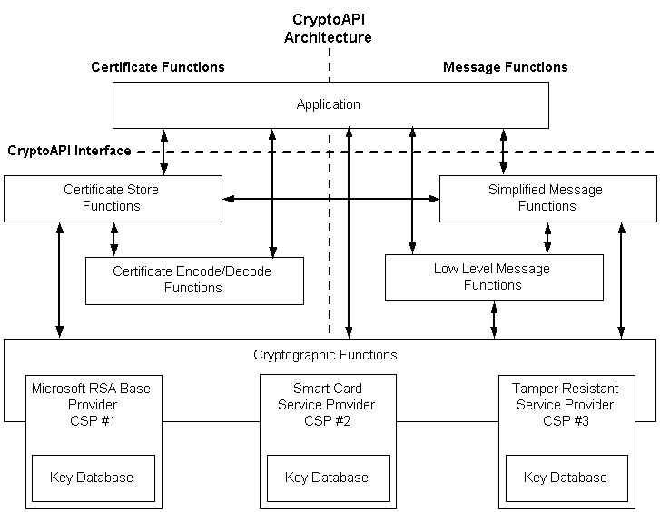
CryptoAPI: architecture
X.509
PKCS#7/CMS
Cryptographic algorithms

Slide 39
Certificate stores
Physical stores: files, registry,…
Logical stores – collection of physical stores
System stores – logical stores associated with
Current user
Local computer
A service
All the stores are identified by a string: “MY”, “CA”, “ROOT”
CryptoAPI has tools for the creation and management of certificate stores
There is also a Microsoft Management Console snap-in for this purpose
Contents of the certificate stores
Trusted root certificates (trust anchors)
Personal certificates (associated private key is store on the CryptoAPI)
Other certificates (e.g. intermediate certificates)

Slide 40
SSL/TLS on Windows: examples
Configuring HTTPS
Server – IIS
Client – IE, Firefox
Programming HTTPS clients and servers
ASP.NET server page
Client with and without authentication
Certificate policies
Web services using HTTPS transport
Client
Service

Slide 41
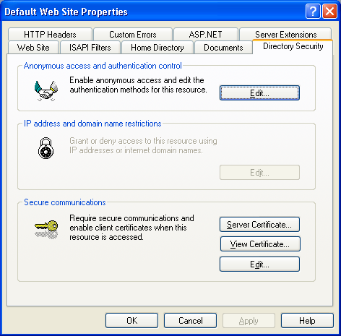
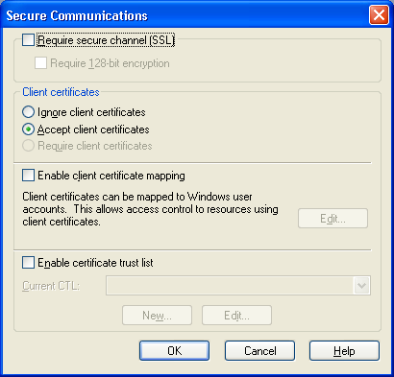
Configuring IIS (server)
Certificate (public key) + private key
Client Authentication
Trust anchors

Slide 42
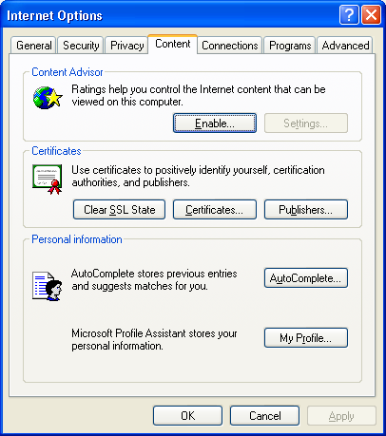
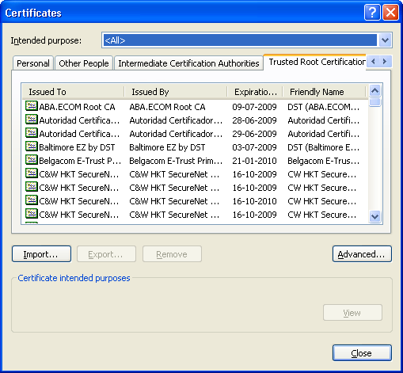
Configuring IE (client)
Certificate (public key) + private key
Trust anchors

Slide 43
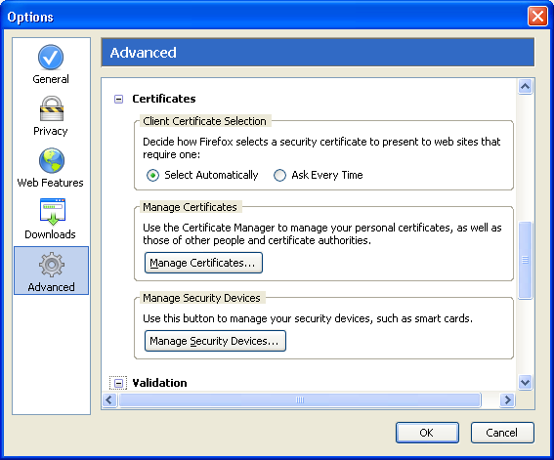
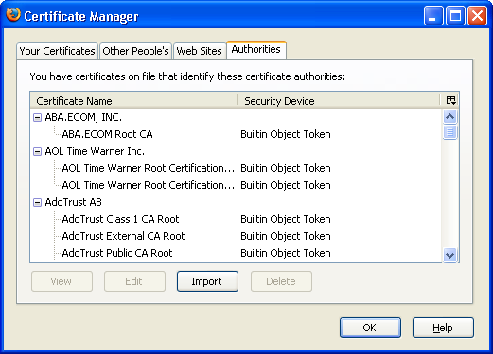
Configuring Firefox (client)
Certificate (public key) + private key
Trust anchor

Slide 44
Server: ASP.NET page using HTTPS
public class CertEcho : System.Web.UI.Page{
protected TextBox message;
protected override void OnLoad(EventArgs ea) {
// Get the client certificate
HttpClientCertificate clientCert = Context.Request.ClientCertificate;
// check if the certificate exists
if(clientCert.IsPresent == false) {
message.Text = "No client authentication";
}else{
// show the certificate information
message.Text = "Client authentication using certificate:" + "\n";
message.Text += "Issuer : " + clientCert.Issuer + "\n";
message.Text += "Subject : " + clientCert.Subject + "\n";
}
}
}

Slide 45
Client: HTTP request
HTTP request
static void GetHttp(string url)
{
HttpWebRequest req = WebRequest.Create(url) as HttpWebRequest;
HttpWebResponse res = req.GetResponse() as HttpWebResponse;
ShowResponseContent(res);
}

Slide 46
Client: HTTPS request
HTTPS request
Additions
Define the trust policy
static void GetHttpSecure(string url)
{
ServicePointManager.CertificatePolicy = new MyCertificatePolicy1();
ServicePointManager.SecurityProtocol = SecurityProtocolType.Tls;
HttpWebRequest req = WebRequest.Create(url) as HttpWebRequest;
HttpWebResponse res = req.GetResponse() as HttpWebResponse;
ServicePoint sp = req.ServicePoint;
Console.WriteLine("Certificate : "+sp.Certificate.GetName());
ShowResponseContent(res);
}

Slide 47
ICertificatePolicy interface
The ICertificatePolicy interface defines the certificate verification policy
public class MyCertificatePolicy1 : ICertificatePolicy
{
public bool CheckValidationResult(ServicePoint sp, X509Certificate cert, WebRequest request, int problem)
{
...
return ValidationResult;
}
}

Slide 48
Client : HTTPS request with client authentication
HTTPS request with client authentication
Additions
Define the client certificate and associated private key
static void GetHttpSecureWithClientAuth(string url){
ServicePointManager.CertificatePolicy = new MyCertificatePolicy1();
HttpWebRequest req = WebRequest.Create(url) as HttpWebRequest;
req.ClientCertificates.Add(
X509Certificate.CreateFromCertFile("c:/.../pedrofelix.cer")
);
HttpWebResponse res = req.GetResponse() as HttpWebResponse;
ServicePoint sp = req.ServicePoint;
Console.WriteLine("Certificate : "+sp.Certificate.GetName());
Console.WriteLine("Client Certificate : "+ sp.ClientCertificate.GetName() );
ShowResponseContent(res);
}

Slide 49
ClientCertificates
The ClientCertificates property returns the certificate collection that can be used to authenticate the client
The client must have a private key associated with the certificate
The chosen certificate has a root trusted by the CA
The ServicePoint.ClientCertificate returns the used certificate

Slide 50
Usage on Web Services (ASP.NET)
Service
The client certificate is available on the request context
public class certecho : System.Web.Services.WebService{
[WebMethod]
public string CertEcho() {
// Obter certificado de cliente
HttpClientCertificate clientCert = Context.Request.ClientCertificate;
...
Client
Add the client certificate to the proxy certificate collection
ServicePointManager.CertificatePolicy = new TLSClient.MyCertificatePolicy1();
proxy.ClientCertificates.Add(
X509Certificate.CreateFromCertFile("c:/.../pedrofelix.cer")
);

