Slide 1


Distributed Systems I Lab Introduction - part 2
REST API crash course - The bare minimum
Beshr Al Nahas

Slide 2
API: What, Why?
API = Application Programming Interface
You use API’s all the time
Web API: A set of methods exposed over the web via HTTP to allow programmatic access to applications.
Allows you to quickly add functionality/data that others have created.
Allows frontend developers and backend developers to agree on a common interface
Functions
View the board
Add a new entry
Delete an entry
An example API
GET /board
POST /entries
DELETE /entries/entryID

Slide 3
REST - An Architectural Style, Not a Standard
HTTP-based RESTful APIs
Base URL, such as http://api.example.com/resources/
An internet media type
Standard HTTP methods (e.g., OPTIONS, GET, PUT, POST, and DELETE)
While REST is not a standard, it does use standards:
HTTP,
URL,
XML/HTML/GIF/JPEG/etc (Resource Representations),
text/xml, text/html, image/gif, image/jpeg, etc (MIME Types)

Slide 4
RESTful Characteristics
Client-Server
a pull-based interaction style
Stateless
each request from client to server must contain all the information necessary to understand the request.
Cache
to improve network efficiency responses must be capable of being labeled as cacheable or non-cacheable.
Layered components
intermediaries, such as proxy servers, cache servers, gateways, ... etc., can be inserted between clients and resources to support performance, security, etc.

Slide 5
RESTful: Uniform Interface
Organized around resources
Uniform interface
Resources can be accessed using a generic interface;
e.g., HTTP GET, POST, PUT, DELETE
Named resources
Each resource has a URI.
Resource representation:
Generic formats; e.g., HTML, XML, JSON, TXT,..
Functions
View the board
Add a new entry
Delete an entry
An example API
GET /board
POST /entries
DELETE /entries/entryID

Slide 6
RESTful: Uniform Interface
Self-explanatory answer
Metadata in the request and response;
i.e., HTTP status code (OK 200, Not Found 404, … etc.), Content-Type etc.
Example Request
POST /entries/1 HTTP/1.1 Host: 129.16.23.84:63100 Content-Length: 25 Content-Type: application/x-www-form-urlencoded Accept: text/html entry=sample+msg&delete=1

Slide 7
How to consume an API -- for testing code
Terminal: curl
Firefox: RESTClient
Chrome: Postman
Online: https://www.hurl.it/
Examples:
http://nflarrest.com/api/v1/team
http://buscentral.herokuapp.com/suggestions POST (Feedback, message) or GET
https://www.youtube.com/watch?v=suHY8dLKzCU

Slide 8
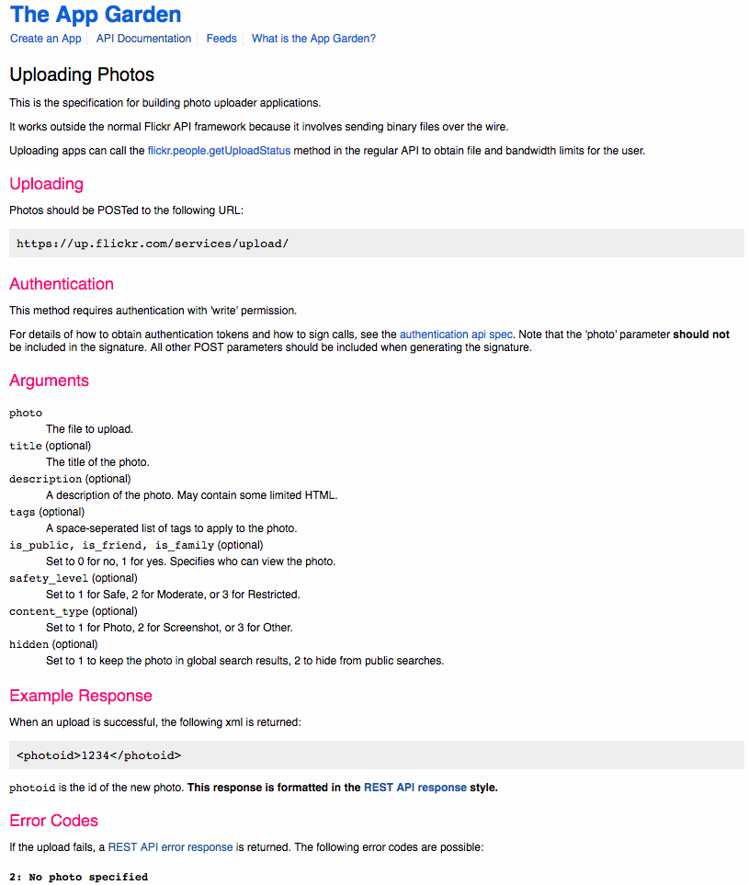
Real example: https://www.flickr.com/services/api/upload.api.html

Slide 9
REST: Using the Web Browser as a GUI
We hope you learn something cool
RESTful is cool (for industry)

Slide 10
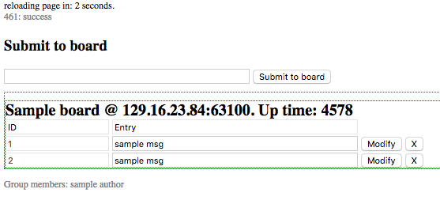
The Web Browser as a GUI
Web applications need integration between client side (HTML/HTTP) and server side

Slide 11
The (distributed) board API
Each function has a name and parameters
REST: HTTP method + URL
Functions | Example API | Parameters | Returns
View the board’s contents | GET /board | None | The whole board start page : html
Retrieve entries only | GET /entries | None | List of available entries (not the full page) : html
Add a new entry | POST /entries | entry : text | Status
Retrieve one entry | GET /entries/entryID | None | The entry : html
Modify an entry | PUT /entries/entryID | entry : text | Status
Delete an entry | DELETE /entries/entryID | None | Status

Slide 12
Sending a GET Request
Clicking a link generates a GET request
Dynamic update – implemented for you
Use a JS timer to periodically refresh the page
Look for: var page_reload_timeout = 5; //in seconds
The user does not feel good when interrupted by page reload
We want to refresh a specific section of the page, i.e., the board contents
emulate a static GUI with dynamic contents

Slide 13
Sending a GET Request - Dynamic
Partial reload using JavaScript (JS) – implemented for you
Sends the same request as if you press the browser reload button
Extracts the relevant element from the response
Updates the display of the HTML element with the specified ID only
The server needs to tag the board contents with the same ID; e.g., <div id="boardcontents_placeholder”>...</div>

Slide 14
Sending a POST request - HTML forms
POST /entries send new entries to the board
HTML form
Method: HTML supports only GET or POST requests (No DELETE or PUT)
Action: the URL
<form id="usrform" target="noreload-form-target">
<input type="text" name=”entry" size="50" autofocus required /> <input type="submit" formmethod="post" formaction=”entries" value="Submit to board"/>
</form>
Submitting the form generates a post request with entry in the body entry=‘…..’
If we use GET instead, the parameter will be appended to the URL GET /entries?entry=‘…..’

Slide 15
After GET or POST
The browser navigates to the new address
and expects a response from the server
Good for GET most of the time since you want to see the new result
POST from a form results in loading a new page
Interrupts the user - Not nice
Work around:
Change the default behavior using JS
Use form target – defines where the response of the post goes to
Instead of loading the whole page

Slide 16
Sending DELETE and PUT requests
HTML forms supports only GET or POST requests (No DELETE or PUT)
Use JS to send the request
Or for the sake of this course, change the API to use GET or POST
Use extra parameters
Functions | API | Parameters | Returns
Add a new entry | POST /entries | entry : text | Status
Modify an entry | PUT /entries/entryID | entry : text | Status
Delete an entry | DELETE /entries/entryID | None | Status
Modify or Delete an entry | POST /entries/entryID | entry : text delete: logical | Status

Slide 17
Client / Server HTML
The server sends each entry as an HTML form
The text of the entry itself is put into a textbox so it can be edited
This form contains all the parameters necessary to identify the entry
<form class="entryform" target="noreload-form-target” method="post" action="entries/1">
<input type="text" name=”id" value=”1" readonly disabled> <!-- disabled field won’t be sent --> <input type="text" name="entry" value=”msg" size="50"> <button type="submit" name="delete" value="0">Modify</button> <button type="submit" name="delete" value="1">X</button>
</form>
When you press the button Modify:
The HTTP header: POST /entries/1
The body of the post: entry=‘msg’&delete=0
Note that the parameters are separated by &

Slide 18
Code Skeleton
Code Skeleton
Python (server code) + HTML templates (GUI)
The files are full of comments. Read them.
It is optional to use this skeleton
I strongly recommend it for making your (labs) life easy ☺
Separate the core from GUI
For code readability: Avoid mixing core code with HTML markup
Use HTML templates
Don’t waste time trying to make it look beautiful
Use exception handling

Slide 19
HTML Template for use with python code
The template is saved in external file
Use python format (e.g.; %d for integers, %s for strings, … etc.)
Escape special characters (like %)
Create a new entry
Read the template file to a variable
Fill the parameters in the template
newEntry = template % (”entries/1”, 1, ”First message” )
Template example
<form class="entryform" target="noreload-form-target" method="post" action="%s"> <input type="text" name="id" value="%d" readonly disabled> <input type="text" name="entry" value="%s" size="70%%"> <button type="submit" name="delete" value="0">Modify</button> <button type="submit" name="delete" value="1">X</button> </form>

Slide 20
Tips for efficient development cycle
Automate repetitive tasks:
Show boards from different servers in one window e.g.; use frames
test_multiple_instances.html– update the addresses
To make it automatically, fill neighborlist.txt and run sh make_frames.sh >test_multiple_instances.html
Automate sending requests to quickly find bugs
Use curl for example. See slide 7. How to consume an API

Slide 21
HTTPServer
Python 2.7

Slide 22
How to make a basic server
HTTPServer is the class running the server
You can extend it to manage variables
Single-threaded and event-driven
BaseHTTPRequestHandler
Handle the requests received by the server through do_GET and do_POST
the server is an instance variable of the handler

Slide 23
Parsing POST requests
POST requests data is usually encoded as an application/x-www-form-urlencoded
Looks like that: field1=this+is+the+value&field2=is+encoded
Parse the request to retrieve information
Either implement it yourself,
or use parse_qs

Slide 24
Connect to a HTTP Server
HTTPConnection
an instance of the class represents a HTTP connection with a server
You can choose the method (GET,POST,…), and plenty of other parameters
You should check the HTTP response code to be sure the server understood your request
And catch exceptions!!

Slide 25
Demo
Demo the server in action
Tour of the code
Show the source of test_multiple_instances.html

Slide 26
References
API Crash Course, Patrick Murphy at CWU Startup Club, http://cwustartup.com/APICrashCourse.pptx
Building Web Services the REST Way, Roger L. Costello, http://www.xfront.com/REST-Web-Services.html
REST Architecture Model: Definition, Constraints and Benefits, Ricardo Plansky, http://imasters.expert/rest-architecture-model-definition-constraints-benefits/
API Integration in Python - Part 1, Aaron Maxwell, https://realpython.com/blog/python/api-integration-in-python/
https://en.wikipedia.org/wiki/Representational_state_transfer
http://www.w3schools.com/html

