Slide 1
RCS
Network Operations
Service Report
December 2025
1

Slide 2
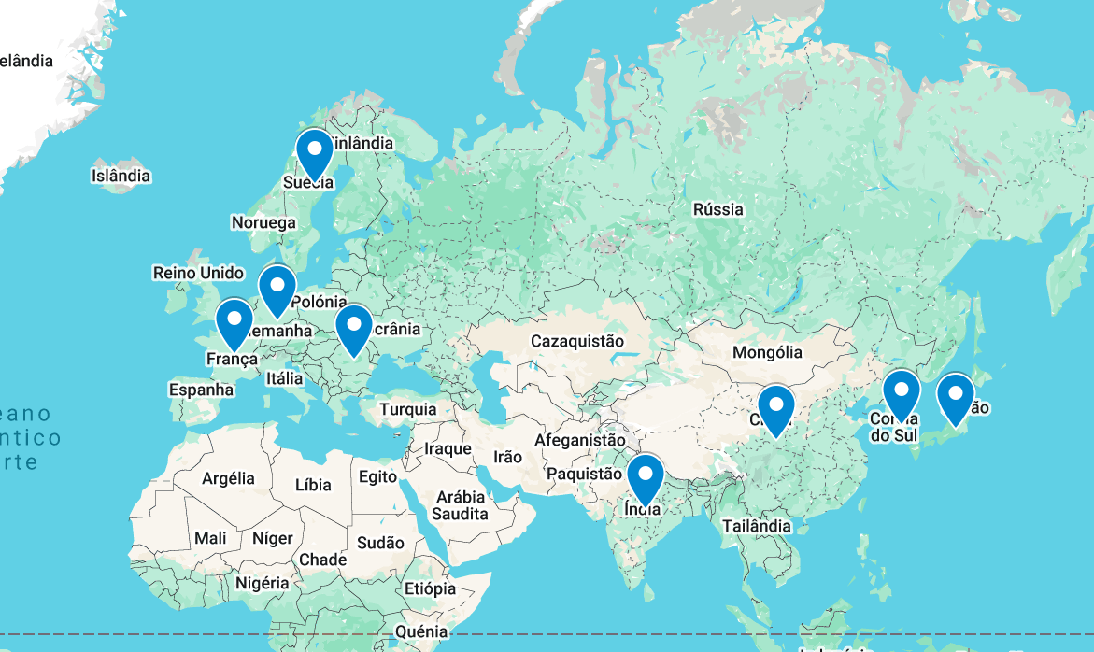

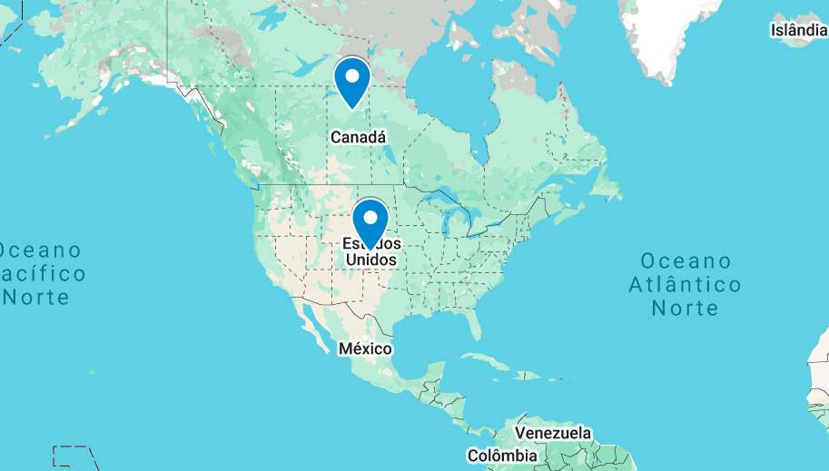
01 | Network Health Overview
Veoneer’s network performance and reliability undergo daily manual validation through Health Checks and continuous monitoring
Network Overall Health
2
2

Slide 3
02 | Network Operations – Last day of the month
Status of all incidents, changes and requests that were created on the current month and that were active in backlog from previous month
0
0
0
0
0
0
0
0
0
0
0
0
0
0
0

Slide 4
03 | Network Operations – KPIs
During December, a total of 0 Change Requests, 0 Incidents and 0 requests were open
4

Slide 5
04 | Network Operations – KPIs
During December, a total of 0 incidents were open, comprising from P4 to P1
5

Slide 6
05 | Network Operations – KPIs
Resolution times are consistently being met, ensuring timely and efficient handling of incidents.

Slide 7
06 | Network Operations – Ticket Analysis
The maximum incident resolution time was 0 sec
7

Slide 8
07 | Network Operations – KPIs
The average incident resolution time was 2 hours and 1 minute
The overall average resolution time for incidents was 22277 seconds.

