Slide 1
RCS
Network Operations
Service Report
November 2025
1

Slide 2
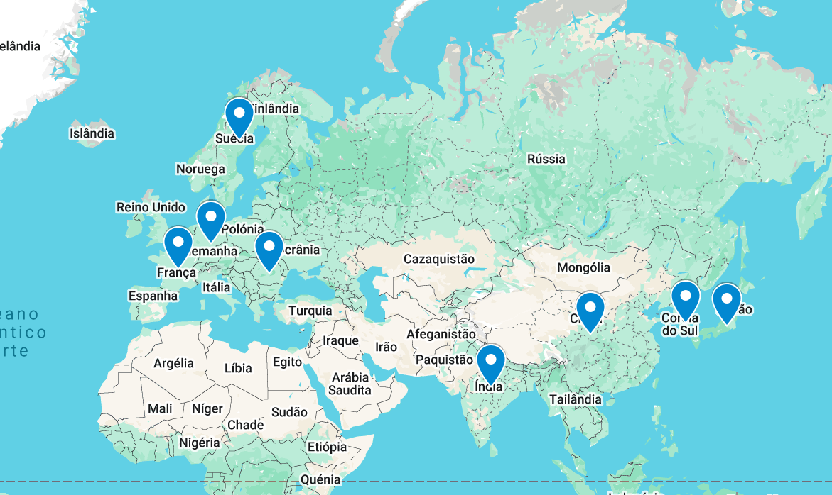



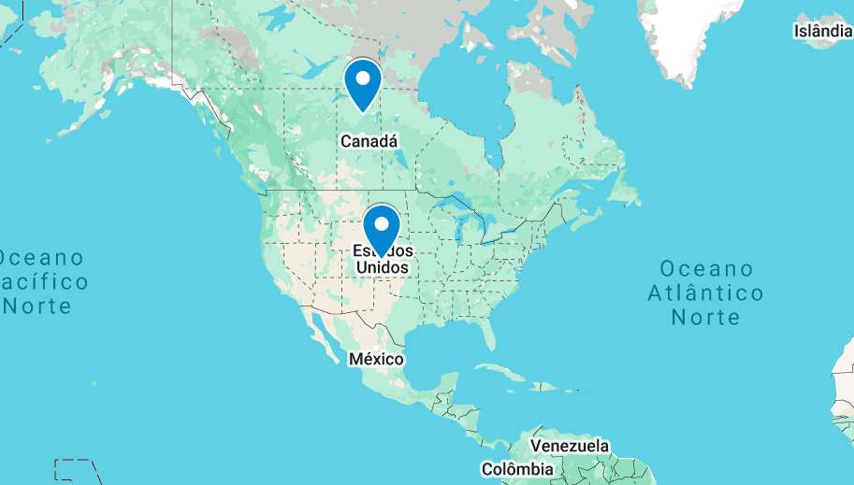
01 | Network Health Overview
Veoneer’s network performance and reliability undergo daily manual validation through Health Checks and continuous monitoring
Network Overall Health
★ INC101552-USA
: Critical server down\n
★ INC102781-India
: Database connection failure\n
● INC201774-Germany
: Incorrect time settings\n
● INC202113-Germany
: Application loading slowly\n
● INC203554-Japan
: WiFi access request\n
● INC204908-Sweden
: Meeting room display flickering\n
● INC205212-USA
: Minor keyboard malfunction\n
● INC206445-France
: Internal chat app delay\n
● INC207991-Korea
: Login attempt locked\n
2
2

Slide 3
02 | Network Operations – Last day of the month
Status of all incidents, changes and requests that were created on the current month and that were active in backlog from previous month
5
8
3
24
2
2
5
1
9
1
4
6
2
13
2

Slide 4
03 | Network Operations – KPIs
During November, a total of 2 Change Requests, 4 Incidents and 5 requests were open
4

Slide 5
04 | Network Operations – KPIs
During November, a total of 27 incidents were created, comprising from P4 to P1
5

Slide 6
05 | Network Operations – KPIs
Resolution times are consistently being met, ensuring timely and efficient handling of incidents.

Slide 7
06 | Network Operations – Ticket Analysis
The maximum incident resolution time was 5 minutes and 40 seconds
7

Slide 8
07 | Network Operations – KPIs
The average incident resolution time was 2 hours and 1 minute

