Slide 1
RCS
Network Operations
Service Report
November 2026
1

Slide 2
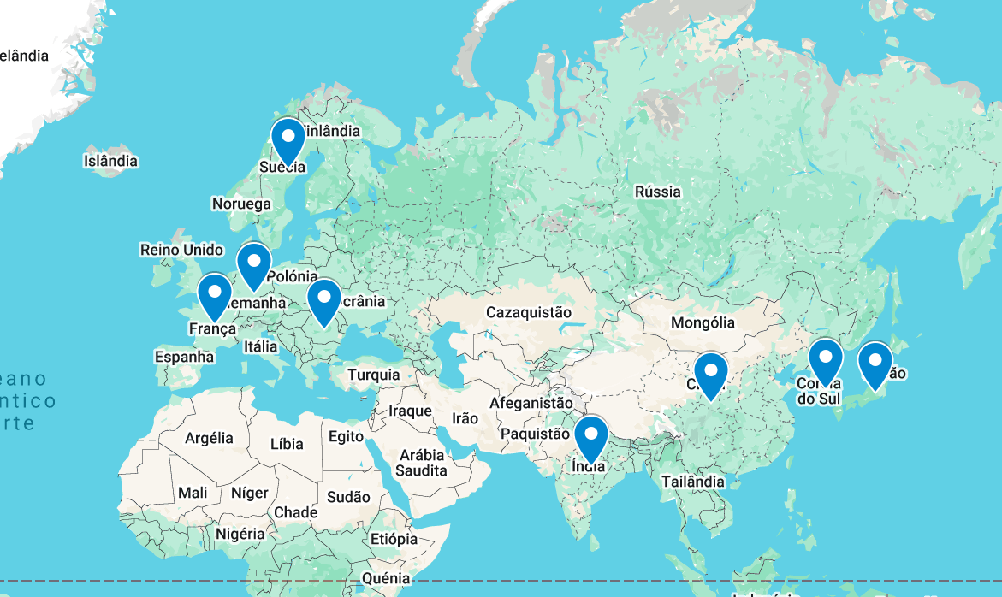



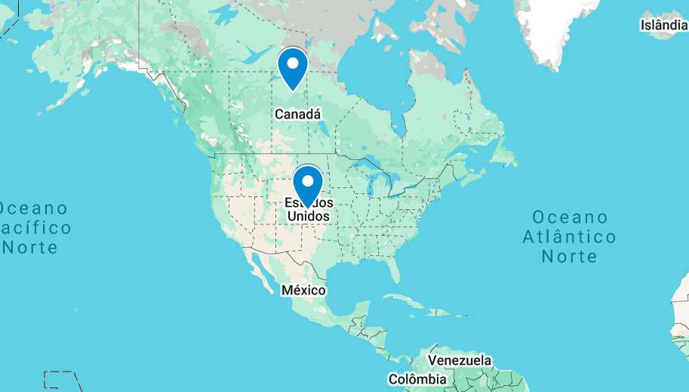
01 | Network Health Overview
Veoneer’s network performance and reliability undergo daily manual validation through Health Checks and continuous monitoring
Network Overall Health
★INC101552-USA: Critical server down
★INC102781-Canada: Database connection failure
●INC201774-Germany: Incorrect time settings
●INC202113-Germany: Application loading slowly
●INC203554-Japan: WiFi access request
●INC204908-Sweden: Meeting room display flickering
●INC205212-USA: Minor keyboard malfunction
●INC206445-France: Internal chat app delay
●INC207991-Korea: Login attempt locked
2
2

Slide 3
02 | Network Operations – Last day of the month
Status of all incidents, changes and requests that were created on the current month and that were active in backlog from previous month
5
8
3
24
2
2
5
1
9
1
4
6
2
13
2

Slide 4
03 | Network Operations – KPIs
During November, a total of 2 Change Requests, 4 Incidents and 5 requests were open
4

Slide 5
04 | Network Operations – KPIs
During November, a total of 27 incidents were open, comprising from P4 to P1
5

Slide 6
05 | Network Operations – KPIs
Resolution times are consistently being met, ensuring timely and efficient handling of incidents.

Slide 7
06 | Network Operations – Ticket Analysis
The maximum incident resolution time was 340 sec
7

Slide 8
07 | Network Operations – KPIs
The average incident resolution time was 2 hours and 1 minute

