Slide 1


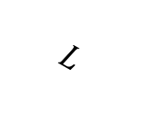
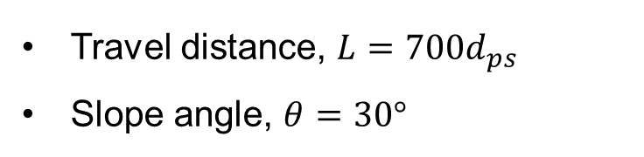
Acceleration zone
Deposition zone
Travel distance, $L=700d_{ps}$
Slope angle, $θ=30°$
Granular material
Releasing gate
Z
$$g$$
$$L$$
Centers of mass
Deposit
X
$$θ$$
Y
Runout

