Slide 1
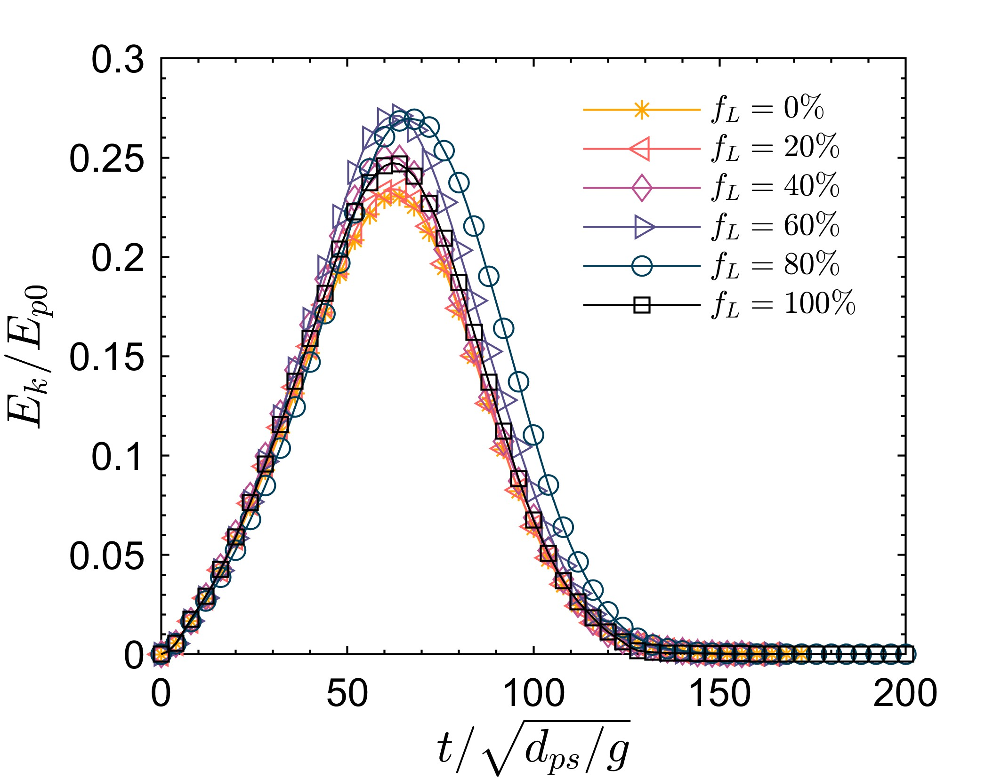
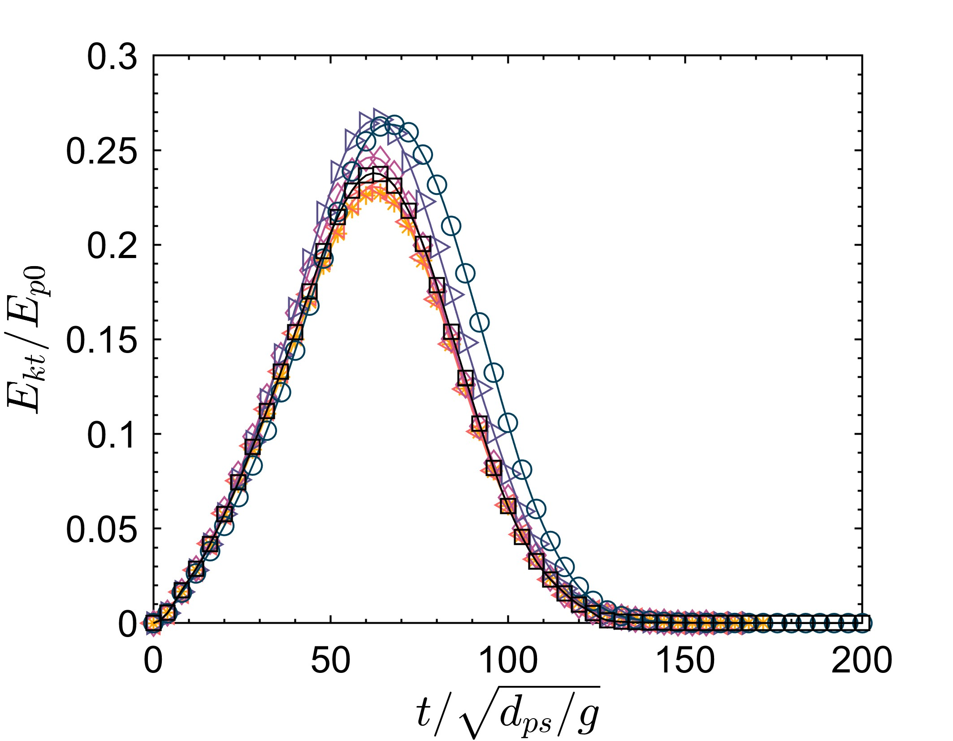
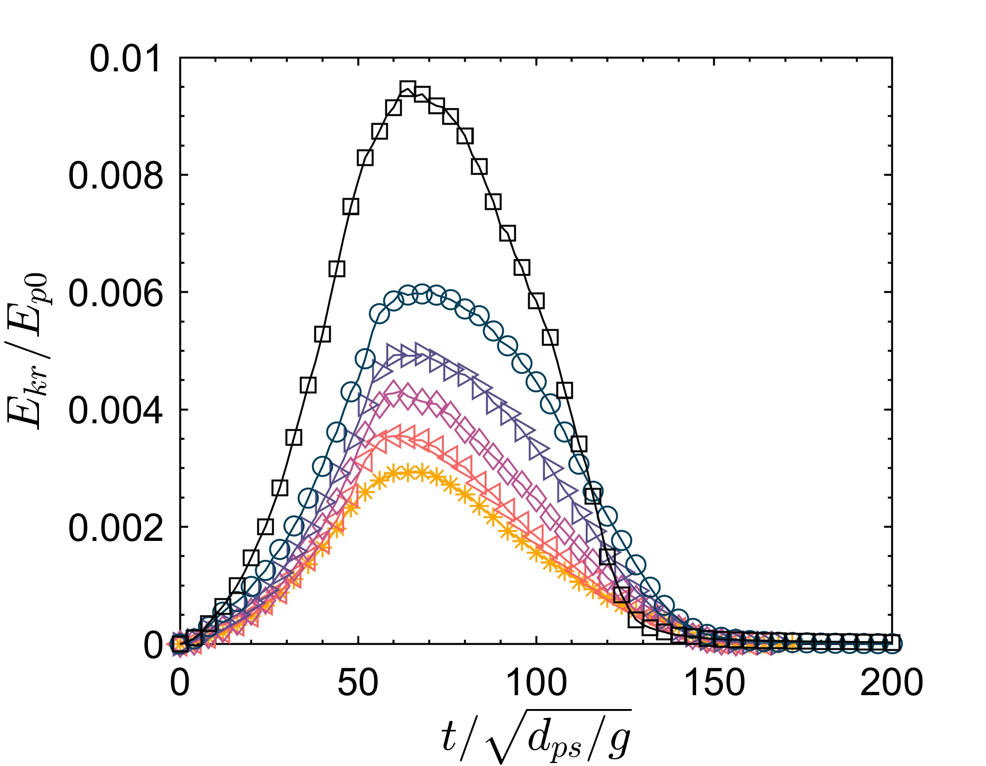
(a)
(b)
(c)
Notes:
KE_time_all_byd
KEt_time_all_byd
KEr_time_all_byds

