Slide 1
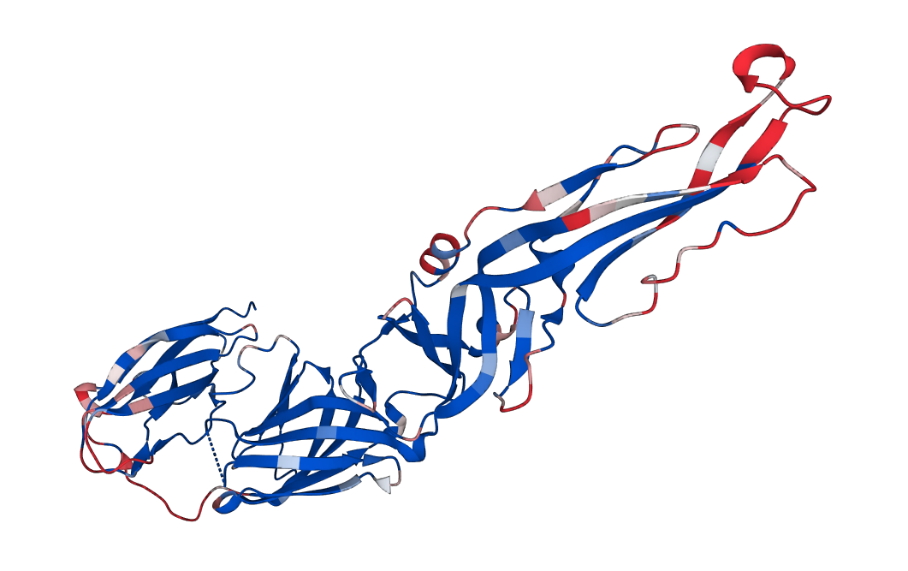
Supplementary Fig.1

