Slide 1

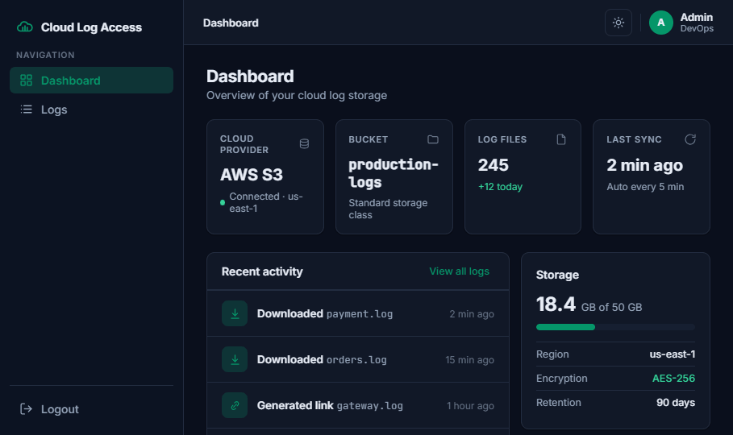


TAKE-HOME DELIVERY
Cloud Log Access Service
Secure, multi-cloud log access — a Go BFF + React SPA .
Role-controlled access to log files across AWS S3, GCP GCS, and Azure Blob.
All required
All 4 bonuses
3 clouds
Runs in one command — published Docker images, no toolchain.
Notes:
No real cloud accounts per the brief — so everything runs locally against emulators, with production-identical code. I'll demo it first, then walk through the design. Lead with: all required features, all four bonuses, three cloud providers, and it runs in a single command from published images.

Slide 2

LIVE
WALKTHROUGH
Live demo
1
Admin login → real S3 logs load in the dashboard
DEMO CREDENTIALS
2
Switch AWS → GCP → Azure — same UI, three clouds
admin@example.com admin123
3
Download a file (streamed) and generate a temporary link — open it in a tab
4
Log in as viewer → AWS-only · GCP shows no-permission · temp-link button gone (RBAC)
viewer@example.com viewer123
localhost:8080
Notes:
Do the demo here. Narrate the security boundary as you click — that is what they grade. Admin sees all three clouds and can download and generate temp links; viewer is scoped to AWS only, GCP returns a no-permission state, and the temp-link button is gone entirely. Keep it to about three minutes.

Slide 3

ARCHITECTURE & BACKEND DESIGN
One enforcement point, three thin adapters
Browser
→
nginx
→
Go BFF
→
Cloud SDK
→
Emulator
React SPA
/api proxy
single enforcement point
S3 · GCS · Blob
prod-identical
One storage.Provider interface
Dual-endpoint signing
A Service facade owns allow-listing, key sanitization & TTL clamping. Adding a cloud = one ~100-line file.
Presigned URLs must open from the browser , but the BFF talks to internal hostnames. SigV4 / SAS sign the host — so I sign against localhost directly.
type Provider interface {
List(ctx, bucket, prefix) ([]Object,
error )
Download(ctx, bucket, key) (io.ReadCloser,
error )
Presign(ctx, bucket, key, ttl) (
string, error )
}
Never rewrite a signed URL.
Notes:
The BFF centralizes auth and hides cloud differences behind one contract; the facade is the single place security lives. Adding a cloud is one ~100-line adapter. The hardest problem: presigned URLs must open from the browser while the BFF talks to internal hostnames — SigV4 and SAS sign the host, so I sign against localhost via a dual-endpoint design, and never rewrite a signed URL.

Slide 4
SECURITY · AUTH & AUTHZ
Defense in depth, every request
RequestID
›
Rate limit
›
JWT auth
›
RBAC
›
Sanitize
›
Handler
JWT HS256 — algorithm-pinned
bcrypt + constant-time auth
Blocks alg:none / confusion. iss/aud/exp/nbf, 1h TTL, jti denylist so logout truly revokes.
No user enumeration. RBAC admin/viewer → viewer scoped to AWS = 403 PROVIDER_NOT_ALLOWED.
Rate limiting & IDOR defense
Security-auditor pass
Keyed on real client IP (X-Real-IP , not the proxy). Path-traversal sanitizer; presigned URLs never logged.
Ran an adversarial audit and implemented its MUST controls — OWASP-mapped, with table-driven tests.
Notes:
This is the heavily-weighted criterion — show the layered, defense-in-depth chain. Every request runs the full middleware pipeline before a handler ever sees it. JWT is algorithm-pinned to block alg:none and confusion attacks; the jti denylist means logout truly revokes. Viewer scoped to AWS returns 403 PROVIDER_NOT_ALLOWED. I also ran a security-auditor pass and implemented its MUST controls, OWASP-mapped.

Slide 5
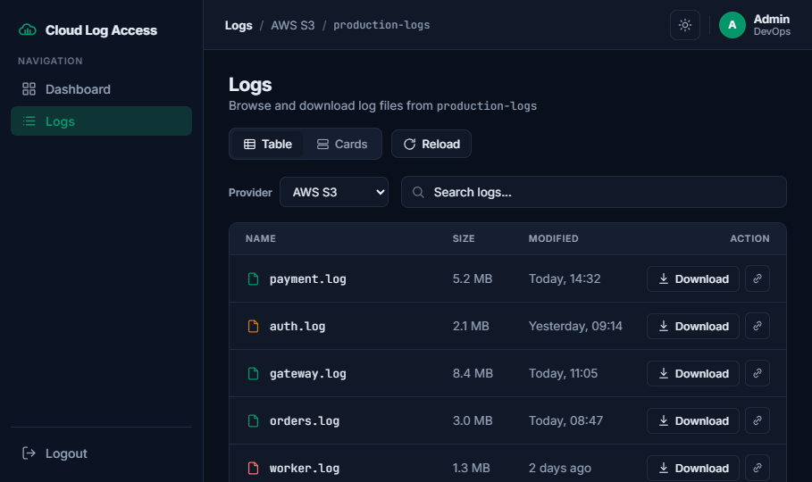
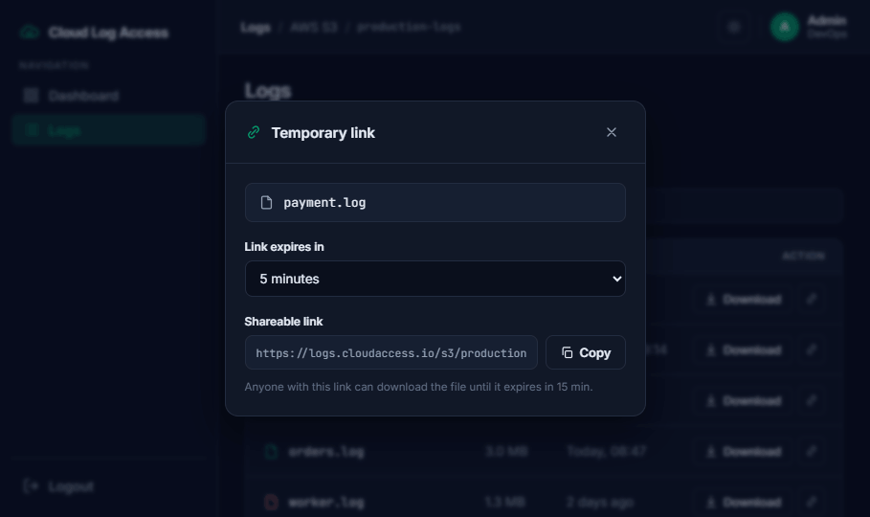
FRONTEND · CONTAINERS · BONUSES
Role-aware UI, zero-build deploy
Frontend
React 18 + TS + Tailwind · Zustand (persisted session) + TanStack Query · route guards · role-aware UI — hidden temp-link & no-permission state for viewers.
Containers
Multi-stage distroless / non-root images. One command runs emulators + seeder + BFF + frontend. Published to Docker Hub → run with zero build.
Bonuses
Terraform (S3 bucket + lifecycle + seed on LocalStack) · GitHub Actions (gofmt/vet/build, go test -race , LocalStack smoke, image builds) · docker-publish pipeline.
Notes:
This ties together UI/UX, containerization best-practices, and the IaC/CI bonuses. The frontend is role-aware — viewers never see the temp-link button and hit a no-permission state. Images are distroless and non-root, published to Docker Hub so it runs with zero build. Bonuses: Terraform provisions an S3 bucket with lifecycle and seeds it on LocalStack, and GitHub Actions runs gofmt/vet/build, go test -race, a LocalStack integration smoke test, and image builds.

Slide 6

DECISIONS, TRADE-OFFS & CLOSE
Deliberate choices, honest trade-offs
DECISION
WHY
PRODUCTION PATH
Go
Streaming io.Copy, first-party SDKs, static distroless binary
GCS real V4 signing (SA key) · httpOnly cookies vs localStorage · persistent users + OIDC · Redis-backed denylist · cloud IAM least-privilege
JWT + RBAC
Robust yet simple, stateless — right-sized vs. full OIDC
Emulators
Production-identical code — swap one endpoint for real cloud
Self-review
Adversarial pass caught & fixed real issues; clean history
github.com/pedrohrbispo/cloud-logs-service
Images on Docker Hub — happy to dive into any part of the code.
Notes:
Close on rigor and honesty. Go for streaming io.Copy, first-party SDKs for all three clouds, and a static distroless binary. JWT+RBAC over OIDC because it is right-sized for the brief. Emulators because the code is production-identical — swap one endpoint for real cloud. Be upfront about trade-offs and the production path. End by inviting them to dive into any part of the code.

