Slide 1

Thesis presentation
Degree:
Joint Master of Science in Hydroinformatics and Water Management
Tampere, August 21st, 2019

Slide 2


Urban sanitary sewer modelling in cold climate
Test case using automatic calibration and precipiration forecast in Finland
Pedro Paulo Almeida Silva
Institutional tutor
Dr. Frank Molkenthin
Institutional tutor
Dr. Markus Sunela

Slide 3
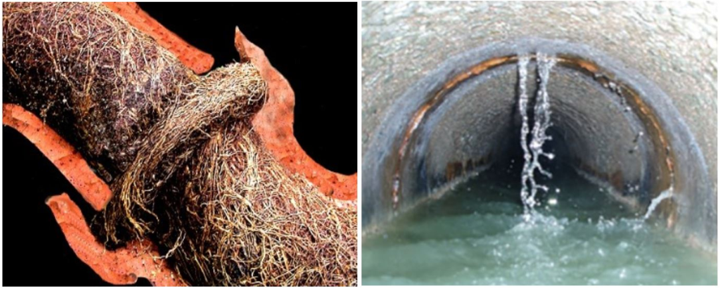
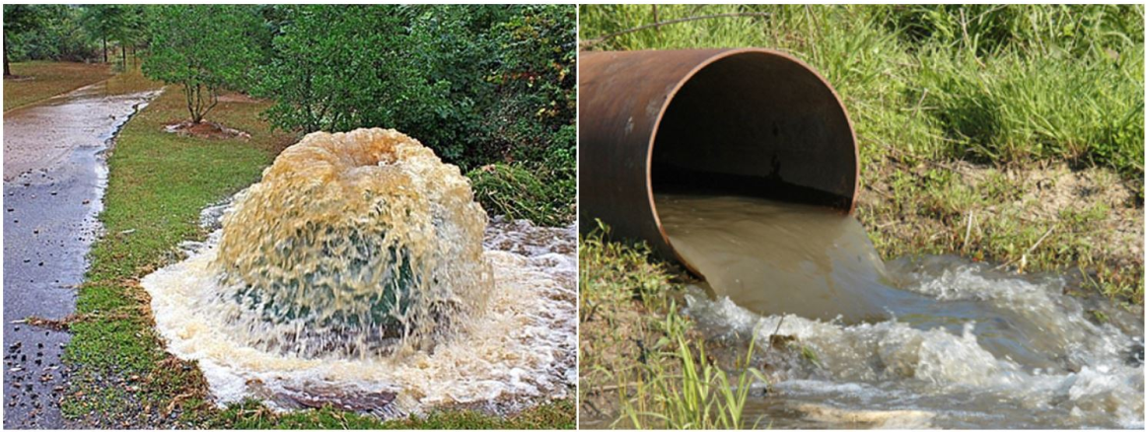
Problem description
Rainfall dependent Inflow and infiltration (RDII).
Inflow – roof or foundation drain connections. Infiltration – pipe cracks, faulty manhole, etc.
Overflows upstream caused by blockage or downstream by the WWTP bypass.
Why model the RDII? Improve design, rehabilitation, operations.
How can RDII be modeled in cold climates? Snow accumulation and snowmelt.
Root intrusion
[1]
Infiltration through cracks
Overflow: upstream
Overflow: downstream
[1]
[2]
[3]
Introduction Methodology Sewer model Case study Results and conclusions
Notes:
Sanitary sewer is the network of pipes used to transport the sewage from houses, industrial or commercial buildings to a disposal point such as the wastewater treatment plant
During wet weather conditions an extra volume of water inflows and infiltrates the sanitary sewer network through roof or foundation drain connections or defects in the network such root intrustions, cracked pipes or faulty manhole cover.
Inflows are associated when stormwater finds its way into the sanitary sewer system faster
Overflows upstream such as manhole floods when the pipe network has a blockage before the disposal or overflows downstream when the wastewater is diverted to rivers or streams through a bypass in the WWTP that has its intake capacity exceeded.

Slide 4
Objectives of the thesis
1. Use two different hydrological modeling approaches in SWMM to simulate RDII
2. Hydrological + hydraulic model for a case study of a town located in the south Finland.
3. Methodology for parameter estimation and calibration of the hydrological models.
4. Forecasted precipitation data and key aspects for a forecasting system.
Introduction Methodology Sewer model Case study Results and conclusions

Slide 5
Methodology
Include the fIGURE nOT included in the THesis.
Introduction Methodology Sewer model Case study Results and conclusions

Slide 6
Introduction Methodology Sewer model Case study Results and conclusions

Slide 7
Introduction Methodology Sewer model Case study Results and conclusions

Slide 8
Introduction Methodology Sewer model Case study Results and conclusions

Slide 9
References
[1] Test case using automatic calibration and precipiration forecast in Finland
[2]

