Slide 1




Project Soul
Confidential Information Memorandum
Colombia

Slide 2
Disclaimer
IGC has been retained by Químicos y Plasticos Industriales s.a.s. (“Company”), on an exclusive basis, to advise the Company in its investment process (“Transaction”). This material (“Information Memorandum”) describes and summarizes the Company, its assets, market, and economic and financial indicators and has been prepared exclusively to assist the recipient in deciding whether he/she/it wishes to proceed with a further investigation of a possible Transaction with the Company. In no event, the recipient shall use any of this information for any commercial purposes or for other purposes than the one for which this memorandum is furnished.
All information contained in this Information Memorandum has been prepared based on the documents and/or information provided by Company or obtained directly by IGC through legal sources and/or through independent research. IGC has not investigated, verified, or audited the documents and information used for the preparation of this Information Memorandum. This Information Memorandum contains statements, estimates, and projections provided by the Client concerning anticipated future performance. Such statements, estimates, and projections reflect assumptions by our Client concerning anticipated results, which may or may not prove to be correct. No representations, expressed or implied are made as to the accuracy of such statements, estimates, and projections. No representations, expressed or implied are made as to the accuracy of such statements, estimates, and projections.
This Memorandum of Information is not intended to form any part of the basis of any investment decision or other evaluation or any decision to participate in the Transaction process and should not be considered as a recommendation by the Company or IGC to any reader of this material. Each reader must make his/her/own valuation of the Transaction presented to determine whether to continue or not with its participation in the process.
No liability is or shall be attributed to the members of IGC, including its partners, directors, or employees, in connection with the accuracy or completeness of the information contained herein.
This material belongs to IGC and shall not be copied, reproduced, distributed, and/or disclosed, in whole or in part, including by digital media, to any third party without the express and prior consent, in writing, of IGC. By accepting this material, the recipient agrees to return it as soon as requested by IGC. The recipient of this material shall maintain in strict confidentiality and absolute secrecy all information contained in this material, and shall not disclose it to any third party, either directly or indirectly, without the prior authorization of IGC, and shall not use them for any purposes other than for the valuation of a possible consummation of Transaction
Furthermore, since the existence of the Transaction described herein is not publicly disclosed and may not be known by the members of the Company and other third parties, the recipient of this Memorandum of Information agrees not to approach or contact any officer or employee of the Company, its clients, suppliers and/or representatives of any nature without the express permission, in writing, of IGC, and shall keep confidential any information contained herein or otherwise made available in connection with the Company. In furnishing this material, IGC undertakes no obligation to provide the recipient with access to any additional information or to update this material or additional information, or to correct any inaccuracies therein which may become apparent, and reserve the right, at any time, without advance notice, to change the procedure for the conduction of the Transaction or terminate negotiations at any time before the execution of any binding agreement.
Flávia Silveira
IGC Partners
All communications, questions, and/or requests regarding this material shall be directly addressed to the Company.
Av. Brigadeiro Faria Lima, 2.277, 6th floor Zip Code 01452-000 | São Paulo – SP
Tel: (55 11) 3815-3533
E-mail: flavia.silveira@igcp.com.br
2

Slide 3

Executive Summary
04
Introduction
06
Investment Thesis
18
Company Overview
23
Financial Information

Slide 4
Syrsa at a Glance
Syrsa is one of the largest distributors of specialty chemicals and ingredients in the Mexican market available for M&A
Renowned Distributor of Specialty Chemicals in Latin America
Syrsa is a leading distributor serving the food, personal care, and industrial sectors, offering a range of products and services to the region’s top companies
Long-Term Relationships with Renowned Suppliers and Blue-Chip Clients
A supplier base comprising renowned American, European, and Asian companies, along with over 600 prestigious clients across various industries with high purchase recurrence
Financial and Operational Highlights
USD 79 M
Revenues in 2024E
⁺200
Products Sold in 2024E
Integrated Distribution Capabilities
An owned fleet featuring top-of-the-line tankers, semi-trucks, and box trucks, providing comprehensive distribution capabilities throughout Mexico
High Value-Added Services
The company recently invested in a highly skilled team and state-of-the-art equipment to offer to its clients high-value-added services
⁺80
Total Employees
⁺20k m²
Total Built Area for Storage
State-of-the-art Infrastructure
2 state-of-the-art warehouses distributed throughout Mexico, totaling +15,000 square meters of built area for storage, with top-of-the-line boilers, mixers, and storage tanks
Clear Growth Avenues
Expansion plan includes internationalization, growth of physical presence across Mexico, expansion of its third-party services business, and diversification of client base
Various Value-Added Segments
Increasing Profitability
Solid Financial Performance
Growth in Active Clients
Performance
Highlights
Segments by Revenue YTD Nov-24 (%)
Gross Profit/Ton (USD)
Revenue & EBITDA Margin (USD m, %)
Evolution of active clients (#)
Goliath has effectively improved its negotiations with clients and suppliers, focused on selling higher-value products, and recently started offering highly profitable services to its key clients, leading to its relevant increase in profitability in the last year
CAGR: 30 %

Slide 5
Executive Summary
04
Introduction
06
Investment Thesis
18
Company Overview
23
Financial Information

Slide 6










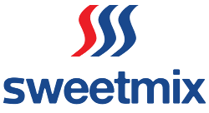












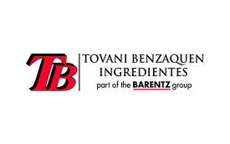



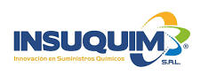











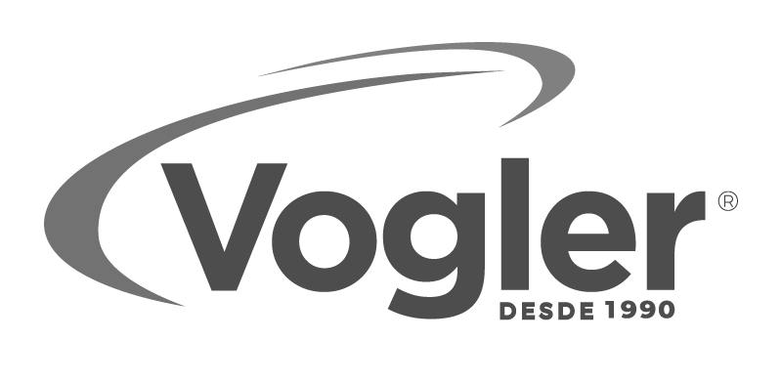


The Chemical Distribution Market in LatAm is Pointing to a Consolidation…
Latin America is still going through a consolidation process, but with the wave of acquisitions in recent years, there are limited acquisition opportunities
Chemical Distribution Market Concentration
Recent Acquisitions in the Sector in Latin America
Buyer | Targets
Compared to other regions, Latin American players have more room to make acquisitions and increase their market share
⁺30 M&A Transactions in LatAm over the last 5 years¹
Source: ICIS, Merger Market and Capital IQ Notes: (1) Only includes M&A Transactions for the selected players
6

Slide 7
The Beauty and Personal Care Market in Latin America is Thriving
The global beauty market is growing, with LatAm featuring accelerated growth due to cultural and economic trends
… And Colombia Having High Projected Growth in the Segment
The Global Cosmetics Market is Growing …
CAGR: 3%
Revenue of Colombian Cosmetics Industry (in billion USD)
Global Revenue of Cosmetics Industry (in billion USD)
CAGR: 5%
… With the LatAm Market Having Ample Room for Growth …
Global Regions by Cosmetic Revenue Share (%)
North America
North
Asia
Europe
South Asia
& MENA
Latin
America
Source: Statista 2023

Slide 8



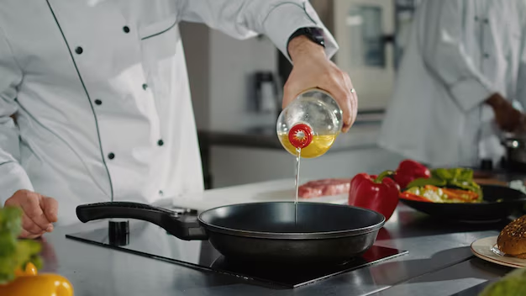
Almatia is a Leader in The Plastics and Coatings Market in the Region…
Almatia has built a complete portfolio for various segments, including plastics and coatings
Plastics
Main Products
79%
% of Total Gross Profit in 2024
⁺479
SKUs Sold
in 24
PET
The company’s largest segment, with the company serving as a one stop shop for the industry
Additives
Almatia serves as a one stop shop for the plastics and coatings markets in Colombia
Masterbatch Additives
Coatings
Main Products
15%
% of Total Gross Profit in 2024
⁺314
SKUs Sold
in 24
Organic Pigments
Wide portfolio of chemicals for the largest coatings and paint manufacturers in the region
Acrylic Resins
Pearlescent coatings
Main Products
Others
6%
% of Total Gross Profit in 2024
⁺26
SKUs Sold
in 24
Frying Oil Additives
Specialty food additives and architectural solutions
Staron Surfaces
Sintered stone slabs

Slide 9


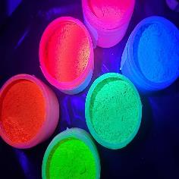

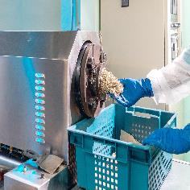


…Serving as a One-Stop-Shop in Those Segments
Almatia stands out with its extensive range of SKUs and product offerings across its segments, supplying everything from specialty additives to essential products
Portfolio of solutions
Key end-markets¹
Performance
Essentials
Plastics
PET
Polystyrene
Polypropylene
Titanium Dioxide
PVC Compounds
Nylon 6
⁺221
# of SKUs
~8%
Gross Margin FY24
90%
Differentiators
Coatings
Revenue Evolution
(Revenue, USD ‘000)
Enhancers
9%
Others
69%
of FY24 Gross Profit
Functionals
2%
Source: Company Information Notes: (1) % related to Gross Profit;

Slide 10
…Serving as a One-Stop-Shop in Those Segments
Almatia stands out with its extensive range of SKUs and product offerings across its segments, supplying everything from specialty additives to essential products
Portfolio of solutions
Key end-markets¹
Performance
Essentials
Plastics
Bio-based Resins
Pearlescent coatings
Specialty Pigments
Acrylic Resins
Fire Retardants
UV Resistors
Masterbatch Stabilizers
Rheological Modifiers
⁺440
# of SKUs
~15%
Gross Margin FY24
66%
Differentiators
Coatings
Revenue Evolution
(Revenue, USD ‘000)
Enhancers
34%
Others
24%
of FY24 Gross Profit
Functionals
0%
Source: Company Information Notes: (1) % related to Gross Profit;

Slide 11
…Serving as a One-Stop-Shop in Those Segments
Almatia stands out with its extensive range of SKUs and product offerings across its segments, supplying everything from specialty additives to essential products
Portfolio of solutions
Key end-markets¹
Performance
Essentials
Plastics
Cooking Oil Additives
Masterbatch Modifiers
Purge Compounds
Clays & Emulsions
Process Aids
⁺18
# of SKUs
~31%
Gross Margin FY24
66%
Differentiators
Coatings
Revenue Evolution
(Revenue, USD ‘000)
Enhancers
31%
Others
4%
of FY24 Gross Profit
Functionals
3%
Source: Company Information Notes: (1) % related to Gross Profit;

Slide 12
…Serving as a One-Stop-Shop in Those Segments
Company Overview
Almatia stands out with its extensive range of SKUs and product offerings across its segments, supplying everything from specialty additives to essential products
Portfolio of solutions
Key end-markets¹
Performance
Essentials
Plastics
Staron Surfaces
Sintered Stone Slabs
Staron Adhesives
⁺94
# of SKUs
~39%
Gross Margin FY24
99%
Differentiators
Coatings
Revenue Evolution
(Revenue, USD ‘000)
Enhancers
1%
Others
3%
of FY24 Gross Profit
Functionals
0%
Source: Company Information Notes: (1) % related to Gross Profit;

Slide 13
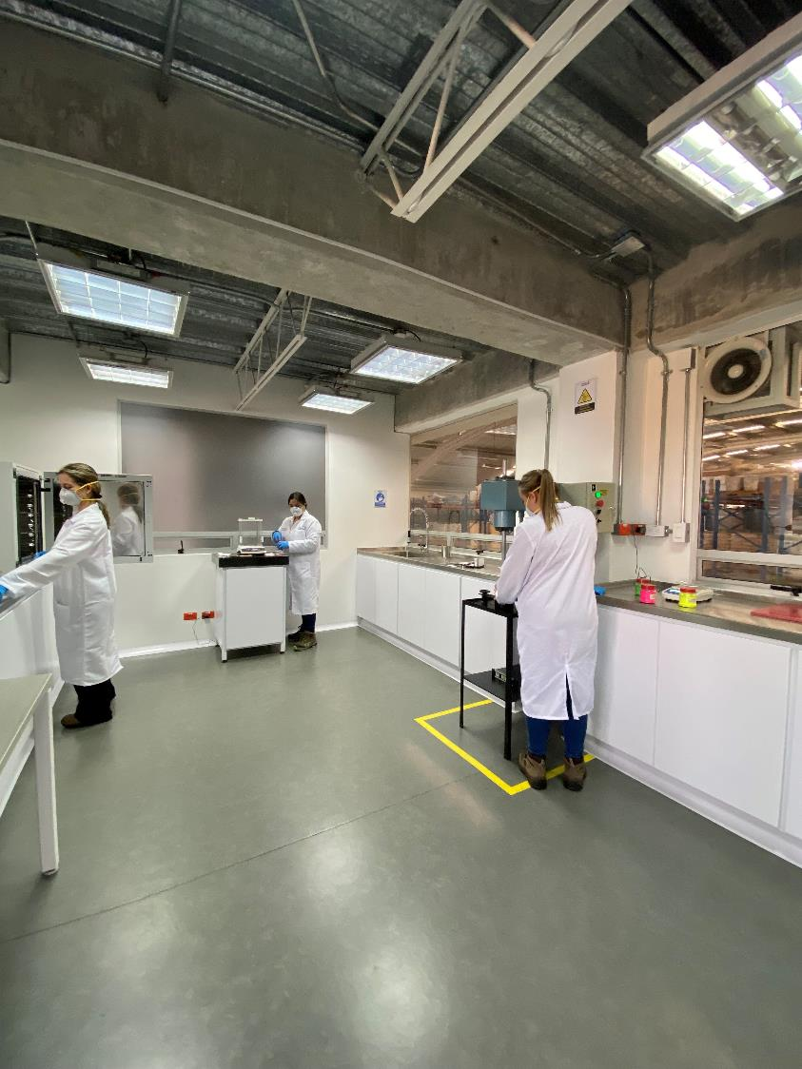

... With an Advanced Applications Laboratory to Provide Formulations and Service to Clients
The company has an applications laboratory for it paints and coatings business
Almatia has an Innovation Space in their Bogotá facilities where they support their customers and partners in the analysis of raw materials and the development of efficient formulations, showcasing the performance of our products
Advantages of Laboratory
Helps clients discover formulations where they can use Almati’s specialty portfolio
Drives sales of higher margin products
Catalyst for new customer acquisition
Catalyst for new customer acquisition
Location in Country’s main industrial hub
Bogota
Metropolitan Area
The company has a wide range of tests available
Viscosity
Determination of dispersion fineness
Dispersion tests using Cowles
pH Determination
Determination of specular gloss and gloss retention
Determination of stability
Color measurement by spectrophotometry
Determination of hiding power

Slide 14













Loyal & Recurrent Blue-Chip Client Base
The company has cultivated an impressive and highly diversified client base
Highly Recurring Purchasing Dynamics
Long-term Client Base
Extremely Diversified Client Base
# of top 50 active clients by purchasing frequency in 2024.2
Almatia has maintained relationships with long-term clients...
Revenue share (%) of top 10 clients in 2024²
⁺32
more than 94%
of 2024 revenue²
Clients made purchases in at least 10 months of 2024
Active clients for more than 2 years
more than 88%
of 2024 revenue²
⁺1,900
active clients¹
Active clients for more than 3 years
more than 85%
of 2024 revenue²
Active clients for more than 4 years
6 Months or less
7
Months
8
Months
9
Months
10
Months
11
Months
12
Months
(1) We consider active clients to be clients that purchased that year (2) The graph shows the number of clients based on their monthly purchasing frequency in 2024

Slide 15



























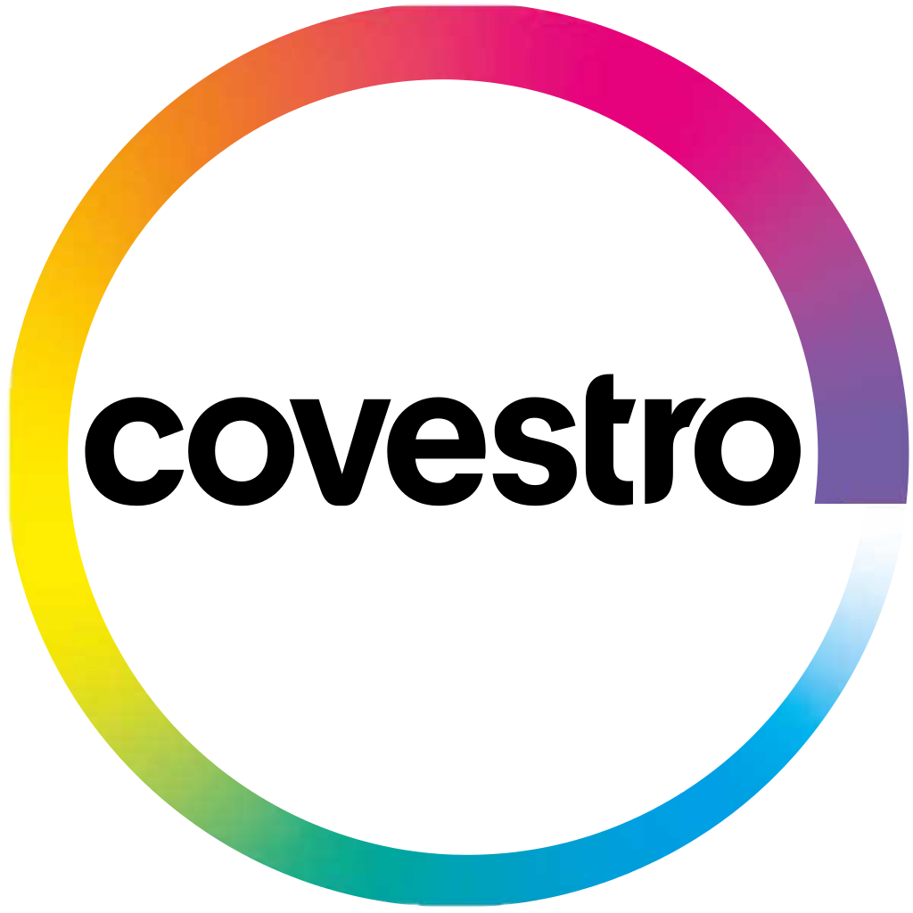


Almatia is the Trusted Partner for World-Class Suppliers
The main suppliers are globally renowned companies ...
The company has established itself as a leading distributor of the largest global manufacturers in the sector
Supplier
Country
Years of Relationship
Description of Relationship¹
Description
Products Sold
Being a reliable partner to some of the leading global suppliers
Arabia saudita
Exclusive distribution agreement for Colombia
Global leader in specialized in the production of chemicals & Polymers
Polyethylene
Polypropylene
⁺X years
USA
Exclusive distribution agreement for Colombia
Integrated producer of polystyrene and styrene monomer
⁺X years
Polystyrene
Corea
Exclusive distribution agreement for Colombia
One of the largest petrochemical producers in Asia
Polypropylene
Polycarbonate
ABS
⁺X years
China
Exclusive distribution agreement for Colombia
Global leader in the manufacture of pigments & colorants
Pearlescent Pigments
⁺X years
China
Exclusive distribution agreement for Colombia
Leading supplier of specialty pigments
Powdered Pigments
Plastic pigments
⁺X years
Alemanha
Exclusive distribution agreement for Colombia
Leader in the production of high-performance metal pigments
Aluminum Pellets
Aluminum Paste
⁺X years

Slide 16
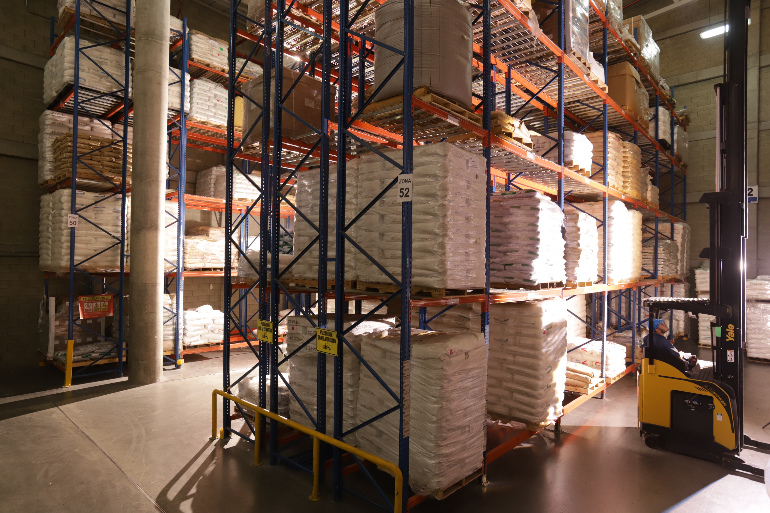
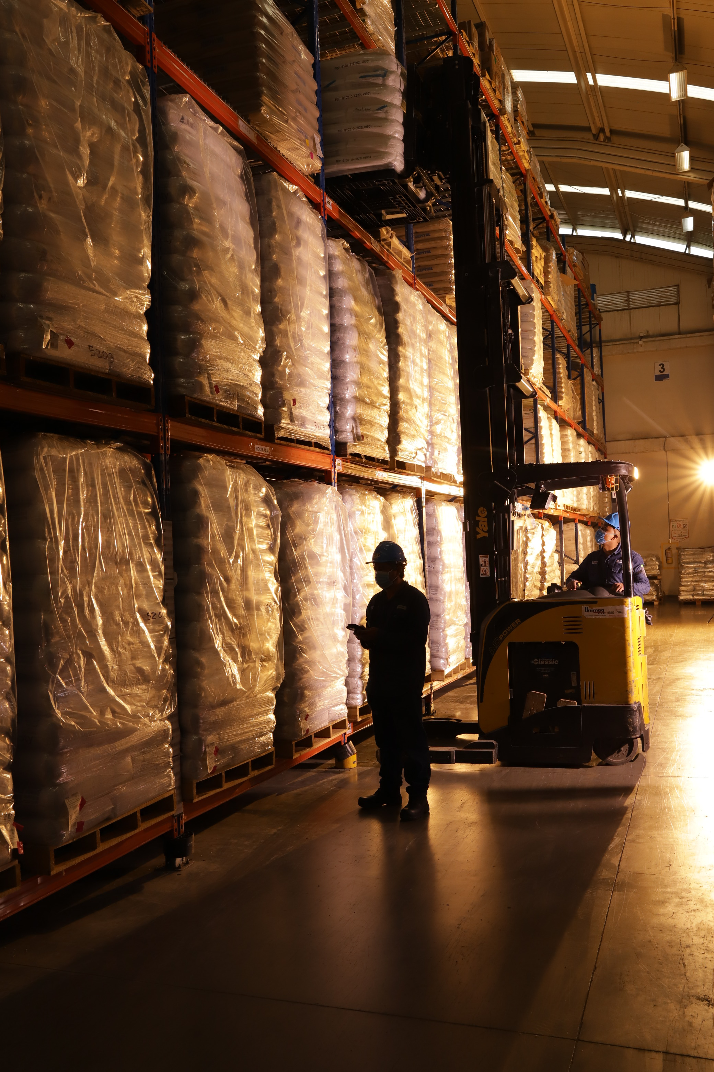
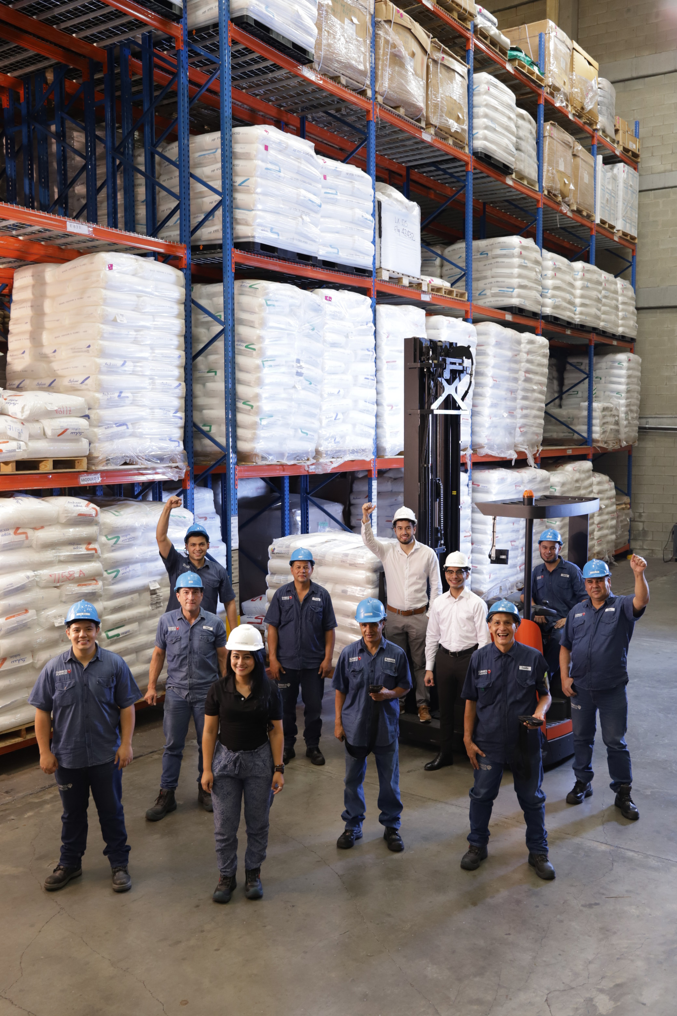



Almatia is a Consolidated Player with Multiple Warehouses & Global Commercial Presence
By combining state-of-the-art infrastructure, logistics know-how, and global commercial presence, Almatia has become the distribution partner of choice
Presence Worldwide
Commercial Offices & DCs
Cota Warehouse
Envigado HQ
Costa Rica Office
DCs & Offices
3 Sites
7,500m² Total Area
2 countries Export Countries
Colombia
Costa Rica

Slide 17
Almatia has Wide Geographical Reach Within the Colombian Market
Through its Warehouse network and commerical presence, the company serves the most importante regions in the colombian market
Almatia has an extensive presence across all Colombian regions...
...and is steadily penetrating all regions in the country...
09%
% of Total Gross Revenue
Southeast
South
Mid-West
Northeast
North
Abroad
36%
02%
2019
2024
% of Total Gross Revenue, FY24
06%
40%
03%
1
Cundinamarca & surrounding departments
2
Antioquia
3
Atlantic Coast
4
Coffee Axis
5
Pacific
6
Santanders
Source: Company Information

Slide 18


Growth Avenues
We have well-defined growth strategies, focusing on diversifying our business to strengthen our position as the leading specialty distributor in the region
1
3
Diversification of Client Base
2
Growth of laboratory services
Expansion into new segments
We are focused on diversifying our client base by expanding our reach among mid-sized and small clients
We plan to expand the capacity of our applications laboratory and enhance the custom formulations available to clients
We are expanding into the food segment, with new suppliers already in the pipeline
We aim to further diversify our business, expanding to new segments, and expanding our laboratory capabilities
Supplier Pipeline

Slide 19
Executive Summary
04
Introduction
06
Investment Thesis
18
Company Overview
23
Financial Information

Slide 20
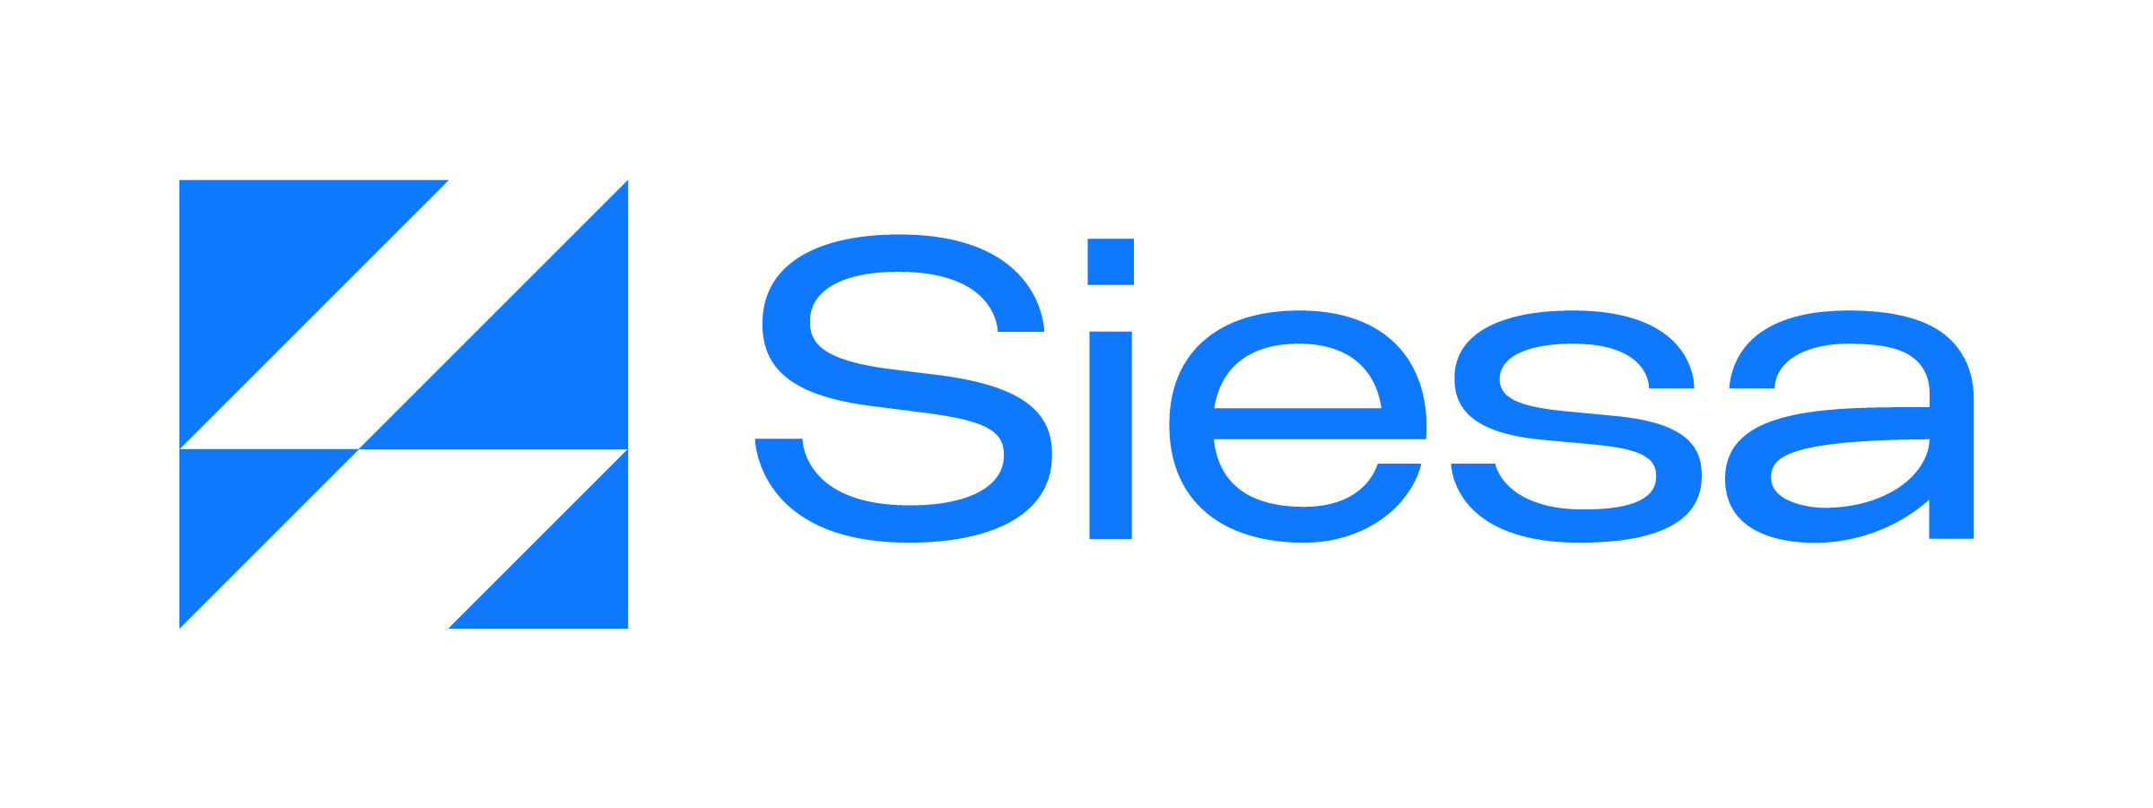





High Standard Corporate Governance Practices
From the beginning, the Company has invested in training professionals, software, certifications, and has been active in social issues
Focus on Social Impact and a DNA of Sustainability
E
S
G
Environmental
Social
Governance
The company distributes products sustainably and is committed to social responsibility
Highly commitment to environmental conservation:
Active in funding social causes:
Highly qualified management, with an average of 15 years of experience in the industry and advanced pedigree
Refines PKO subproducts, supporting the circular economy
Supports the development of communities through projects like the Magdalena River Nut Project
The company has used Siesa as their ERP since 2015
Professionalized Governance
Promotes regional development through local sourcing of fats, oils, glycerin, and corn derivatives
The company has been audited for more than 5 years by RSM
The company has an experienced management team and structured governance, winning various certifications
Collective agreement inside the company
Certifications that attest professionalized management
20% of the energy used comes from the solar panels installed in the facilities
Financial assistance to employees for education, housing, vehicles, and more
20

Slide 21



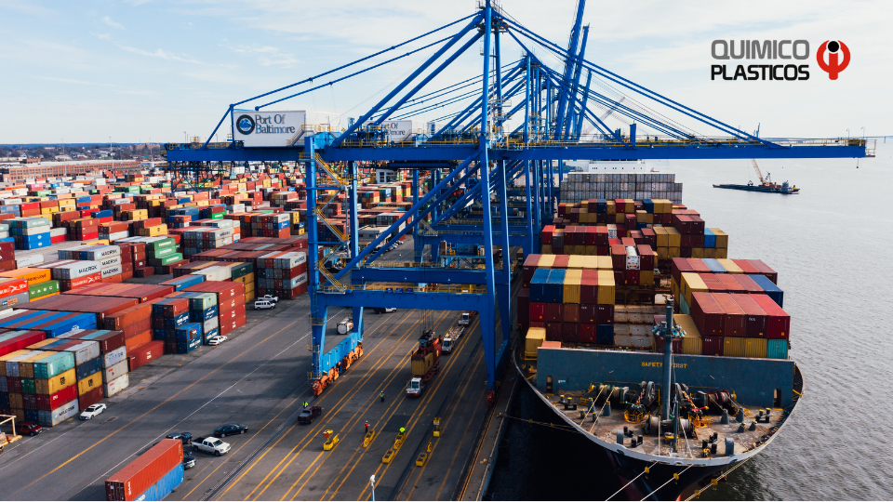
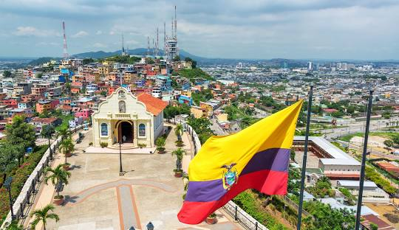





Nuestra historia
1982
1992
2002
2003
2007
2021
2023
2024
Fundación
Quimicoplásticos ingresa a la industria de pinturas y recubrimientos
Establecimos el acuerdo de distribución de TiO2 para Colombia
Abrimos el canal de ventas tipo trading a través de QP Trading CR
Iniciamos relaciones comerciales con SABIC
Recibimos la certificación como Operador económico autorizado - OEA
QP inicia su expansión internacional, en Ecuador
Cambiamos nuestra marca
Quimicoplásticos se estableció como distribuidor de resinas de poliestireno, producidas por Dow Química de Colombia, en Cartagena, Colombia.
Ahora somos Grupo Almatia. Renovamos nuestra identificad corporativa, reafirmando nuestro compromiso con diferentes industrias.
Quimicoplásticos incursiona en estas industrias, a su vez, ampliando el portafolio de materias primas para plástico, añadiendo pigmentos.
Convirtiéndonos en los agentes exclusivos de dióxido de titanio (TiO2) de Millennium Inorganic, luego Cristal y ahora Ineos Pigments.
Empresa comercial con sede en Costa Rica creada para expandir nuestras ventas en los grandes convertidores de plásticos.
Para resinas plásticas PE y PP en Colombia.
La máxima calidad de confianza que genera una empresa en sus operaciones de comercio exterior ante autoridades aduaneras.
Iniciamos operaciones comerciales en el mercado Ecuatoriano.

Slide 22
Shareholder’s Structure
Company Overview
Current cap table of Almatia is comprised of 4 partners of the Cantillo Family
50%
Alejandro
Cantillo Lopez
25%
Ana Mará Vacca Ossa
12.5%
Alejandro Jose Cantillo Vacca
12.5%
Alvaro Cantillo Vacca

Slide 23
Sumiquim’s Organizational Structure
Company Overview
Solid and well-structured organizational framework
Director General
Alejandro Cantillo
Sales Chief
Ingrid Real
Foreign Trade Manager
Aida Luz Grajales
Logistics Manager
Jessica Román
Systems Chief
Edilso Portilla
Finance Manager
Carlos Miguel Villa
Accounting Manager
Diego Fernando Concha
HR Manager
Alexander Guevara
Technical Manager
Pharma Sales Executive (2)
Foreign Trade Assistant
Logistics Processes Coordinator (3)
General Services Aid (2)
Accountant
Technical Support Executive
Home Care Sales Executive (2)
Accounting Aid
⁺25
Total
employees
Personal Care Sales Executive
(4)

Slide 24
Product Breakdown: Essentials
The company has drastically improved its profitability by ramping up new value-added services and products
1
Gross Profit
(Million USD)
⁺41%
Gross Margin 24’
⁺15%
CAGR 22'-24’
Segmento
Glycerin
2
Hydrating Nucleus
Gross Profit
(Million USD)
⁺53%
Gross Margin 24’
⁺125%
CAGR 22'-24’
Segmento
3
Soy Lecithin
Gross Profit
(Million USD)
⁺52%
Gross Margin 24’
⁺22%
CAGR 22'-24’
Segmento
4
Services
Gross Profit
(Million USD)
⁺50%
Gross Margin 24’
⁺388%
CAGR 22'-24’
Segmento
5
Xanthan Gum
Gross Profit
(Million USD)
⁺40%
Gross Margin 24’
⁺96%
CAGR 22'-24’
Segmento
6
Oils
Gross Profit
(Million USD)
⁺40%
Gross Margin 24’
⁺238%
CAGR 22'-24’
Segmento
7
Gross Profit
(Million USD)
⁺15%
Gross Margin 24’
⁺18%
CAGR 22'-24’
Segmento
Others

Slide 25
Product Breakdown: Differentiators
The company has drastically improved its profitability by ramping up new value-added services and products
1
Gross Profit
(Million USD)
⁺41%
Gross Margin 24’
⁺15%
CAGR 22'-24’
Segmento
Glycerin
2
Hydrating Nucleus
Gross Profit
(Million USD)
⁺53%
Gross Margin 24’
⁺125%
CAGR 22'-24’
Segmento
3
Soy Lecithin
Gross Profit
(Million USD)
⁺52%
Gross Margin 24’
⁺22%
CAGR 22'-24’
Segmento
4
Services
Gross Profit
(Million USD)
⁺50%
Gross Margin 24’
⁺388%
CAGR 22'-24’
Segmento
5
Xanthan Gum
Gross Profit
(Million USD)
⁺40%
Gross Margin 24’
⁺96%
CAGR 22'-24’
Segmento
6
Oils
Gross Profit
(Million USD)
⁺40%
Gross Margin 24’
⁺238%
CAGR 22'-24’
Segmento
7
Gross Profit
(Million USD)
⁺15%
Gross Margin 24’
⁺18%
CAGR 22'-24’
Segmento
Others

Slide 26
Product Breakdown: Enhancers
The company has drastically improved its profitability by ramping up new value-added services and products
1
Gross Profit
(Million USD)
⁺41%
Gross Margin 24’
⁺15%
CAGR 22'-24’
Segmento
Glycerin
2
Hydrating Nucleus
Gross Profit
(Million USD)
⁺53%
Gross Margin 24’
⁺125%
CAGR 22'-24’
Segmento
3
Soy Lecithin
Gross Profit
(Million USD)
⁺52%
Gross Margin 24’
⁺22%
CAGR 22'-24’
Segmento
4
Services
Gross Profit
(Million USD)
⁺50%
Gross Margin 24’
⁺388%
CAGR 22'-24’
Segmento
5
Xanthan Gum
Gross Profit
(Million USD)
⁺40%
Gross Margin 24’
⁺96%
CAGR 22'-24’
Segmento
6
Oils
Gross Profit
(Million USD)
⁺40%
Gross Margin 24’
⁺238%
CAGR 22'-24’
Segmento
7
Gross Profit
(Million USD)
⁺15%
Gross Margin 24’
⁺18%
CAGR 22'-24’
Segmento
Others

Slide 27
Product Breakdown: Functionals
The company has drastically improved its profitability by ramping up new value-added services and products
1
Gross Profit
(Million USD)
⁺41%
Gross Margin 24’
⁺15%
CAGR 22'-24’
Segmento
Glycerin
2
Hydrating Nucleus
Gross Profit
(Million USD)
⁺53%
Gross Margin 24’
⁺125%
CAGR 22'-24’
Segmento
3
Soy Lecithin
Gross Profit
(Million USD)
⁺52%
Gross Margin 24’
⁺22%
CAGR 22'-24’
Segmento
4
Services
Gross Profit
(Million USD)
⁺50%
Gross Margin 24’
⁺388%
CAGR 22'-24’
Segmento
5
Xanthan Gum
Gross Profit
(Million USD)
⁺40%
Gross Margin 24’
⁺96%
CAGR 22'-24’
Segmento
6
Oils
Gross Profit
(Million USD)
⁺40%
Gross Margin 24’
⁺238%
CAGR 22'-24’
Segmento
7
Gross Profit
(Million USD)
⁺15%
Gross Margin 24’
⁺18%
CAGR 22'-24’
Segmento
Others

Slide 28
Executive Summary
04
Introduction
06
Investment Thesis
18
Company Overview
23
Financial Information

Slide 29
Flavia Silveira
flavia.silveira@igcp.com.br
11 3815 3533
Marcos Berridi
marcos.berridi@igcp.com.br
11 3815 3533
Juan Pablo Cardenas
juan.cardenas@igcp.com.br
11 3815 3533
Avenida Brigadeiro Faria Lima, 2.277, 6th floor 01452-000, Jardim Paulistano, São Paulo
55 11 3815-3533

