Slide 1
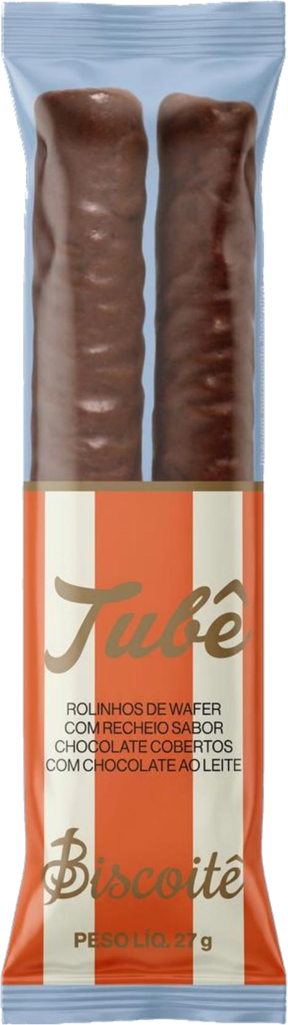
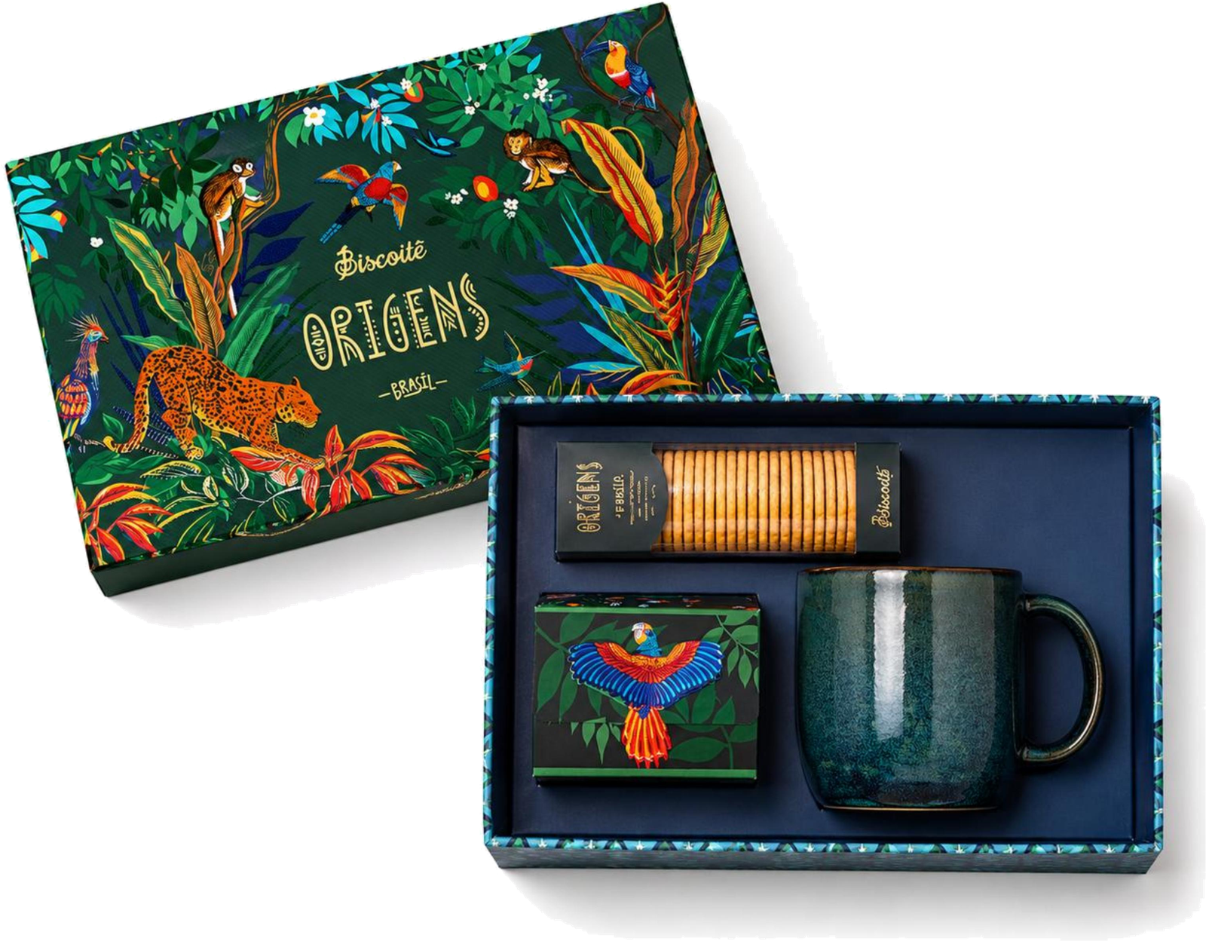
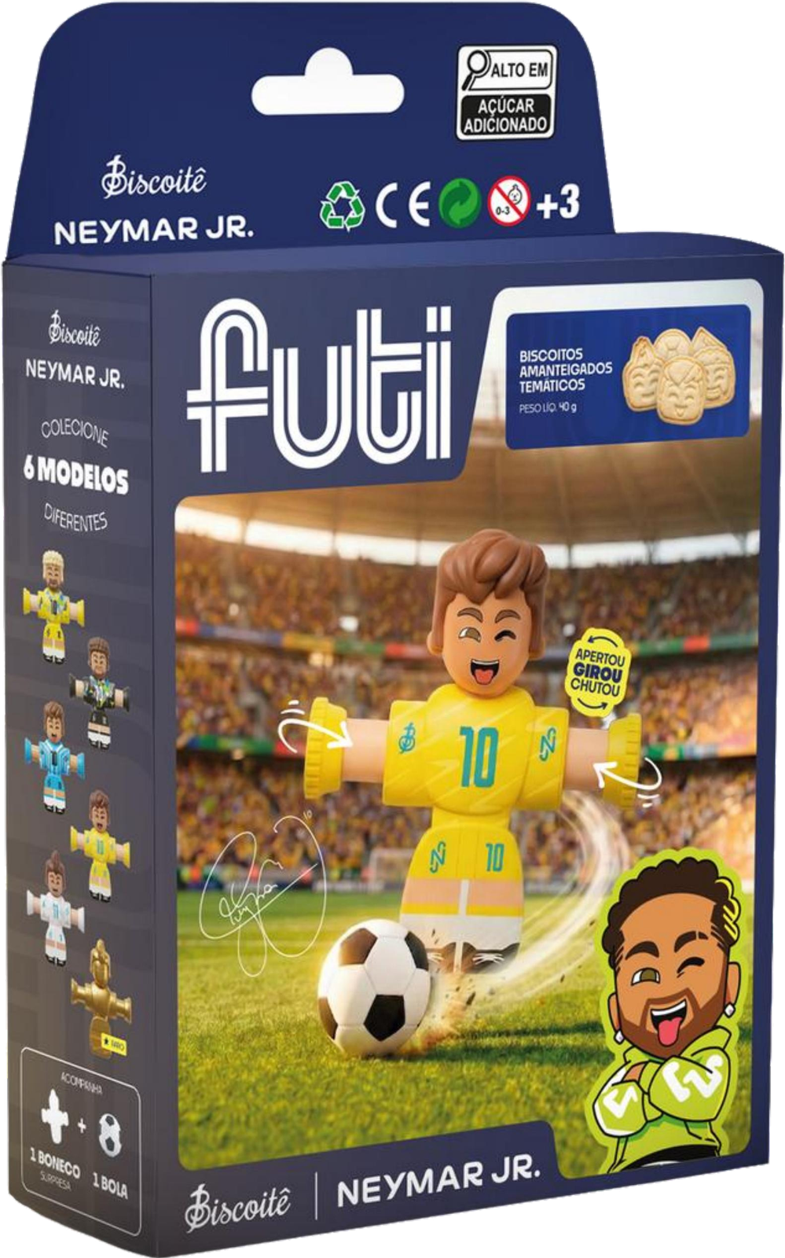
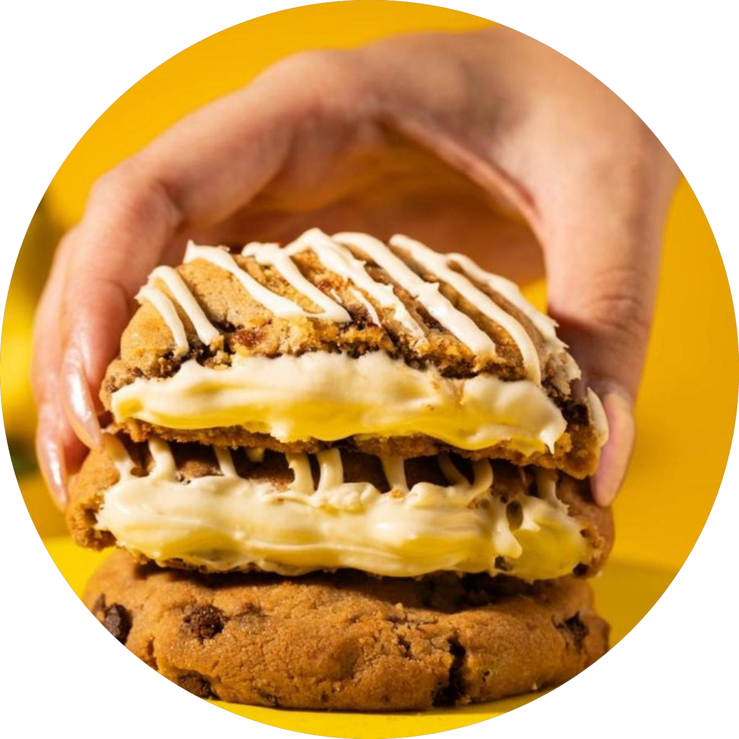
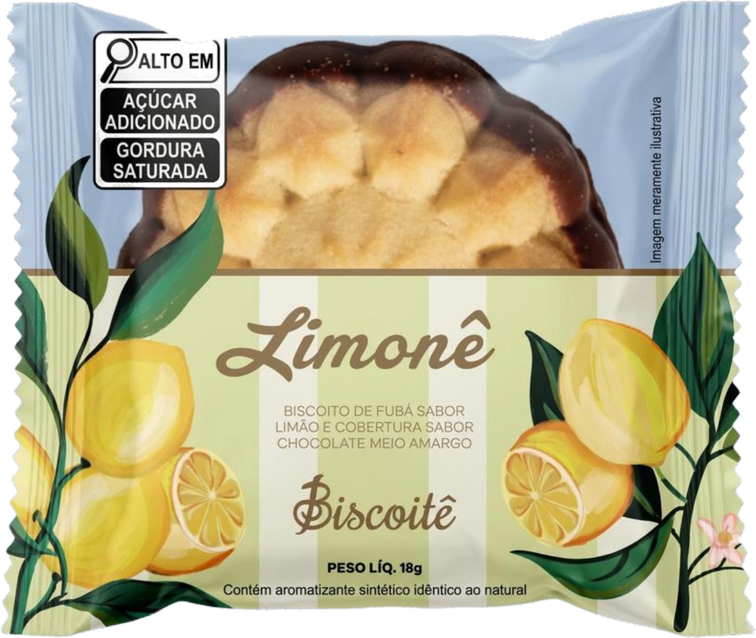
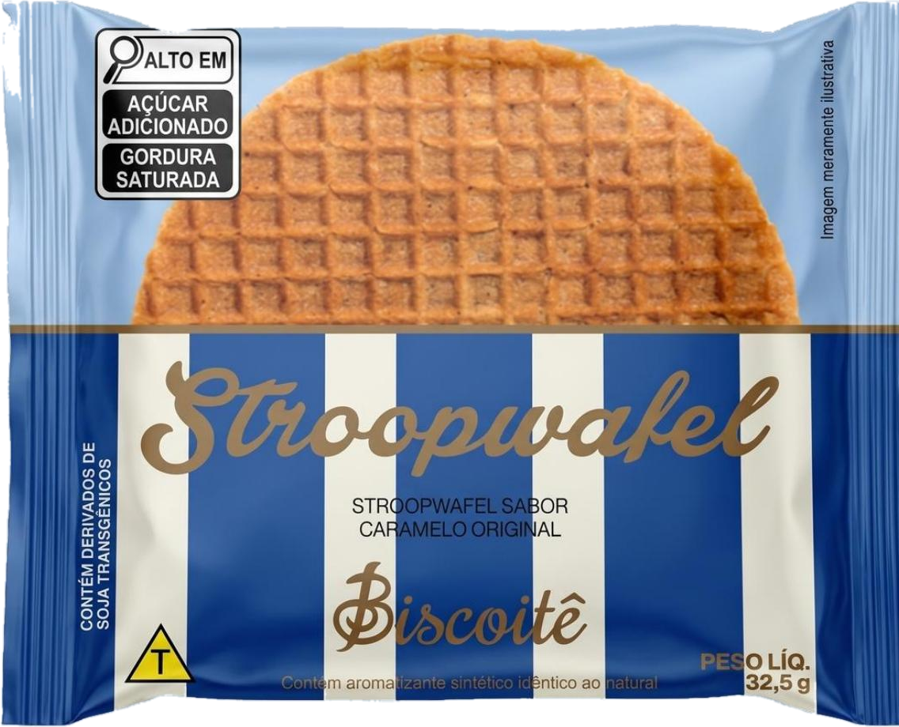
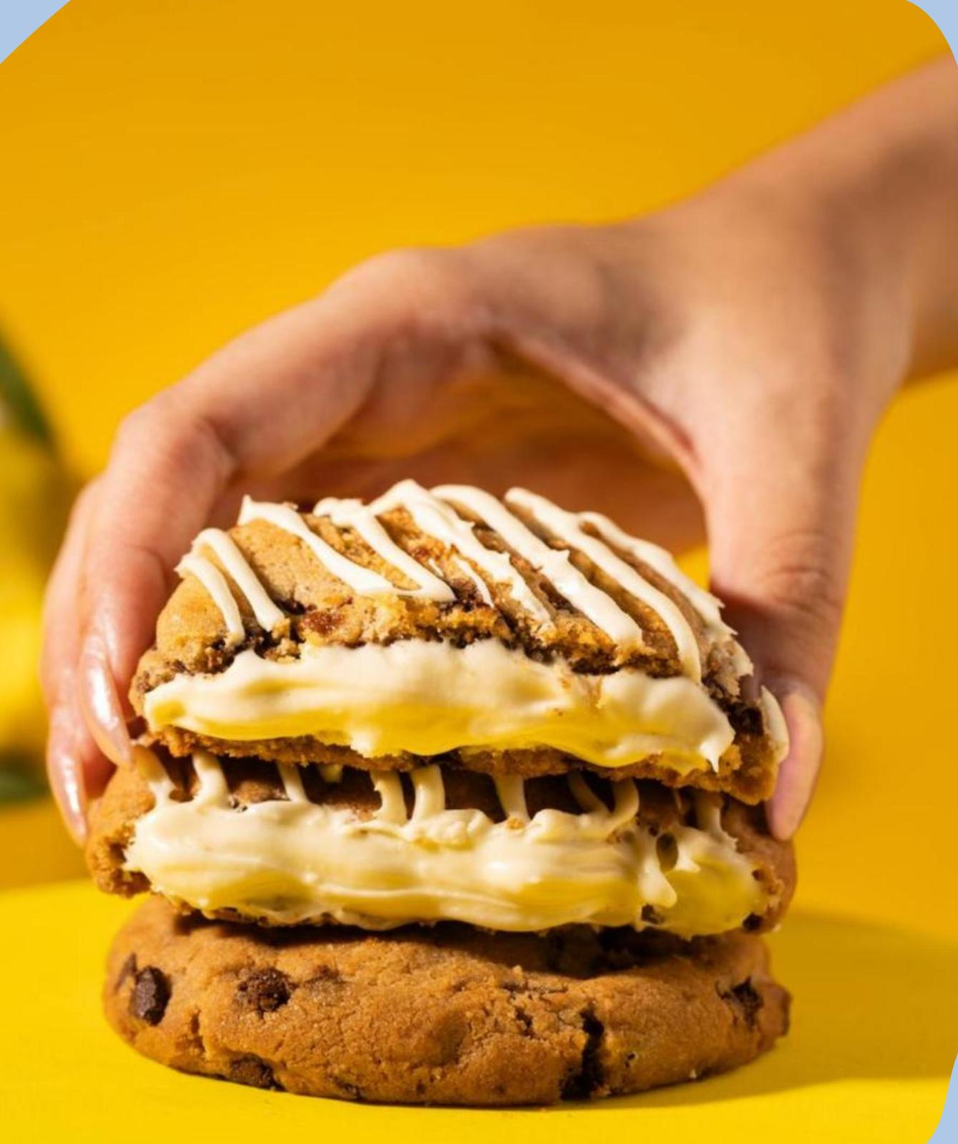
New
Company overview
A continuous innovation pipeline broadens the audience and increases purchase frequency
The 2026 roadmap adds an accessible everyday line, a proprietary Brazilian-flavor range and licensed collectibles, expanding consumption occasions without diluting the premium positioning
B.Eat
Origens
Futi × Neymar Jr.
Soft Cookie 2.0
Already in stores
2026 pipeline
2026 pipeline
2026 pipeline
Individually wrapped biscuits at an accessible price point give customers a reason to walk in mid-week, not only for a gift. Limonê is already in stores, with Tubê and Stroopwafel to follow.
Benchmark: +22% visit frequency on the same customer base and 1 in 3 new triers returning within 30 days
A line built on Brazilian ingredients — Brasilê with Brazil nut and cashew, Marú with cumaru. No other artisanal biscuit chain in Brazil runs a dedicated national-flavor range.
A licensing partnership with the most followed Brazilian athlete turns biscuits into collectibles across three price points — Card, blind-box Collection and Arena — with a national campaign in 2026.
The soft cookie range was reformulated for texture, flavor intensity and consistent execution across stores. Biscoitê PRO adds a zero-sugar, 12g-protein bar from Jan/27.
Source: Company

