Slide 1
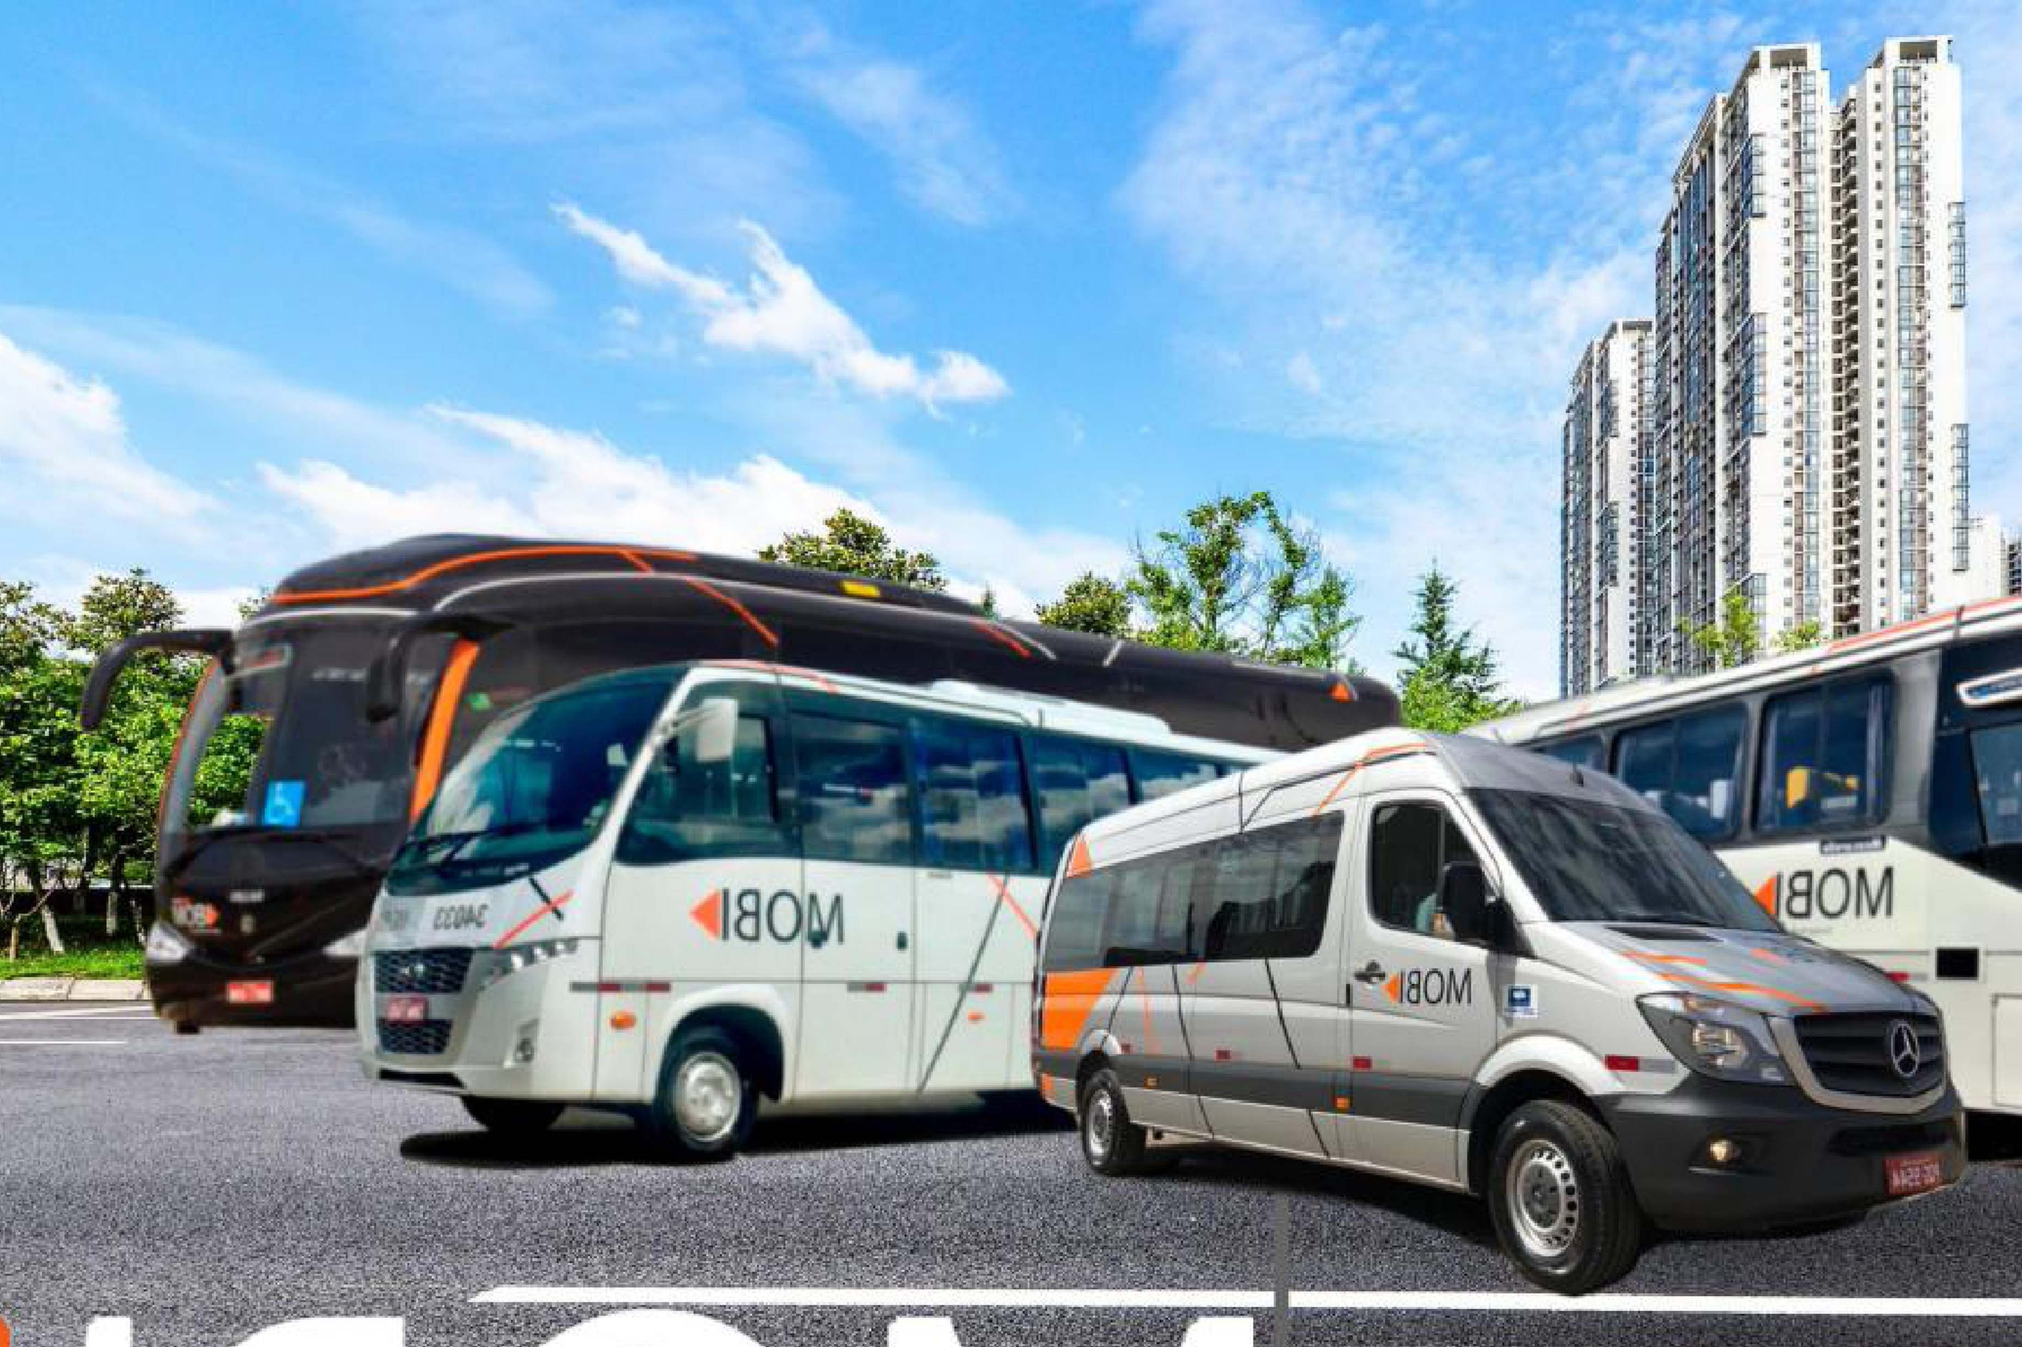

Project Compass
Confidential Information Memorandum

Slide 2
Disclaimer
Project Compass
IGC has been retained by MOBI (“Company”; “Mobi”), on an exclusive basis, to advise the Company in its’ M&A process (“Transaction”).This material (“Information Memorandum”) describes and summarizes the Company, its assets, market and economic and financial indicators and has been prepared exclusively to assist the recipient in deciding whether he/she/it wishes to proceed with a further investigation of a possible Transaction with the Company. In no event, the recipient shall use any of this information for any commercial purposes or for other purposes than the one for which this memorandum is furnished.
All information contained in this Information Memorandum has been prepared based on the documents and/or information provided by Company or obtained directly by IGC through legal sources and/or through independent researches. IGC has not investigated, verified or audited the documents and information used for the preparation of this Information Memorandum. This Information Memorandum contains statements, estimates and projections provided by the Client concerning anticipated future performance. Such statements, estimates and projections reflect assumptions by our Client concerning anticipated results, which may or may not prove to be correct. No representations, expressed or implied are made as to the accuracy of such statements, estimates and projections. No representations, expressed or implied are made as to the accuracy of such statements, estimates and projections.
This Memorandum of Information is not intended to form any part of the basis of any investment decision or other evaluation or any decision to participate in Transaction process and should not be considered as a recommendation by the Company or IGC to any reader of this material. Each reader must make his/her/its own valuation of the Transaction presented in order to determine whether to continue or not with its participation in the process.
No liability is or shall be attributed to the members of IGC, including its partners, directors or employees, in connection with the accuracy or completeness of the information contained herein.
This material belongs to IGC and shall not be copied, reproduced, distributed and/or disclosed, in whole or in part, including by digital media, to any third party without the express and prior consent, in writing, of IGC. By accepting this material, the recipient agrees to return it as soon as requested by IGC. The recipient of this material shall maintain in strict confidentiality and absolute secrecy all information contained in this material, and shall not disclose it to any third party, either directly or indirectly, without the prior authorization of IGC, and shall not use them for any purposes other than for the valuation of a possible consummation of Transaction
Furthermore, since the existence of the Transaction described herein is not publicly disclosed and may not be known by the members of the Company and other third parties, the recipient of this Memorandum of Information agrees not to approach or contact any officer or employee of the Company, its clients, suppliers and/or representatives of any nature without the express permission, in writing, of IGC, and shall keep confidential any information contained herein or otherwise made available in connection with the Company. In furnishing this material, IGC undertakes no obligation to provide the recipient with access to any additional information or to update this material or additional information or to correct any inaccuracies therein which may become apparent, and reserve the right, at any time, without advance notice, to change the procedure for the conduction of the Transaction or terminate negotiations at any time prior to the execution of any binding agreement
All communications, questions, and/or requests regarding this material shall be directly addressed to the Company.
Bruno Iervolino
Av. Brigadeiro Faria Lima, 2277 - 6th floor
Zip Code 01452-000 São Paulo – SP
Tel: (55 11) 3815-3533
E-mail: bruno.iervolino@igcp.com.br

Slide 3
Executive Summary
01
Introduction
02
Investment Thesis
03
Company Overview
04
Financial Highlights

Slide 4


Mobi at a glance
Mobi is a leading platform in corporate employee transportation (fretamento), reaching BRL 140 Mn of net revenue in 2025
Gross revenue by entity — 1Q2025 vs. 1Q2026
BRL Mn
With +20 years of experience in corporate employee transportation, Mobi is one of the leading platforms in corporate mobility, serving industrial, agribusiness and consumer goods clients across the Midwest and Southeast of Brazil
With [XXX] contracts executed in recent years, Mobi has built a strong portfolio of recurring revenue contracts with blue-chip clients, reflecting trusted and long-term partnerships
Operational strength underpinned by a modern fleet of 373 vehicles⁽¹⁾ with an average age of ~6 years(1), enabling a full and flexible service offering across buses, micro-buses and vans, tailored to client needs
Strong emphasis on operational reliability, supported by GPS-based telemetry and driver monitoring systems[; in-house maintenance capabilities to be confirmed with management], ensuring consistently high performance
Highlights
Experienced and scalable workforce, with [XXX] employees, a seasoned management team, and a strong commitment to operational safety
High quality fleet of ~BRL 198 Mn in value⁽²⁾
Strong revenue visibility, backed by [XXX] of contract backlog⁽³⁾
~BRL 140 Mn of net revenue 2025, with ~BRL 36 Mn of EBITDA (~26% margin)
Strong growth, with +41.3% 1Q gross revenue (YoY)
Source: Company; Jan-2026 fleet register. (1) Considers owned assets; average fleet age of 4 years per Company materials vs. ~6 years based on chassis manufacture year per fleet register — to reconcile with management; (2) Considers owned assets; (3) To be confirmed with Company.

Slide 5
Executive Summary
01
Introduction
02
Investment Thesis
03
Company Overview
04
Financial Highlights

Slide 6
Investment thesis
Investment Thesis
Mobi is well positioned for continued growth, supported by strong value drivers
Exposure to a large and structurally growing corporate mobility market
01.
Structural demand for corporate employee transportation is supported by clients’ operational needs, a national shortage of professional drivers, and labor regulations (NR-31) requiring compliant transport in areas without adequate public transit
Solid revenue model aligned with client demand, supporting strong customer stickiness
02.
Long-term contracts (3-5 years) with built-in annual price adjustment mechanisms (IPCA, collective bargaining agreement, and diesel price variation) protect margin and reinforce client retention
Asset base that compounds competitive advantage
03.
A modern, fully-owned fleet of 373 vehicles segregated across buses, micro-buses and vans creates operational flexibility, service quality control, and barriers that are hard for competitors to replicate
Integrated capabilities that deliver a full-service edge
04.
GPS-based telemetry and driver monitoring systems[, combined with in-house maintenance capabilities to be confirmed with management,] position Mobi as a reliable, high-uptime operator across its network of operational bases in the Midwest and Southeast of Brazil
Multiple growth avenues
05.
Geographic expansion, fleet electrification, technology-enabled services, and consolidation opportunities in a fragmented market create a clear and executable path for continued value creation

Slide 8






Solid track record with blue-chip companies, backed by long-term contracts
2
Mobi has consistently focused on long-term contracts with blue-chip clients across industrial, agribusiness and consumer goods sectors
Evolution of number of contracts [pending Company data]
Average revenue per contract [pending Company data]
Selected clients
#
BRL Mn / #
[XXX] client’s revenue⁽¹⁾
[XXX] client’s revenue⁽¹⁾
[X] contracts delivered
[X] years of relationship
[X] contracts delivered
[X] years of relationship
[X]
[X]
[XXX] client’s revenue⁽¹⁾
[XXX] client’s revenue⁽¹⁾
[X]
[XXX]
[X] contracts delivered
[X] years of relationship
[X] contracts delivered
[X] years of relationship
[X]
[XXX] client’s revenue⁽¹⁾
[XXX] client’s revenue⁽¹⁾
[X]
[X] contracts delivered
[X] years of relationship
[X] contracts delivered
[X] years of relationship
Highlights
Recurring revenue contract model
3-5 years average contract term⁽²⁾
[XXX] contracts executed in recent years
[XXX] of contract backlog
Source: Company. Client relationship metrics (contracts delivered, years of relationship, client revenue) to be confirmed with management. (1) Average contract term based on current portfolio structure.
Confidential
Notes:
https://agenciainfra.com/blog/minerais-criticos-vao-receber-us-213-bilhoes-ate-2030-diz-ibram/ https://www.coppermetal.com.br/setor-de-mineracao-no-brasil/
https://ibram.org.br/wp-content/uploads/2024/02/mineracao-em-numero-2023.pdf

Slide 9
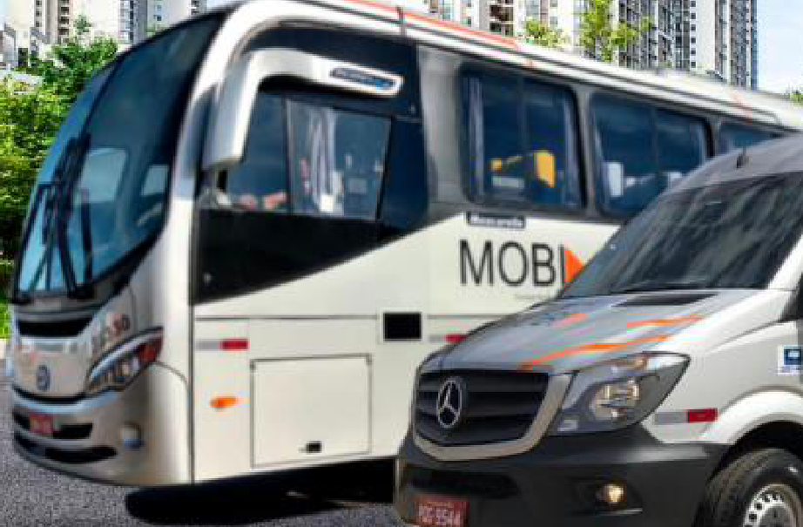
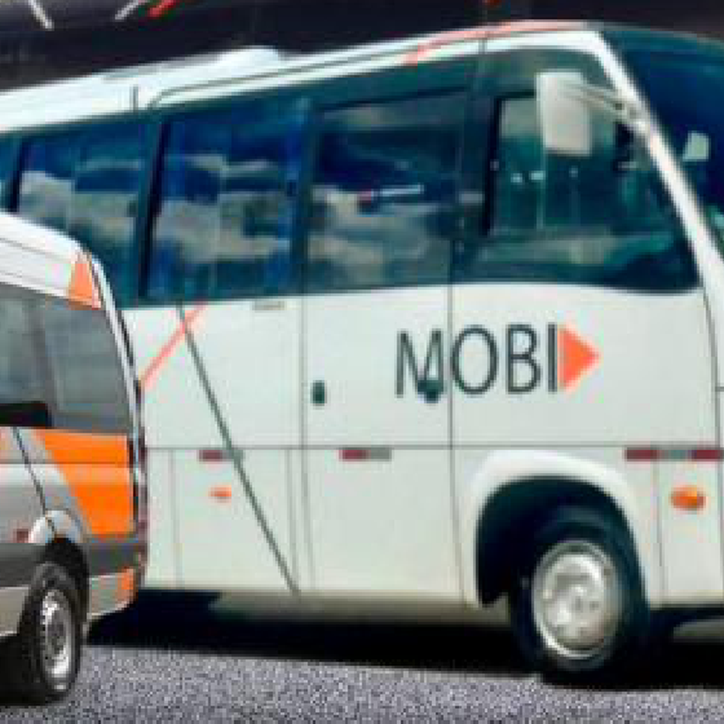
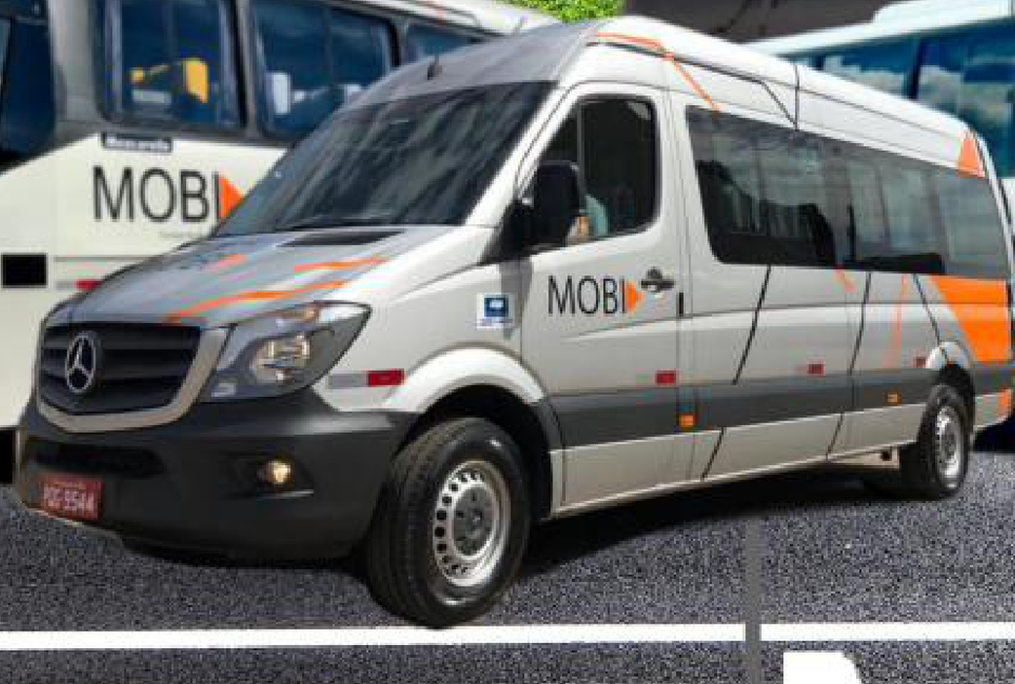
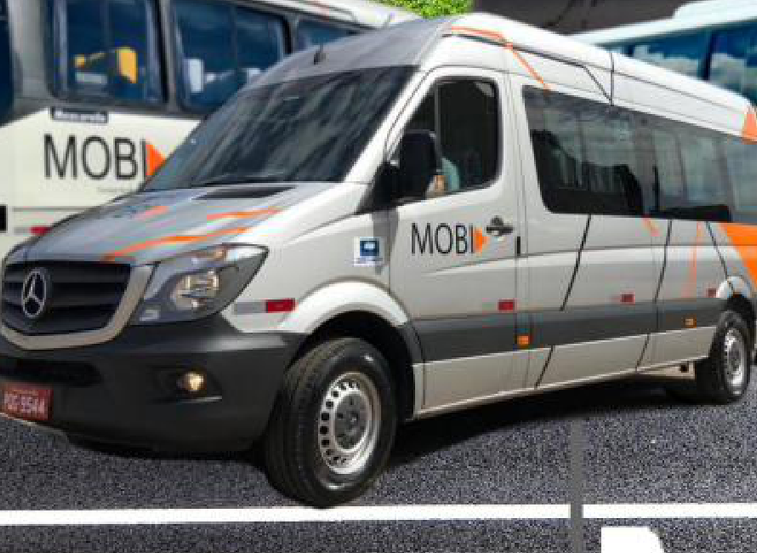










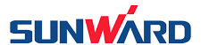
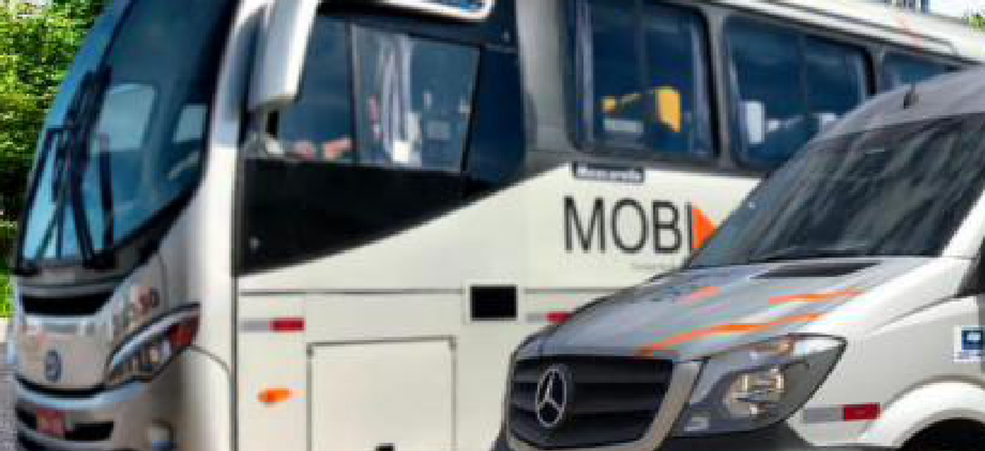
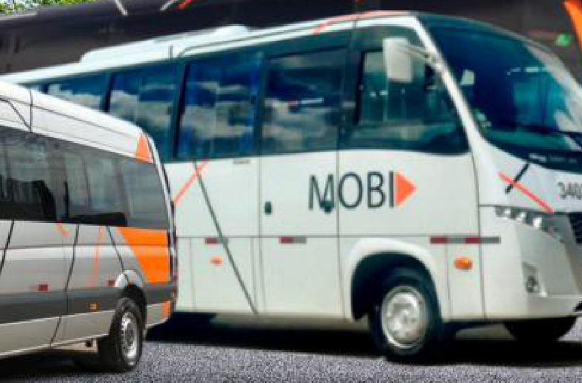
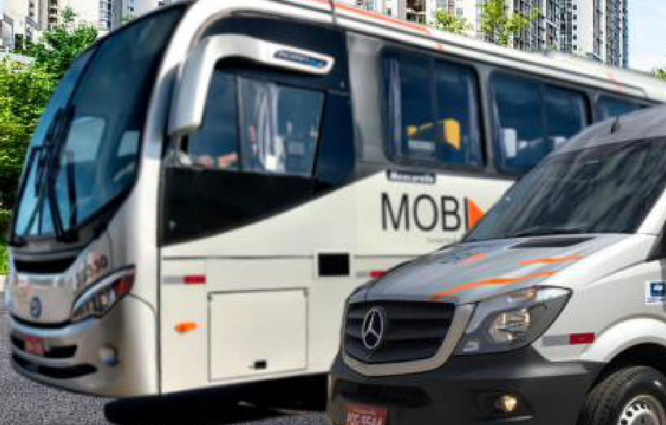
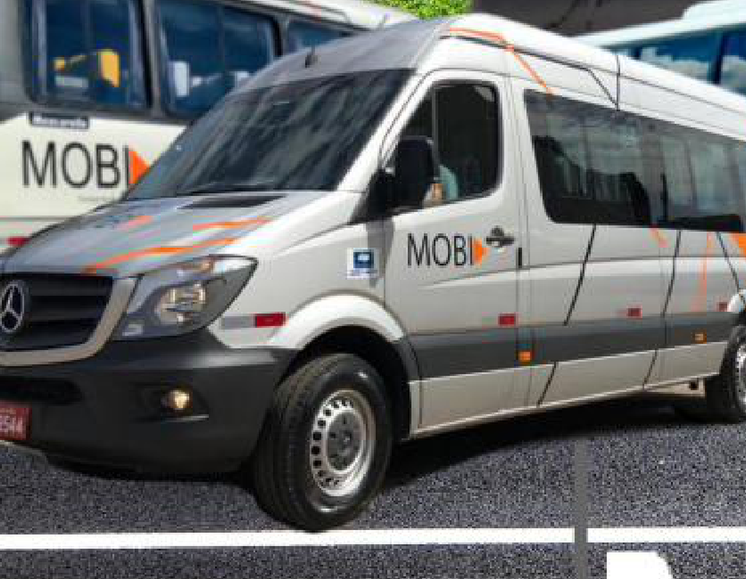


Modern, fully-owned fleet tailored to client needs
3
Fleet composition and leading chassis brands
Fleet composition
Highlights
Bus
Microbus
Van
Support vehicle
~6 years
Average fleet age⁽¹⁾
223 un.
74 un.
55 un.
17 un.
373
Total fleet⁽²⁾
Truck
Pickup truck
Owned fleet
% owned
~BRL 198 Mn
Total equipment value⁽³⁾
2 un.
2 un.
373 un.
100%
Source: Company; Jan-2026 fleet register. (1) Based on chassis manufacture year; Company materials cite 4 years — to reconcile with management; (2) Considers 373 owned assets (100% of fleet); (3) Considers owned assets.
Confidential
Notes:
https://agenciainfra.com/blog/minerais-criticos-vao-receber-us-213-bilhoes-ate-2030-diz-ibram/ https://www.coppermetal.com.br/setor-de-mineracao-no-brasil/
https://ibram.org.br/wp-content/uploads/2024/02/mineracao-em-numero-2023.pdf

Slide 10
Strategically positioned across the Midwest and Southeast of Brazil
4
From its headquarters to 10 operational bases across Goiás, the Federal District and Minas Gerais, Mobi is positioned close to its clients’ sites
Goiânia – GO
Headquarters
Corporate headquarters (Garagem Central) centralizing fleet management, monitoring infrastructure, and administrative functions
10 active operational bases
Anápolis – GO
Operational base
Largest operational base outside headquarters supporting fleet availability across the Goiás corridor
Mobi maintains operational bases close to client sites across Goiás, the Federal District and Minas Gerais, enabling faster response times, stronger execution oversight, and greater service reliability
Brasília – DF
Operational base
Garagem BSB supporting operations across the Federal District
Senador Canedo – GO
Operational base
Operational support base close to client sites in the Senador Canedo region, enabling faster response times and greater service reliability
States with operational bases
Uberlândia – MG
Operational base
Operational support base serving the Triângulo Mineiro region, enabling faster response times and greater service reliability
Source: Company; Jan-2026 fleet register
Notes:
https://agenciainfra.com/blog/minerais-criticos-vao-receber-us-213-bilhoes-ate-2030-diz-ibram/ https://www.coppermetal.com.br/setor-de-mineracao-no-brasil/
https://ibram.org.br/wp-content/uploads/2024/02/mineracao-em-numero-2023.pdf

Slide 11



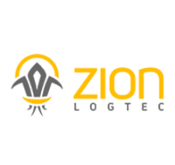







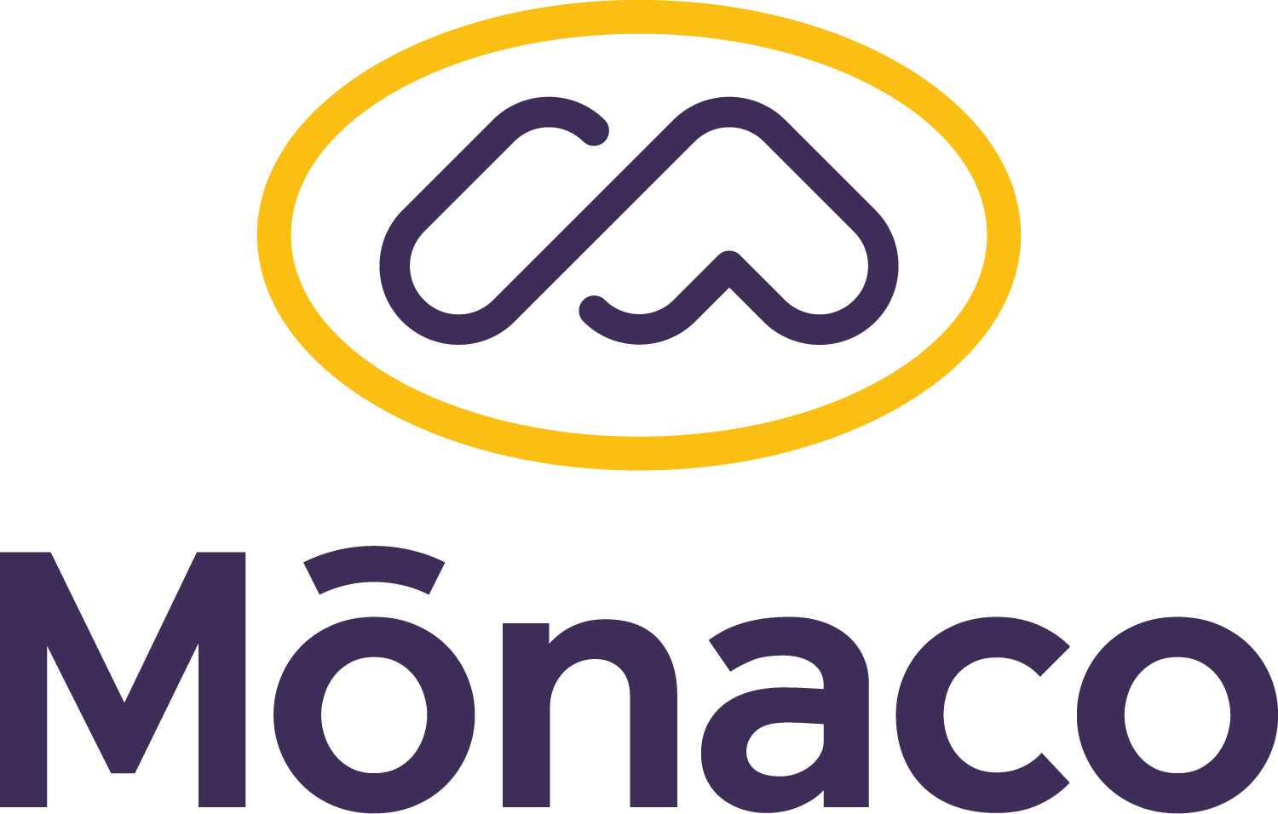

Technology-enabled operations support high reliability
4
Mobi combines GPS-based telemetry, driver monitoring, and operational discipline to keep its fleet running reliably
Mobi leverages GPS-based fleet telemetry and monitoring systems to support its operations...
... in-house maintenance capabilities to be confirmed with management
[XXX — ERP used by the Company]
[XXX — fleet maintenance management software]
In-house maintenance [TBC]
[To be confirmed with management: scope and structure of maintenance operations]
AI-powered telemetry for driver fatigue monitoring
[XXX — warehouse management system]
GPS Telemetry & Driver Monitoring
Vehicle tracking / GPS software
[XXX — tool crib management software]
GPS-based tracking and AI-powered driver fatigue monitoring support continuous oversight of the fleet and drivers across all operational bases
[XXX — route tracking software]
[XXX — PPE management software]
[XXX% annual fleet availability]
[XXX preventive maintenance services per year]
[XXX — fleet documentation management software]
[XXX — digital checklist and inspection software]
Source: Company
Confidential
Notes:
https://agenciainfra.com/blog/minerais-criticos-vao-receber-us-213-bilhoes-ate-2030-diz-ibram/ https://www.coppermetal.com.br/setor-de-mineracao-no-brasil/
https://ibram.org.br/wp-content/uploads/2024/02/mineracao-em-numero-2023.pdf

Slide 12
Growth avenues
Investment Thesis
5
Geographic expansion, consolidation opportunities, and fleet electrification position Mobi for a continued value creation trajectory
Mobi’s growth is expected to be driven by 3 main avenues, to be validated with management
A
Deepening client wallet share and geographic expansion
B
Consolidation of a fragmented market
C
Fleet electrification and technology-enabled services
Well-positioned to deepen wallet share with existing clients while capturing contracts with new clients
Expansion within the existing Goiás-DF-Minas Gerais corridor, and selectively into adjacent regions, leverages existing operational bases and client relationships
The Brazilian corporate transportation market remains fragmented, with consolidation already underway among larger operators in adjacent segments
Mobi’s scale and operational track record position it as a natural consolidation platform for smaller regional fretamento operators
Gradual fleet electrification responds to clients’ ESG and Scope-3 emission-reduction commitments, while a technology layer (route optimization, booking apps, carbon dashboards) can strengthen client stickiness
Formal driver capacitation and retention programs address the sector’s structural driver shortage, supporting fleet growth without a labor bottleneck
Source: Company; press research (see Pillar 1 sources)
Confidential
Notes:
https://agenciainfra.com/blog/minerais-criticos-vao-receber-us-213-bilhoes-ate-2030-diz-ibram/ https://www.coppermetal.com.br/setor-de-mineracao-no-brasil/
https://ibram.org.br/wp-content/uploads/2024/02/mineracao-em-numero-2023.pdf

Slide 13
Executive Summary
01
Introduction
02
Investment Thesis
03
Company Overview
04
Financial Highlights

Slide 14
Timeline
Mobi has +20 years of experience in corporate employee transportation
Foundation of Mobi [year TBC]
[Milestone — TBC]
[Milestone — TBC]
[Milestone — TBC]
[Milestone — TBC]
[XXXX]
[XXXX]
[XXXX]
[XXXX]
[XXXX]
[XXXX]
[XXXX]
[XXXX]
2025
2026
[Milestone — TBC]
[Milestone — TBC]
[Milestone — TBC]
[Milestone — TBC]
Positioned for continued growth
Gross revenue evolution [pending data]
CAGR [XX]
BRL Mn
Source: Company — milestone dates and descriptions below to be confirmed with management
Confidential
Notes:
https://agenciainfra.com/blog/minerais-criticos-vao-receber-us-213-bilhoes-ate-2030-diz-ibram/ https://www.coppermetal.com.br/setor-de-mineracao-no-brasil/
https://ibram.org.br/wp-content/uploads/2024/02/mineracao-em-numero-2023.pdf

Slide 15



Key management
Company Overview
Management team overview — to be confirmed with Company
Antônio Gabriel
Morgana
Pedro
Gabriela
[Name — TBC]
[Role — TBC]
[Role — TBC]
[Role — TBC]
[Role — TBC]
[Role — TBC]
[Background — TBC]
[Background — TBC]
[Background — TBC]
[Background — TBC]
[Background — TBC]
[Background — TBC]
[Background — TBC]
[Background — TBC]
[Background — TBC]
[Background — TBC]
[Background — TBC]
[Background — TBC]
[Background — TBC]
Source: Company
Notes:
https://agenciainfra.com/blog/minerais-criticos-vao-receber-us-213-bilhoes-ate-2030-diz-ibram/ https://www.coppermetal.com.br/setor-de-mineracao-no-brasil/
https://ibram.org.br/wp-content/uploads/2024/02/mineracao-em-numero-2023.pdf

Slide 16
Organization chart
Mobi operates under a multi-entity corporate structure (Grupo AGM Caetano / AGM Alpha) — simplified representation, to be confirmed with Company
Corporate structure by entity
Family Shareholders
Family shareholders
Total fleet: 373 vehicles
Family shareholders
AGM Caetano Part.
Holding company
AGM Caetano LTDA
MOBI X
AGM Alpha
[Related party]
MOBI Alpha
(Matriz Brasília)
[Pedro — 100% direct ownership]
[Entity — TBC]
Moura e Carrilho Participações
[Pedro — 100% direct ownership]
Filial Goiânia
Filial Senador Canedo
Filial Alexânia
Filial Nerópolis
Filial Uberlândia
Filial Rio Verde
Filial Pires do Rio
Filial Anápolis
Filial Itumbiara
Source: Company
Notes:
https://agenciainfra.com/blog/minerais-criticos-vao-receber-us-213-bilhoes-ate-2030-diz-ibram/ https://www.coppermetal.com.br/setor-de-mineracao-no-brasil/
https://ibram.org.br/wp-content/uploads/2024/02/mineracao-em-numero-2023.pdf

Slide 17

Success case: Cargill operation
Company Overview
Long-term relationship example — details to be confirmed with Company
Start of contract
Current contract
[City — State]
BRL [XXX]k
[X] months
[Service scope — TBC]
BRL [XXX]Mn
[X] years
[Service scope — TBC]
of total value
of total term
service scope
of total value
of total term
service scope
Timeline
[Mon-YY]
[Milestone — TBC]
[Mon-YY]
[Milestone — TBC]
[Mon-YY]
[Milestone — TBC]
[Mon-YY]
[Milestone — TBC]
Source: Company — to be confirmed
Notes:
https://agenciainfra.com/blog/minerais-criticos-vao-receber-us-213-bilhoes-ate-2030-diz-ibram/ https://www.coppermetal.com.br/setor-de-mineracao-no-brasil/
https://ibram.org.br/wp-content/uploads/2024/02/mineracao-em-numero-2023.pdf

Slide 18
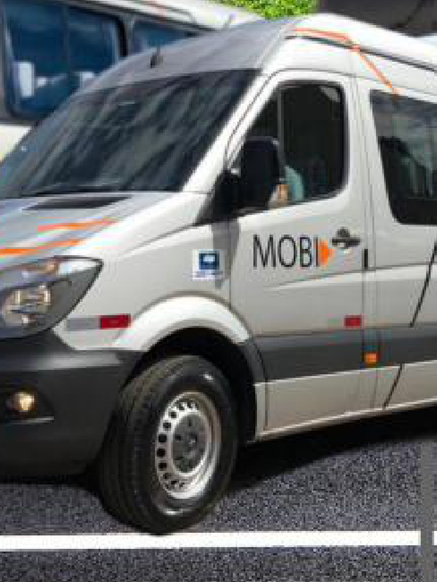

Success case: JBS operation
Company Overview
Long-term relationship example — details to be confirmed with Company
Start of contract
Current contract
[City — State]
BRL [XXX]k
[X] years
[Service scope — TBC]
BRL [XXX]Mn
[X] years
[Service scope — TBC]
of total value
of total term
service scope
of total value
of total term
service scope
Timeline
[Mon-YY]
[Milestone — TBC]
[Mon-YY]
[Milestone — TBC]
[Mon-YY]
[Milestone — TBC]
[Mon-YY]
[Milestone — TBC]
Source: Company — to be confirmed
Notes:
https://agenciainfra.com/blog/minerais-criticos-vao-receber-us-213-bilhoes-ate-2030-diz-ibram/ https://www.coppermetal.com.br/setor-de-mineracao-no-brasil/
https://ibram.org.br/wp-content/uploads/2024/02/mineracao-em-numero-2023.pdf

Slide 19
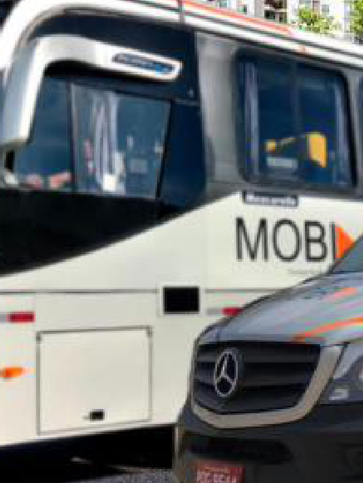

Success case: Votorantim Cimentos operation
Company Overview
Long-term relationship example — details to be confirmed with Company
Start of contract
Current contract
[City — State]
BRL [XXX]Mn
[X] months
[Service scope — TBC]
BRL [XXX]Mn
[X] years
[Service scope — TBC]
of total value
of total term
service scope
of total value
of total term
service scope
Timeline
[Mon-YY]
[Milestone — TBC]
[Mon-YY]
[Milestone — TBC]
[Mon-YY]
[Milestone — TBC]
Source: Company — to be confirmed
Notes:
https://agenciainfra.com/blog/minerais-criticos-vao-receber-us-213-bilhoes-ate-2030-diz-ibram/ https://www.coppermetal.com.br/setor-de-mineracao-no-brasil/
https://ibram.org.br/wp-content/uploads/2024/02/mineracao-em-numero-2023.pdf

Slide 20
Executive Summary
01
Introduction
02
Investment Thesis
03
Company Overview
04
Financial Highlights

Slide 23
Bruno Iervolino
bruno.iervolino@igcp.com.br
11 3815 3533
Gabriel Brito
gabriel.brito@igcp.com.br
11 3815 3533
[Team member — TBC]
[email — TBC]
11 3815 3533
+55 11 3815-3533
Av. Brigadeiro Faria Lima, 2277 - 6th floor
São Paulo, SP, Brazil - 01452-000

