Slide 1
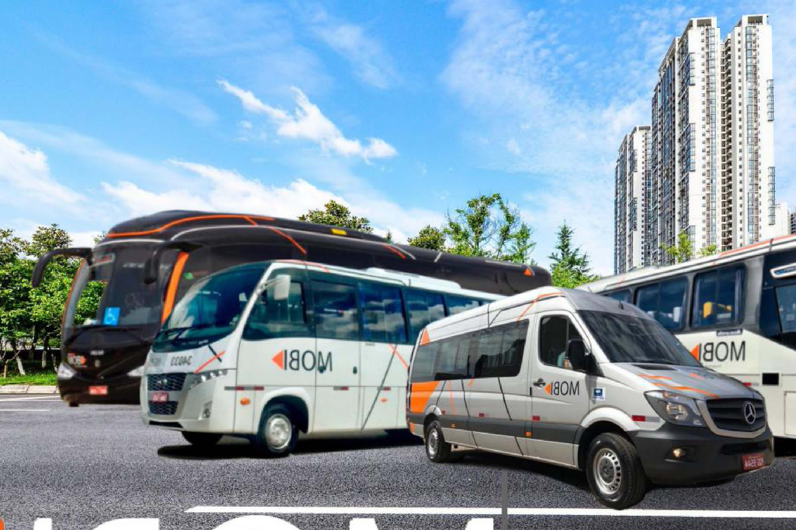



PROJECT COMPASS
Confidential Information Memorandum
São Paulo, 2026 | Confidencial
Urban mobility platform · Midwest & Southeast of Brazil

Slide 2

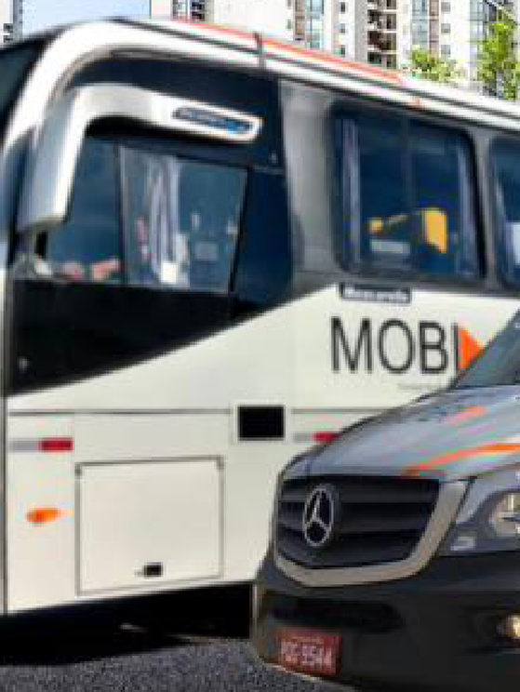

Disclaimer
Project Compass
IGC has been retained by MOBI (“Company”; “Mobi”), on an exclusive basis, to advise the Company in its M&A process (“Transaction”). This material (“Information Memorandum”) describes and summarizes the Company, its assets, market and economic and financial indicators and has been prepared exclusively to assist the recipient in deciding whether it wishes to proceed with a further investigation of a possible Transaction with the Company. In no event shall the recipient use any of this information for any commercial purposes or for purposes other than the one for which this memorandum is furnished.
All information contained in this Information Memorandum has been prepared based on documents and/or information provided by the Company or obtained directly by IGC through legal sources and/or independent research. IGC has not investigated, verified or audited the documents and information used for its preparation. This Information Memorandum contains statements, estimates and projections provided by the Client concerning anticipated future performance, which may or may not prove correct. No representations, expressed or implied, are made as to their accuracy.
This Memorandum of Information is not intended to form any part of the basis of any investment decision and should not be considered a recommendation by the Company or IGC. Each reader must make its own valuation of the Transaction to determine whether to continue in the process. No liability is or shall be attributed to the members of IGC, including its partners, directors or employees, in connection with the accuracy or completeness of the information contained herein.
This material belongs to IGC and shall not be copied, reproduced, distributed and/or disclosed, in whole or in part, including by digital media, to any third party without the express and prior written consent of IGC. By accepting this material, the recipient agrees to return it as soon as requested by IGC and to maintain strict confidentiality over all information contained herein.
Since the existence of the Transaction is not publicly disclosed and may not be known by members of the Company or third parties, the recipient agrees not to approach or contact any officer, employee, client, supplier or representative of the Company without the express written permission of IGC. In furnishing this material, IGC undertakes no obligation to provide access to additional information or to update it, and reserves the right, at any time and without notice, to change the procedure for the Transaction or terminate negotiations prior to the execution of any binding agreement.
Bruno Iervolino
IGC Partners
Av. Brigadeiro Faria Lima, 2277 – 6th floor
01452-000 | São Paulo – SP Tel: (55 11) 3815-3533
bruno.iervolino@igcp.com.br
2 Confidential

Slide 3
Executive
Summary
INTRODUCTION
04
INVESTMENT THESIS
08
COMPANY OVERVIEW
14
FINANCIAL HIGHLIGHTS
21

Slide 4
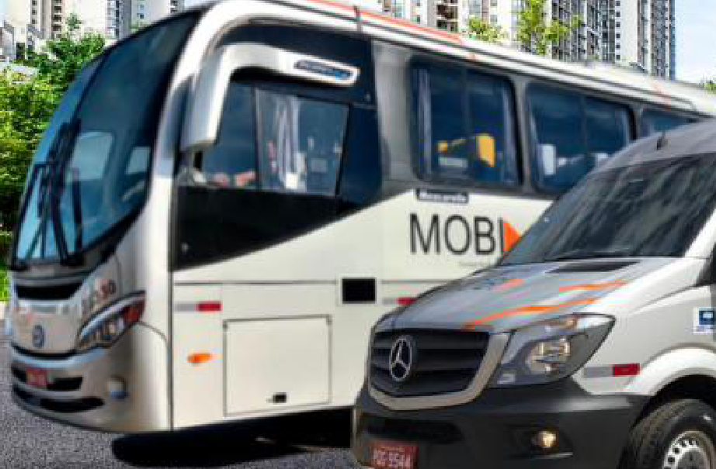
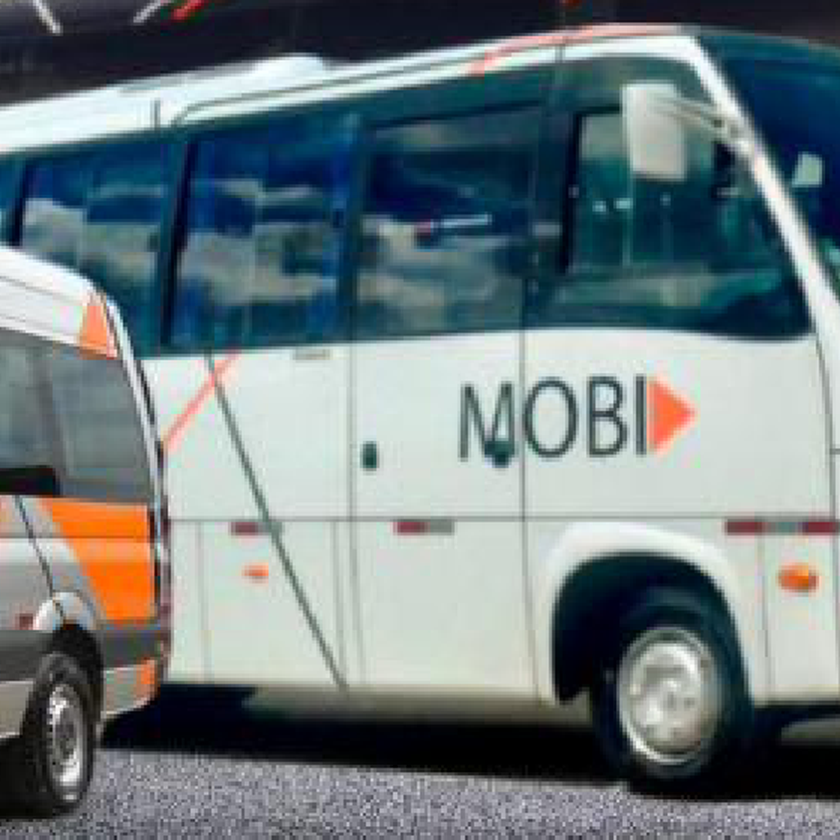
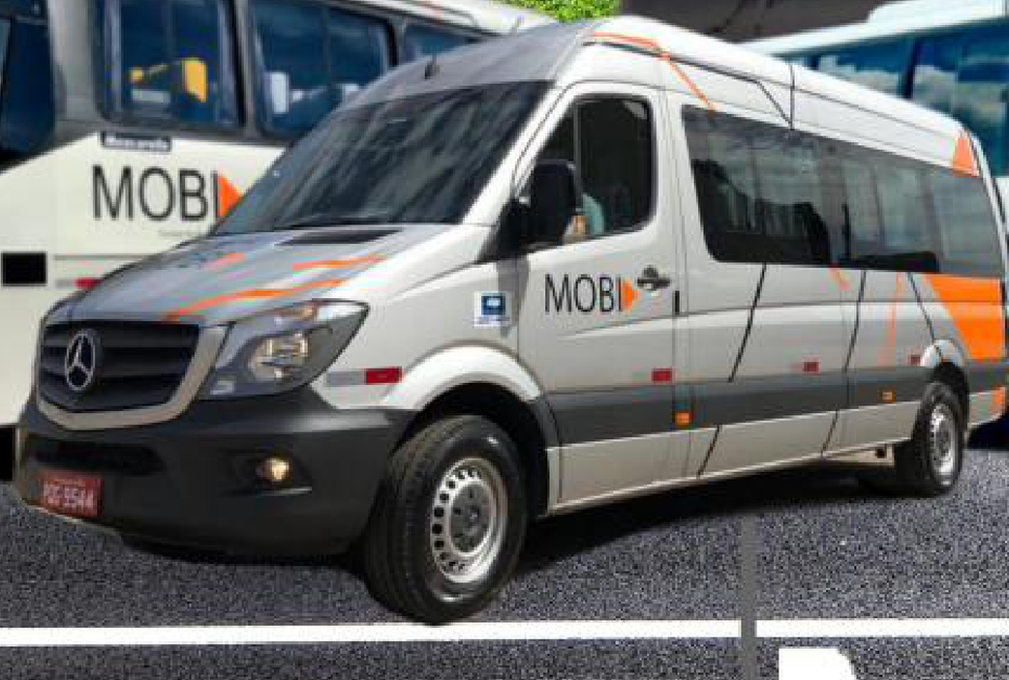




Introduction
Mobi at a glance
An urban mobility platform with +20 years of operations, serving employees of large corporations and residents of condominiums
KEY HIGHLIGHTS
Essential mobility platform
Route-optimized transportation for corporations and condominiums, supporting a recurring-revenue model
BRL 140 Mn
BRL 36 Mn
Net revenues 2025
EBITDA 2025 (~26%)
Scaled operational platform
Modern fleet backed by intensive monitoring and telemetry, tailored to serve clients’ needs
+50
+400
Clients
Vehicles¹
Visible, resilient cash flow
Long-term contracts (3–5 years) with built-in price adjustment mechanisms supporting margin resilience
BRL 200 Mn
4 years
Value of the fleet
Average fleet age²
Strategic footprint
Headquarters in Goiânia plus 10 operational bases across Goiás, the Federal District and Minas Gerais
SELECTED CLIENTS
Source: Company management information; Jan-2026 fleet register. (1) Aggregate fleet per Company materials; 373 owned vehicles per Jan-26 fleet register. (2) Average age per Company materials.
4 Confidential

Slide 5
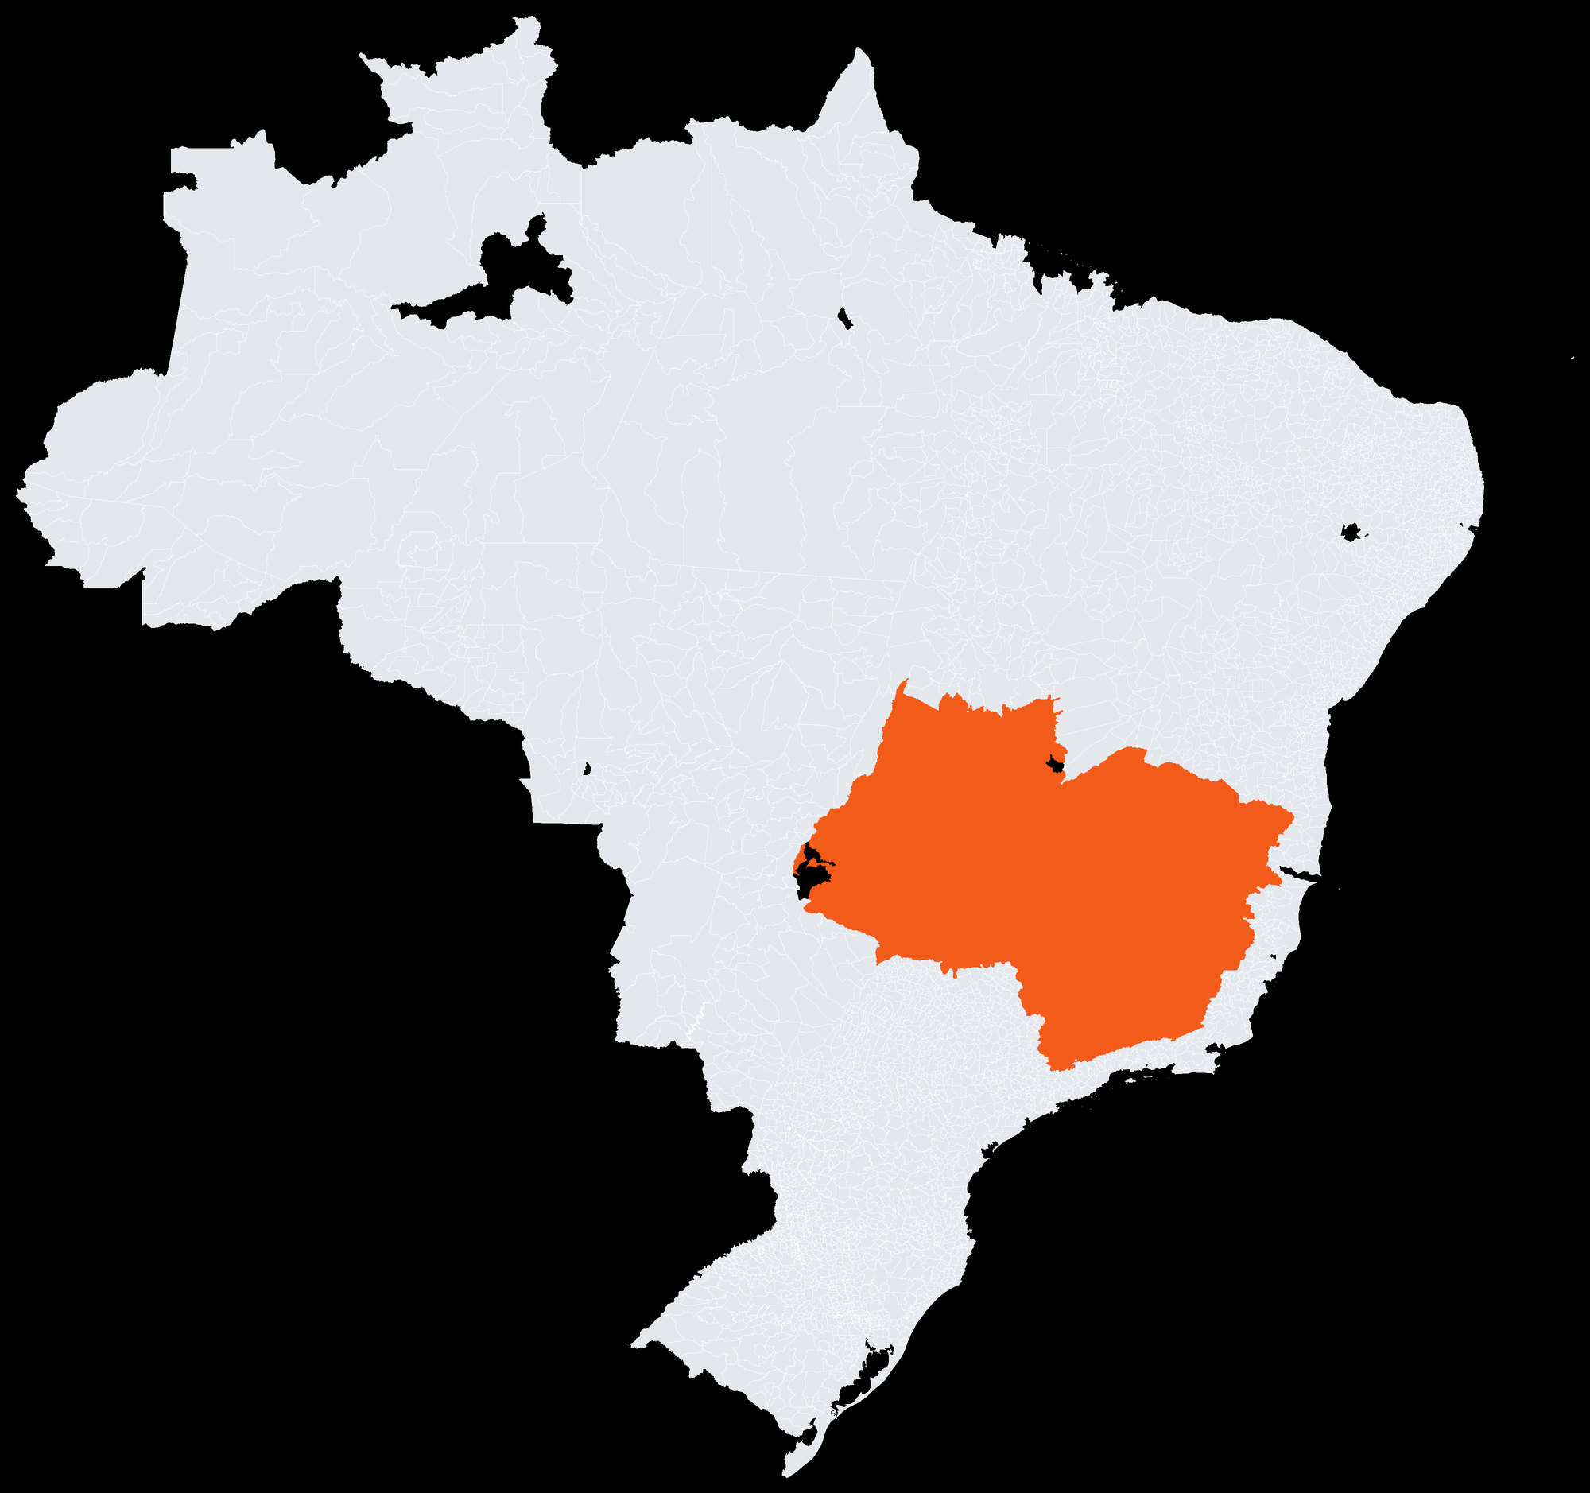
Introduction
A scalable platform with strong recent momentum
Operations concentrated in the high-growth Midwest–Southeast corridor, with double-digit revenue growth
Gross revenue by entity — 1Q25 vs. 1Q26
+41.3% YoY¹
BRL Mn
BRL 140 Mn
~26%
10
States of operation — GO · DF · MG
Net revenues 2025
EBITDA margin 2025
Operational bases · 3 states
Source: Company. Gross revenue by operating entity. (1) 1Q gross revenue growth year-over-year.
5 Confidential

Slide 6


Introduction
Two complementary fronts within one platform
Mobi combines corporate employee transportation with urban mobility for condominium residents, across two operating entities
Corporate transportation
83% of 1Q26
Condominium & urban mobility
17% of 1Q26
Route-optimized employee transportation (fretamento) for industrial, agribusiness and consumer-goods clients
Route-optimized transportation for residents of condominiums, extending the platform beyond the corporate segment
Long-term contracts (3–5 years) with IPCA, CBA and diesel pass-through adjustment mechanisms
Operated through AGM Alpha (Matriz Brasília), leveraging the same fleet, monitoring and operating standards
Blue-chip portfolio including Heineken, Roche, Kraft Heinz and Cargill
Fastest-growing front: +74% gross revenue growth in 1Q26 (YoY)
AGM Caetano BRL 36.2 Mn 1Q26 gross revenue · +36% YoY
AGM Alpha BRL 7.3 Mn 1Q26 gross revenue · +74% YoY
Source: Company management information. Entity split per 1Q26 gross revenue; growth 1Q26 vs. 1Q25. Segment economics to be confirmed with management.
6 Confidential

Slide 7
Executive
Summary
INTRODUCTION
04
INVESTMENT THESIS
08
COMPANY OVERVIEW
14
FINANCIAL HIGHLIGHTS
21

Slide 8
Investment Thesis
Mobi is well positioned for continued growth
A resilient, contracted business model supported by strong structural value drivers
1
Essential mobility platform in a structurally growing market — consistent demand from corporations and condominiums, a national driver shortage and labor regulations (NR-31) sustain recurring demand
2
Solid, contracted revenue model with high stickiness — long-term contracts (3–5 years) with IPCA, CBA and diesel pass-through adjustments protecting margins
3
An asset base that compounds competitive advantage — a modern, fully-owned fleet (+400 vehicles) creating flexibility and hard-to-replicate barriers
4
Integrated capabilities delivering a full-service edge — GPS telemetry and driver monitoring, with in-house maintenance [TBC], for a high-uptime operation
5
Multiple, executable growth avenues — geographic expansion, fleet electrification, technology-enabled services and consolidation of a fragmented market
Source: Company; press research. NR-31 = Brazilian rural-labor safety regulation on worker transport.
8 Confidential

Slide 9







Investment Thesis
1
A solid track record with blue-chip clients
Long-term contracts across industrial, agribusiness and consumer-goods sectors — serving +50 clients
SELECTED CLIENTS
PORTFOLIO CHARACTERISTICS
+50
clients served
3–5 years
average contract term
Recurring
revenue contract model
[XXX]
of contract backlog
Source: Company. Client relationship metrics (contracts delivered, years, share of revenue) to be confirmed with management.
A recurring, contracted revenue base with blue-chip clients underpins visibility and resilience
9 Confidential

Slide 10






Investment Thesis
2
A modern, fully-owned fleet tailored to client needs
+400 vehicles across buses, micro-buses and vans, sourced from leading chassis brands
FLEET COMPOSITION (OWNED, JAN-26)
HIGHLIGHTS
Bus
223 un.
4 years
Average fleet age¹
Micro-bus
74 un.
+400
Van
55 un.
Vehicles²
Support vehicle
17 un.
LEADING CHASSIS & EQUIPMENT BRANDS
BRL 200 Mn
Value of the fleet³
Truck
2 un.
100%
Pickup truck
2 un.
Owned fleet²
Source: Company; Jan-2026 fleet register. (1) Average age per Company materials. (2) 373 owned vehicles per Jan-26 fleet register; +400 aggregate fleet per Company materials. (3) Value of the fleet per Company materials.
A fully-owned, modern fleet creates operational flexibility and barriers that are hard to replicate
10 Confidential

Slide 11














Investment Thesis
3
Technology-enabled operations support high reliability
GPS telemetry, driver monitoring and operational discipline keep the fleet running reliably
GPS Telemetry & Driver Monitoring
ERP & Management
GPS-based tracking and AI-powered driver-fatigue monitoring provide continuous oversight across all bases
TOTVS Protheus underpins enterprise resource planning and back-office control
Fleet & Maintenance Management
Safety, PPE & Inspection
Specialized systems manage maintenance workflows, parts and fleet operations
Digital checklists, PPE control and safety management reinforce operational discipline
Source: Company. Availability and preventive-maintenance metrics, and scope of in-house maintenance, to be confirmed with management.
Intensive monitoring and telemetry ensure a high level of service across the network
11 Confidential

Slide 12



Investment Thesis
4
Multiple avenues for continued value creation
Geographic expansion, consolidation and fleet electrification position Mobi for a sustained growth trajectory
A
B
C
Deepen share & expand geographically
Electrification & tech-enabled services
Consolidate a fragmented market
Grow wallet share with existing clients and win new logos; expand within the GO–DF–MG corridor and selectively into adjacent regions, leveraging existing bases
Gradual fleet electrification aligned to clients’ ESG and Scope-3 goals; a technology layer (route optimization, apps, carbon dashboards) deepens stickiness
A highly fragmented Brazilian market with consolidation underway; Mobi’s scale and track record position it as a natural platform for smaller regional operators
Source: Company; press research. Growth avenues to be validated with management.
A clear and executable path for continued value creation
12 Confidential

Slide 13
Executive
Summary
INTRODUCTION
04
INVESTMENT THESIS
08
COMPANY OVERVIEW
14
FINANCIAL HIGHLIGHTS
21

Slide 14
Company Overview
A track record built over more than 20 years
Mobi has +20 years of experience in urban mobility and corporate employee transportation
[Year TBC]
[Year]
[Year]
2025
2026E
Foundation of Mobi
[Milestone — TBC]
[Milestone — TBC]
BRL 140 Mn net revenues
[Milestone — TBC]
Positioned for continued growth
Source: Company. Foundation year and milestone dates to be confirmed with management.
More than two decades of disciplined operation, positioned for its next phase of growth
14 Confidential

Slide 15
Company Overview
Strategically positioned across the Midwest and Southeast
From its Goiânia headquarters to 10 operational bases across Goiás, the Federal District and Minas Gerais
Headquarters — Goiânia, GO
Corporate HQ (Garagem Central) centralizing fleet management, monitoring infrastructure and administration
10 ACTIVE OPERATIONAL BASES
Anápolis – GO
Largest base outside HQ, supporting fleet availability across the Goiás corridor
Brasília – DF
Garagem BSB supporting operations across the Federal District
Senador Canedo – GO
Support base close to client sites, enabling faster response times
Uberlândia – MG
States with operational bases
Serving the Triângulo Mineiro region with strong execution oversight
1
10
3
+400
Headquarters
Operational bases
States covered
Vehicles
Source: Company; Jan-2026 fleet register.
15 Confidential

Slide 16
Company Overview
A recurring, contract-based revenue model
Revenue is generated through long-term transportation contracts across two operating entities
1
2
3
Dedicated fleet contracts
Route & shift management
Two operating entities
Long-term contracts (3–5 years) providing dedicated vehicles, drivers and routes, billed on a recurring monthly basis
Transportation planned around client shifts, sites and condominium routes, with telemetry ensuring reliability and safety
Revenue consolidated across AGM Caetano and AGM Alpha, together reaching BRL 140 Mn of net revenues in 2025
Source: Company. Revenue split and contract economics to be confirmed with management.
16 Confidential

Slide 17
Company Overview
An experienced and committed management team
Management team overview — names, roles and backgrounds to be confirmed with the Company
AG
M
P
G
?
Antônio Gabriel
Morgana
Pedro
Gabriela
[Name TBC]
[Role — TBC]
[Role — TBC]
[Role — TBC]
[Role — TBC]
[Role — TBC]
[Background — to be
confirmed with the
Company]
[Background — to be
confirmed with the
Company]
[Background — to be
confirmed with the
Company]
[Background — to be
confirmed with the
Company]
[Background — to be
confirmed with the
Company]
Source: Company. Roles and backgrounds to be confirmed with management.
17 Confidential

Slide 18
Company Overview
Organization & corporate structure
Multi-entity structure (Grupo AGM Caetano / AGM Alpha) — simplified representation, to be confirmed
Family Shareholders
Fleet +400 vehicles
AGM Caetano Participações
Holding company
AGM Caetano LTDA
MOBI Alpha
Moura e Carrilho Part.
Operating entity
Matriz Brasília
[Related party]
OPERATIONAL BRANCHES (FILIAIS)
Filial Goiânia
Filial Anápolis
Filial Nerópolis
Filial Senador Canedo
Filial Itumbiara
Filial Alexânia
Filial Uberlândia
Filial Rio Verde
Filial Pires do Rio
Source: Company. Simplified representation; entities and ownership to be confirmed with management.
18 Confidential

Slide 19
Company Overview
Long-standing relationships with anchor clients
Selected success cases illustrating Mobi’s durable, multi-year client partnerships — details to be confirmed
[City — State]
[City — State]
[City — State]
BRL [XXX] Mn
[X] years
BRL [XXX] Mn
[X] years
BRL [XXX] Mn
[X] years
total value
total term
total value
total term
total value
total term
[Service scope — TBC]
[Service scope — TBC]
[Service scope — TBC]
[Relationship highlights and milestones to be confirmed with the Company]
[Relationship highlights and milestones to be confirmed with the Company]
[Relationship highlights and milestones to be confirmed with the Company]
Source: Company — to be confirmed with management.
19 Confidential

Slide 20
Executive
Summary
INTRODUCTION
04
INVESTMENT THESIS
08
COMPANY OVERVIEW
14
FINANCIAL HIGHLIGHTS
21

Slide 21
Financial Highlights
Financial highlights
Solid profitability in 2025; full historical series and projections pending Company data
BRL 140 Mn
BRL 36 Mn
~26%
+41.3%
Net revenues 2025
EBITDA 2025
EBITDA margin 2025
1Q gross revenue YoY
Net revenues & EBITDA evolution — BRL Mn
Net revenues
EBITDA
2022–2024 and 2026E
figures pending Company data
Source: Company management information. 2025 figures are preliminary; historical series and projections to be confirmed with management.
21 Confidential

Slide 22
Financial Highlights
Consolidated income statement
Combined figures for AGM Caetano and AGM Alpha — full series to be confirmed with the Company
BRL Mn
2022
2023
2024
2025
2026E
Gross revenue
—
—
—
—
—
Taxes
—
—
—
—
—
Net revenues
—
—
—
~140
—
growth %
—
—
—
—
—
COGS
—
—
—
—
—
Gross profit
—
—
—
—
—
gross margin %
—
—
—
—
—
Personnel expenses
—
—
—
—
—
General & administrative
—
—
—
—
—
Selling expenses
—
—
—
—
—
EBITDA
—
—
—
~36
—
EBITDA margin %
—
—
—
~26%
—
D&A
—
—
—
—
—
Financial result
—
—
—
—
—
EBT
—
—
—
—
—
Net income
—
—
—
—
—
Source: Company. Illustrative structure; all figures to be confirmed with management. Net revenues and EBITDA for 2025 are preliminary.
22 Confidential

Slide 23
Deal team
Bruno Iervolino
bruno.iervolino@igcp.com.br
+55 11 3815-3533
Gabriel Brito
gabriel.brito@igcp.com.br
+55 11 3815-3533
Av. Brigadeiro Faria Lima, 2277 – 6th floor
01452-000, Jardim Paulistano, São Paulo – SP
+55 11 3815-3533
Confidential Information Memorandum

