Slide 1
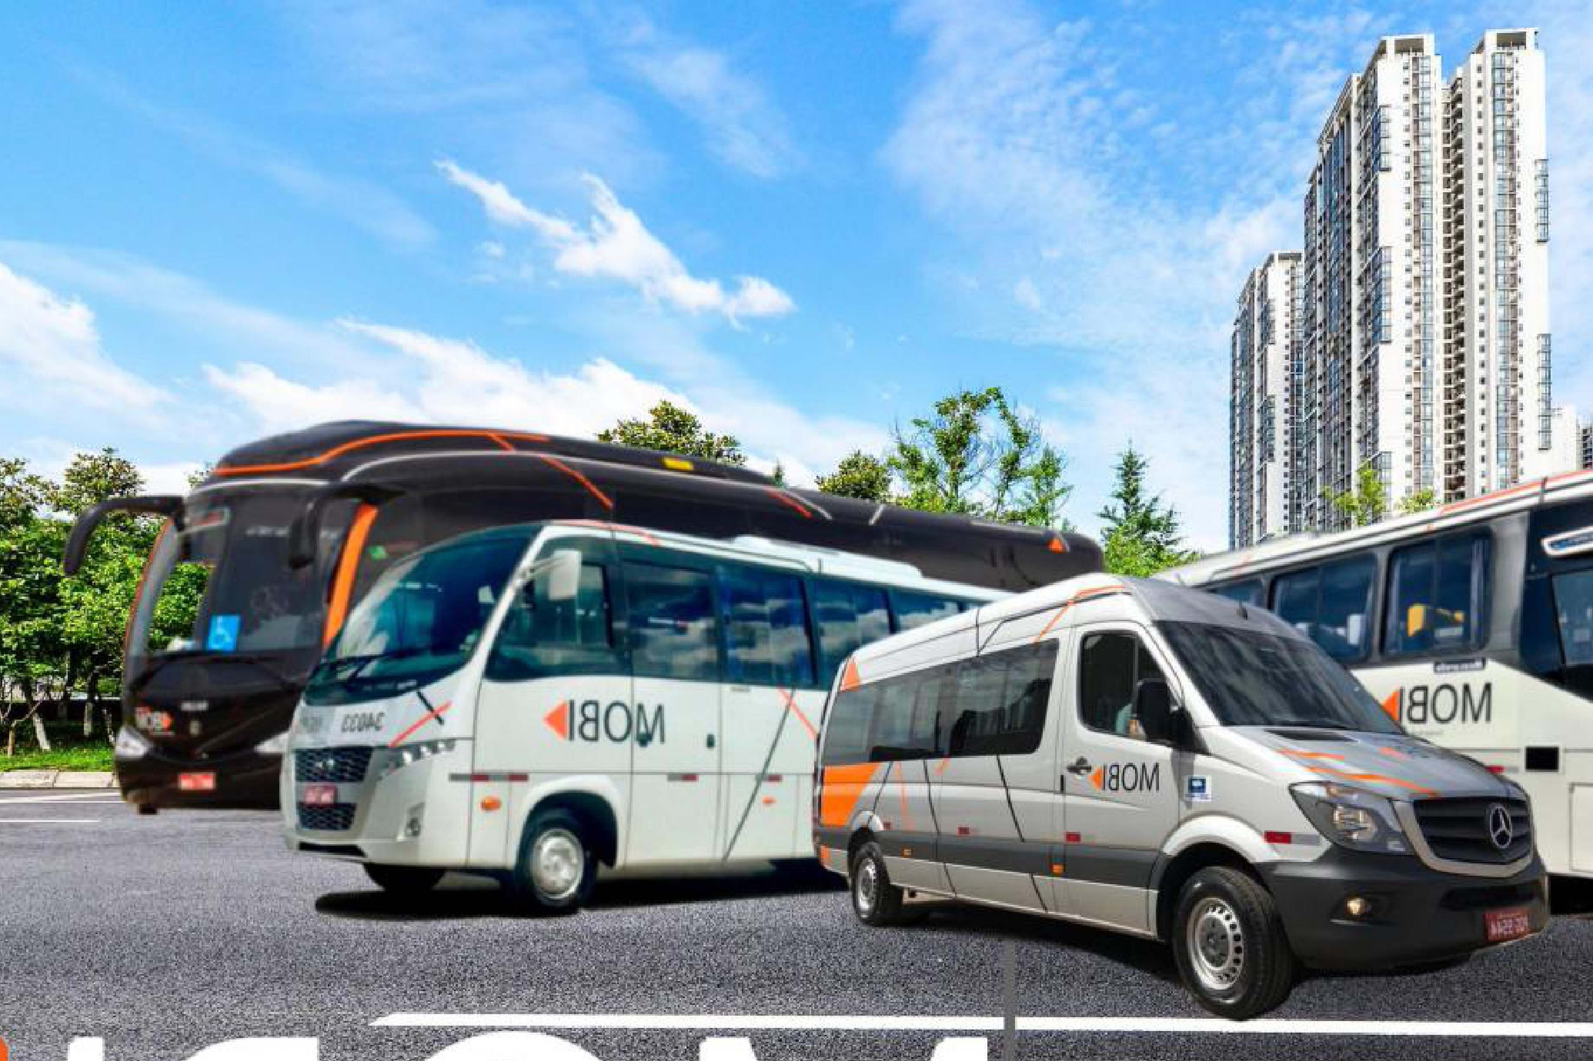



PROJECT COMPASS
Confidential Information Memorandum
São Paulo · 2026
Urban mobility platform · Midwest & Southeast of Brazil

Slide 2
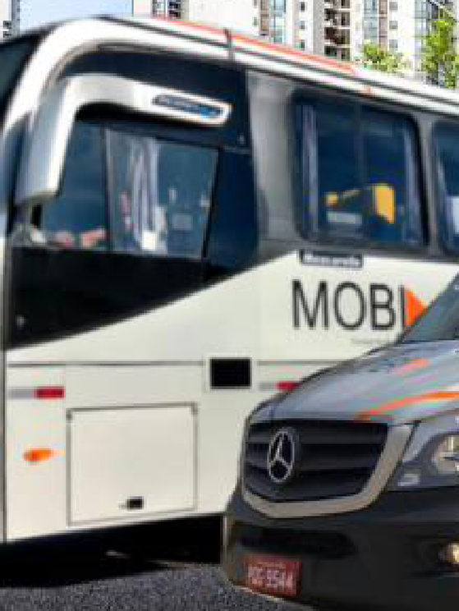

Disclaimer
Project Compass
IGC has been retained by MOBI (“Company”; “Mobi”), on an exclusive basis, to advise the Company in its M&A process (“Transaction”). This material (“Information Memorandum”) describes and summarizes the Company, its assets, market and economic and financial indicators and has been prepared exclusively to assist the recipient in deciding whether it wishes to proceed with a further investigation of a possible Transaction with the Company. In no event shall the recipient use any of this information for any commercial purposes or for purposes other than the one for which this memorandum is furnished.
All information contained in this Information Memorandum has been prepared based on the documents and/or information provided by the Company or obtained directly by IGC through legal sources and/or through independent research. IGC has not investigated, verified or audited the documents and information used for its preparation. This Information Memorandum contains statements, estimates and projections provided by the Client concerning anticipated future performance, which may or may not prove to be correct. No representations, expressed or implied, are made as to their accuracy.
This Memorandum of Information is not intended to form any part of the basis of any investment decision or other evaluation, or any decision to participate in the Transaction process, and should not be considered a recommendation by the Company or IGC to any reader. Each reader must make its own valuation of the Transaction in order to determine whether to continue with its participation in the process. No liability is or shall be attributed to the members of IGC, including its partners, directors or employees, in connection with the accuracy or completeness of the information contained herein.
This material belongs to IGC and shall not be copied, reproduced, distributed and/or disclosed, in whole or in part, including by digital media, to any third party without the express and prior written consent of IGC. By accepting this material, the recipient agrees to return it as soon as requested by IGC, and to maintain strict confidentiality over all information contained herein.
Since the existence of the Transaction is not publicly disclosed and may not be known by members of the Company or third parties, the recipient agrees not to approach or contact any officer, employee, client, supplier or representative of the Company without the express written permission of IGC. In furnishing this material, IGC undertakes no obligation to provide access to additional information, to update it, or to correct any inaccuracies which may become apparent, and reserves the right, at any time and without notice, to change the procedure for the Transaction or terminate negotiations prior to the execution of any binding agreement.
All communications, questions and/or requests regarding this material shall be addressed directly to IGC.
Bruno Iervolino
IGC Partners
Av. Brigadeiro Faria Lima, 2277 — 6th floor
01452-000 São Paulo – SP Tel: (55 11) 3815-3533
bruno.iervolino@igcp.com.br
2 Confidential

Slide 3
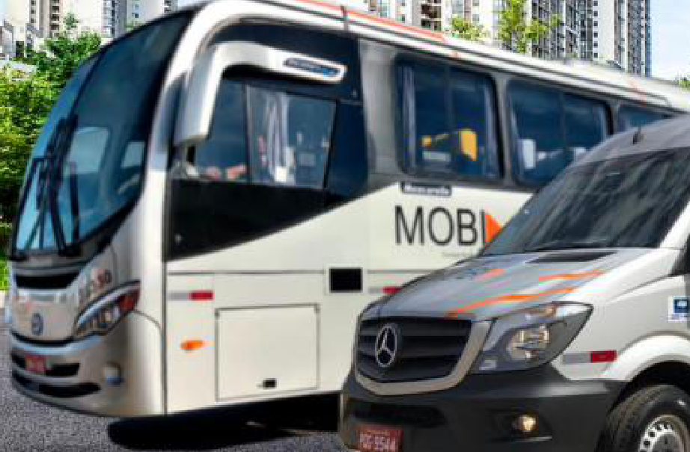
Executive
Summary
INTRODUCTION
04
INVESTMENT THESIS
10
COMPANY OVERVIEW
17
FINANCIAL HIGHLIGHTS
25
3

Slide 4









Introduction
Mobi at a glance
An urban mobility platform with +20 years of operations, serving employees of large corporations and residents of condominiums
Essential mobility platform
Scaled operational platform
KEY HIGHLIGHTS
Route-optimized transportation for corporations and condominiums, underpinning a recurring-revenue model
Modern fleet backed by intensive monitoring and telemetry, tailored to each client's needs
BRL 140 Mn
Net revenues 2025
BRL 36 Mn
EBITDA 2025 (~26% margin)
Visible, resilient cash flow
Strategic footprint
+50
Clients
Long-term contracts (3–5 years) with built-in price adjustment mechanisms supporting margin resilience
Headquarters in Goiânia plus 10 operational bases across Goiás, the Federal District and Minas Gerais
+400
Vehicles¹
BRL 200 Mn
4 years
SELECTED CLIENTS
Value of the fleet
Average fleet age²
A recurring, contracted mobility platform with BRL 140 Mn of net revenues and a fully-owned fleet
Source: Company management information; Jan-2026 fleet register. (1) Aggregate fleet per Company materials; 373 owned vehicles per the Jan-26 register. (2) Average age per Company materials; ~6 years based on chassis manufacture year — to reconcile with management.
4 Confidential
4 Confidential

Slide 5



Introduction
What Mobi does
Mobi operates dedicated employee-transportation contracts (fretamento) — planning, running and monitoring fixed routes on behalf of its clients
Route design
Fleet allocation
Live monitoring
Maintenance
Reporting & billing
Routes, stops and shift windows are planned around each client's sites and headcount
Dedicated vehicles and drivers are assigned to the contract from the owned fleet
GPS telemetry and driver-fatigue monitoring track every trip across all bases
Preventive and corrective maintenance keeps contracted vehicles available
Recurring monthly billing with contractual price-adjustment mechanisms
Dedicated, not shared
Owned, not leased
Contracted, not spot
Vehicles and drivers are committed to a single client contract, which is what makes revenue recurring and predictable
100% of the operating fleet is owned, giving Mobi control over service quality, availability and asset value
3–5 year contracts with IPCA, collective-bargaining and diesel pass-through clauses protect margin over the cycle
Source: Company. Illustrative representation of the service model; contract-level operating metrics to be confirmed with management.
A dedicated, owned and contracted service model — the source of Mobi's revenue visibility
5 Confidential

Slide 6


Introduction
Two client fronts on one operating platform
The same fleet, bases and monitoring infrastructure serve corporate employee transportation and condominium residents
Corporate employee transportation
Condominium & urban mobility
Route-optimized transportation of employees to and from industrial, agribusiness and consumer-goods sites — the core of the platform
Transportation for residents of condominiums, extending the platform beyond the corporate segment using the same operating base
Blue-chip client base including Heineken, Roche, Kraft Heinz and Cargill
Same fleet, operational bases and monitoring standards
Long-term contracts (3–5 years) with price-adjustment mechanisms
Broadens the addressable market beyond corporate contracts
Driven by clients' operational needs and NR-31 compliance requirements
Segment economics to be confirmed with management
Source: Company management information; Project Compass teaser. Revenue split between client fronts to be confirmed with management.
One platform, two demand pools — corporate contracts and condominium mobility
6 Confidential

Slide 7
Introduction
Recent momentum across both operating entities
Gross revenue grew +41.3% year-on-year in the first quarter, with both operating entities expanding
Gross revenue by operating entity — 1Q25 vs. 1Q26
+41.3% YoY
AGM Caetano
BRL Mn
Core operating entity
BRL 36.2 Mn 1Q26
+36% YoY
from BRL 26.6 Mn in 1Q25
AGM Alpha
Matriz Brasília
BRL 7.3 Mn 1Q26
+74% YoY
from BRL 4.2 Mn in 1Q25
Source: Company management information. 1Q gross revenue by operating entity, 1Q26 vs. 1Q25. Entity-level scope of operations to be confirmed with management.
Both entities growing — a combined +41.3% YoY in 1Q gross revenue
7 Confidential

Slide 8



Introduction
A structurally supported corporate mobility market
Demand for outsourced employee transportation is underpinned by regulation, labour scarcity and client operating needs
Regulatory requirement
Professional driver shortage
Outsourcing of non-core logistics
Fragmented supplier base
NR-31 and related labour regulations require compliant employee transport where adequate public transit is unavailable, making the service non-discretionary for many industrial and agribusiness sites
A national shortage of qualified professional drivers raises the barrier to entry and favours operators that can recruit, train and retain drivers at scale
Corporations increasingly outsource employee transportation to specialised operators rather than running fleets in-house, converting fixed assets into contracted service costs
The Brazilian fretamento market remains highly fragmented among small regional operators, creating consolidation opportunity for platforms with scale and governance
+20 years
3 states
10 bases
100%
of operations
GO · DF · MG
plus headquarters
owned fleet
Source: Company; press research. NR-31 = Brazilian rural-labour safety regulation governing worker transport. Market sizing and share data to be developed with management.
Demand is structural, not cyclical — and the supplier base is fragmented
8 Confidential

Slide 9
Executive
Summary
INTRODUCTION
04
INVESTMENT THESIS
10
COMPANY OVERVIEW
17
FINANCIAL HIGHLIGHTS
25
9

Slide 10
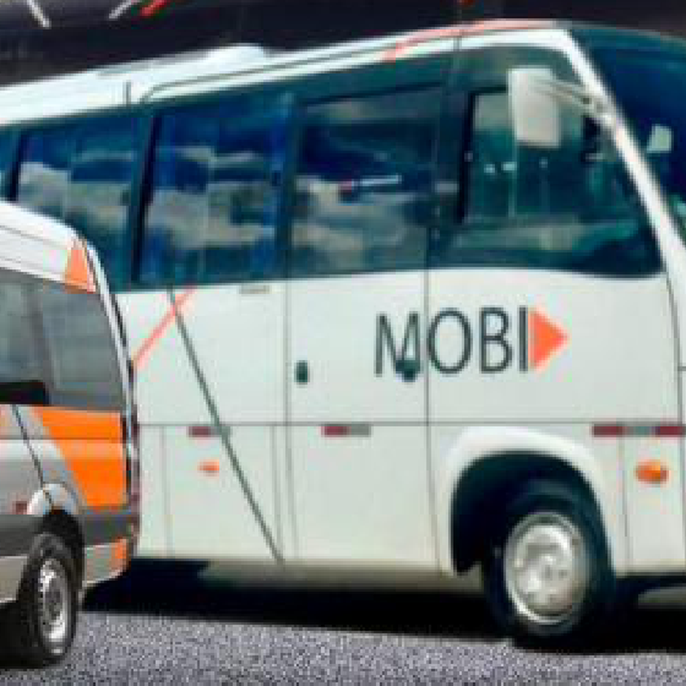
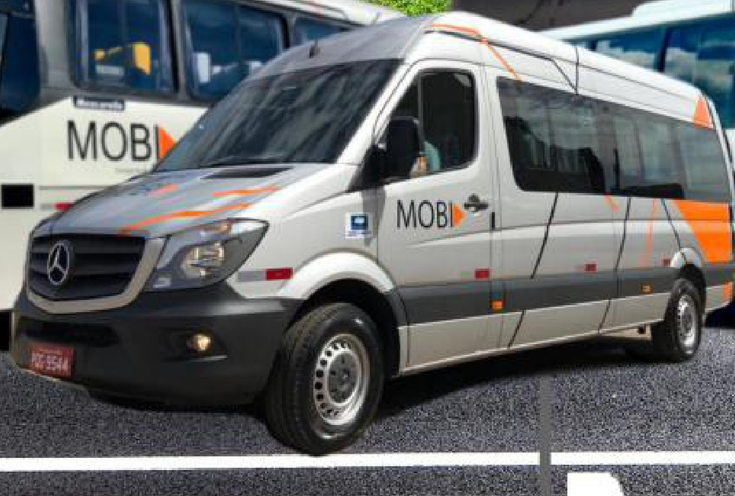
Investment Thesis
Mobi is well positioned for continued growth
A resilient, contracted business model supported by strong structural value drivers
1
Essential mobility platform in a structurally growing market — Consistent demand from corporations and condominiums, a national driver shortage and labour regulations (NR-31) sustain recurring demand
2
Solid, contracted revenue model with high stickiness — Long-term contracts (3–5 years) with IPCA, collective-bargaining and diesel pass-through adjustments protecting margins
3
An asset base that compounds competitive advantage — A modern, 100% owned fleet of 373 vehicles creating operational flexibility and hard-to-replicate barriers
4
Integrated capabilities delivering a full-service edge — GPS telemetry and driver monitoring, with in-house maintenance [TBC], for a high-uptime operation
5
Multiple, executable growth avenues — Geographic expansion, fleet electrification, technology-enabled services and consolidation of a fragmented market
Source: Company; press research. NR-31 = Brazilian rural-labour safety regulation on worker transport.
10 Confidential

Slide 11




Investment Thesis
1
A solid track record with blue-chip clients
Long-term contracts across industrial, agribusiness and consumer-goods sectors — serving +50 clients
SELECTED CLIENTS
PORTFOLIO CHARACTERISTICS
+50
clients served
3–5 years
average contract term
Recurring
revenue contract model
[XXX]
of contract backlog
Source: Company. Client relationship metrics (contracts delivered, years of relationship, share of revenue) to be confirmed with management.
A recurring, contracted revenue base with blue-chip clients underpins visibility and resilience
11 Confidential

Slide 12


Investment Thesis
2
A contracted revenue model built for stickiness
Long-term contracts with built-in adjustment mechanisms transfer the main cost risks and protect margin over the cycle
BUILT-IN PRICE ADJUSTMENT MECHANISMS
CONTRACT PROFILE
3–5 years
Typical contract term
IPCA
Collective bargaining
Diesel variation
General inflation indexation applied to the contract value
Driver wage increases negotiated sector-wide are passed through
Fuel price movements — the largest variable cost — are passed through
Monthly
Recurring billing cycle
WHY CLIENTS RENEW
Dedicated
Operational embedding — Routes, shift windows and stops are designed around the client's own operation — switching supplier means redesigning it
Vehicles and drivers per contract
[XXX]
Compliance exposure — Employee transport carries labour and safety obligations; an established, compliant operator lowers the client's risk
Contract backlog
[XXX]
Dedicated assets — Vehicles and drivers are committed to the contract, so service continuity does not depend on spot capacity
Contracts executed recently
Source: Company. Contract terms per Company materials; contract-level economics and backlog to be confirmed with management. IPCA = Brazilian consumer price index; CBA = collective bargaining agreement.
Contracts that pass through the main cost risks and are costly for clients to unwind
12 Confidential

Slide 13






Investment Thesis
3
A modern, fully-owned fleet tailored to client needs
373 owned vehicles across buses, micro-buses and vans, sourced from leading chassis brands
FLEET COMPOSITION (OWNED, JAN-26)
HIGHLIGHTS
Bus
223 un.
4 years
Average fleet age¹
Micro-bus
74 un.
+400
Van
55 un.
LEADING CHASSIS & EQUIPMENT BRANDS
Vehicles²
BRL 200 Mn
Support vehicle
17 un.
Value of the fleet³
Truck
2 un.
100%
Owned fleet
Pickup truck
2 un.
Source: Company; Jan-2026 fleet register. (1) Average age per Company materials; ~6 years based on chassis manufacture year — to reconcile with management. (2) 373 owned vehicles per the Jan-26 register; +400 aggregate fleet per Company materials. (3) Value of the fleet per Company materials.
A fully-owned, modern fleet creates operational flexibility and barriers that are hard to replicate
13 Confidential

Slide 14





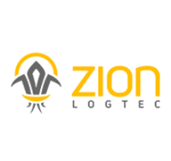





Investment Thesis
4
Technology-enabled operations support high reliability
GPS telemetry, driver monitoring and operational discipline keep the fleet running reliably across all bases
GPS Telemetry & Driver Monitoring
ERP & Management
GPS-based tracking and AI-powered driver-fatigue monitoring provide continuous oversight across all bases
TOTVS Protheus underpins enterprise resource planning and back-office control
Fleet & Maintenance Management
Safety, PPE & Inspection
Specialized systems manage maintenance workflows, parts and fleet operations
Digital checklists, PPE control and safety management reinforce operational discipline
Source: Company. Availability and preventive-maintenance metrics, and the scope of in-house maintenance, to be confirmed with management.
Intensive monitoring and telemetry ensure a high level of service across the network
14 Confidential

Slide 15
Investment Thesis
5
Multiple avenues for continued value creation
Geographic expansion, consolidation and fleet electrification position Mobi for a sustained growth trajectory
A
B
C
Deepen share & expand geographically
Electrification & tech-enabled services
Consolidate a fragmented market
Grow wallet share with existing clients and win new logos
Gradual fleet electrification aligned to clients' ESG and Scope-3 goals
A highly fragmented Brazilian market with consolidation already underway
Expand within the GO–DF–MG corridor and selectively into adjacent regions
A technology layer — route optimization, booking apps, carbon dashboards
Mobi's scale and track record position it as a natural consolidation platform
Leverage the existing base network to serve new sites
Driver capacitation and retention programmes addressing the labour bottleneck
Selective acquisition of smaller regional fretamento operators
Source: Company; press research. Growth avenues to be validated with management.
A clear and executable path for continued value creation
15 Confidential

Slide 16
Executive
Summary
INTRODUCTION
04
INVESTMENT THESIS
10
COMPANY OVERVIEW
17
FINANCIAL HIGHLIGHTS
25
16

Slide 17
Company Overview
A track record built over more than 20 years
Mobi has +20 years of experience in urban mobility and corporate employee transportation
[Year TBC]
[Year]
[Year]
2025
2026E
Foundation of Mobi
[Milestone — TBC]
[Milestone — TBC]
BRL 140 Mn net revenues
Positioned for continued growth
+20
+50
373
10
3
years of operations
clients served
owned vehicles
operational bases
states covered
Source: Company. Foundation year and milestone dates to be confirmed with management.
More than two decades of disciplined operation, positioned for its next phase of growth
17 Confidential

Slide 18
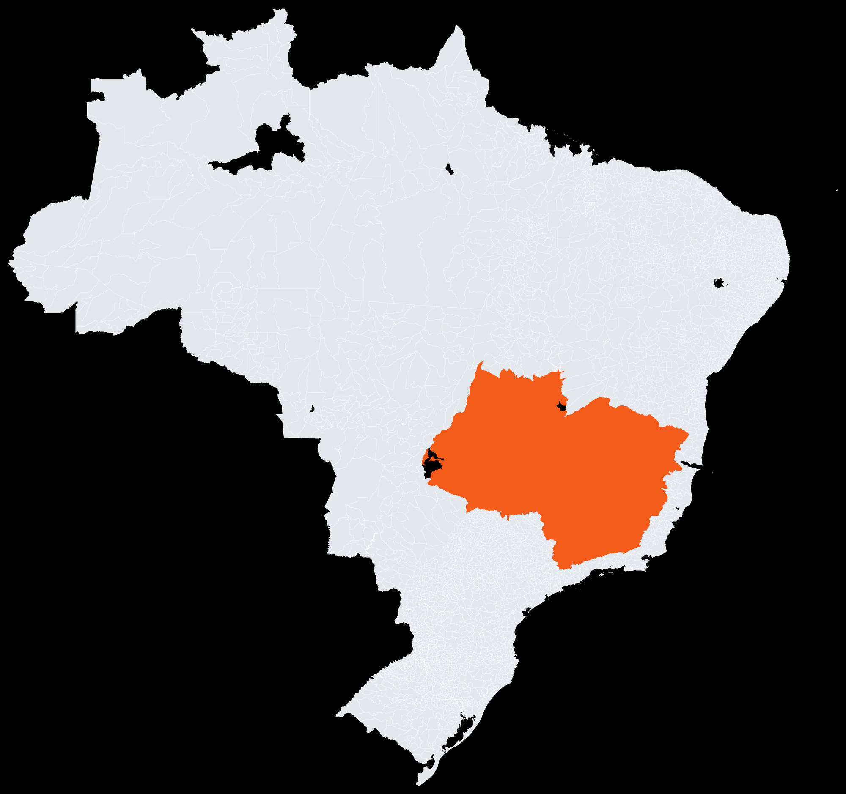
Company Overview
Strategically positioned across the Midwest and Southeast
From its Goiânia headquarters to 10 operational bases across Goiás, the Federal District and Minas Gerais
Headquarters — Goiânia, GO
Corporate HQ (Garagem Central) centralizing fleet management, monitoring infrastructure and administration
10 ACTIVE OPERATIONAL BASES
Anápolis – GO
Largest base outside HQ, supporting fleet availability across the Goiás corridor
Brasília – DF
Garagem BSB supporting operations across the Federal District
Senador Canedo – GO
Support base close to client sites, enabling faster response times
Uberlândia – MG
States with operational bases
Serving the Triângulo Mineiro region with strong execution oversight
1
Headquarters
10
Operational bases
Further bases: Nerópolis, Alexânia, Rio Verde, Pires do Rio and Itumbiara
3
States covered
373
Owned vehicles
Source: Company; Jan-2026 fleet register.
18 Confidential

Slide 19
Company Overview
A recurring, contract-based operating model
Revenue is generated through long-term transportation contracts operated across two entities and a network of bases
1
2
3
Dedicated fleet contracts
Route & shift management
Two operating entities
Long-term contracts (3–5 years) providing dedicated vehicles, drivers and routes, billed on a recurring monthly basis
Transportation planned around client shifts, sites and condominium routes, with telemetry ensuring reliability and safety
Revenue consolidated across AGM Caetano and AGM Alpha, together reaching BRL 140 Mn of net revenues in 2025
Source: Company. Revenue split and contract economics to be confirmed with management.
Revenue anchored in dedicated, long-term contracts across a network of operational bases
19 Confidential

Slide 20
Company Overview
Success case: Cargill operation
An illustrative long-term client relationship — contract values, terms and milestones to be confirmed with the Company
SUCCESS CASES
START OF CONTRACT
CURRENT CONTRACT
BRL [XXX]k
BRL [XXX] Mn
Cargill
of total value
of total value
Agribusiness & food ingredients
[X] months
of total term
[X] years
of total term
JBS
Protein & food processing
RELATIONSHIP TIMELINE
[Mon-YY]
[Mon-YY]
[Mon-YY]
[Mon-YY]
Votorantim Cimentos
Cement & building materials
[Milestone — TBC]
[Milestone — TBC]
[Milestone — TBC]
[Milestone — TBC]
[Service scope — to be confirmed with the Company]
[Relationship highlights, contracted routes and headcount served to be confirmed]
Source: Company — relationship details, contract values and milestone dates to be confirmed with management.
A long-standing relationship with Cargill — details to be confirmed with the Company
20 Confidential

Slide 21
Company Overview
Success case: JBS operation
An illustrative long-term client relationship — contract values, terms and milestones to be confirmed with the Company
SUCCESS CASES
START OF CONTRACT
CURRENT CONTRACT
BRL [XXX]k
BRL [XXX] Mn
Cargill
of total value
of total value
Agribusiness & food ingredients
[X] months
of total term
[X] years
of total term
JBS
Protein & food processing
RELATIONSHIP TIMELINE
[Mon-YY]
[Mon-YY]
[Mon-YY]
[Mon-YY]
Votorantim Cimentos
Cement & building materials
[Milestone — TBC]
[Milestone — TBC]
[Milestone — TBC]
[Milestone — TBC]
[Service scope — to be confirmed with the Company]
[Relationship highlights, contracted routes and headcount served to be confirmed]
Source: Company — relationship details, contract values and milestone dates to be confirmed with management.
A long-standing relationship with JBS — details to be confirmed with the Company
21 Confidential

Slide 22
Company Overview
Success case: Votorantim Cimentos operation
An illustrative long-term client relationship — contract values, terms and milestones to be confirmed with the Company
SUCCESS CASES
START OF CONTRACT
CURRENT CONTRACT
BRL [XXX]k
BRL [XXX] Mn
Cargill
of total value
of total value
Agribusiness & food ingredients
[X] months
of total term
[X] years
of total term
JBS
Protein & food processing
RELATIONSHIP TIMELINE
[Mon-YY]
[Mon-YY]
[Mon-YY]
[Mon-YY]
Votorantim Cimentos
Cement & building materials
[Milestone — TBC]
[Milestone — TBC]
[Milestone — TBC]
[Milestone — TBC]
[Service scope — to be confirmed with the Company]
[Relationship highlights, contracted routes and headcount served to be confirmed]
Source: Company — relationship details, contract values and milestone dates to be confirmed with management.
A long-standing relationship with Votorantim Cimentos — details to be confirmed with the Company
22 Confidential

Slide 23
Company Overview
An experienced and committed management team
Management team overview — names, roles and backgrounds to be confirmed with the Company
AG
M
P
G
?
Antônio Gabriel
Morgana
Pedro
Gabriela
[Name TBC]
[Role — TBC]
[Role — TBC]
[Role — TBC]
[Role — TBC]
[Role — TBC]
[Background — to be
confirmed with the
Company]
[Background — to be
confirmed with the
Company]
[Background — to be
confirmed with the
Company]
[Background — to be
confirmed with the
Company]
[Background — to be
confirmed with the
Company]
Source: Company. Roles and backgrounds to be confirmed with management.
23 Confidential

Slide 24
Company Overview
Organization & corporate structure
Multi-entity structure (Grupo AGM Caetano / AGM Alpha) — simplified representation, to be confirmed
Family Shareholders
Fleet 373 vehicles
AGM Caetano Participações
Holding company
AGM Caetano LTDA
MOBI Alpha
Moura e Carrilho Part.
Operating entity
Matriz Brasília
[Related party]
OPERATIONAL BRANCHES (FILIAIS)
Filial Goiânia
Filial Anápolis
Filial Nerópolis
Filial Senador Canedo
Filial Itumbiara
Filial Alexânia
Filial Uberlândia
Filial Rio Verde
Filial Pires do Rio
Source: Company. Simplified representation; entities and ownership to be confirmed with management.
24 Confidential

Slide 25
Executive
Summary
INTRODUCTION
04
INVESTMENT THESIS
10
COMPANY OVERVIEW
17
FINANCIAL HIGHLIGHTS
25
25

Slide 26
Financial Highlights
Financial highlights
Solid profitability in 2025; the full historical series and projections are pending Company data
BRL 140 Mn
BRL 36 Mn
~26%
+41.3%
Net revenues 2025
EBITDA 2025
EBITDA margin 2025
1Q gross revenue YoY
Net revenues & EBITDA evolution — BRL Mn
2022–2024 and 2026E figures pending Company data
Source: Company management information. 2025 figures are preliminary; historical series and projections to be confirmed with management.
26 Confidential

Slide 27
Financial Highlights
Revenue momentum
First-quarter gross revenue grew +41.3% year-on-year, with growth in both operating entities
1Q25
1Q26
YoY
Gross revenue — 1Q25 vs. 1Q26 (BRL Mn)
Total 1Q gross revenue
BRL 30.8 Mn
BRL 43.5 Mn
+41.3%
AGM Caetano
BRL 26.6 Mn
BRL 36.2 Mn
+36.1%
AGM Alpha
BRL 4.2 Mn
BRL 7.3 Mn
+74.3%
+41.3%
Combined 1Q gross revenue growth (YoY)
Both entities contributed to growth
Source: Company management information. 1Q gross revenue by operating entity; figures are preliminary and to be confirmed with management.
1Q gross revenue up +41.3% year-on-year across both operating entities
27 Confidential

Slide 28
Financial Highlights
Consolidated income statement
Combined figures for AGM Caetano and AGM Alpha — full series to be confirmed with the Company
BRL Mn
2022
2023
2024
2025
2026E
Gross revenue
–
–
–
–
–
Taxes
–
–
–
–
–
Net revenues
–
–
–
~140
–
growth %
–
–
–
–
–
COGS
–
–
–
–
–
Gross profit
–
–
–
–
–
gross margin %
–
–
–
–
–
Personnel expenses
–
–
–
–
–
General & administrative
–
–
–
–
–
Selling expenses
–
–
–
–
–
EBITDA
–
–
–
~36
–
EBITDA margin %
–
–
–
~26%
–
D&A
–
–
–
–
–
Financial result
–
–
–
–
–
EBT
–
–
–
–
–
Net income
–
–
–
–
–
Source: Company. Illustrative structure; all figures to be confirmed with management. Net revenues and EBITDA for 2025 are preliminary.
28 Confidential

Slide 29
Deal team
Bruno Iervolino
bruno.iervolino@igcp.com.br
+55 11 3815-3533
Gabriel Brito
gabriel.brito@igcp.com.br
+55 11 3815-3533
Av. Brigadeiro Faria Lima, 2277 — 6th floor
01452-000 Jardim Paulistano, São Paulo – SP
+55 11 3815-3533
Confidential Information Memorandum

